Slide 1
Fetching Data
Michael Borck

Slide 2
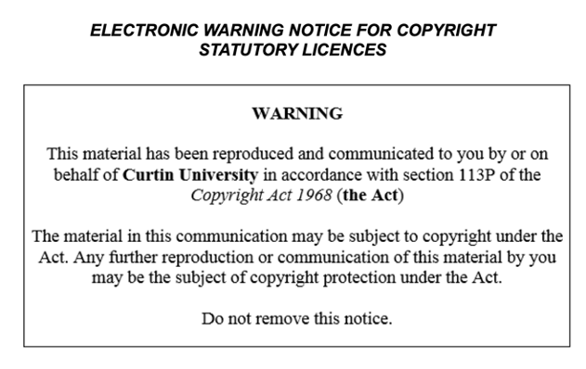

Slide 3
Today
Emphasise the importance of understanding APIs and data fetching in Python
Highlight the skills that will be learned in this session, such as:
Fetching data using the OpenWeatherMap API
Parsing JSON data
Handling errors

Slide 4
Live Coding - Fetching Data
Demonstrate how to use the requests library to fetch data from the OpenWeatherMap API
Introduce the concept of HTTP requests and responses
Show how to handle errors and exceptions in Python

Slide 5
Parsing JSON Data
Introduce the concept of JSON data and how it is used to represent data
Demonstrate how to use the json library to parse JSON data in Python
Highlight the importance of data parsing and how it is used in the weather dashboard project

Slide 6
Error Handling
Introduce the concept of error handling in Python and its importance
Demonstrate how to use try-except blocks to handle errors in Python
Highlight the importance of error handling in the weather dashboard project

Slide 7
Breakout Room Activity
Emphasise the importance of teamwork and collaboration in the project
Encourage students to work together to fetch and parse data for different cities

Slide 8
Demo and Discussion
Demonstrate how to use the fetched data to create a basic weather dashboard
Encourage students to share their findings and discuss challenges

Slide 9
Q&A and Wrap-Up
Address any questions and provide additional tips
Emphasize the importance of practicing and experimenting with the concepts learned in the session

Slide 10
Homework*
Assign homework that reinforces the concepts learned in the session
Encourage students to experiment with different APIs and data fetching techniques

