Slide 1
Welcome
Michael Borck

Slide 2
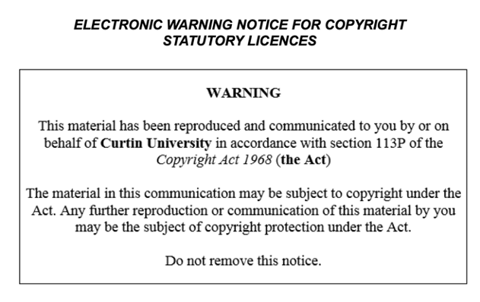

Slide 3
Today
– Introduce the course and project goals. – Set up the development environment. • Activities: – Overview of the weather dashboard project. – Install Python, Jupyter, and necessary libraries. – Basic Git commands: clone, commit, push.

Slide 4
Introduction to the Course
Welcome and course overview
Introduction to the WeatherVista project

Slide 5
Demo of Completed WeatherVista Dashboard (20 minutes) • Show the completed dashboard
Highlight key features and functionalities

Slide 6
Setting Up Development Environment (30 minutes)
Walkthrough installation of Python, Jupyter, and necessary libraries
Set up GitHub/GitLab repository

Slide 7
Introduction to Git
Basic Git commands: clone, commit, push
Demonstrate cloning the project repository

Slide 8
Creating Project Directory Structure (20 minutes)
Create directories for data, scripts, notebooks, and tests
Brief explanation of the purpose of each directory

Slide 9
Breakout Room Activity
Students work in small groups to set up their project structure
Instructors available for assistance

Slide 10
Q&A and Wrap-Up
Address any questions about setup and project structure
Homework: Research the OpenWeatherMap API and sign up for an API key

