Slide 1
Data Handling Adventures: CSV and SQL Edition
Become a Data Hero with Python Tools Michael Borck

Slide 2
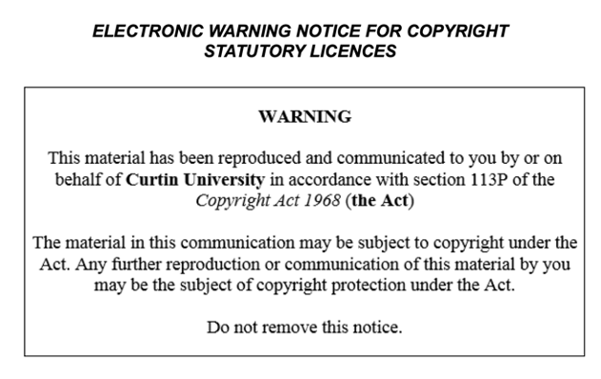

Slide 3
Today
Learn how to manage weather data using CSV files
Understand how to use SQL to store and retrieve weather data
Practice reading, writing, and processing data with pandas and SQLite

Slide 4
OpenWeatherMap API (Homework)
Navigate OpenWeatherMap API endpoints.
Customise requests with parameters.
Understand API response formats.
Handle common API errors.

Slide 5
Project Overview
Web app displays weather trends.
Uses OpenWeatherMap API data.
Shows current and forecast weather.
Location selection and unit switch.
Handles API errors gracefully.

Slide 6
Setup Project
Create GitHub repository.
Clone repository locally.
Structure project folders.
Create Python environment.
Install dependencies via requirements.txt.

Slide 7
Breakout Room Activity
Setup Project Folder and Environment

Slide 8
Managing Data with CSV Files
Reading data from a CSV file
Processing data by converting temperature from Kelvin to Celsius
Writing data to a new CSV file

Slide 9
Read data
import pandas as pd df = pd.read_csv('data/raw/weather_data.csv') df

Slide 10
Processing data
def convert_temp_kelvin_to_celsius(temp_k): return temp_k - 273.15 df['Temperature (C)'] = df['Temperature (K)'].apply(convert_temp_kelvin_to_celsius) df.drop(columns=['Temperature (K)'], inplace=True) df

Slide 11
Saving data
df.to_csv('data/processed/processed_weather_data.csv', index=False)

Slide 12
Managing Data with SQL
Creating a SQLite database and table
Inserting data into the table
Querying data from the table

Slide 13
Create database
import sqlite3 conn = sqlite3.connect('data/weather_data.db') cursor = conn.cursor() cursor.execute(''' CREATE TABLE IF NOT EXISTS weather ( location TEXT, temperature_c REAL, humidity INTEGER, weather_description TEXT ) ''') conn.commit()

Slide 14
inserting into table
for index, row in df.iterrows(): cursor.execute(''' INSERT INTO weather (location, temperature_c, humidity, weather_description) VALUES (?, ?, ?, ?) ''', (row['Location'], row['Temperature (C)'], row['Humidity (%)'], row['Weather'])) conn.commit()

Slide 15
Querying form table
cursor.execute('SELECT * FROM weather') rows = cursor.fetchall() for row in rows: print(row) df_sql = pd.DataFrame(rows, columns=['Location', 'Temperature (C)', 'Humidity (%)', 'Weather']) df_sql

Slide 16
Combining CSV and SQL Data Management
Reading additional weather data from a CSV file
Inserting data into the SQLite table
Querying combined data from the SQLite table

Slide 17
Code snippet:
additional_data = pd.read_csv('data/raw/additional_weather_data.csv') for index, row in additional_data.iterrows(): cursor.execute(''' INSERT INTO weather (location, temperature_c, humidity, weather_description) VALUES (?, ?, ?, ?) ''', (row['Location'], row['Temperature (C)'], row['Humidity (%)'], row['Weather'])) conn.commit()

Slide 18
Verify
cursor.execute('SELECT * FROM weather') combined_rows = cursor.fetchall() df_combined = pd.DataFrame(combined_rows, columns=['Location', 'Temperature (C)', 'Humidity (%)', 'Weather']) df_combined

Slide 19
Homework
Complete Understanding the Weather Dashboard Project: WeatherVista worksheet
Write fetch_data.py and test_fetch_data.py
Practice reading and writing data to CSV files with different weather datasets
Explore additional SQL queries to retrieve specific subsets of the weather data

Slide 20
Summary
manage weather data using CSV files and SQL.
practice reading, writing, and processing data with pandas and SQLite
combined both techniques to manage our weather data effectively.

Slide 21
Next Session
we will focus on basic data visualisation with Matplotlib.

