Slide 1
API Adventures: Conquering OpenWeatherMap
From API Requests to CSV Files in a Breeze Michael Borck

Slide 2
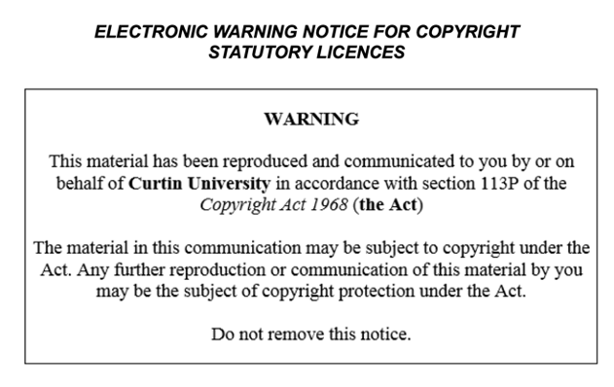

Slide 3
Today
Emphasize the importance of understanding APIs and data fetching in Python.
Highlight the skills that will be learned in this session:
Fetching data using the OpenWeatherMap API.
Parsing JSON data.
Handling errors.

Slide 4
Review Homework
Review the provided notebook on basics of Python

Slide 5
Introduction to OpenWeatherMap API
The OpenWeatherMap API provides weather data for various locations. You need to sign up and get an API key to access the data.
Steps to Get API Key:
Go to OpenWeatherMap and sign up for an account.
After signing up, navigate to the API keys section and generate a new API key.
Keep this API key safe, as you will need it to make API requests.

Slide 6
Fetching Data
Demonstrate how to use the requests library to fetch data from the OpenWeatherMap API.
Introduce the concept of HTTP requests and responses.
Show how to handle errors and exceptions in Python.

Slide 7
Example - Create Function
import requests def fetch_weather_data(api_key, location): url = f"http://api.openweathermap.org/data/2.5/weather?q={location}&appid={api_key}" response = requests.get(url) if response.status_code == 200: data = response.json() return data else: print(f"Failed to fetch data: {response.status_code}") return None

Slide 8
Example - Use function
api_key = 'your_api_key_here' location = 'London' data = fetch_weather_data(api_key, location) data

Slide 9
What is JSON
JavaScript Object Notation,
JSON is a text-based format
JSON is easy to read and write
JSON is widely used for data exchange

Slide 10
Parsing JSON Data
JSON used to represent data.
import json to serialise list, dict etc to JSON
response.json() convert JSON to Python dict.
Highlight the importance of data parsing and how it is used in the weather dashboard project.

Slide 11
Example - parse_weather_data
def parse_weather_data(data): if data: weather = { "Location": data["name"], "Temperature (K)": data["main"]["temp"], "Humidity (%)": data["main"]["humidity"], "Weather": data["weather"][0]["description"] } return weather else: return None parsed_data = parse_weather_data(data) parsed_data

Slide 12
Saving Data to a CSV File
CSV another format for sharing data
We’ll save the fetched data to a CSV file using pandas.
pandas open-source library for data manipulation and analysis

Slide 13
Example
import pandas as pd def save_to_csv(data, filename): df = pd.DataFrame([data]). # convert dict to df df.to_csv(filename, index=False) save_to_csv(parsed_data, 'data/raw/weather_data.csv')
df = pd.read_csv('data/raw/weather_data.csv') df

Slide 14
Error Handling
Introduce the concept of error handling in Python and its importance.
Demonstrate how to use try-except blocks to handle errors in Python.
Highlight the importance of error handling in the weather dashboard project.

Slide 15
Error Handling - Example
invalid_location = 'InvalidCity' invalid_data = fetch_weather_data(api_key, invalid_location) invalid_data

Slide 16
Breakout Room Activity
Emphasise the importance of teamwork and collaboration in the project.
Encourage students to work together to fetch and parse data for different cities.
Encourage students to share their findings and discuss challenges.

Slide 17
Q&A and Wrap-Up
In this session, we learned how to fetch weather data from the OpenWeatherMap API, parse the JSON response, and save the data to a CSV file. We also covered basic error handling to manage failed API requests.
Any questions”
The importance of practising and experimenting with the concepts learned in the session.
Next session, we will focus on managing data with CSV and SQL.

Slide 18
Homework
Experiment with fetching weather data for different cities.
Explore the OpenWeatherMap API documentation to see what other data you can fetch.

