Slide 1
Plotting Perfection: Mastering Matplotlib Dashboards
Create Engaging and Insightful Visual Stories Michael Borck

Slide 2
Today
Create daily forecast cards with high/low temperatures.
Design a layout for the dashboard using subplots and grids.
Use icons to represent weather conditions.
Output:
04_advanced_vix.ipynb
visualise_data.py

Slide 3
Recap and Introduction (10 minutes)
Recap of Session 4:
Key takeaways
Any remaining questions
Introduction:
Importance of advanced data visualisation
Advanced visualisations can provide more insights by combining multiple plots into a single figure, allowing for easier comparison and analysis.
Overview of dashboard layout techniques

Slide 4
Principles of Effective Data Visualisation
Clarity:
Ensure the visual is easy to understand.
Avoid clutter and unnecessary elements.
Accuracy:
Represent data truthfully.
Avoid misleading scales or distortions.
Efficiency:
Convey information quickly.
Use visual cues like color and sise effectively.

Slide 5
Dashboard Design Best Practices
Consistency:
Maintain a uniform style and layout.
Use consistent colors, fonts, and iconography.
Relevance:
Include only necessary information.
Prioritise key metrics and insights.
Interactivity:
Enhance user engagement.
Allow for exploration and filtering of data.

Slide 6
What Makes Plots Advanced?
Combining Multiple Plots:
Use subplots to create complex visualisations within a single figure.
Examples: 2x2 grids, multi-panel plots.
Customisations:
Annotations, colour schemes, and styles to enhance readability.
Interactive elements for user engagement.
Data Transformation:
Using statistical transformations (e.g., regression lines, smoothing).
Aggregating and summarising data for better insights.

Slide 7
Import Required Libraries
import pandas as pd import matplotlib.pyplot as plt import numpy as np

Slide 8
Reading Data
We’ll start by reading the processed weather data from the CSV file.
df = pd.read_csv('processed_weather_data.csv') df['Datetime'] = pd.to_datetime(df['Datetime']) df.head()

Slide 9
Creating a 2x2 Grid of Plots
Subplots allow us to create multiple plots within a single figure.
We’ll create a 2x2 grid of plots to visualise different aspects of the weather data.
fig, axs = plt.subplots(2, 2, figsize=(14, 10))

Slide 10
fig & axs
fig: Entire figure container object
axs: Array of subplot axes
You can use fig to adjust figure-wide settings (like the overall size) and
axs to customise each subplot individually.

Slide 11
Access each subplot by indexing into axs
axs[0, 0].plot([1, 2, 3], [1, 4, 9]) # Top-left subplot axs[0, 1].plot([1, 2, 3], [1, 2, 3]) # Top-right subplot axs[1, 0].plot([1, 2, 3], [9, 4, 1]) # Bottom-left subplot axs[1, 1].plot([1, 2, 3], [3, 2, 1]) # Bottom-right subplot plt.tight_layout() plt.show() # Save the figure fig.savefig('my_plot.png')

Slide 12
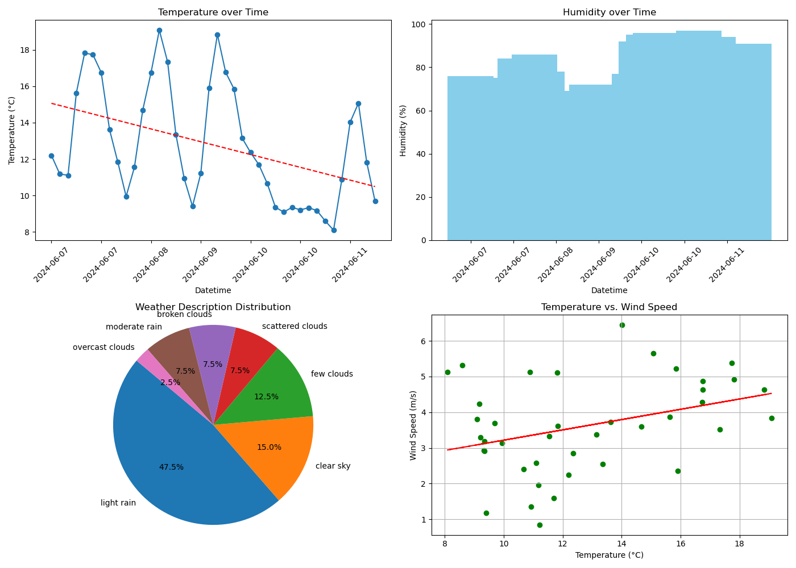
Four plots

Slide 13
Plot 1: Line plot for Temperature over Time
# Select every 6th datetime value for x-ticks x_ticks = df['Datetime'][::6] axs[0, 0].plot(df['Datetime'], df['Temperature (C)'], marker='o') axs[0, 0].set_title('Temperature over Time') axs[0, 0].set_xlabel('Datetime') axs[0, 0].set_ylabel('Temperature (°C)') axs[0, 0].set_xticks(x_ticks) axs[0, 0].tick_params(axis='x', rotation=45)

Slide 14
Add line of best fit for Temperature over Time
s = np.polyfit(df['Datetime'].astype(np.int64) // 10**9, df['Temperature (C)'], 1) p = np.poly1d(s) axs[0, 0].plot(df['Datetime'], p(df['Datetime'].astype(np.int64) // 10**9), "r--")

Slide 15
Plot 2: Bar plot for Humidity over Time
axs[0, 1].bar(df['Datetime'], df['Humidity (%)'], color='skyblue') axs[0, 1].set_title('Humidity over Time') axs[0, 1].set_xlabel('Datetime') axs[0, 1].set_ylabel('Humidity (%)') axs[0, 1].set_xticks(x_ticks) axs[0, 1].tick_params(axis='x', rotation=45)

Slide 16
Plot 3: Pie chart for Weather Description
weather_counts = df['Weather'].value_counts() axs[1, 0].pie(weather_counts, labels=weather_counts.index, autopct='%1.1f%%', startangle=140) axs[1, 0].set_title('Weather Description Distribution') axs[1, 0].axis('equal') # Equal aspect ratio ensures that pie is drawn as a circle.

Slide 17
Plot 4: Scatter plot for Temperature vs. Wind Speed
axs[1, 1].scatter(df['Temperature (C)'], df['Wind Speed (m/s)'], c='g', marker='o') axs[1, 1].set_title('Temperature vs. Wind Speed') axs[1, 1].set_xlabel('Temperature (°C)') axs[1, 1].set_ylabel('Wind Speed (m/s)') axs[1, 1].grid(True)

Slide 18
Add line of best fit for Temperature vs. Wind Speed
s = np.polyfit(df['Temperature (C)'], df['Wind Speed (m/s)'], 1) p = np.poly1d(s) axs[1, 1].plot(df['Temperature (C)'], p(df['Temperature (C)']), "r--") # Adjust layout plt.tight_layout() plt.show()

Slide 19
Customising Subplots
Customising subplots can enhance their readability and presentation.
Annotations
Colours and Styles

Slide 20
Setup a plot
fig, ax = plt.subplots(figsize=(10, 6)) ax.plot(df['Datetime'], df['Temperature (C)'], marker='o') ax.set_title('Temperature over Time') ax.set_xlabel('Datetime') ax.set_ylabel('Temperature (°C)') ax.set_xticks(x_ticks) ax.tick_params(axis='x', rotation=45) ax.grid(True)

Slide 21
Annotate the highest temperature
max_temp = df['Temperature (C)'].max() max_temp_time = df.loc[df['Temperature (C)'] == max_temp, 'Datetime'].iloc[0] ax.annotate(f'Max Temp: {max_temp:.2f}°C', xy=(max_temp_time, max_temp), xytext=(max_temp_time, max_temp+2), arrowprops=dict(facecolor='black', shrink=0.05)) plt.show()

Slide 22
Customising Colours and Styles
fig, ax = plt.subplots(figsize=(10, 6)) ax.plot(df['Datetime'], df['Temperature (C)'], marker='o', linestyle='--', color='b') ax.set_title('Temperature over Time', fontsize=14, fontweight='bold') ax.set_xlabel('Datetime', fontsize=12) ax.set_ylabel('Temperature (°C)', fontsize=12) ax.set_xticks(x_ticks) ax.tick_params(axis='x', rotation=45) ax.grid(True, linestyle='--', linewidth=0.5) plt.show()

Slide 23
Summary
In this session, we learned how to visualise weather data using advanced techniques in Matplotlib. We created subplots and grids, combined multiple plots into a single figure, and customised these plots for better presentation.

Slide 24
Homework - Design Dashboard
Task:
Modify, Refine and enhance existing visualisations
For example: remove line of best fit, change colours, titles
Create additional subplots to visualise other aspects of the weather data (e.g., wind speed, pressure).
For example: compare min/max over 5 days, Word Cloud for description
Experiment with different types of subplots and customisations to enhance the visualisations.
Inspiration form internet or Search
Python Graph Library
Matplotlib Gallery
Submission:
Upload the refined notebook and script to the shared folder

