Slide 1
Plotting Magic: Visualizing Weather Data with Matplotlib
Create Eye-Catching Visuals with Python Michael Borck

Slide 2
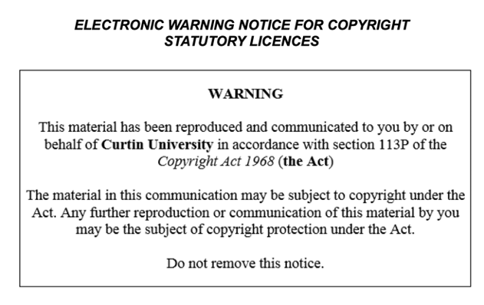

Slide 3
Today
Introduce the importance of data visualisation in Python.
Learn how to visualise weather data using Matplotlib
Understand how to create basic plots to represent weather data
Customise plots to enhance readability and presentation

Slide 4
Why Visualise Data?
Simplifies complex data
Identifies patterns and trends
Aids in decision-making
Enhances data storytelling
Facilitates better communication

Slide 5
What is Data Visualisation?**
Visual representation of data
Uses charts, graphs, and plots
Helps in understanding data insights

Slide 6
Popular Libraries in Python**
Matplotlib: Highly customisable, widely used
Seaborn: Built on Matplotlib, easier syntax
Plotly: Interactive visualisations, web-based
Bokeh: Interactive plots, for web apps
Altair: Declarative statistical visualisation

Slide 7
Workflow
Find the data you want
What story do you want to tell
Pick from the Python Graph Galley
Get data (upload, wget, etc)
Implement in notebook (or script)

Slide 8
Common Visualisation Roles
Showing change over time
Showing a part-to-whole composition
Looking at how data is distributed
Comparing values between groups
Observing relationships between variables
Looking at geographical data

Slide 9
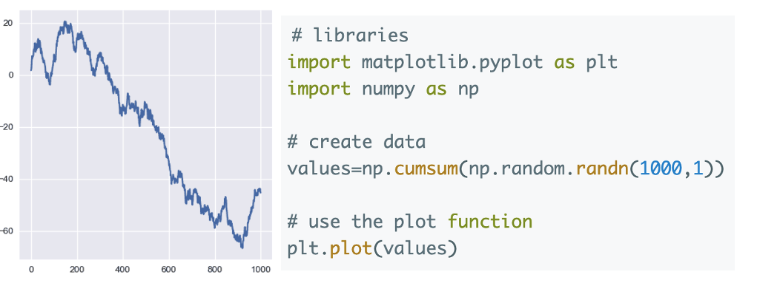
Python Graph Gallery

Slide 10
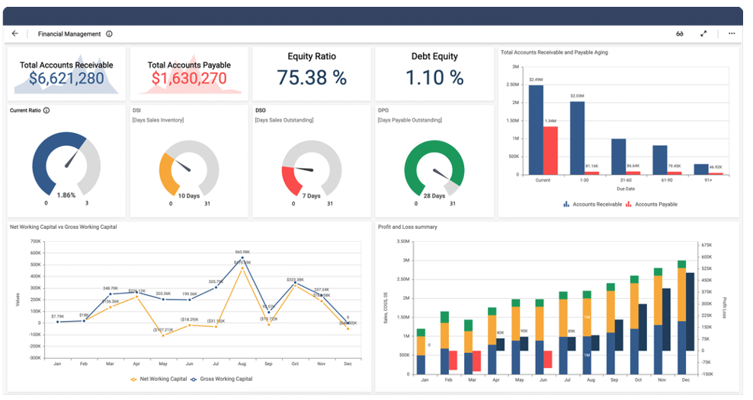
Dashboard

Slide 11
Introduction to Matplotlib
Matplotlib is a widely used Python library for creating static, animated, and interactive visualisations
Import required libraries: import pandas as pd and import matplotlib.pyplot as plt

Slide 12
Reading Data
Read processed weather data from the CSV file created in the previous session
import pandas as pd df = pd.read_csv('data/processed/processed_weather_data.csv')

Slide 13
Creating Basic Plots
line plot for temperature
bar plot for humidity
pie chart ofr weather description
scatter plots temperature vs windspeed

Slide 14
Line plot for temperature
plt.plot(df['Location'], df['Temperature (C)'], marker='o') plt.title('Temperature by Location') plt.xlabel('Location') plt.ylabel('Temperature (°C)') plt.xticks(rotation=45) plt.grid(True) plt.show()

Slide 15
Bar plot for humidity
plt.bar(df['Location'], df['Humidity (%)'], color='skyblue') plt.title('Humidity by Location') plt.xlabel('Location') plt.ylabel('Humidity (%)') plt.xticks(rotation=45) plt.show()

Slide 16
Pie chart for weather description
weather_counts = df['Weather'].value_counts() plt.pie(weather_counts, labels=weather_counts.index, autopct='%1.1f%%', startangle=140) plt.title('Weather Description Distribution') plt.axis('equal') plt.show()`

Slide 17
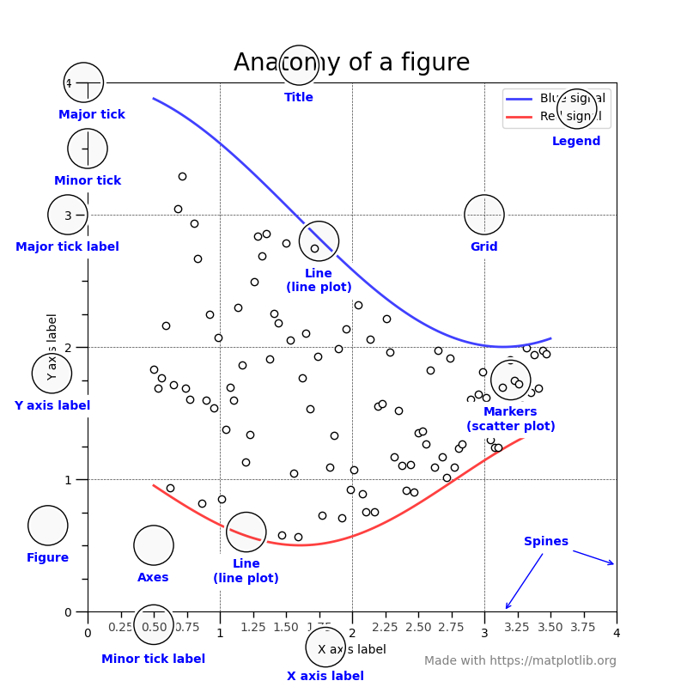
Customising Plots

Slide 18
Adding annotations
plt.annotate(f'Max Temp: {max_temp:.2f}°C', xy=(max_temp_location, max_temp), xytext=(max_temp_location, max_temp+2), arrowprops=dict(facecolor='black', shrink=0.05))

Slide 19
Customising colors and styles
plt.plot(df['Location'], df['Temperature (C)'], marker='o', linestyle='--', color='b') plt.title('Temperature by Location', fontsize=14, fontweight='bold') plt.xlabel('Location', fontsize=12) plt.ylabel('Temperature (°C)', fontsize=12) plt.xticks(rotation=45) plt.grid(True, linestyle='--', linewidth=0.5) plt.show()

Slide 20
Effective Data Visualisation
Choose the right type of chart
Maintain clarity and simplicity
Use colour wisely
Ensure accuracy and precision
Tailor visualisations to the audience

Slide 21
Conclusion
In this session, we learned how to visualise weather data using Matplotlib
We created basic plots such as line plots, bar plots, and pie charts, and we customised these plots to improve readability and presentation
Next session, we will focus on advanced data visualisation techniques using subplots and grids.

Slide 22
Homework
Create additional plots to visualise other aspects of the weather data (e.g., wind speed, pressure)
Experiment with different types of plots and customisations to enhance the visualisations

