Slide 1

Teaching That Lands
Death by PowerPoint?
In one day · 1 of 3
© Teaching That Lands · CC BY 4.0 · https://teachingthatlands.uk/
Notes:
ONE-DAY VERSION. Built from ttl-day1-death-by-powerpoint.pptx by tools/one_day_decks.py: don't edit this file, edit the master and rebuild. Timings and running order: /facilitator/one-day. The other notes come from the three-session version: read "next week" as "after lunch" or "in the 1-week email".
TIMING
0:00
SAY
Welcome. Three sessions, one week apart.
You'll leave with one session (yours, or one you'd like to teach) rebuilt.
IF SHORT
Never cut.

Slide 2

What makes a good teacher?
…did anyone say slides?
Notes:
TIMING
0:00–0:05 (5 min)
BUILDS
1: '…did anyone say slides?'
SAY
Click only once it's clear nobody said it.
Nobody said 'good slides'. Hold onto that.
ASK
What makes a good teacher? Scribe answers on the whiteboard.
WHY
Activates prior experience: andragogy, unnamed. → /theories/andragogy
IF SHORT
3 minutes is enough.

Slide 3
What do we need people to do differently?
…and how will our teaching make that happen?
Notes:
TIMING
0:05–0:07 (2 min)
BUILDS
1: '…and how will our teaching make that happen?'
SAY
This is the question for all three weeks.
Most teaching starts with the content or the agenda. We'll start with the change.
OPTIONAL (30 s): an advert is designed backwards from the one thing they want you to do. Most teaching isn't.
IF SHORT
Keep the slide; drop the advert line.

Slide 4
Building your session
Learners & context
Need
Outcomes
Evidence
Activities
This morning: the slides
Activities
Follow-through
Before lunch: what learners do · This afternoon: outcomes → evidence → follow-through
Notes:
TIMING
0:07–0:09 (2 min)
BUILDS
1: six boxes · 2: Activities highlighted, 'Day 1 · the slides' · 3: Day 2 / Day 3 line
SAY
One session, rebuilt across three weeks.
Today, the most visible bit: the slides. By Day 3 we work back up to the top.
WHY
Advance organiser. It reappears at every move between sections.
IF SHORT
Never cut (it's the map).

Slide 5
Look at the next slide…
(no notes, just look)
Notes:
TIMING
0:09
SAY
Just look at the next slide. No notes, no phones. It disappears after 30 seconds.

Slide 6
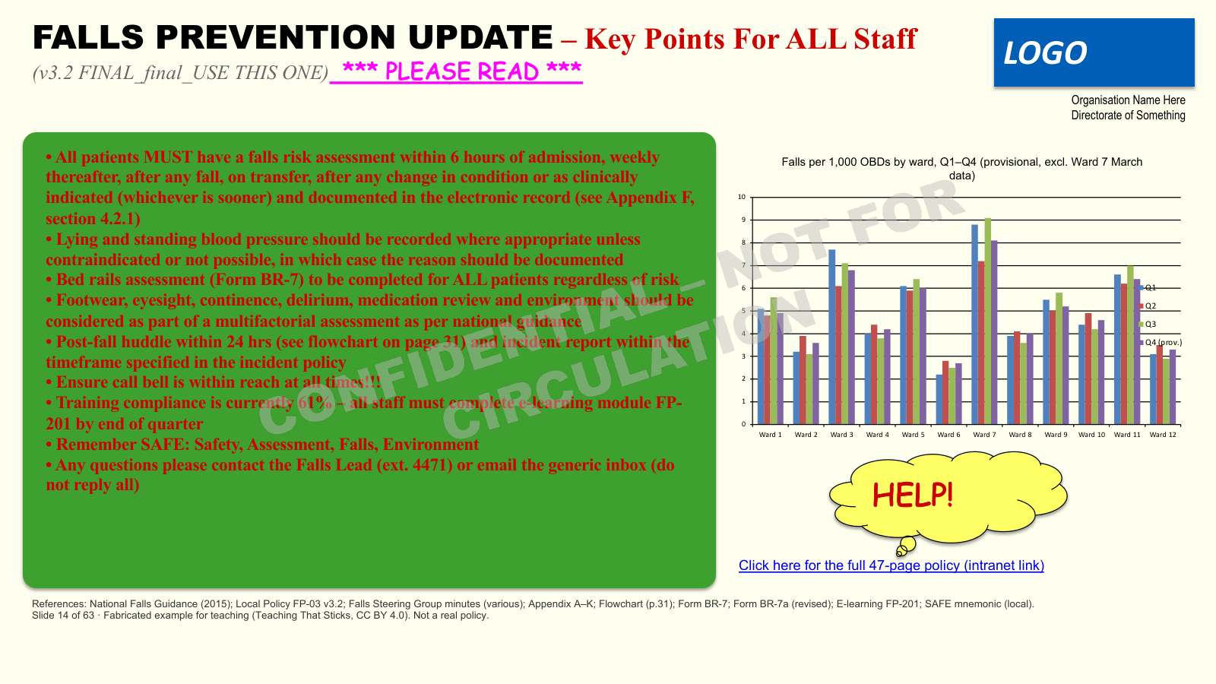
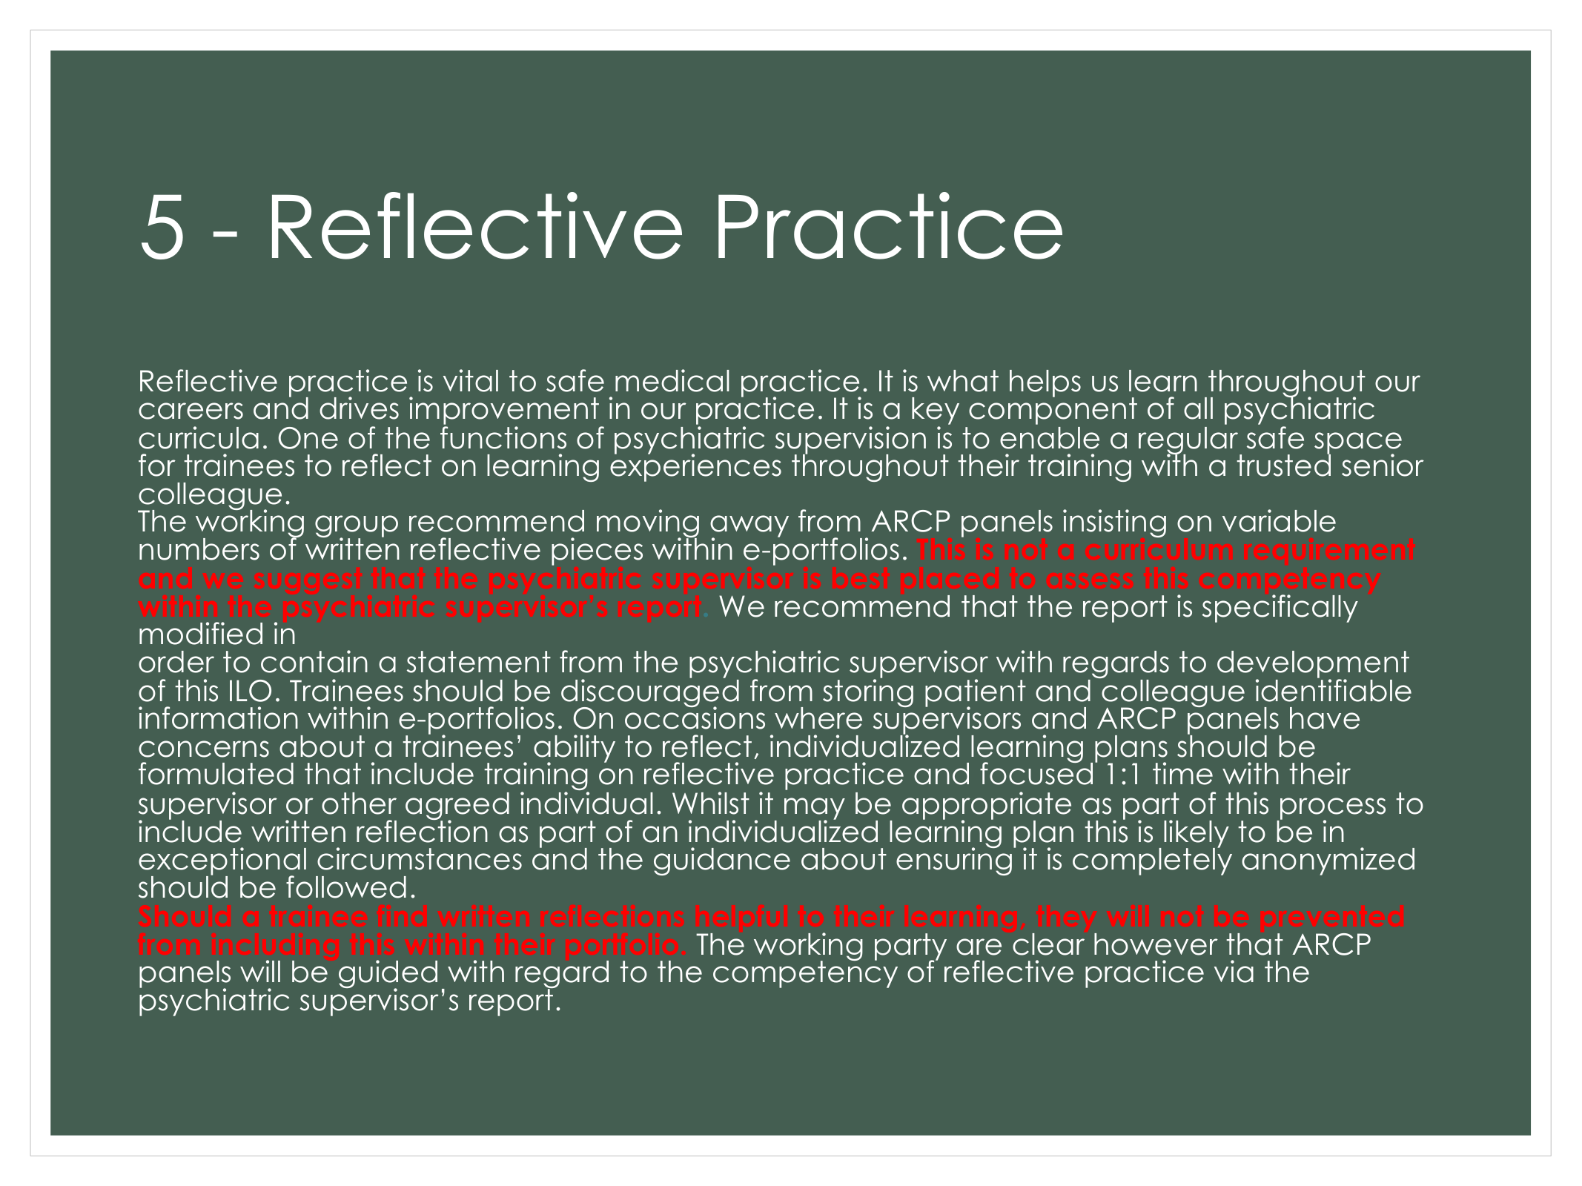
Notes:
TIMING
0:09–0:10 (auto-advances after 30 s)
SAY
Nothing. Silence is the point.

Slide 7
Notes:
TIMING
0:10
SAY
Screen's off.

Slide 8
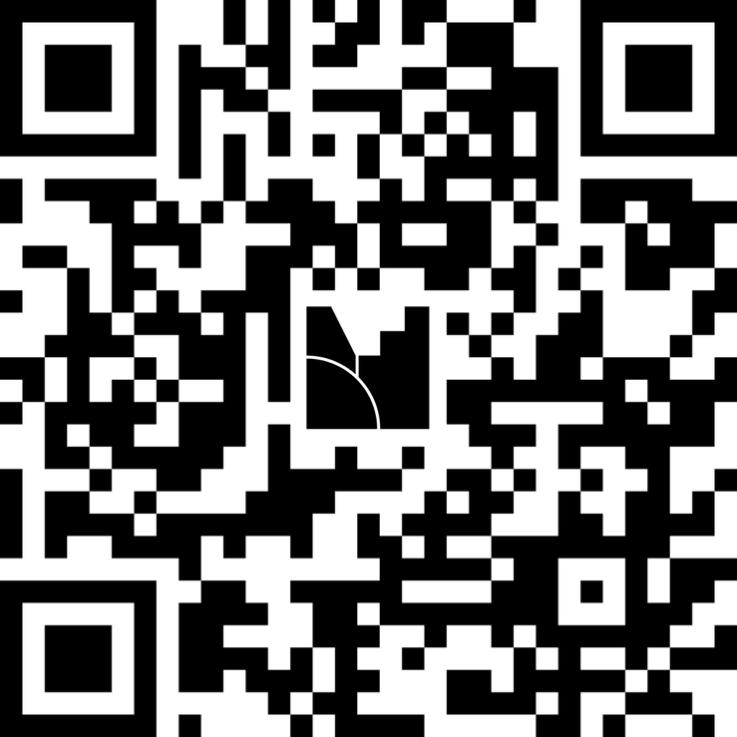
What do you remember?
One or two words each
Notes:
TIMING
0:10–0:14 (4 min)
SAY
One or two words each. Read the answers out; let the laughter happen.
HOW TO RUN
Menti word cloud: show Menti alongside this slide, or paste your own QR code and joining code onto it.
No Menti, or no wifi? Shout-outs onto the whiteboard or a flipchart. The slide works either way.
WHY
A 30-second retrieval test of an overloaded slide: they feel the problem before the theory.

Slide 9
The bottleneck
Long-term memory
effectively unlimited
Working memory
~4 items
encode
retrieve
Notes:
TIMING
0:14–0:17 (3 min)
BUILDS
1: working memory · 2: long-term memory · 3: encode arrow (wipe) · 4: retrieve arrow (wipe)
SAY
Small working memory, huge long-term memory, a narrow bottleneck between.
Learning = getting through it.
Put everything on a slide and you rest YOUR memory and tax THEIRS.
(click 4) Remember this arrow. It comes back next week.
WHY
~4 items: Cowan (2001), revising Miller's 7±2. → /theories/cognitive-load
IF SHORT
Never cut.

Slide 10


✗ noise
✓ signal
Notes:
TIMING
0:17–0:19 (2 min)
BUILDS
1: busy advert · 2: MacBook advert · 3: ✗ noise / ✓ signal
SAY
Sweller: some load belongs to the topic (intrinsic). You can scaffold it, not remove it.
Some is just noise (extraneous), and that's the part WE control.
Everything on that bad slide was noise.
ASK
What do you notice? (Pause 5–8 s.)
WHY
Keep it to two types. 'Germane' load is contested and Sweller later folded it back in; mention only if asked. → /theories/cognitive-load
CREDITS
'Navy Exchange Black Friday 2011 Ad Scan – Page 7', Hotcouponworld.com, CC BY-SA 2.0, https://openverse.org/image/f564d68c-6499-4314-ba86-f1c4dd8fac11
'MacBook advert', Toby Shuttleworth, CC BY 2.0, https://openverse.org/image/8962af27-38b6-4533-b2a3-0d249d64d468

Slide 11
Two channels
Text
Voice
+
→
competes ✗
Image
Voice
+
→
complements ✓
Notes:
TIMING
0:19–0:22 (3 min)
BUILDS
1: reading text + your voice · 2: competes ✗ · 3: an image + your voice · 4: complements ✓
SAY
A slide full of words pulls learners' eyes away from you, and they read ahead. Learners pick one.
An image plus your voice uses eyes and ears together.
Notice what's happening right now: a diagram, and me talking.
WHY
Dual coding is PAIVIO; the slide-design principles (redundancy, modality) are MAYER's multimedia learning. Printed words compete with the pictures for learners' eyes; a few key words are fine. Not 'always add images': a busy infographic is just more noise. → /theories/dual-coding
IF SHORT
Never cut (feeds the redesign).

Slide 12
Redesign: round 1
1
Pick your pieces
2
Cut the noise
3
Image + voice
⏱ 15 min on paper (laptop if you're comfy) · then swap
Notes:
TIMING
0:22–0:39 (15 min + 2 min swap)
SAY
Build one slide from the kit that helps a nurse do ONE thing before leaving the bedside. Choose your pieces, cut the noise, image + voice. Anything needed but not for the learner's eyes goes in the speaker-notes strip.
Comfortable on a laptop? Do it in PowerPoint on a slide of your own instead. Same rules.
Then 2 minutes swapping with a neighbour: what did they discard?
FACILITATOR
Hand out the falls slide kit (pre-cut in envelopes saves 5 minutes): the frame, the pieces, scissors or Blu Tack.
Laptop route only: show once on screen: select slides (Shift / Ctrl / Cmd-click), Duplicate slide, Undo, Designer off.
WHY
Paper takes the computer out of the way: the decisions (what stays, what goes, how big, where) are the skill. Picking and arranging given parts is a completion task, which suits novices (Sweller). The discard pile is extraneous load you can point at.
IF SHORT
Cut the swap, not the build.

Slide 13
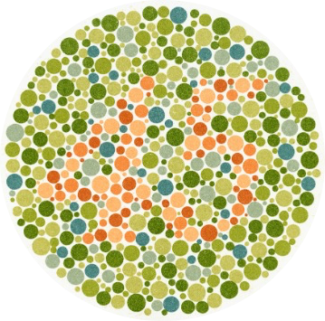
Who can see all the numbers?
≈ 1 in 12 men, 1 in 200 women
Notes:
TIMING
0:39–0:42 (3 min)
BUILDS
1: ≈ 1 in 12 men · 1 in 200 women
SAY
In a room of 15, odds are someone sees this differently.
So never let colour carry meaning on its own.
ASK
Who can read every plate? Voluntary: share only if you're comfortable.
FACILITATOR
If you know someone is colour-blind, ask them privately BEFOREHAND whether they're happy to share. If they volunteer, it's often the most memorable moment of the day. Don't linger: move on after a minute.
CREDITS
'Eight Ishihara charts for testing colour blindness, Europe', Wellcome Collection, CC BY 4.0’, 3x images used from the collection:
'https://commons.wikimedia.org/wiki/File:Eight_Ishihara_charts_for_testing_colour_blindness,_Europe_Wellcome_L0059162.jpg'
‘https://commons.wikimedia.org/wiki/File:Eight_Ishihara_charts_for_testing_colour_blindness,_Europe_Wellcome_L0059161.jpg’
‘https://commons.wikimedia.org/wiki/File:Eight_Ishihara_charts_for_testing_colour_blindness,_Europe_Wellcome_L0059160.jpg’

Slide 14




Readable?
Size is important (40 pt)
Size is important (36 pt)
Size is important (32 pt)
Size is important (28 pt)
Size is important (24 pt)
Size is important (20 pt)
Size is important (18 pt)
Size is important (16 pt)
Size is important (14 pt)
Size is important (12 pt)
Hard to Read
Hard to Read
Hard to Read
0 1 2 3 4 5 6 7 8 9
Notes:
TIMING
0:42–0:44 (2 min)
BUILDS
1: size ladder · 2: contrast strip 0–9 · 3: head at the bottom of the screen
SAY
24pt or more. Strong contrast. Nothing important at the bottom of the screen (heads).
PowerPoint has an accessibility checker. You'll use it next.
ASK
From where you're sitting, where does it stop being readable?
WHY
Accessible = less extraneous load for EVERYONE. → WCAG quick reference
IF SHORT
Merge into the round-2 instructions.
CREDITS
Silhouette: 'Profile Photo Placeholder – smooth edges', domdomegg, CC0, https://commons.wikimedia.org/wiki/File:Profile_photo_placeholder_-_smooth_edges.svg

Slide 15
Redesign: round 2
1
Readable from the back
2
No colour-only meaning
3
Hold it up!
⏱ 15 min same slide · laptop: run the accessibility checker
Notes:
TIMING
0:44–0:59 (15 min)
SAY
Same slide, accessibility pass. Swap pieces for size and contrast; no meaning by colour alone.
Then HOLD IT UP across the room: can the back row read it?
Laptop route: Review → Check Accessibility.
WHY
The readability test becomes physical: they feel 24pt rather than being told it.
FALLBACK
No laptops needed: this round is designed for paper.

Slide 16
Show us!
✓
One thing that works
?
One question
Notes:
TIMING
0:59–1:11 (12 min; cut this first)
SAY
2–3 volunteers: before and after. (Bigger group: gallery walk, laptops open.)
WATCH FOR
The mandated-template objection. Agree it's real; what's still in your control? Fewer words, images, size, order.
IF SHORT
CUT THIS FIRST: down to one volunteer.

Slide 17
Who is this slide for?
Notes:
TIMING
1:11–1:12 (1 min)
SAY
Just the question. Hold it for a moment, then click on.
WHY
Sets up the next slide: they'll judge it against this question.

Slide 18
Constructive Alignment (Biggs, 1996)
Constructive alignment was described by John Biggs in 1996
Every element of a teaching session should serve an intended learning outcome
Intended learning outcomes, teaching and learning activities and assessment tasks should all be aligned
Many slides are written for the presenter rather than for the learner
Presenters often make slides so that they won't forget stuff (a "security blanket")
This adds extraneous cognitive load (Sweller, 1988)
Ask yourself: does each element of this slide show what the learner needs to do?
If the honest answer is "no, the slide is for me", the slide needs to be redesigned
And if you’ve got to the bottom of this… you weren’t listening!
Notes:
TIMING
1:12–1:14 (2 min)
SAY
READ EVERY WORD ALOUD, slowly, facing the screen. That's the experience.
Don't comment. Click on.
WHY
They feel what it's like when the slide is the presenter's script: two channels competing, and nobody looking at them.
IF SHORT
Read the first four bullets only, then click on.

Slide 19

Who is this slide for?
✓ the learner
✗ your memory
Notes:
TIMING
1:14–1:15 (1 min)
BUILDS
1: ✓ the learner / ✗ your memory
SAY
Same message. One image, one question, your voice.
The last slide was a security blanket: it was for me.
ASK
(Think, don't answer.) Ever put everything on a slide so you wouldn't forget it?
WHY
Constructive alignment at slide scale (Biggs): does it serve what the learner needs to do? → /theories/constructive-alignment
CREDITS
'It's my blanket!', Elecé, CC BY 2.0, https://www.flickr.com/photos/11498085@N00/5648654531

Slide 20
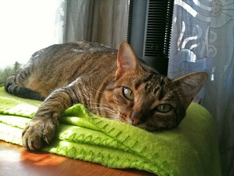
Current slide
Speaker notes
Constructive alignment (Biggs, 1996): every element of teaching serves what learners need to be able to do. Outcomes, activities and assessment line up.
Slides written so you won't forget are a security blanket. They're for you, not the learner.
Text on the slide plus your voice = extra load and the redundancy effect (Sweller; Mayer).
So ask of every slide: does this serve what the learner needs to do? If the honest answer is "me", it belongs here, in the notes.
Who is this slide for?
✓ the learner
✗ your memory
The detail didn't disappear.
It moved.
Notes:
TIMING
1:15–1:17 (2 min)
BUILDS
Morph in from the previous slide · 1: 'The detail didn't disappear…'
SAY
So where did all that text go?
Into the notes: the one place that IS for you.
You can't decide what goes on the slide until you know what learners need to do. That's Day 3.
Also, notice the difference – 9 bullet points to a guided tour, one chunk at a time = scaffolding for the learner.
WHY
Moves the security blanket to the presenter's notes rather than banning it; links the spine to Day 3.
Scaffolding (Wood, Bruner & Ross, 1976) and segmenting (Mayer). It manages the topic's own difficulty, not just the clutter. → /theories/zone-of-proximal-development
IF SHORT
Never cut this slide: it's the payoff of the previous two.
CREDITS
'It's my blanket!', Elecé, CC BY 2.0, https://www.flickr.com/photos/11498085@N00/5648654531

Slide 21
But sometimes the best slide is… no slide at all
Notes:
TIMING
1:17–1:19 (2 min)
SAY
Hold that thought for next week.
IF SHORT
Never cut (it's 10 seconds).

Slide 22
The ask
Before next week I will:
identify and redesign one or two slides
(my own, or an example I find) and bring them.
Notes:
TIMING
1:19–1:26 (7 min)
SAY
Write it on the card NOW, in the room. Add WHICH slides or WHERE you'll look. Photograph it.
No slides of your own? The ask is to FIND one (intranet, a lecture, a training day) and fix it.
We start next week by looking at what you did.
WHY
A specific written intention plus a follow-up loop (implementation intentions). The follow-up is next week's opener. → /theories/implementation-intentions
IF SHORT
NEVER CUT. Start at 1:20 even mid-discussion.

Slide 23

See you next week
We start with your slides.
Notes:
TIMING
1:26–1:30 (close + buffer)
SAY
Thank you. Next week starts with your slides.
QR Code goes to website

Slide 24
Credits
Busy advert: 'Navy Exchange Black Friday 2011 Ad Scan – Page 7', Hotcouponworld.com, CC BY-SA 2.0 (via Openverse)
MacBook advert: Toby Shuttleworth, CC BY 2.0 (via Openverse)
Ishihara plates: 'Eight Ishihara charts for testing colour blindness, Europe', Wellcome Collection, CC BY 4.0
Silhouette: 'Profile Photo Placeholder – smooth edges', domdomegg, CC0
Cat: 'It's my blanket!', Elecé, CC BY 2.0 (Flickr)
Fox illustrations: Teaching That Lands, CC BY 4.0
Theory library: teachingthatlands.uk/theories
This deck: Teaching That Lands, CC BY 4.0. Copy it, adapt it, share it.
Notes:
SAY
Not presented. Here for licence compliance and for anyone adapting the deck.

