Slide 1
Slide kit · Teaching That Lands · CC BY 4.0 · fabricated, not a real policy
Speaker notes

Slide 2
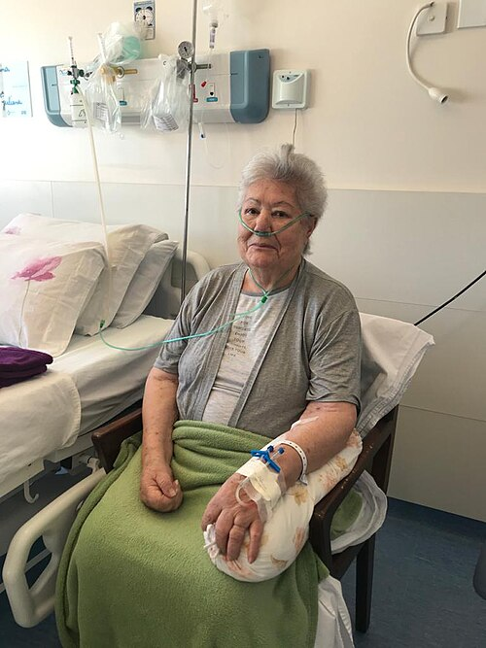
Slide kit · Teaching That Lands · CC BY 4.0 · fabricated, not a real policy
FALLS PREVENTION UPDATE – Key Points For ALL Staff (v3.2 FINAL_final) *** PLEASE READ ***
Falls Prevention: Updated Guidance for Inpatient Areas Following Review of Incidents in Q3
Falls prevention update
Before you leave the bedside
• Ensure the bed is returned to its lowest height setting unless clinically contraindicated (document the reason)
• Place the call bell within the patient's reach and check they know how to use it
• Ensure the patient has well-fitting non-slip footwear on or readily available
• Check and clear the floor area of trip hazards (cables, spills, equipment, clutter)
• Compliance will be audited monthly
Following a review of inpatient falls incidents and in line with the updated local policy (FP-03 v3.2, see Appendix F section 4.2.1), all clinical staff are reminded that before leaving any patient who has been assessed as being at risk of falls, they should ensure that the bed has been returned to its lowest height setting (unless clinically contraindicated, in which case the reason should be documented), that the call bell is placed within the patient's reach and that they know how to use it, that the patient is wearing well-fitting non-slip footwear or has it readily available, and that the immediate floor area has been checked and cleared of trip hazards such as cables, spills, equipment and clutter. Compliance with this will be audited monthly.
What do you check before you leave?
Would you leave your mum like this?
Four checks
Falls: a whole-team approach
Could you prevent the next fall?
FOUR CHECKS!!!
Notes:
“Paciente em recuperação da COVID-19 fazendo oxigenoterapia via cânula nasal.” by Parzeus (CC BY-SA 4.0): https://commons.wikimedia.org/wiki/File:Oxigenoterapia_para_COVID-19_-_São_Borja_23-04-2021.jpg

Slide 3
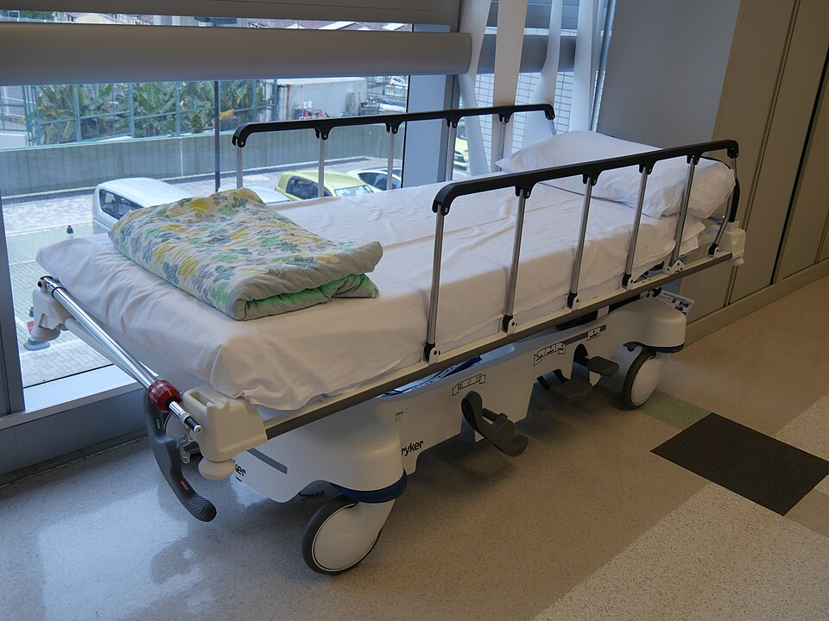
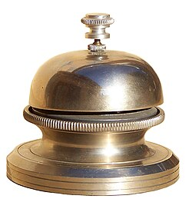
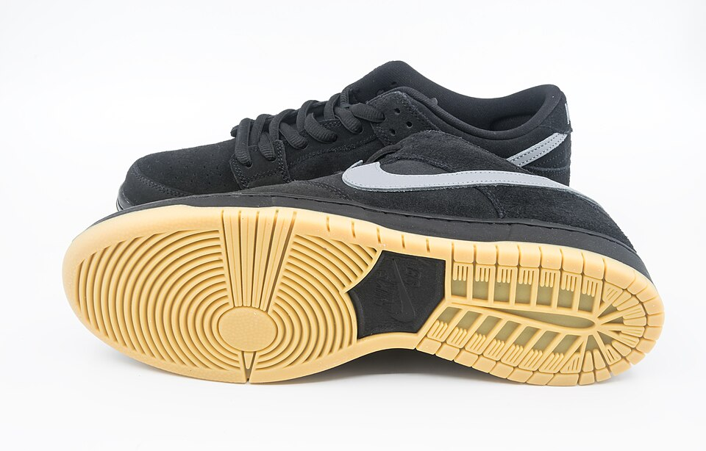
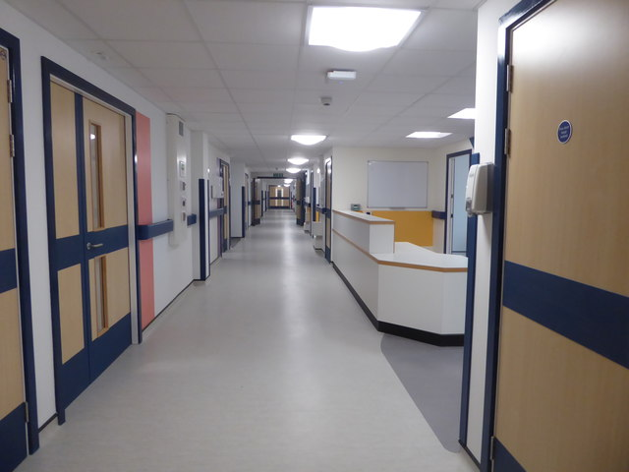
Slide kit · Teaching That Lands · CC BY 4.0 · fabricated, not a real policy
Bed at lowest height
Call bell within reach
Non-slip footwear on
Floor clear of trip hazards
Bed low
Bell in reach
Footwear on
Floor clear
Bed low
Bed low
Bed low
Bed low
Bed low
Bed lowered (where appropriate)
Bed low · Bell in reach · Footwear on · Floor clear
Notes:
Bed: “A Modern Hospital Bed at out-patients clinic in Pok Oi Hospital in Yuen Long, Hong Kong” by Peachyeung316 (CC BY-SA 4.0): https://commons.wikimedia.org/wiki/File:A_Modern_Hospital_Bed_in_Pok_Oi_Hospital.jpg
Bell: “Sonnette de type hôtel ou de table. Elle s'actionne en faisant tourner la petite partie supérieure.” by Ceridwen~commonswiki (CC BY-SA 4.0): https://commons.wikimedia.org/wiki/File:Sonnette_1.jpg
Shoes: ” Nike SB Dunk Low Pro shoes” by Jacek Halicki (CC BY-SA 4.0): https://commons.wikimedia.org/wiki/File:2023_Nike_SB_Dunk_Low_Pro_(3).jpg
Ward: “Worcestershire Royal Hospital - 21st century ward” by Chris Allen (CC BY-SA 2.0) https://commons.wikimedia.org/wiki/File:Worcestershire_Royal_Hospital_-_21st_century_ward_-_geograph.org.uk_-_6481391.jpg

Slide 4
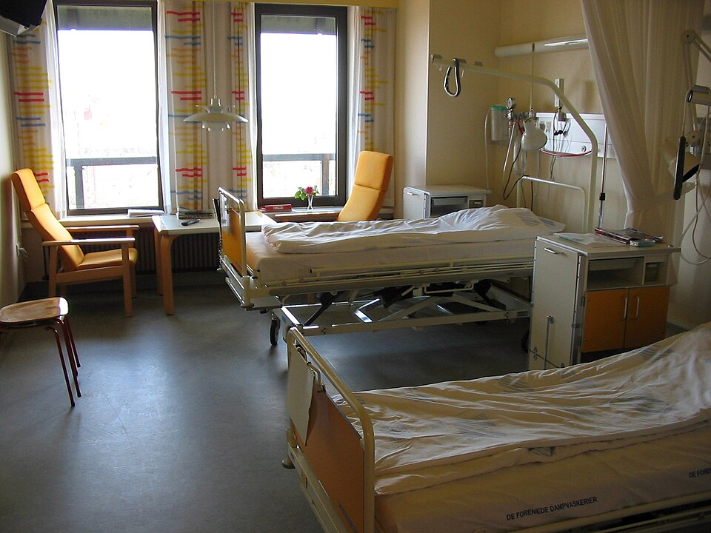
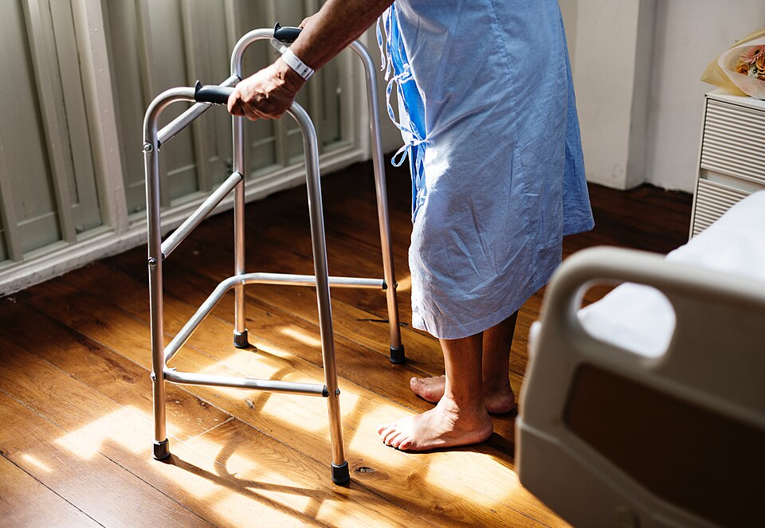
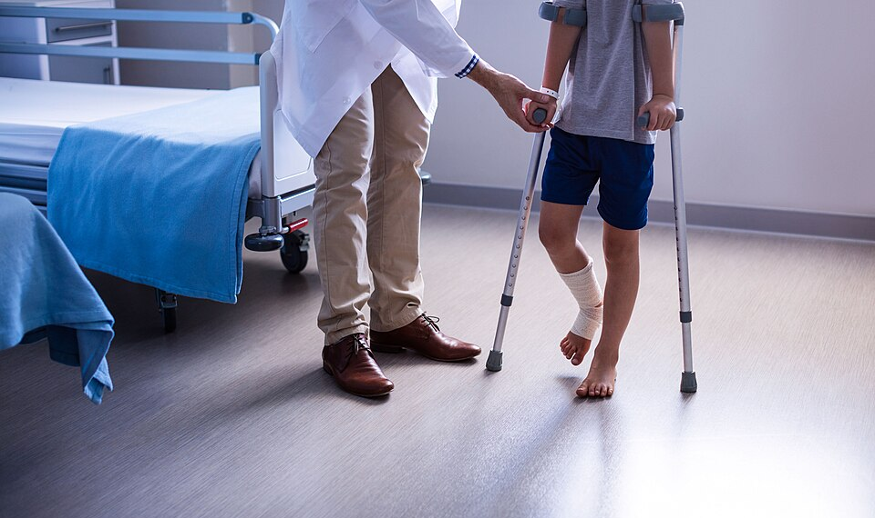
Slide kit · Teaching That Lands · CC BY 4.0 · fabricated, not a real policy
Floor clear
Floor clear
Floor clear
Floor clear
Floor clear
2
falls last month
Training compliance is currently 61%
Notes:
Hospital Ward: “A hospital room with 2 beds in a Danish Hospital” by Tomasz Sienicki (Public Domain): https://commons.wikimedia.org/wiki/File:Hospital_room_ubt.jpeg
Zimmer frame: “A woman supporting herself with a walking frame” by rawpixel.com (CC0 1.0): https://commons.wikimedia.org/wiki/File:A_woman_supporting_herself_with_a_walking_frame.jpg
Crutches: “A doctor assisting a foot injured boy to walk with crutches.” by Awesome Content (for any purpose): https://commons.wikimedia.org/wiki/File:Doctor_assisting_foot_injured_boy_to_walk_with_crutches.jpg

Slide 5
Slide kit · Teaching That Lands · CC BY 4.0 · fabricated, not a real policy
TTL
Teaching That Lands
Health and Safety Department
HELP!
*** PLEASE READ ***
CONFIDENTIAL – NOT FOR CIRCULATION
Click here for the full 47-page policy (intranet link)
Slide 14 of 63
Any questions please contact the Falls Lead (ext. 4471)
References: National Falls Guidance (2015); Local Policy FP-03 v3.2; Falls Steering Group minutes (various); Appendix A–K; Form BR-7; Form BR-7a (revised); E-learning FP-201
Remember SAFE: Safety, Assessment, Falls, Environment
Compliance will be audited monthly
Bed low · Bell close · Shoes on · Floor safe
The 4 Bs: Bed, Bell, Boots, Barriers
Check all four before you leave
Before you leave: bed, bell, footwear, floor, obs, fluids, pain, toileting
● Bed ● Bell ● Footwear ● Floor
(green = done, red = not done)
Around 1 in 3 adults over 65 living at home fall at least once a year
Unless contraindicated: document why. Check they can use the bell. Hospital socks only if they grip.

Slide 6
Credits
Page 2, patient: “Paciente em recuperação da COVID-19 fazendo oxigenoterapia via cânula nasal” by Parzeus, CC BY-SA 4.0. commons.wikimedia.org/wiki/File:Oxigenoterapia_para_COVID-19_-_São_Borja_23-04-2021.jpg
Page 3, bed: “A Modern Hospital Bed at out-patients clinic in Pok Oi Hospital in Yuen Long, Hong Kong” by Peachyeung316, CC BY-SA 4.0. commons.wikimedia.org/wiki/File:A_Modern_Hospital_Bed_in_Pok_Oi_Hospital.jpg
Page 3, bell: “Sonnette de type hôtel ou de table” by Ceridwen~commonswiki, CC BY-SA 4.0. commons.wikimedia.org/wiki/File:Sonnette_1.jpg
Page 3, shoe: “Nike SB Dunk Low Pro shoes” by Jacek Halicki, CC BY-SA 4.0. commons.wikimedia.org/wiki/File:2023_Nike_SB_Dunk_Low_Pro_(3).jpg
Page 3, ward corridor: “Worcestershire Royal Hospital - 21st century ward” by Chris Allen, CC BY-SA 2.0 (red circle added; this adapted image is CC BY-SA 2.0). commons.wikimedia.org/wiki/File:Worcestershire_Royal_Hospital_-_21st_century_ward_-_geograph.org.uk_-_6481391.jpg
Page 4, hospital room: “A hospital room with 2 beds in a Danish Hospital” by Tomasz Sienicki, public domain. commons.wikimedia.org/wiki/File:Hospital_room_ubt.jpeg
Page 4, walking frame: “A woman supporting herself with a walking frame” by rawpixel.com, CC0 1.0. commons.wikimedia.org/wiki/File:A_woman_supporting_herself_with_a_walking_frame.jpg
Page 4, crutches: “A doctor assisting a foot injured boy to walk with crutches” by Awesome Content, free for any purpose. commons.wikimedia.org/wiki/File:Doctor_assisting_foot_injured_boy_to_walk_with_crutches.jpg
Fox illustrations: Teaching That Lands, CC BY 4.0.
Images keep their own licences, as above. Everything else in this kit (text, layout, made-up content) is Teaching That Lands, CC BY 4.0. Fabricated teaching content: not a real policy.

