Slide 1
Titanic Panic
By Tyler Anderson, Kelvin Mutua, Victoria Medrano, and Molly Pike.

Slide 2
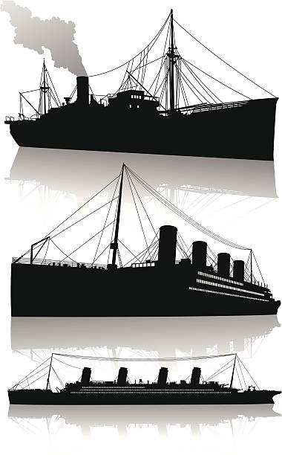
Agenda
All about our data
Present data
Explanation of Results
Conclusion
Dashboard / Interactive
Notes:
Our agenda is to tell you the basics about our data. Answer the burning questions you may have. Present to you the steps and information regarding our data and processes we did to our data for our machine learning model. We will explain our results and what conclusions we came to due to the results. Finally we will present to you our dashboard and interactive.

Slide 3
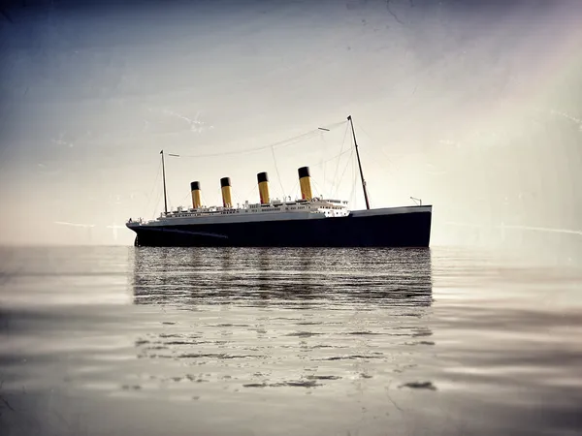
ALL ABOUT OUR DATA.
Why?
Notes:
The Reason we selected this as our project is due to our interest in the historical event. We all appreciated the dataset included a variety of information to analyze in our machine learning model. We saw the opportunity with this data to be able to use a variety of different methods to analyze our data. As well as maybe prove or disprove some commonly thought information about the likeliness to survive depending on a few parameters we will go over in our hypotheses.

Slide 4
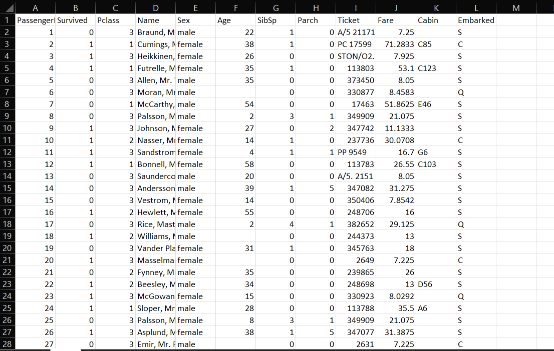
What?
Why?
Where from?
ALL ABOUT OUR DATA.
Notes:
Our dataset was retrieved from Kaggle.com. This data was gathered as part of a machine learning competition, because of this, the data was pre-split into a training and test dataset. The training set, which can be seen in the image on the screen holds information on 891 passengers and the test dataset holds the same information for the remaining 418 passengers. Both datasets hold the same columns except the test dataset does not contain the predictive feature column of “Survived”. (Give a brief description over the columns). Column A is used as an index and holds the passenger number for each passenger. Column B details whether a passenger survived or perished where 0 equals those who did not survive. Column C refers to the class of each passenger and whether they belonged to the first, second, or third class and displaying the economic status of the passengers. Columns D, E, and F are pretty straightforward and hold descriptive information on each passenger such as their full name, sex and age if known of the passenger. Column G details the amount of siblings and or spouses that particular passenger held. Column H is very similar but holds the number of parents or children of that passenger. Column I holds the ticket number and Column J holds the price paid for that ticket. If the information was available Column K would detail the information of room number or cabin number of that passenger to give an idea of where they may have been located on the ship. And last but not least Column L details which port, out of 3, each passenger boarded the Titanic at

Slide 5
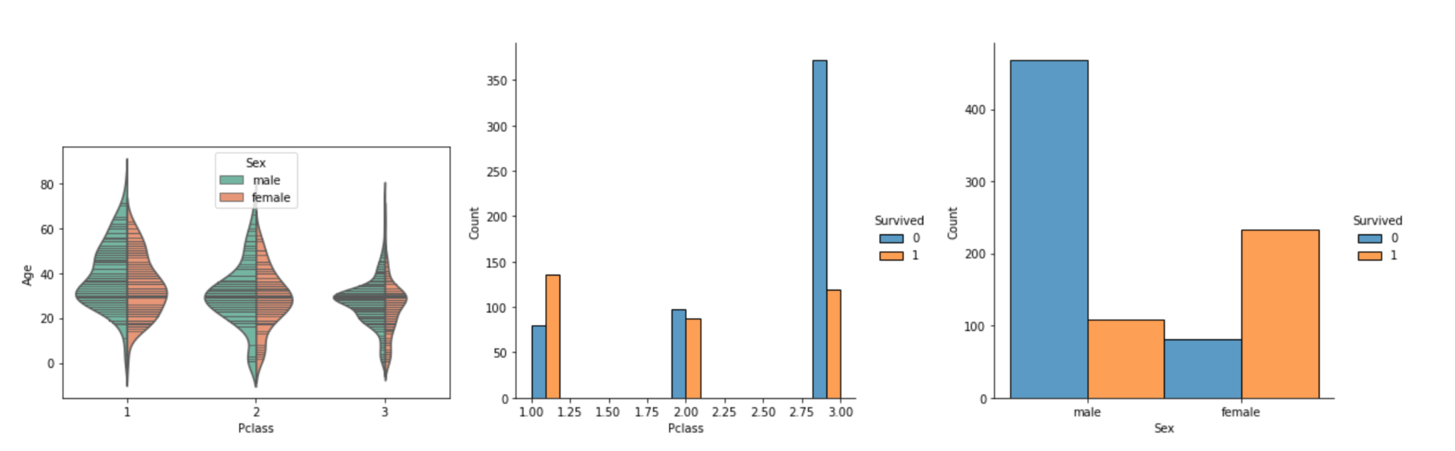
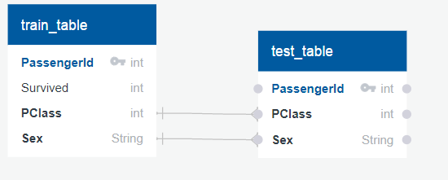
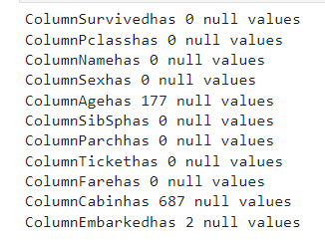
DATA EXPLORATION
Notes:
The initial data processing included checking the values in the dataset. There were 891 rows across a variety of columns as pictured below. Based on our preliminary analysis, we noticed a greater number of deaths for males than females and those in the lower cabins. We decided to use gender and class as our features based on these observations. After reviewing the initial data, we checked for null values across the dataframe. From the image we can see that two columns were missing a significant amount of data. We will discuss the removal of certain columns and how we handled missing values in the machine learning portion of this presentation.In deciding which features to use in our model, we completed further analysis to compare rates of survival based on the different categories. In the images on the screen, 0(blue) represents non-survival and 1 represents survived for the passengers. We observed the categories of gender and boarding class had unique trends worth further exploration.
After discussion of this analysis, we decided to use these as the primary features of our machine learning model.Our original dataset contained twelve different features. We chose to focus on and keep four of these features for our machine learning model. Those features were passenger ID, whether the passenger survived or not, passenger gender, and the economic class of each passenger. For this project, our team wanted to see if we were able to predict survival of passengers aboard the Titanic based on passenger gender and economic class. These specific features were chosen due to our background knowledge of the Titanic and that women and children were two of the groups to be ushered to safety first. Additionally, we also inferred that higher class ranking passengers would more likely have a higher chance of survival given the placement of their cabins (upper deck) on the boat as well as their socioeconomic status and privilege may have also allowed them a spot on a lifeboat.

Slide 6
HYPOTHESES
Hypothesis: The class of passenger impacts the survival rate aboard the Titanic.
Alternative: The gender of passengers impacts the survival rate aboard the Titanic.
Null Hypothesis: The class of passenger does not impact the survival rate aboard the Titanic.
Notes:
Our project will be using machine learning to determine if survival aboard the Titanic can be predicted from passenger class and gender. Questions the team hopes to answer
Hypothesis: The class of passenger impacts the survival rate aboard the Titanic.
Alternative: The gender of passengers impacts the survival rate aboard the Titanic.
Null Hypothesis: The class of passenger does not impact the survival rate aboard the Titanic.
Does gender impact survival odds aboard the Titanic?
Does class of passenger impact survival odds aboard the Titanic?
Can we achieve an machine learning accuracy rate above 80%?

Slide 7
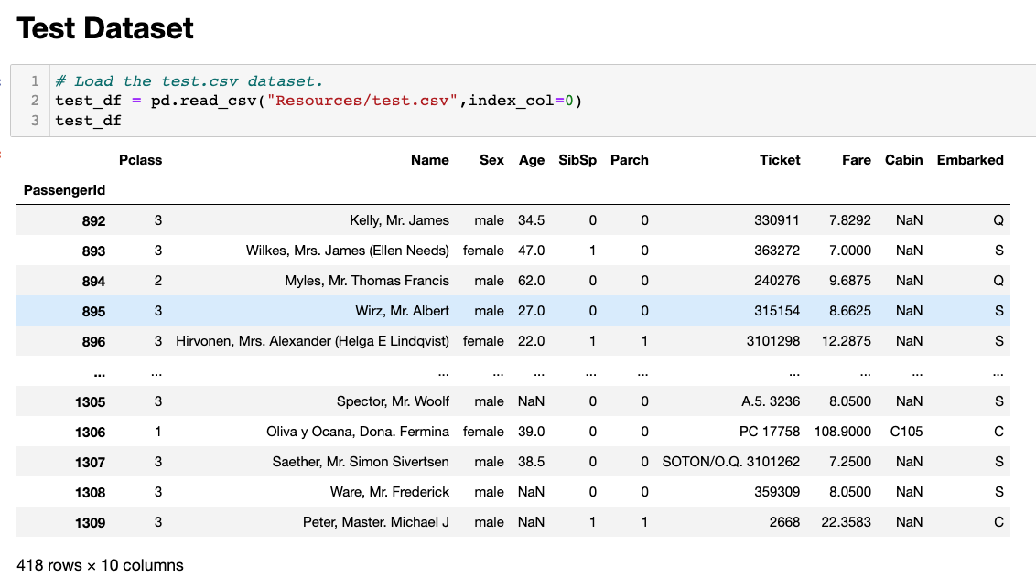
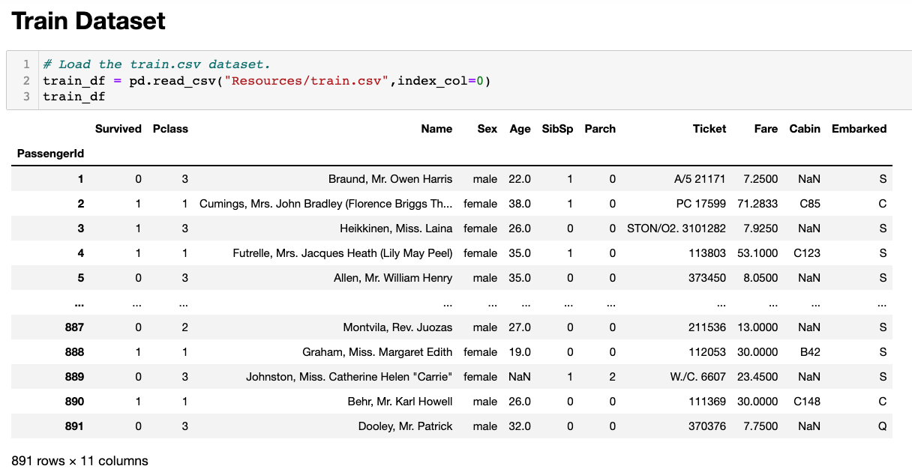
Loading Testing & Training Datasets for Cleaning
Notes:
load Testing and training data and convert them into a dataframe and check for nulls
Remove columns with null values and that will not be helpful

Slide 8
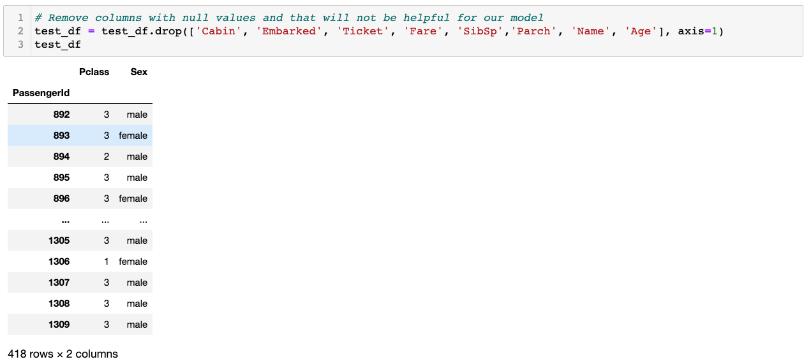
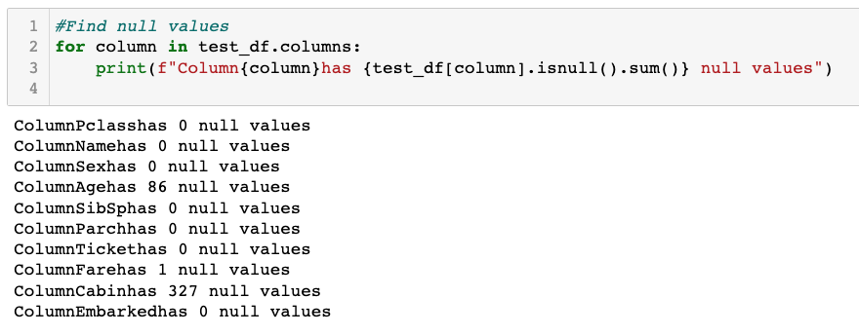
Removing Columns and Nulls
Notes:
-Check the columns with Nulls
-Removed several columns that we thought would be less useful and those columns contained null values so we didn't need to worry about nulls

Slide 9
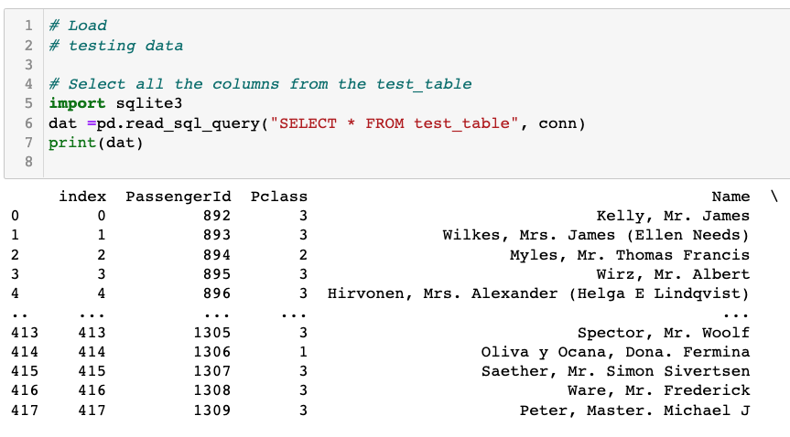
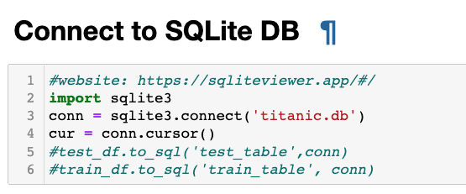
Connecting and Loading Data
Notes:
-Data base was connected to a sqlite data base with a simple connection
-dataframes stored as as sql tables–train table, test table
-data retrieved using a sql querry

Slide 10
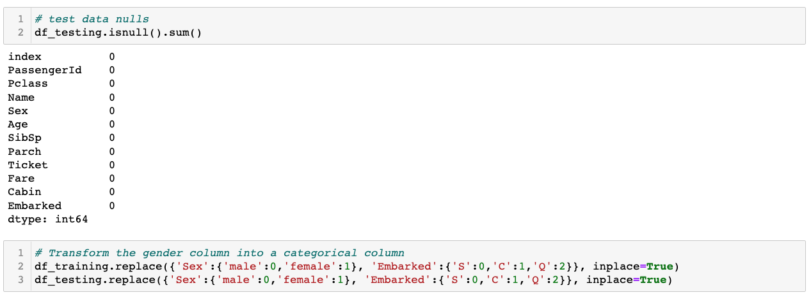
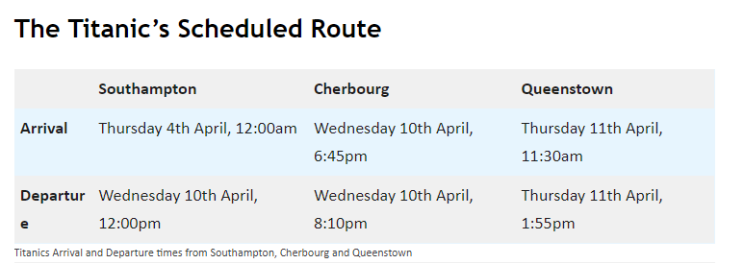
Confirm and Transforming
Notes:
-port of embarkment include Southampton, Cherbourg, Queenstown
-none of the variables has null values , this is because data was previously cleaned and stored in a sqlite database
-data transformed into categorical column because sklleran

Slide 11
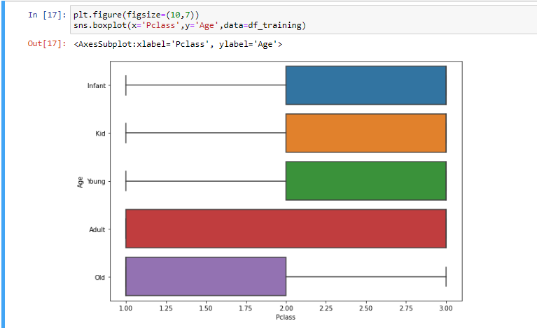
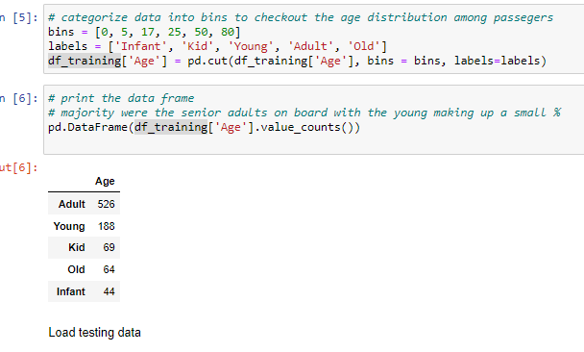
confirm age distribution for training datasets
Notes:
-place age into 4 bins–infant, kid, young, adult , and old
-plot
adults were distributed across all the classes
-the old preferred the first and second class on the ship

Slide 12
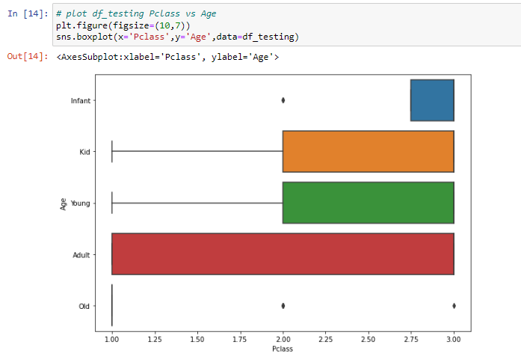
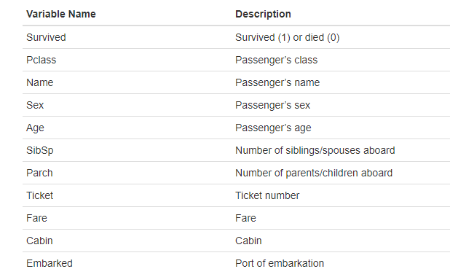
Variable names and description
Notes:
-we will utilize survival for the training data,predict it using logistics regression for the testing data
-Pclass, embarked, Sex were selected for the ml model, could affect chances of survival
-adult distributed across all classes in the testing data
-less to no infants

Slide 13
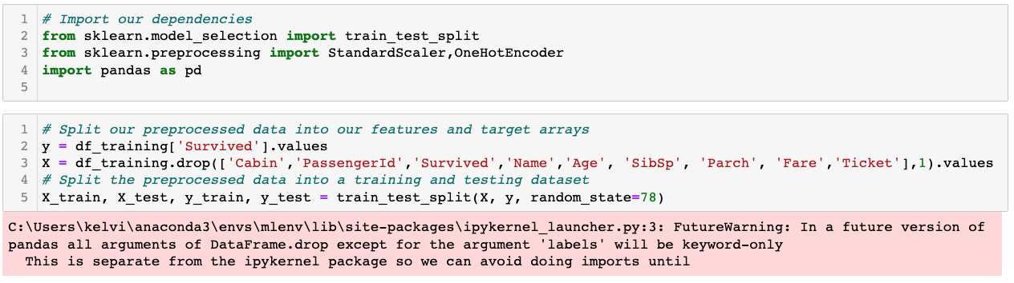
Importing ML Dependencies and Splitting Data
Notes:
-Import ml dependencies
-split our preprocessed data into features and target arrays

Slide 14
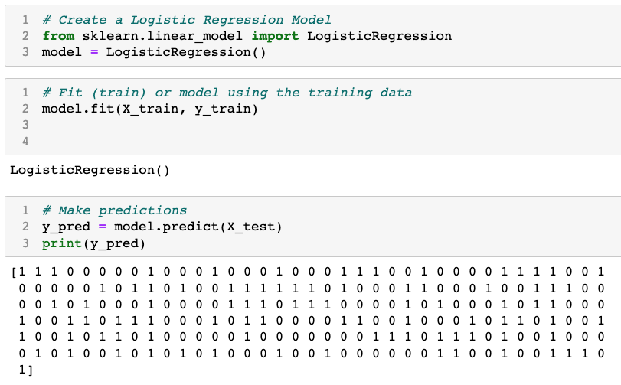
Logistic Regression
Notes:
-Fit model
-make predictions

Slide 15
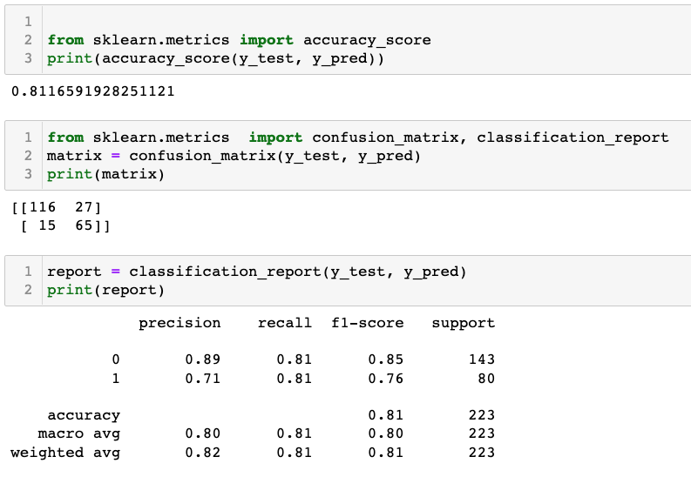
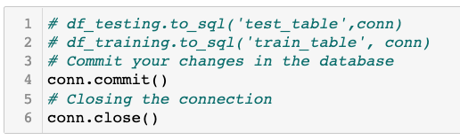
Accuracy and Confusion Matrix
Closing Database Connection

Slide 16
Technologies, languages, tools, and algorithms used throughout the project
Technologies-Git,Github, Jupyter notebook,
Languages-Python, SQL
Algorithms-supervised ml, logistic regression
Tools-sqlite, VsCode, Zoom, Slack

Slide 17
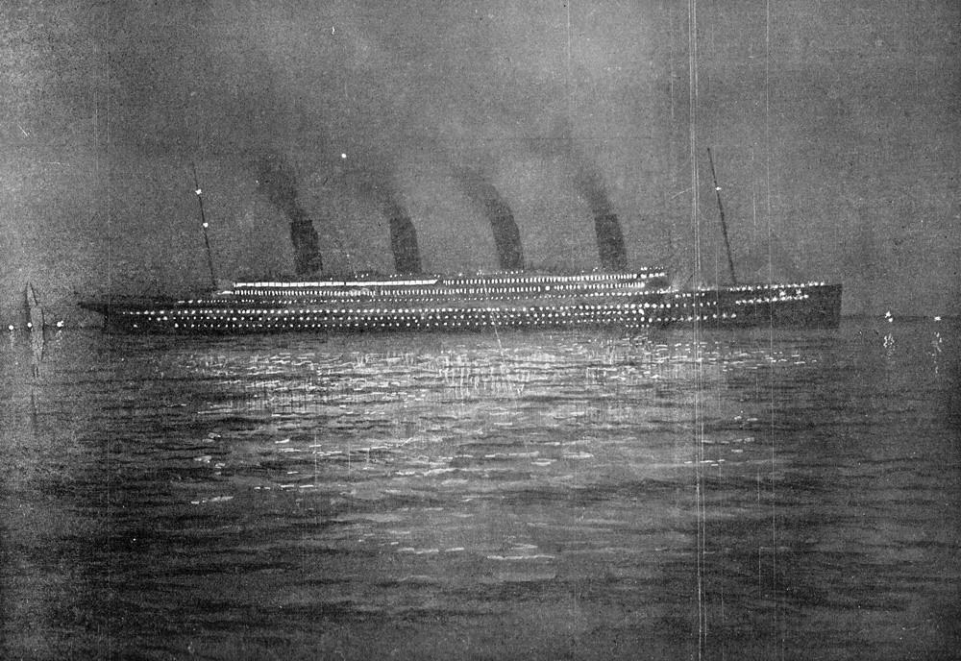
Compare to other disasters
Visualize passenger/members for demographics & info
Determine location on ship with survival rates
Family/Relationship dynamics before/during/after
Future Analysis
Notes:
Future Analysis

Slide 18
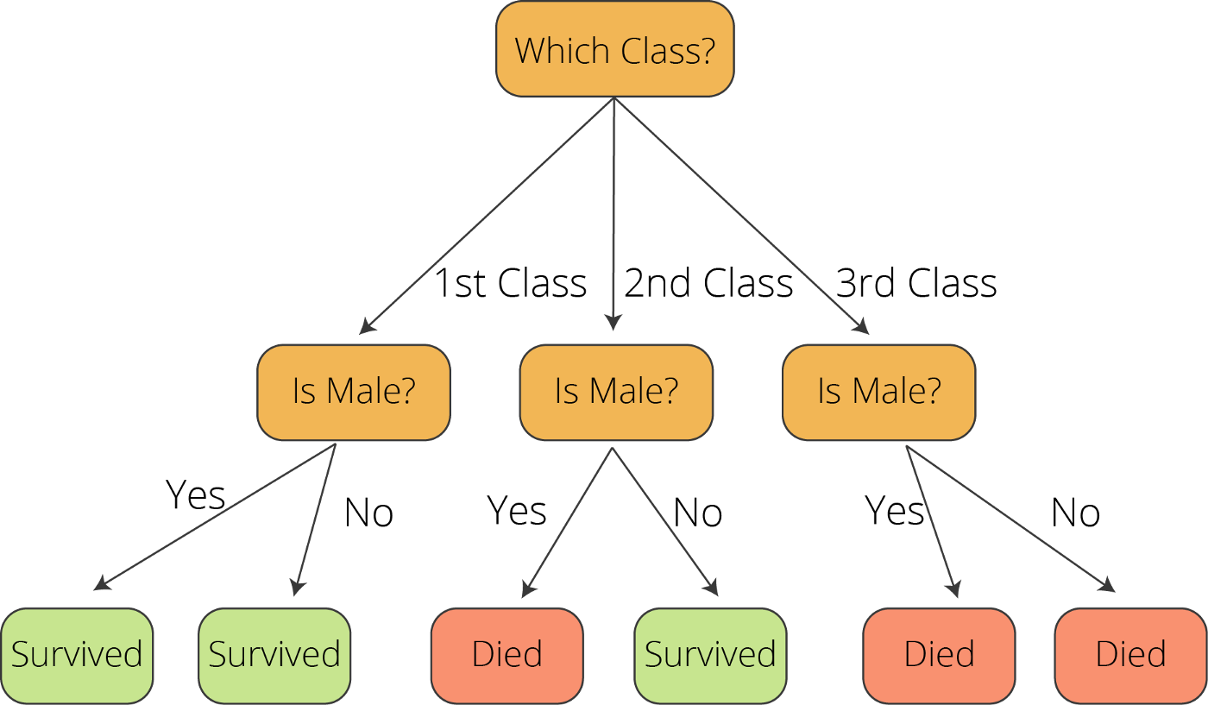
Decision Tree
Visualized Survival Chances
Breakdown by passenger
Classification by Data
Additional Data
Changes to the Design
Notes:
Anything the team would have done differently?

