Slide 1
Titanic Panic
By Tyler Anderson, Kelvin Mutua, Victoria Medrano, and Molly Pike.

Slide 2

Agenda
All about our data
Present data
Dashboard / Interactive
Explanation of Results
Conclusion

Slide 3
Selected topic
Reason the topic was selected
Description of the source of data
Questions the team hopes to answer with the data
Description of the data exploration phase of the project
Description of the analysis phase of the project
Technologies, languages, tools, and algorithms used throughout the project
Result of analysis
Recommendation for future analysis
Anything the team would have done differently

Slide 4
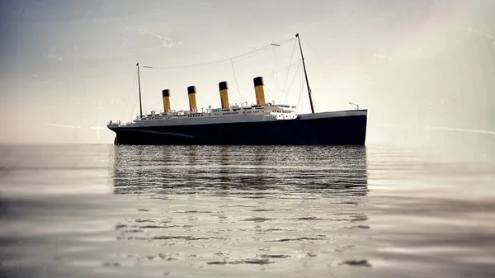
What?
Why?
Where from?
All about our data.

Slide 5
What?
All about our data.

Slide 6
Why?
All about our data.

Slide 7
Where from?
All about our data.

Slide 8
The presentation should be finalized in Google Slides and include the following:
Slides are primarily images or graphics (rather than primarily text).
Images are clear, in high-definition, and directly illustrative of subject matter.

Slide 9
Requirements for the live presentation follow:
All team members present in equal proportions.
The team demonstrates the dashboard's real-time interactivity.
The presentation falls within any time limits provided by the instructor.
The submission includes speaker notes, flashcards, or a video of the presentation rehearsal.

