Slide 1
PMP Overview
Presented by Muqeet Ahmad
Block X
April 2, 2013

Slide 2

Project Management
Background
Requirements
Prestige
Notes:
PMP around for thousands of years
Started to become formalized in 1917 by creation of Gant Chart
PMI (founded 10/9/1969), is the official company that administers PMP certifications
Requirements: 1: 4yr bachelor’s degree and 3+ yrs on project management experience, with 4500 hrs leading and directing projects and 35 hours of project management education
2: high school diploma with 5+ years in project management experience, with 7500 hrs leading and directing projects and 35 hrs of project management education
Only 400,000 (393,413) PMPs in the world

Slide 3

Project
General Projects
Planning
Organizing
Directing
Controlling
Project Management
Initiation
Planning
Execution
Control
Closing
Notes:
Project is a series of tasks, arranged in a defined sequence, that produces a predefined outcome/effect. It always has a start, middle, and end.
Project consists of teamwork, resources, risks, time investment
Planning: mission, goals, etc.
Organizing: Design, architecture, repeatability
Directing: dealing with team, negotiation, motivation, communication
Control: measure success, validate progress

Slide 4
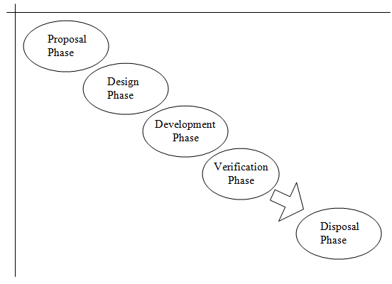
Project Management Process
Project Management Process Groups
Project Management Domains
Notes:
Process Groups: Initiation, Plan, Execute, Control, Close
Domains: scope management, integration management, schedule management, cost management, leadership, and risk management

Slide 5
Key Terms
Scope
  Project Scope
  Product Scope
  Scope Creep
Milestones
Scheduling
Cost
Statement of Work (SOW)
Notes:
Project Scope: work that goes into actual product, what is required for the project to be built | work oriented (how)
Product Scope: characterizes the project, features, functional requirements etc.| (what)
Scope Creep: expansion of the scope of a project (can result in cost overrun)
features scope creep: programmers add extra work to make their application better
business scope creep: requirements are poorly defined and changes need to be made later on, can also result from lack of communication
Milestones: a significant major event in a project _{(usually a major deliverable)}
Scheduling: planned activity for performing work and the planned dates for meeting deadlines
Inputs: activity, work, deadlines
Work: thing that needs to be done
Activity: thing that needs to be done plus the time that it will take to do it
Tools: Calendar
Output: Schedule
Cost: the monetary value of a project’s work. Includes cost for labor, and broken down into fixed and variable costs.
SOW: a document that discusses the scope of the work ***Very much like the SPMP
conditions in which the work will be performed
form in which the work will be delivered
capacity requirements
problems being solved
objective of the work being completed
main topics the work should include
suggestions, constraints, performance parameters,
dates and contractual terms and conditions
financial payment plans, penalties

Slide 6
Project Management Processes
Initiation
Planning
  Strategic Planning
  Tactical Planning
  Operational Planning
Execution
Monitor & Control
Closing
Notes:
Initiation: define the scope, obtain the project charter, create the statement of work, define milestones
Planning: develop the project plan, risk management, activity sequencing, etc… MAJOR COMPONENT--- amount of time it takes to plan is proportional to the scope
Strategic: figure out what the problem is
Tactical: know the problem, determine steps to solve the problem
Operational Planning: determine how to apply resources to problem.
Execution: actually do the work
implement the plan, keep quality assurance in mind
Control: cost control, quality control, schedule control, risk management, report the work…
Closing: completion of project, settlement of contract, information distribution

Slide 7
Project Management Domains
Scope Management
  RTVM
  WBS
Integration Management
Schedule Management
  Gant Chart
Cost Management
Leadership
Risk Management
Notes:
Scope: Requirements Traceability Verification Matrix
Work Breakdown Structure
constraints, scope change control plan, assumptions.
Integration: watch over the whole project as it is being carried out.
Schedule Management: define and sequence activities, prioritize activities
Gant Chart: helps with making a schedule, allowing the team to look at the structure of the project and easily identify responsibilities
worst case + 4*most probable + best case
Estimated time = ----------------------------------------------------------------
6
Cost Management: budgeting $$$ for the project
estimate cost using 1 of 2 models
analogous: comparison to previous similar activity
bottom up: break down task and take cost of each individual part
Leadership: communication, motivational skills, reward & recognition, ACTIVE LISTENING [all with teammates]
Risk Management: 1. Identify risks
2. Evaluate risks
3. Mitigate risks
Look at RIM!!!

Slide 8
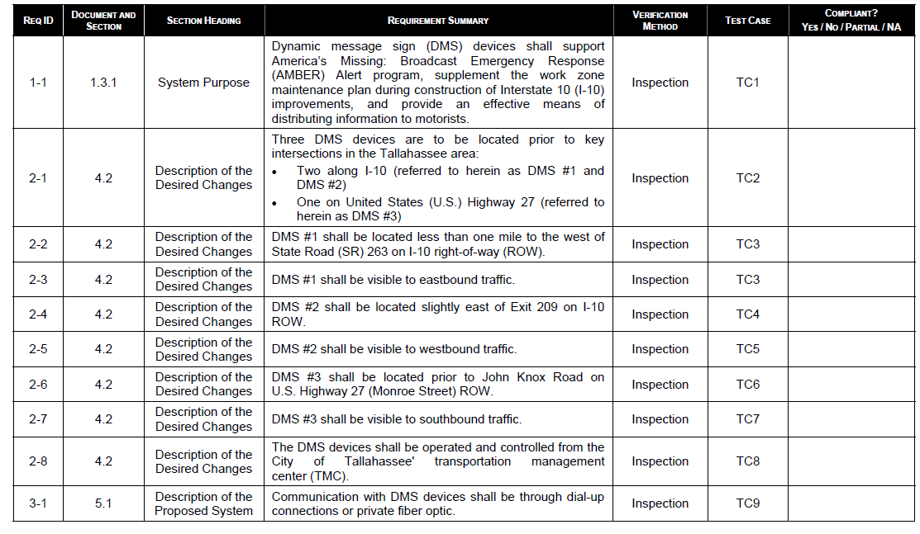
RTVM

Slide 9
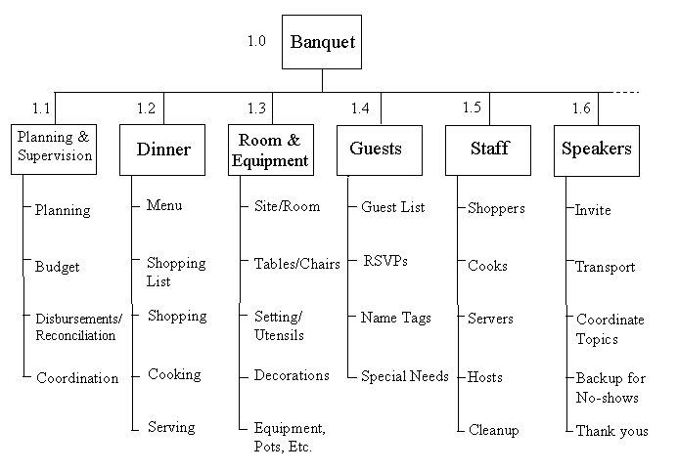
WBS

Slide 10
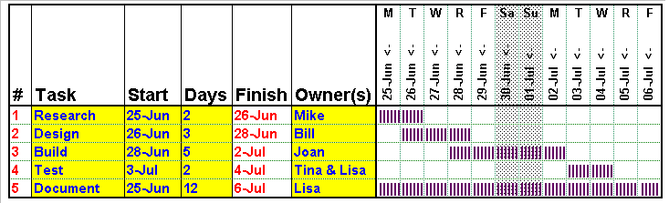
Gant Chart

Slide 11
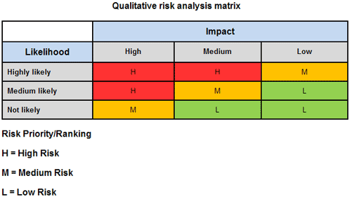
Risk Impact Matrix

Slide 12
Acknowledgements
My brother (for the powerpoint)
Ayman Nassar
Mr. Estep
Notes:
Audience!!!

Slide 13
Bibliography
Chapman, J. R. (2007, February 26). Work Breakdown Structure. Retrieved April 4, 2011, from http://www.hyperthot.com/‌pm_wbs.htm
Founders. (2011). Retrieved April 4, 2011, from Project Management Institute Inc. website: http://www.pmi.org/‌en/‌About-Us/‌Leaders- Founders.aspx
Mahmoud, H. (2010, January 13). Are you acting on the Highest Priority Risks? Retrieved April 4, 2011, from Project Manager Planet website: http://www.projectmanagerplanet.com/‌tools/‌article.php/‌3858291/‌Ar e-You-Acting-on-the-Highest-Priority-Risks.htm
Nassar, A. (2009). Principles of Project Management: In 3 Hrs. Intercontinental Networks, LLC .
Project Management Institute. (2006). History of Project Management. Retrieved April 4, 2011, from Process Quality Associates Inc. website: http://www.pqa.net/‌ProdServices/‌ccpm/‌W05002001.html
Reis, J. (2010, February). Project Management: Project Initation. Retrieved April 4, 2011, from Learn That! website: http://learnthat.com/‌2010/‌02/‌project-management-project- initiation/
Writing a PSEMP. (n.d.).

Slide 14

Questions?

