Slide 1
OpenFrameworks Final
Nicholas Fortugno

Slide 2
Last Hope Mechanics
Wanted to prototype a mechanic that could be used in a Clash of Clans style game
Needed to be approachable by a casual audience, but deep enough for longer play
Space theme is the narrative basis.

Slide 3
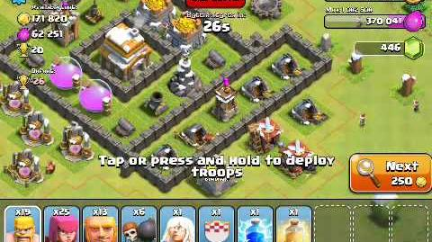
Class of Clans

Slide 4
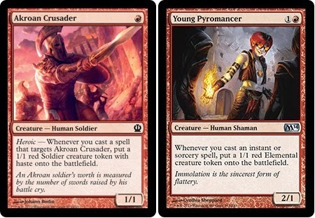
Magic:The Gathering

Slide 5
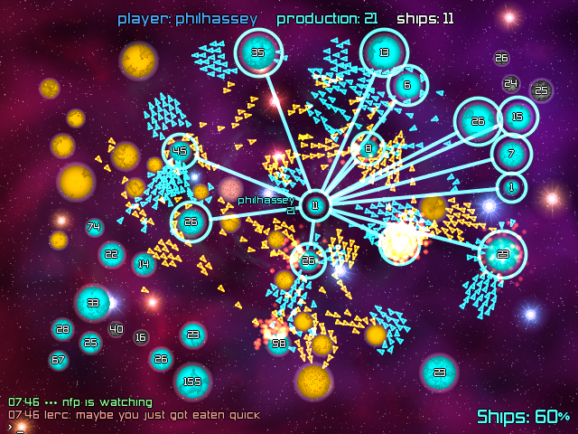
Galcon

Slide 6
Ship 1
Ship 2
Ship 3

Slide 7
Thank You
Nicholas Fortugno
nick@playmatics.com
www.playmatics.com

