Slide 1

From Data to Diagnosis: Predictive Modeling of Brain Tumor Types using Machine Learning
Course: Data Science and Data Analysis
Lecturer: D-r Hristijan Gjoreski
Prepared by: Teodora Domazetovikj
Kristina Kitrozoska
Skopje, 21.05.2025

Slide 2

Introduction
This presentation explores predictive modeling techniques applied to classify brain tumor types using machine learning, based on a structured synthetic dataset. The goal is to simulate how such models could assist in early and accurate detection of tumors by analyzing patterns in patient-related features. Although the data is not collected from real patients, this project demonstrates the potential and workflow of ML techniques in medical diagnostics through synthetic experimentation.

Slide 3
01
Project
Overview

Slide 4
Workflow stages
3. Modeling
1. Data Preproccesing
2. Exploratory Data Analysis
4. Evaluation

Slide 5
Dataset Details
Instances
Features
Missing values
This dataset contains simulated data for brain tumor diagnosis, treatment, and patient details. It consists of 20 columns and 20,000 rows.
Dataset consists of 2 integer features,3 float features and 14 object features
Dataset has 56 missing values which were dropped to achieve 0 missing values .
Feature type
Balance
Feature engineering
From the 14 object features, only one is ordinal. All of them will be encoded to achieve fully binary dataset
The dataset is almost perfectly balanced with 10003 isntances for Benign tumor (binary 0) and 9941 for Malignant tumor (binary 1).
For better results 2 new features are created: Risk Score and Genetic Risk

Slide 6
02
Data Preprocessing

Slide 7
Data Preprocessing
Data preprocessing is the first and one of the most important steps in any machine learning project. It involves loading the raw dataset and preparing it for analysis by performing key tasks such as:
Handling missing values
Encoding categorical variables
Scaling numerical features

Slide 8
03
EDA

Slide 9
Exploratory Data Analysis (EDA) is the step where we get to know the data. It’s like taking a first look before making any big decisions. With the help of graphs, charts, and basic statistics, we try to:
Understand the shape and structure of the data
See how values are spread
Spot anything unusual or wrong
Get ideas about what might affect the outcome
EDA helps us build a clearer picture of the dataset so we can prepare it properly for machine learning
EDA

Slide 10
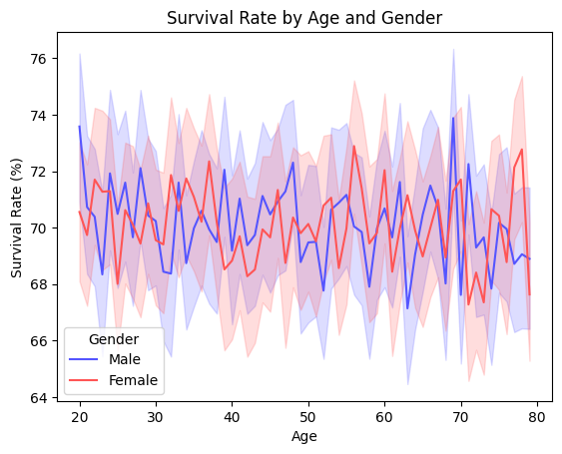
Based on the graph, survival rates fluctuate between 65-75% across all ages for both males and females, with no consistent gender advantage and considerable variability throughout the lifespan.

Slide 11
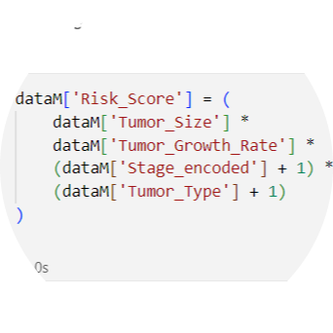
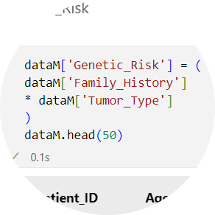
Feature Engineering
We created two new features to achieve better results and these are the formulas:

Slide 12
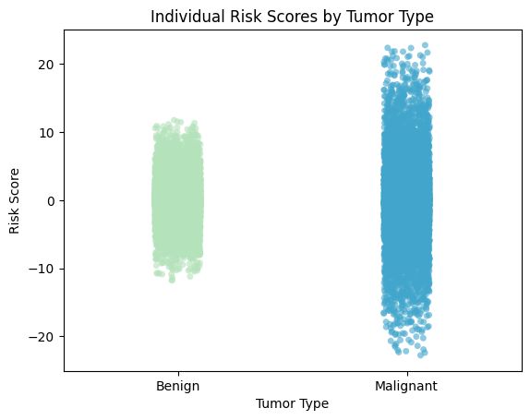
This strip plot shows "Individual Risk Scores by Tumor Type" comparing benign and malignant tumors. We can see that malignant tumors have both higher maximum risk scores and greater overall variance in risk assessment compared to benign tumors.

Slide 13
04
Modeling

Slide 14
Modeling
In the modeling phase, various machine learning algorithms are trained to classify brain tumor types. The dataset is first split into training and testing sets. Models such as Decision Tree, SVM, Random Forest, and others are applied using both random splits and K-Fold cross-validation. This step focuses on learning patterns from the data to make accurate predictions.

Slide 15
Classifiers
We experimented with multiple classifiers to get the best results
1.KNN
3.Decision Tree
5.XGBoost
2.SVM
4.Random Forest
6.Naive Bays

Slide 16
We performed both random train-test split and k-fold cross-validation to ensure robust evaluation of our models. Additionally, we applied hyperparameter optimization to fine-tune the model settings. These steps helped us achieve the best possible performance and ensure the results are reliable and not dependent on a specific data split.

Slide 17

XGBoost with 97% accuracy!
And the model with the best accuracy turned out to be...

Slide 18
05
Evaluation

Slide 19
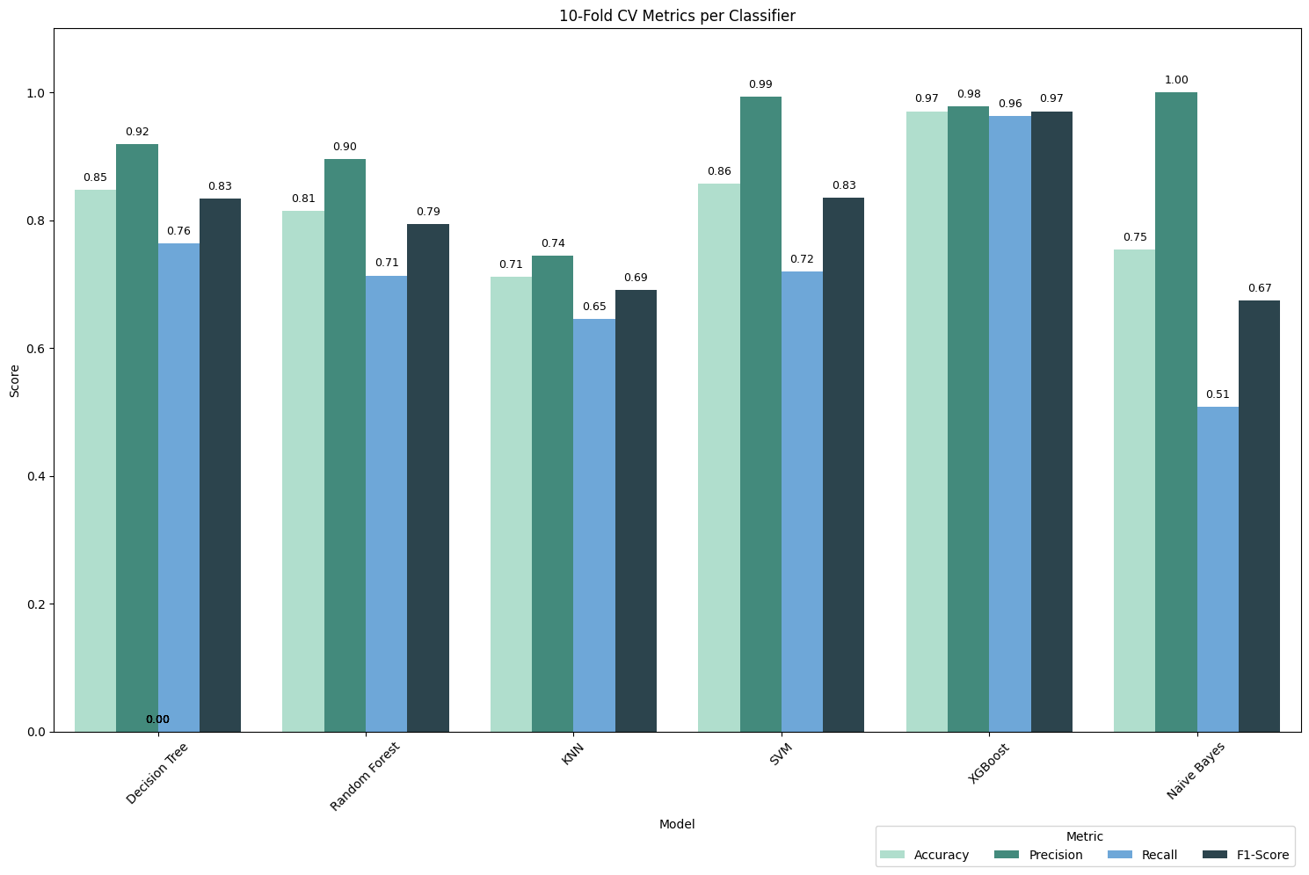
XGBoost achieved the best accuracy among all models we evaluated with a value of 97%.

Slide 20
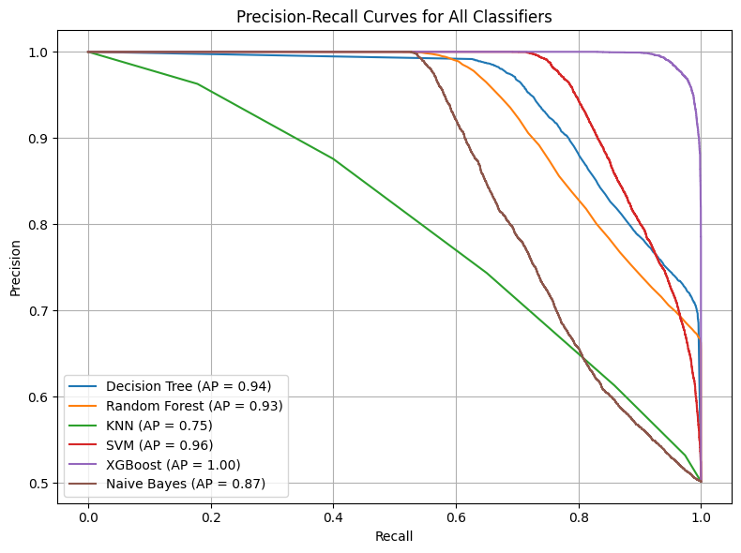
Precision-Recall Curves
Precision: How many of the predicted malign cases were actually malign?
Recall (Sensitivity): How many of the actual malign cases were correctly predicted?
A higher curve indicates better performance.
XGBoost performed the best with an AP of 1.00, indicating near-perfect precision and recall across all thresholds.
SVM (0.96) and Decision Tree (0.94) also showed strong performance, with high recall and precision balance.
KNN (0.75) had the weakest performance, struggling to maintain high precision as recall increased, suggesting it is less reliable for detecting malign tumors.

Slide 21
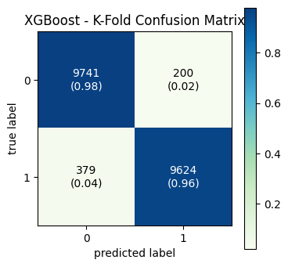
XGBoost Confusion Matrix
True Positives (TP = 9624): → The model correctly identified 9624 malignant tumors, which is crucial for ensuring timely treatment of cancerous cases.
True Negatives (TN = 9741): → The model correctly classified 9741 benign tumors, avoiding unnecessary concern or treatment for non-cancerous cases.
False Positives (FP = 200): → The model incorrectly predicted 200 benign tumors as malignant, potentially leading to unnecessary stress or interventions.
False Negatives (FN = 379): → The model missed 379 malignant tumors, which could delay critical treatment and pose serious health risks

Slide 22
Conclusion
01
02
03
04
This project demonstrated how traditional machine learning techniques can effectively classify brain tumors using structured data, including various clinical features. Key findings include:
Clean preprocessing and balanced data enabled accurate tumor classification
XGBoost delivered the best performance, after that Decision Tree and SVM model.
Models showed high precision and reliability for medical diagnosis
Future work may explore deep learning models or real-time diagnostic applications

Slide 23

Thank you for your attention!
You can see the whole code on github

