Slide 1

Thread Dump Troubleshooting
Jie Chen
March 2010

Slide 2
Agenda
Why & When to take Thread Dump
How to take Thread Dump
Thread State
Analyzing
Case Study

Slide 3
Why & When to take Thread Dump
What / Why
A snapshot of all threads in Java application
Showing each thread’s state / health
When
Bad performance
System hangs
CPU High Usage

Slide 4
How to take Thread Dump
Weblogic
Windows: (Note 659452.1)
Edit *.cmd to output the dump
Press Ctrl+Break
Unix/Linux: (Note 659452.1)
Edit *.sh
Get PID by “ps -ef|grep java”
“Kill -3 <PID>”
E.g, startAgile.cmd
%JAVA_HOME%\bin\java %JAVA_VM% %MEM_ARGS% %JAVA_OPTIONS% -Dweblogic.Name=%SERVER_NAME% … weblogic.Server >c:/temp/mydump.log

Slide 5
How to take Thread Dump
Oracle AS
Windows: (Note 437464.1)
Get PID (Process ID) by “opmnctl status –l”
Run thdump utility by “thdump <PID>”
Unix/Linux (Note 361729.1)
Get PID by “opmnctl status -l”
Run “kill -3 <PID>”
Output written to OC4J~home~default-island~1 (default)

Slide 6
Thread State
Running
Blocked / Waiting for Monitor Entry
Waiting / Timed Waiting
Sleeping / Waiting on Condition

Slide 7
Thread State
Running
Blocked / Waiting for Monitor Entry
Waiting / Timed Waiting
Sleeping / Waiting on Condition

Slide 8
Analyzing
Understand Application
Take more Dumps in a Short Duration
Eliminate Running / Idle Threads
Analyze Blocked / Waiting Threads

Slide 9
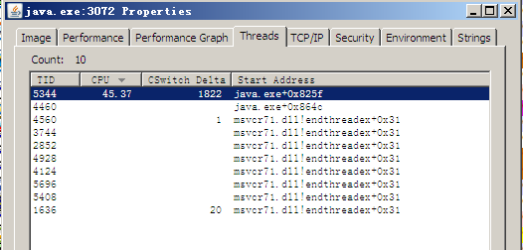
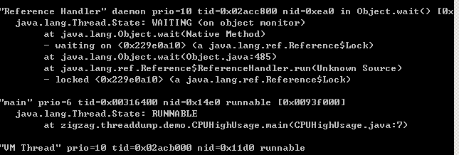
Case Study 1
CPU High Usage
Get Thread Dump first
Get TID (Thread ID)
Process Explorer (Windows)
“ps –eL|grep java” (Unix/Linux)
3. Convert TID to hexadecimal
4. Find out the problem stack

Slide 10
Case Study 2
Classic Deadlock
One thread is blocked to acquire resource which is hold by other blocked thread(s)
===================================================
"Thread-1":
at zigzag.threaddump.demo.TestDeadLock.run(TestDeadLock.java:27)
- waiting to lock <0x22a15c98> (a java.lang.Object)
- locked <0x22a15ca0> (a java.lang.Object)
at java.lang.Thread.run(Unknown Source)
"Thread-0":
at zigzag.threaddump.demo.TestDeadLock.run(TestDeadLock.java:16)
- waiting to lock <0x22a15ca0> (a java.lang.Object)
- locked <0x22a15c98> (a java.lang.Object)
at java.lang.Thread.run(Unknown Source)
Found 1 deadlock.
System Hangs

Slide 11
Case Study 3
Resource Contention
Two or more threads are fighting for the same resource(s)
"Thread-2" prio=6 tid=0x02b48000 nid=0x120c waiting for monitor entry [0x02f1f000]
java.lang.Thread.State: BLOCKED (on object monitor)
at zigzag.threaddump.demo.ResourceContention.run(ResourceContention.java:11)
- waiting to lock <0x22a15e30> (a java.lang.Object)
at java.lang.Thread.run(Unknown Source)
"Thread-1" prio=6 tid=0x02b46c00 nid=0xc3c waiting for monitor entry [0x02ecf000]
java.lang.Thread.State: BLOCKED (on object monitor)
at zigzag.threaddump.demo.ResourceContention.run(ResourceContention.java:11)
- waiting to lock <0x22a15e30> (a java.lang.Object)
at java.lang.Thread.run(Unknown Source)
"Thread-0" prio=6 tid=0x02b45800 nid=0x49c waiting on condition [0x02e7f000]
java.lang.Thread.State: TIMED_WAITING (sleeping)
at java.lang.Thread.sleep(Native Method)
at zigzag.threaddump.demo.ResourceContention.run(ResourceContention.java:12)
- locked <0x22a15e30> (a java.lang.Object)
at java.lang.Thread.run(Unknown Source)
Bad Performance

Slide 12
Case Study 4
Out of Threads
No more room for additional threads running
E.g. 5 tasks need to run but only 2 threads are allowed concurrently.
Task 2,3 and 4 have to wait until Task 0 and 1 finish.
"Zigzag_ThreadPool-1" prio=6 tid=0x02b47000 nid=0x133c runnable [0x02ecf000]
java.lang.Thread.State: RUNNABLE
at zigzag.threaddump.demo.ThreadPoolTest$1.run(ThreadPoolTest.java:44)
at zigzag.threaddump.demo.ThreadPool$PooledThread.run(ThreadPoolTest.java:185)
"Zigzag_ThreadPool-0" prio=6 tid=0x02b46400 nid=0x11d0 runnable [0x02e7f000]
java.lang.Thread.State: RUNNABLE
at zigzag.threaddump.demo.ThreadPoolTest$1.run(ThreadPoolTest.java:44)
at zigzag.threaddump.demo.ThreadPool$PooledThread.run(ThreadPoolTest.java:185)
Bad Performance

Slide 13
Case Script
CPU High Usage
Classic Deadlock
Resource Contention
Out of Threads

Slide 14
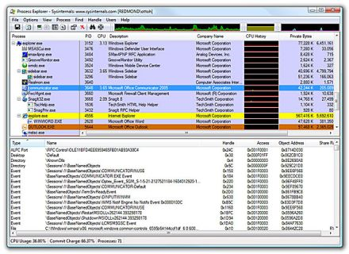
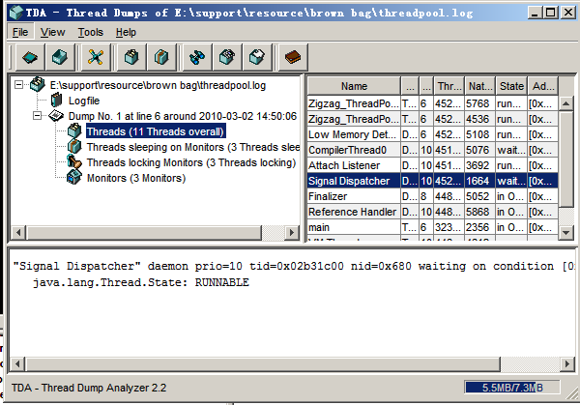
Third Part Utility
Process Explorer
http://technet.microsoft.com/en-us/sysinternals/bb896653.aspx
TDA (Thread Dump Analyzer)
https://tda.dev.java.net

Slide 15

Q/A

