Slide 1
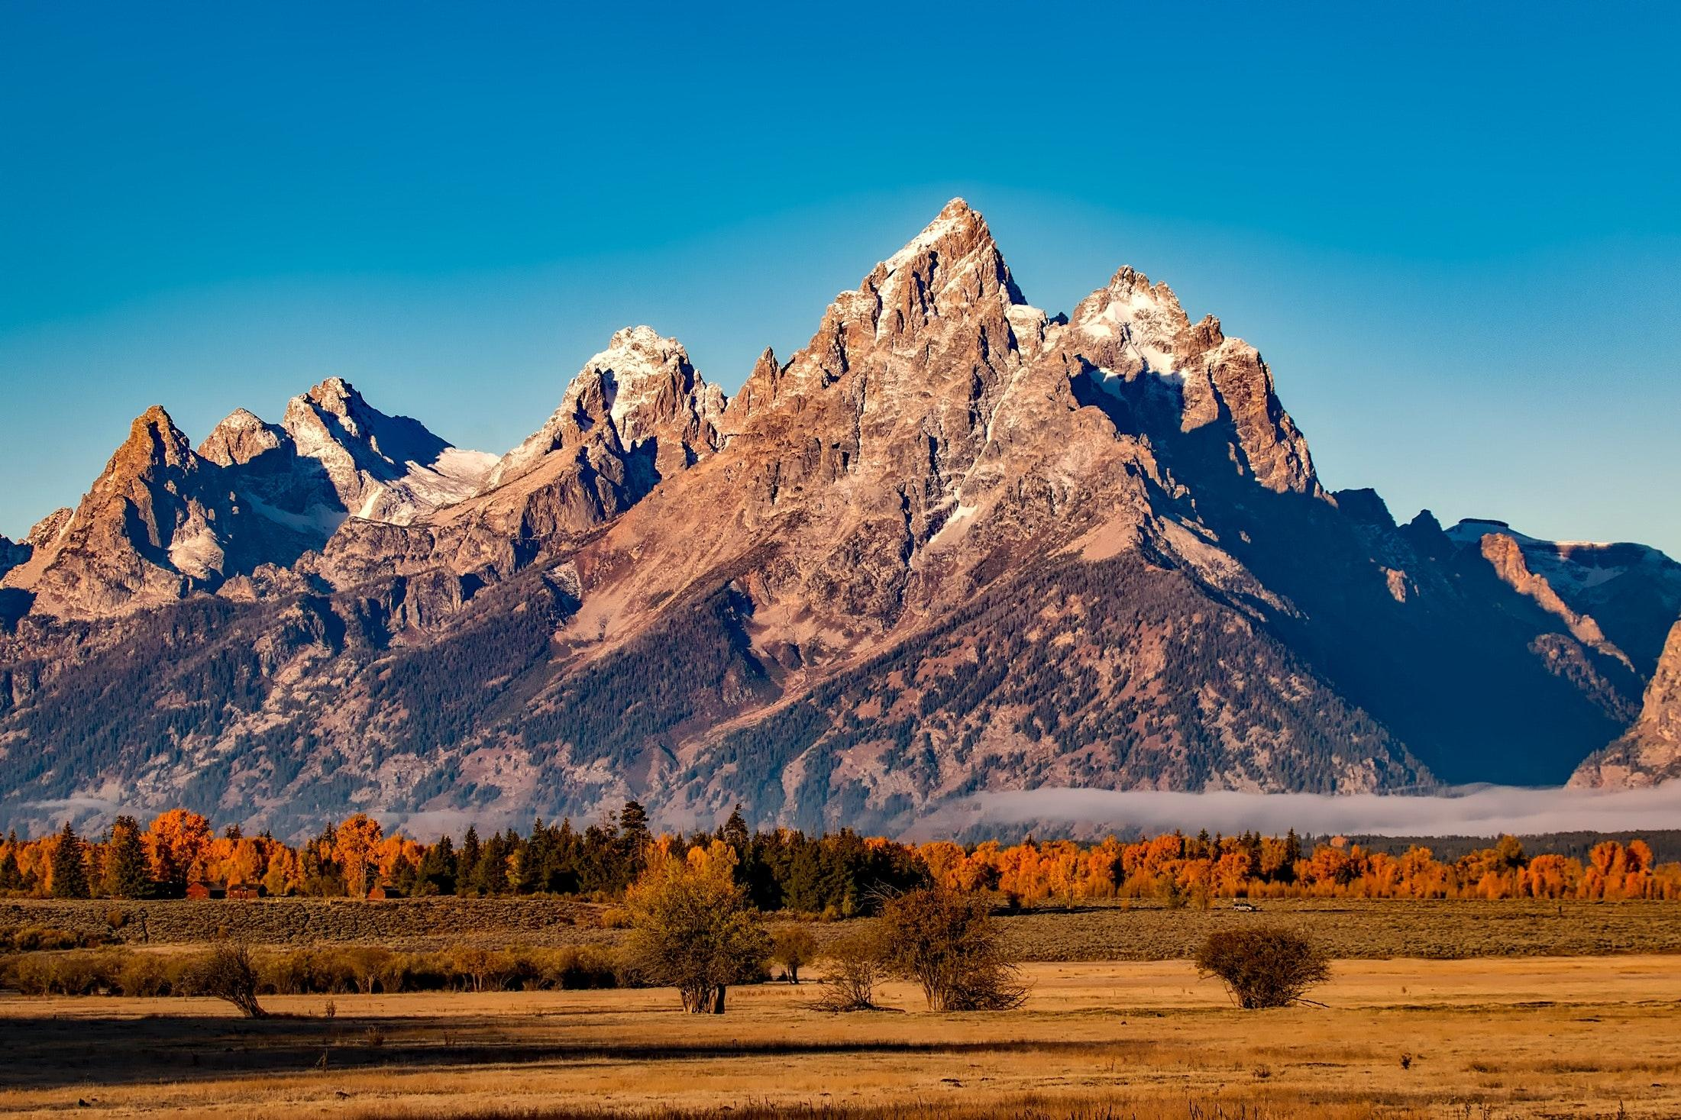
Workshop Admins
johndoe
attendee

