Slide 1
IMPORTANCE OF LEADERSHIP
~Reniel Lao

Slide 2
According to Peter Drucker, “an effective leader is one who can make ordinary men do extraordinary things, make common people do uncommon things. Leadership is a lifting of a man’s sights to a higher vision, the raising of man’s standard to a higher performance, the building of a man's personality beyond its normal limitations.”

Slide 3
There are few common importances:
Motivating workers- A good leader always motivate their followers for doing work hard and with perfection.
Overcome the barriers- They make the path of their workers’ easy. If any problem faced by workers’ it should be overcome with providing necessary resources to perform their task.

Slide 4
Maintains integrity- Leader should maintain institutional integrity and his organization's distinctive identity. They integrate the needs of the individual with those of the group so that the goals are easily reached.
Act as arbitrator- When group experiences internal difference, whether based on emotional or intellectual clashes, a leader can often resolve the difference. He acts as an arbitrator to prevent serious group splintering.

Slide 5
Parental approach- Leaders show personal concern for the workers’. Providing an adequate reward structure to encourage performance of their followers. They delegate the authority where needed and inviting participation from the side of workers’ when possible.

Slide 6
LEADERSHIP THEORIES

Slide 7
Trait Theory
This theory is based on the assumptions that people are born with inherited traits. There are some traits particularly suited to leadership and people who make good leaders have the right (or sufficient) combination of traits.

Slide 8
Early research on leadership was based on the psychological focus of the day, which was of people having inherited characteristics or traits. Attention was thus put on discovering these traits, often by studying successful leaders, but with the underlying assumption that if other people could also be found with these traits, then they, too, could also become great leaders.

Slide 9
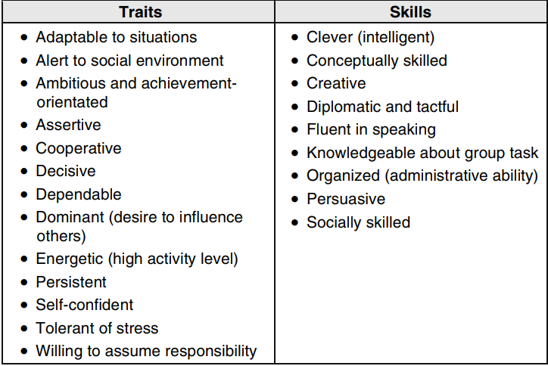

Slide 10
McCall and Lombardo (1983) researched both success and failure identified four primary traits by which leaders could succeed or 'derail':
● Emotional stability and composure: Calm, confident and predictable, particularly when under stress.
● Admitting error: Owning up to mistakes, rather than putting energy into covering up.
● Good interpersonal skills: Able to communicate and persuade others without resort to negative or coercive tactics.
● Intellectual breadth: Able to understand a wide range of areas, rather than having a narrow (and narrow-minded) area of expertise.

Slide 11
Contingency Theory
The leader's ability to lead is contingent upon various situational factors, including the leader's preferred style, the capabilities and behaviours of followers and also various other situational factors are the assumption of this theory.

Slide 12
Contingency theories are a class of behavioural theory that contends that there is no one best way of leading and that a leadership style that is effective in some situations may not be successful in others.
An effect of this is that leaders who are very effective at one place and time may become unsuccessful either when transplanted to another situation or when the factors around them change.

