Slide 1
MISP-Malware Information Sharing Project
Sarah Noles, Brian Mellon, Greg Hoff, and Carl Deicke

Slide 2
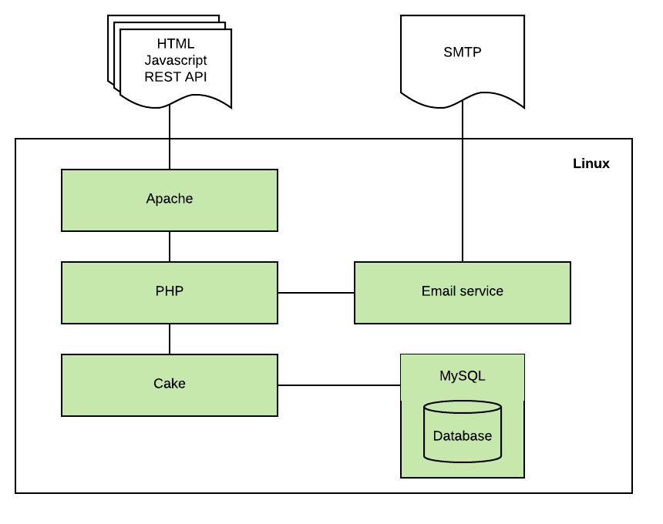
What is MISP -
An open source threat intelligence platform, using open standards for threat sharing.

Slide 3
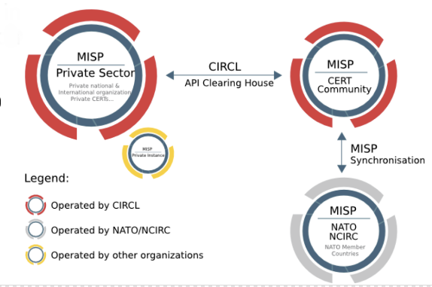
MISP Scenario

Slide 4
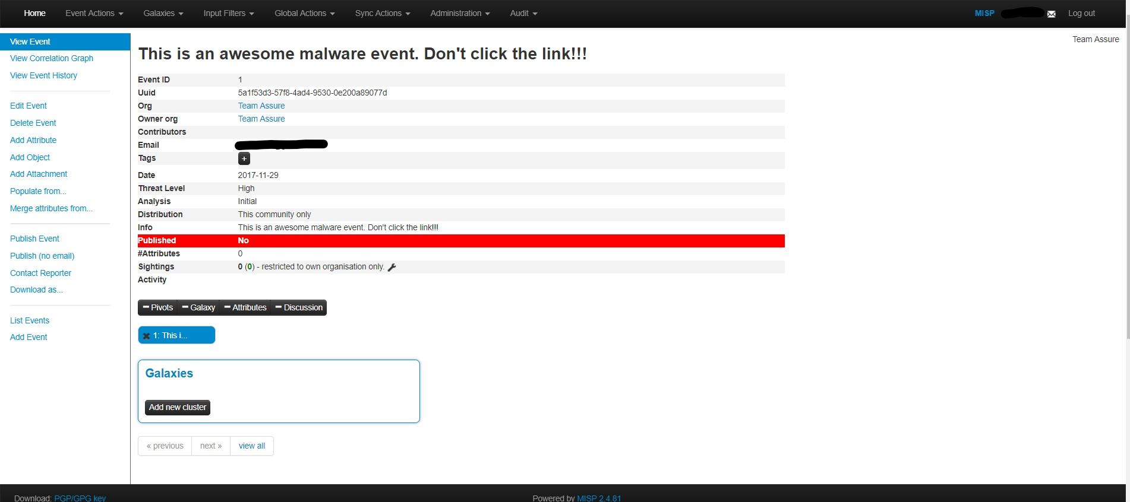
Event Information
https://137.48.187.33

Slide 5
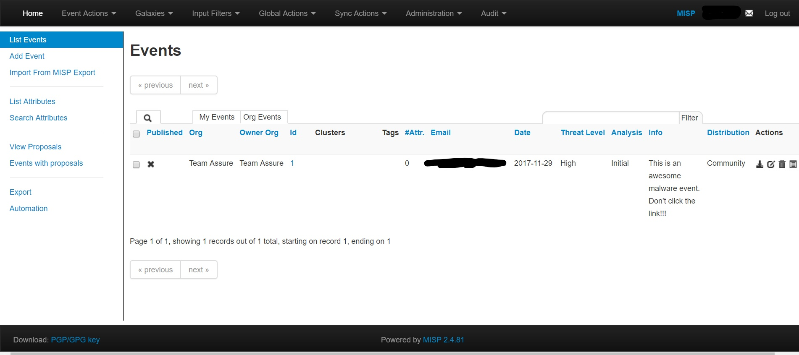
All Events

Slide 6
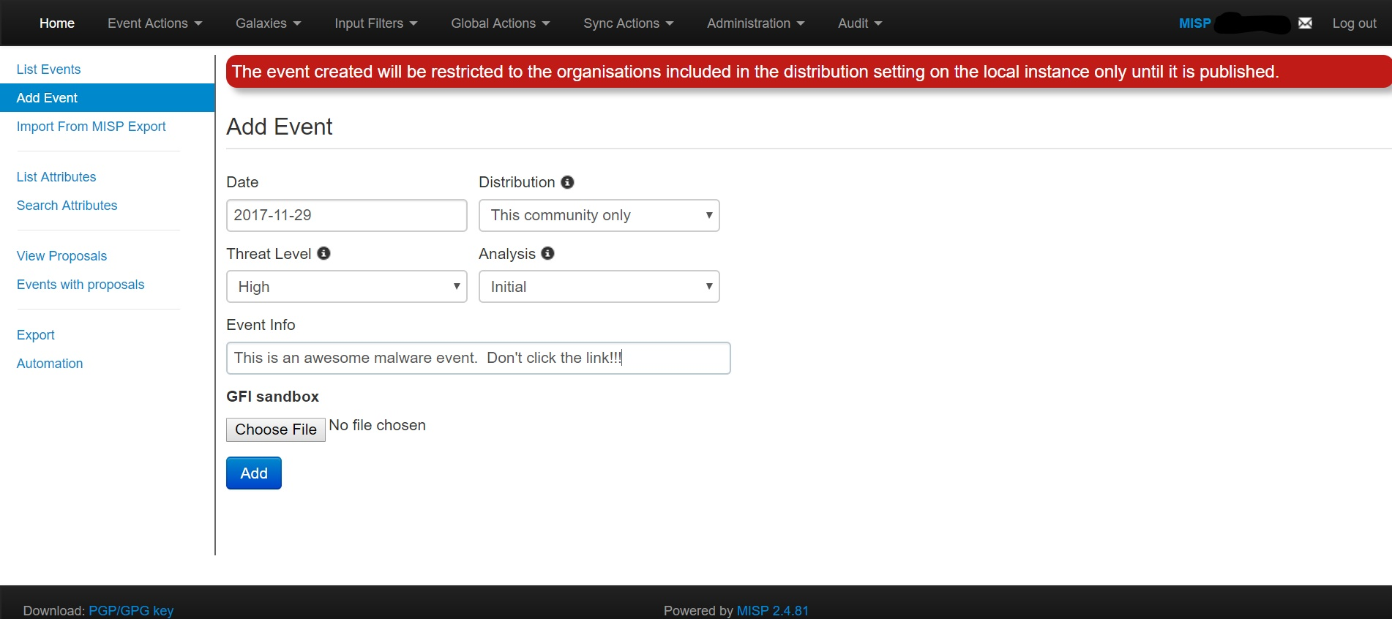
Add Event

Slide 7
Assurance Claims
The system's authentication mechanism is acceptably secure against common authentication attacks.
There are no exploitable Cross-Site Scripting weaknesses in the code.
Role based access is implemented in an acceptably secure manner

Slide 8
Assurance Claims Cont.
System only distributes event information to permitted groups
The user management interface is acceptably secure.

Slide 9
Gaps in security requirements
Apache configuration
Documentation provides minimal recommendations on best practices
Firewall configuration
Documentation does not provide recommendations on best practices
SMTP configuration
Documentation does not discuss configuring SMTP to require authentication

Slide 10
Code Review Findings

Slide 11
Automated Scans
Used two tools
RIPS
Found 296 issues
File Disclosure (101)
File Manipulation (40)
Command Execution (34)
Code Execution (29)
Cross-Site Scripting (28)

Slide 12
Automated Scans
SWAMP
Found 22,207 issues
Most issues found were where the actual code deviated from generally accepted coding conventions
Debate within the MISP GitHub forums about which coding convention to use
not strictly a weakness or vulnerability
Difficult for MISP to alleviate these coding issues as they rely on CakePHP, where the majority of these issues reside

Slide 13
Automated Scan Findings
SWAMP Report cont.
Number of issues by code source:
CakePHP | 17,568 | 79.11%
PHP (MISP written) | 3,955 | 17.81%
CSS | 560 | 2.52%
Javascript | 124 | 0.56%
Totals | 22,207 | 100.00%

Slide 14
Contributions to the original project
The install script composer.phar tries to create a cache directory in the user's home directory which www-run doesn't have permission
Passing the -u & -p parameters are unnecessary because Mariadb by default has the root user authenticate using unix_socket plugin which relies on the os authentication not an entered password.

Slide 15
Questions?

