Slide 1
UNO SHAREBOARD
Featuring: David Stroud, Joshua Eaton, Parker Sprouse, Rachel Guillory, Stefan Haselwanter

Slide 2
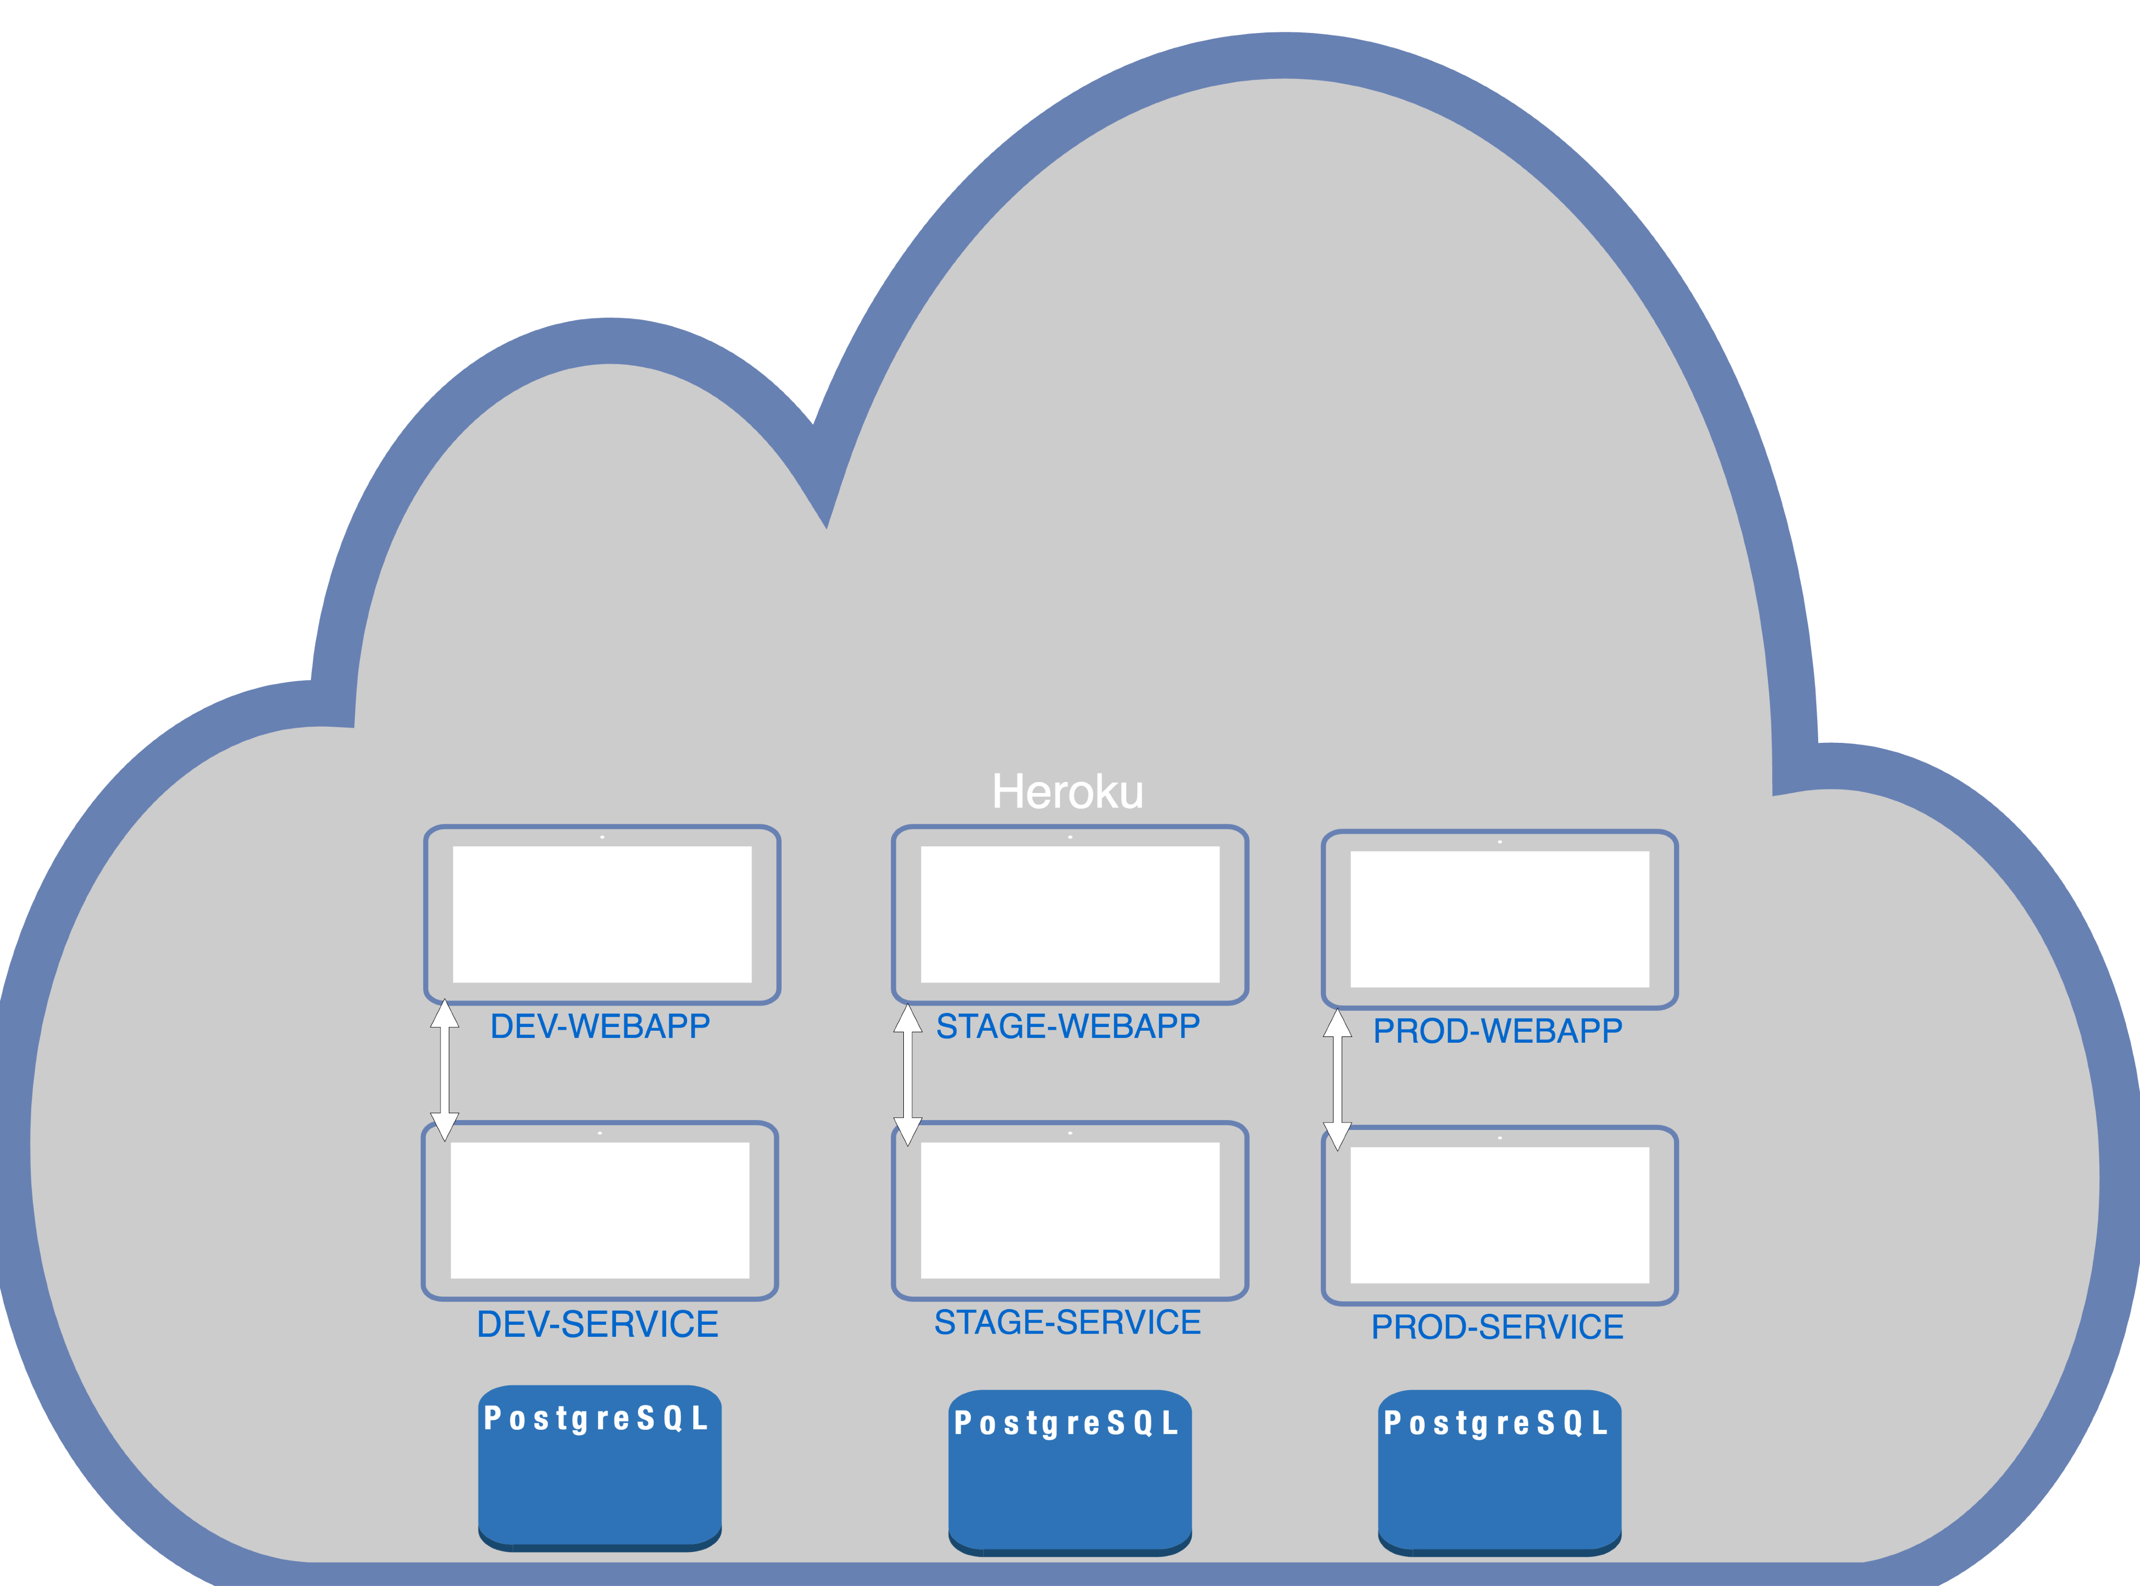

Slide 3
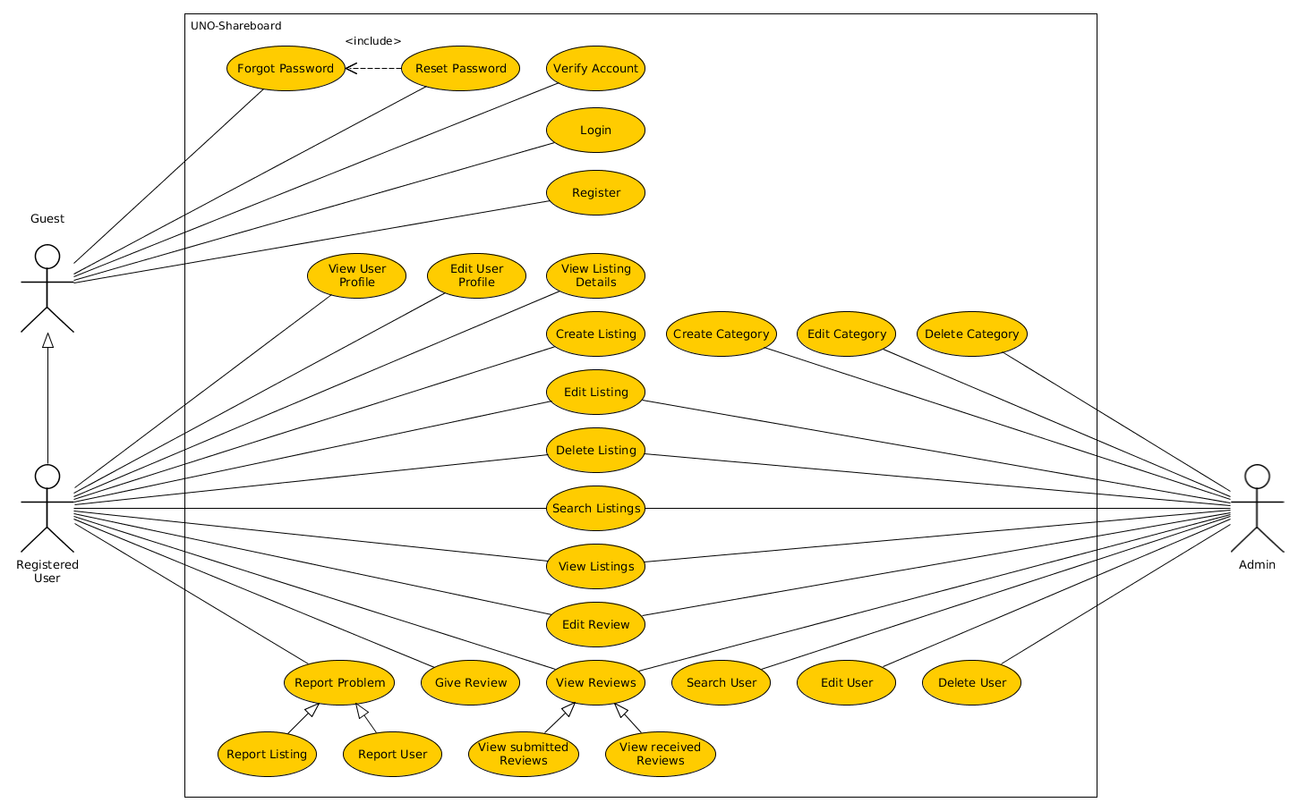

Slide 4
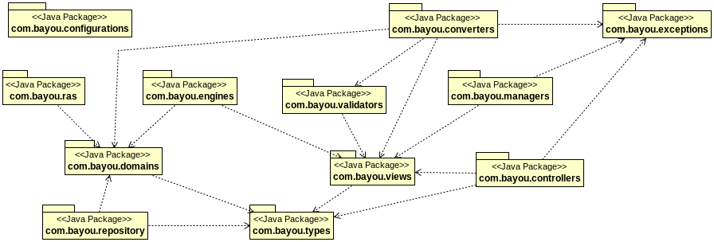

Slide 5
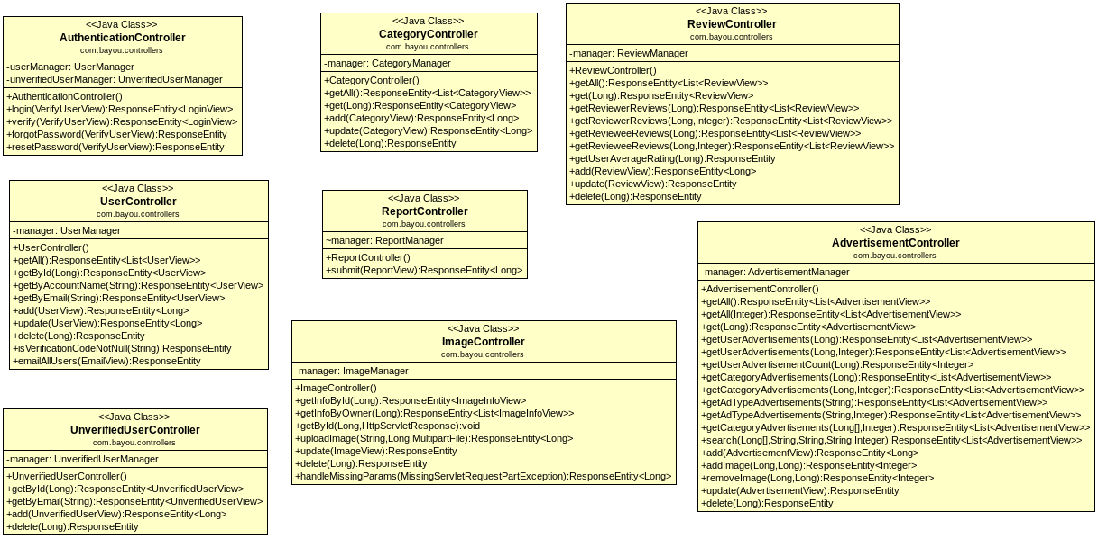

Slide 6
