Slide 1
TaxoClass: Human-like Classifier
(Replicating NAACL 2021 Paper)
Team CoreFinder (Dayea Song, Jaeseong Kim, Jinkyung Jo, Yeongrok Kim)
Notes:
Hello, we are team “CoreFinder”. Our project is “TaxoClass: human-like classifier”. Let me start our presentation of final result of replicating the research paper.

Slide 2
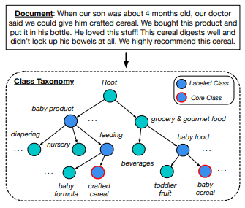
Executive Summary - TaxoClass
TaxoClass: Hierarchical Multi-Label Text Classification Using Only Class Names
Human-like classifier
Finding Core Class
Class Taxonomy
Notes:
Our baseline paper is TaxoClass : Hierarchcial multi-label text classification using only class names. This figure well illustrate the overall human-like classification method of the paper. If you are asked to assign multiple classes to a document, first you will find essential ‘core classes’. Then, check their ancestor classes in the taxonomy. Finally, you will determine which class is most appropriate.

Slide 3
Introduction
Motivation
HMTC is useful in fields such as product categorization and semantic indexing
Purpose
Replicating the paper to confirm reproducibility
Applying recent data
Notes:
HMTC that is covered in this paper is a fundamental task in Natural Language Processing. It is useful in various fields such as product categorization and semantic indexing. Purpose of our project is replicating the paper to confirm reproducibility(리 프로듀서빌리티) and applying recent data.

Slide 4
Related work & Problems
Related Work | Description | Shortcoming | Improvement
Weakly-supervised (WeSH Class, SS-PCEM) | Few labeled documents and Many unlabeled documents | Document has only one class | Document has multiple class
 |  | All class names must appear in the corpus | No need to appear in the corpus
Zero-shot (Hier-0Shot-TC) | Train with seen classes and predict with unseen classes | Need labeled document with seen classes | Do not require labeled document
Our Proposal
Notes:
Now this is the recap on some related work. There exists some weakly-supervised text classifiers. In this method, classifier is trained with few labeled documents and many unlabeled documents. It assumes each document has only one class or all class names must appear in the document text explicitly. Zero-shot text classification has also been recently studied. Shortcoming of this method is labeled documents with seen classes are needed. TaxoClass does not have these shortcomings.

Slide 5
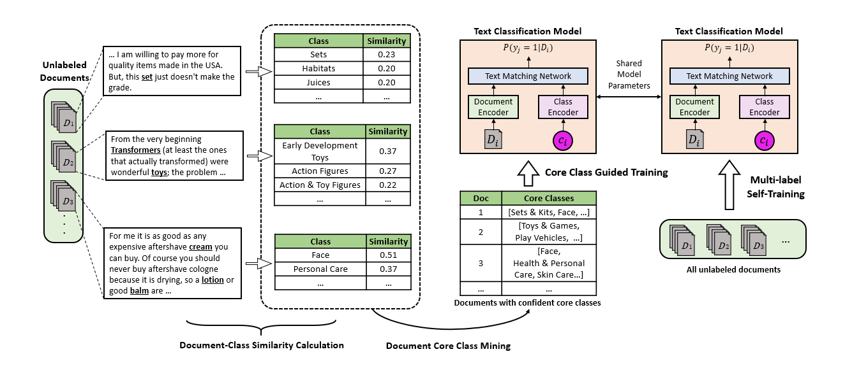
Solution - Architecture Overview
Notes:
We’ve been working on replication of TaxoClass model through four big steps
First, Document-Class Similarity Calculation. Second, Document core class mining. Third, Training the classifier with document encoder and class encoder. Finally, generalize the text classifier to do the multi-label self-training.
This figure is reconstruction of the figure in the paper as our result.

Slide 6
Experiment - Dataset
Dataset | Description | Number of Train set | Number of Test set | Taxonomy level | Number of Classes
Amazon-297 | Product reviews | 30,000 | 15,000 | three-level | 297
DBPedia-298 | Wikipedia articles | 30,000 | 15,000 | three-level | 298
Notes:
And We are using 2 types of datasets on training our replication model. First is Amazon product reviews, second is Wikipedia articles (aka DBPedia). Amazon and DBPedia datasets have about three hundreds of classes. Both of them have three-level taxonomy.

Slide 7
Experiment - Data Example
Amazon
DBPedia
ID : B000FKDEIA
Review text : I have used two of them to hang pictures. I am not allowed to make holes in my walls. They are still up there so so far so good.
Categories : Home & Kitchen, Storage & Organization, Clothing & Closet Storage
ID: 9
Article : "The T.G. Smith Centre is an ice hockey complex in Steinbach, Manitoba. It features two indoor arenas and one outdoor ice rink. ...
Categories: Place, SportFacility, Stadium
Notes:
This is an example of our dataset. We did some preprocessing for categories. Remove special characters such as ‘&’(and) or ‘,’(comma). And blanks were added between two different characters.

Slide 8
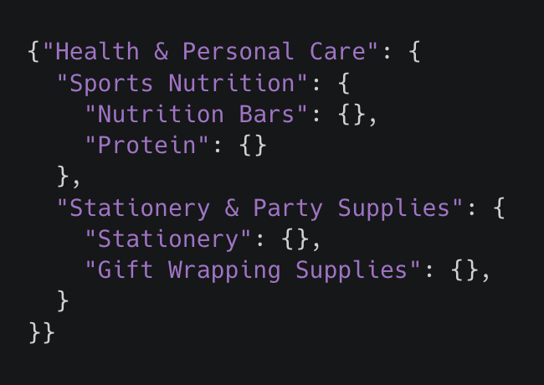
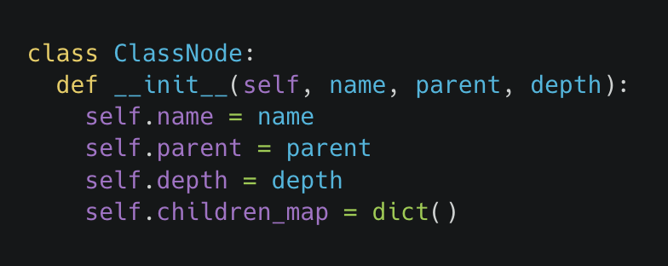
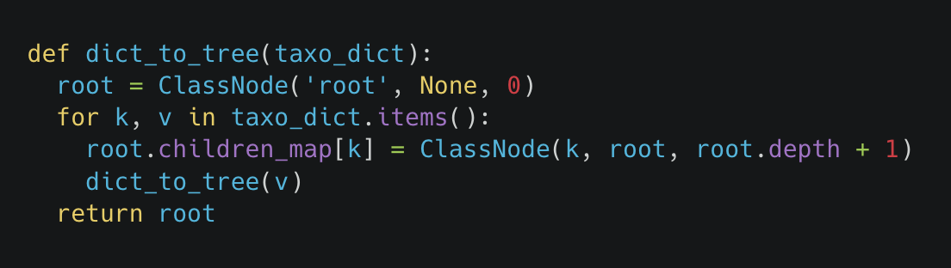
Experiment - Core Class Mining
How to Represent Taxonomy
Taxonomy is stored as json file. Key is class name and value is also json
which recursively consists of children class name as key and children as value.
Taxonomy Dictionary to Tree Structure
Json file is read as python dictionary, and iterated to build custom tree class object.
Notes:
We modified given taxonomy json file included in the dataset slightly so that its key is class name, and value is recursive json consists of children’s class name as key and again their children as value. This taxonomy json file is translated into custom ClassNode class.

Slide 9
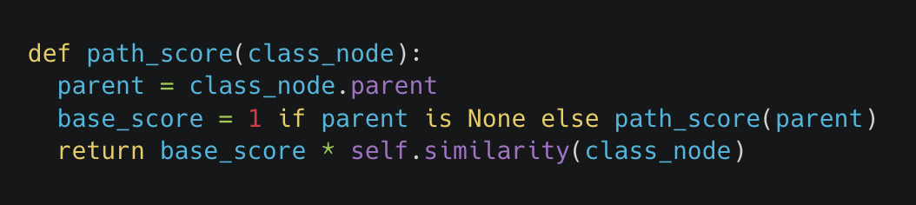
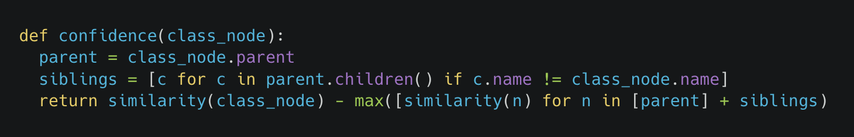
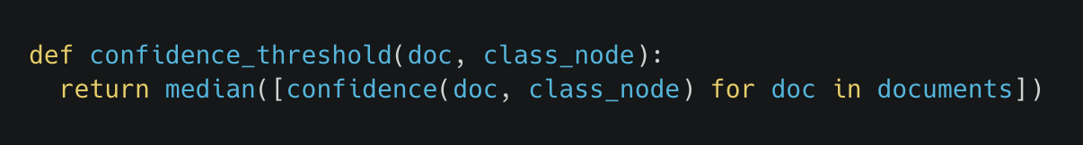
Experiment - Core Class Mining
Finding Candidates
Candidates are classes of top (level + 2) highest path score among classes in same level.
Select Core Classes from Candidates
Final a document’s core class which have higher confidence than threshold(median confidence calculated with other documents - we used documents within the same batch)
Notes:
First, core class candidates are found by selecting class nodes in each level with highest path score, which is calculated as illustrated in first figure. Among candidates, we select final core classes for the text according to their confidence values, which is calculated as the second figure. Candidates with higher confidence than median confidence of all corpus are chosen to be core classes of the text. Due to performance issue, we used all texts in the same batch as target text instead of whole corpus.

Slide 10


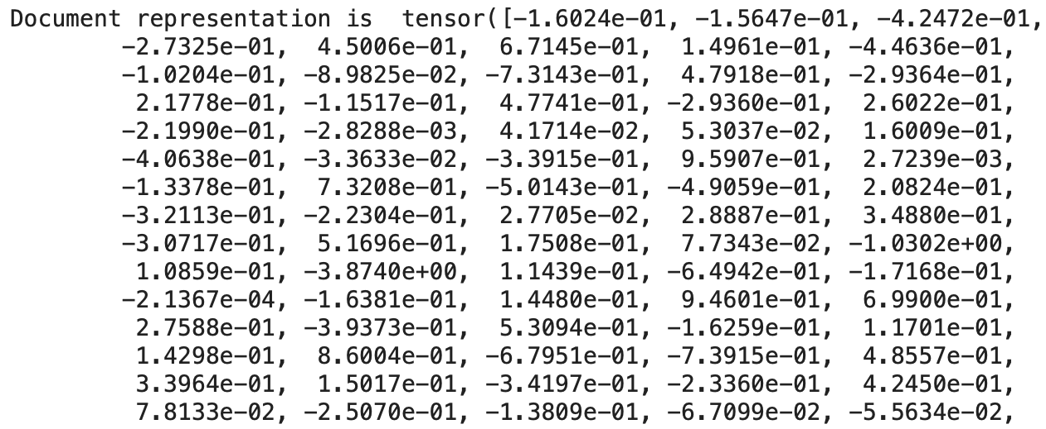
Experiment - Document Encoder
Pre-trained BERT-base-uncased model used
During encoding, documents are lower-cased and
truncated to max token length, 500.
[CLS] token embedding is used as document representation
Document : An atom is the smallest unit of ordinary matter that forms a chemical element. Every solid, liquid, gas, and plasma is composed of neutral or ionized atoms. Atoms are extremely small, typically around 100 picometers across. They are so small that accurately predicting their behavior using classical physics—as if they were tennis balls, for example—is not possible due to quantum effects.
Document Encoding
Notes:
We used the pretrained BERT model in the document encoder. Documents were tokenized using a bert tokenizer, lower-cased and truncated to max length. We will use CLS token embedding as a document representation because CLS embedding reflects the information of the entire document.

Slide 11
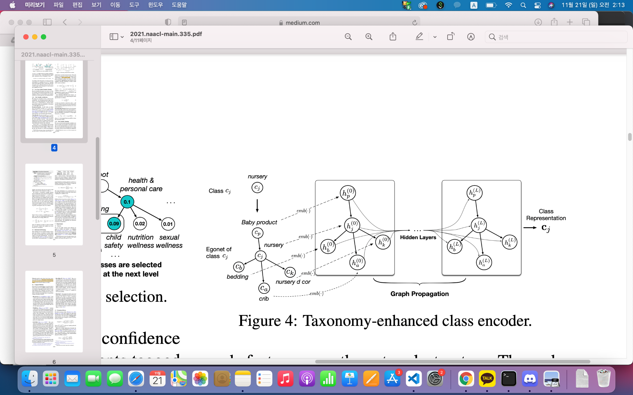
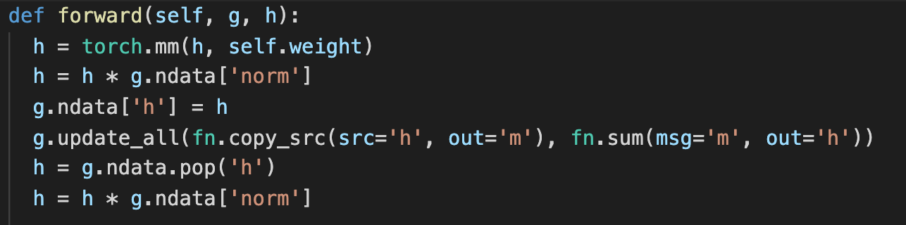
Experiment - Class Encoder
Propagate class feature using GNN
→ text information of the label and taxonomy structure information can be reflected
Class features initialization
pre-trained word embedding
random initialization (if word not in pretrained embedding)
Implementation
Notes:
In order to reflect both the text information of the label and the taxonomy structure, a class encoder was implemented using GNN. The class feature is initialized as pretrained word embedding. Words that are not in the pretrained model were initialized as random vectors.

Slide 12


Experiment - Text Matching Network
Probability of Document i tagged by label j
According to paper, probability is always between ½ and 1. → probability converges to ½!
Remove exp function so that probability lies between 0 and 1
paper’s suggestion
our suggestion
Notes:
By using document representation and class representation, we calculate probability of Document being tagged by label. In text matching network, we use different formula from the paper.
According to the paper, probability will always lies between one half to one. In this case, every probability was converges to one half(½). So We removed exponential function to rescale the probability value from 0 to 1.

Slide 13
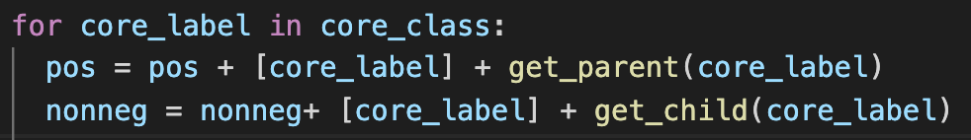
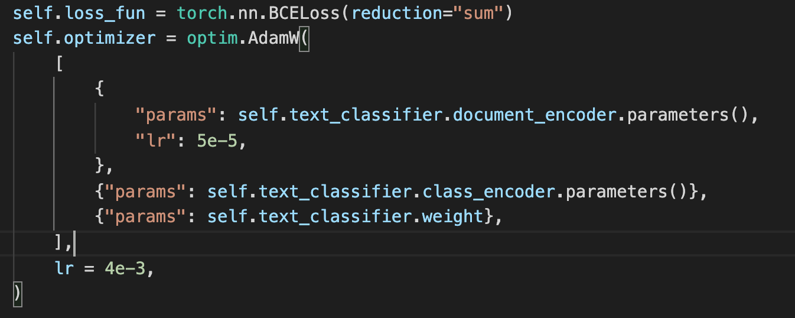
Experiment - Core Class Guided Training
Positive/Negative class for BCE
Positive class includes core class’ parent and labels of the core class.
All labels not adjacent to the core class label are negative classes.
OOM Error by Batch Size
When our model is trained with large batch size, OOM error has occured due to BERT model.
Batch size: 64 → 4 & gradient accumulation with 8
Notes:
We will use the core class to train our encoders and text matching network.
First, labels were divided into positive and negative classes.
We trained our model with Binary cross entropy calculated using positive and negative classes.
In the paper, the batch size was used as 64. but We decreased batch size from 64 to 4 because of the out of memory error. Instead, we accumulate gradient of the previous 8 batches and update parameters every 8 batches.

Slide 14
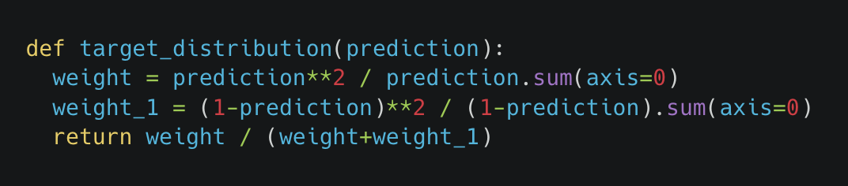
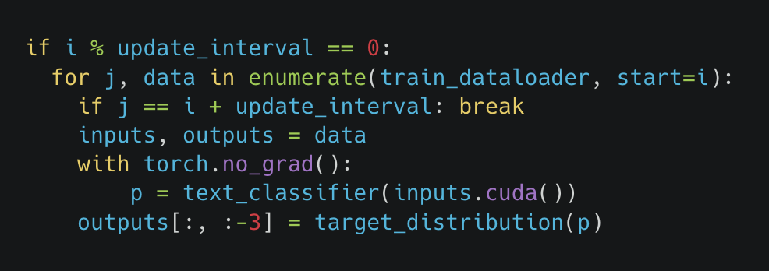
Experiment - Self Training
Target Distribution (Used as Pseudo Label)
Loss (KL-divergence) is calculated against target distribution derived from prediction.
Update Interval
Target distribution Q should be updated every update-interval (ex. 25, 100, 250) iterations. Unlike the original paper, greater update interval made higher accuracy for some extent.
How to Mitigate OOM Error
Since target calculation requires prediction only temporarily, prediction logic is safely wrapped with torch.no_grad() to prevent redundant calculation graph tracking by PyTorch autograd system.
Notes:
Self training is done by using target distribution derived from prediction of our model as pseudo labels of supervised learning. We chose to update this distribution every update_interval we defined. We found update interval of 250 is optimal. with torch.no_grad() context manager is added to prevent pytorch from storing graph data.

Slide 15
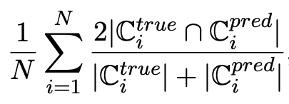
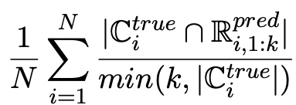
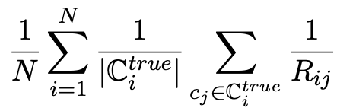
Experiment - Evaluation
Environment: 40 CPU cores, TITAN RTX-24G GPU
Hyperparameters: didn’t change original values except batch size 4, and update interval 250
Metrics
Metrics | Example-F1 | Precision at k | Mean Reciprocal Rank (MRR)
Formula
Notes:
Our evaluation is done under hardware with 40 cpu cores, and 24G memory GPU, hyperparameters are mostly similar to original paper, including normal learning rate and BERT learning rate. but we changed batch size to 4, self training update interval to 250. Metrics used are F1 score, Precision at 1 and 3, and Mean Reciprocal Rank.

Slide 16
Results
Method | Amazon-297 |  |  |  | DBPedia-298
 | F1 | P@1 | P@3 | MRR | F1 | P@1 | P@3 | MRR
TaxoClass-NoST | 24.66 | 43.70 | 30.74 | 25.75 | 16.88 | 31.87 | 19.59 | 16.93
TaxoClass-NoGNN | 17.82 | 28.81 | 26.53 | 7.31 | 8.78 | 32.00 | 16.63 | 15.28
TaxoClass | 25.47 | 47.56 | 32.12 | 27.37 | 18.01 | 31.55 | 19.81 | 17.42
Notes:
This table shows that most results were superior in Amazon than DBPedia, including GNN makes significant performance increase, and including Self Training make slight improvement, which has effect similar to fine tuning. Overall performance metrics shows less than original paper, our analysis on the reason will be discussed in next slide.

Slide 17
Discussion
Limitations
Uncommon acronyms, uncommon special characters, too lengthy to regard
Finding confidence of classes within only same batches not whole corpus
Batch size for core class guided and self training restricted to be less than 8
Suggestions to Overcome
Limit the maximum length or restrict the use of acronyms
Cache similarity calculation results persistently to use larger batch size
Try versions of pretrained model which was latest at the time of original research
Notes:
Compared to the paper, our experimental results showed very low evaluation scores because of limitations. Some categories has uncommon or too lengthy. So, our pretrained model cannot recognize them well. In original paper took the whole corpus to find out confidence of classes, but we use only same batches because of performance limitations. Batch size for core class guided and self training restricted to be less than 8 because pretrained models cannot process bigger batch. Suggestions to overcome these limitations are as follows. limit the maximum length or restrict the use of acronyms. Cache similarity calculation results persistently to use larger batch size. Try versions of pretrained model which was latest at the time of original research.

Slide 18
References
(Dataset) Jens Lehmann, Robert Isele, Max Jakob, A. Jentzsch, D. Kontokostas, Pablo N. Mendes, S. Hellmann, M. Morsey, Patrick van Kleef, S. Auer, and C. Bizer. 2015. Dbpedia a large-scale, multilingual knowledge base extracted from wikipedia. Semantic Web, 6:167–195.
(Previous Research) Yu Meng, Jiaming Shen, Chao Zhang, and Jiawei Han. 2019. Weakly-supervised hierarchical text classification. In AAAI.
(Previous Research) Huiru Xiao, Xin Liu, and Y. Song. 2019. Efficient path prediction for semi-supervised and weakly supervised hierarchical text classification. In The World Wide Web Conference.
(Previous Research) Wenpeng Yin, Jamaal Hay, and Dan Roth. 2019. Benchmarking zero-shot text classification: Datasets, evaluation and entailment approach. In EMNLP/IJCNLP.
(Evaluation Metrics) Ioannis Partalas, A. Kosmopoulos, Nicolas Baskiotis, T. Artières, G. Paliouras, Éric Gaussier, Ion Androutsopoulos, M. Amini, and P. Gallinari. 2015. Lshtc: A benchmark for large-scale text classification. ArXiv, abs/1503.08581.
(Evaluation Metrics) Himanshu Jain, Yashoteja Prabhu, and Manik Varma. 2016. Extreme multi-label loss functions for recommendation, tagging, ranking, and other missing label applications. In KDD.
(Evaluation Metrics) Chuan Fei Guo, Alireza Mousavi, Xiang Wu, Daniel N. Holtmann-Rice, Satyen Kale, Sashank J. Reddi, and Sanjiv Kumar. 2019. Breaking the glass ceiling for embedding-based classifiers for large output spaces. In NeurIPS.
(Main Paper) Jiaming Shen, Wenda Qiu, Yu Meng, Jingbo Shang, Xiang Ren, and Jiawei Han. 2021. Taxoclass: Hierarchical multi-label text classification using only class names. In NAACL.
(Similarity Calculation) Wenpeng Yin, Jamaal Hay, and Dan Roth. 2019. Benchmarking zero-shot text classification: Datasets, evaluation and entailment approach. In EMNLP/IJCNLP.
(BERT) Jacob Devlin, Ming-Wei Chang, Kenton Lee, and Kristina Toutanova. 2019. Bert: Pre-training of deep bidirectional transformers for language understanding. In NAACL-HLT.
(GNN) Thomas Kipf and M. Welling. 2017. Semi-supervised classification with graph convolutional networks. In ICLR.
(Self-training) Junyuan Xie, Ross B. Girshick, and Ali Farhadi. 2016. Unsupervised deep embedding for clustering analysis. In ICML.
(Dataset) Julian J. McAuley and Jure Leskovec. 2013. Hidden factors and hidden topics: understanding rating dimensions with review text. In RecSys.
Notes:
These are papers our work is based upon.
This is end of our final presentation. Thank you for listening.

