Slide 1
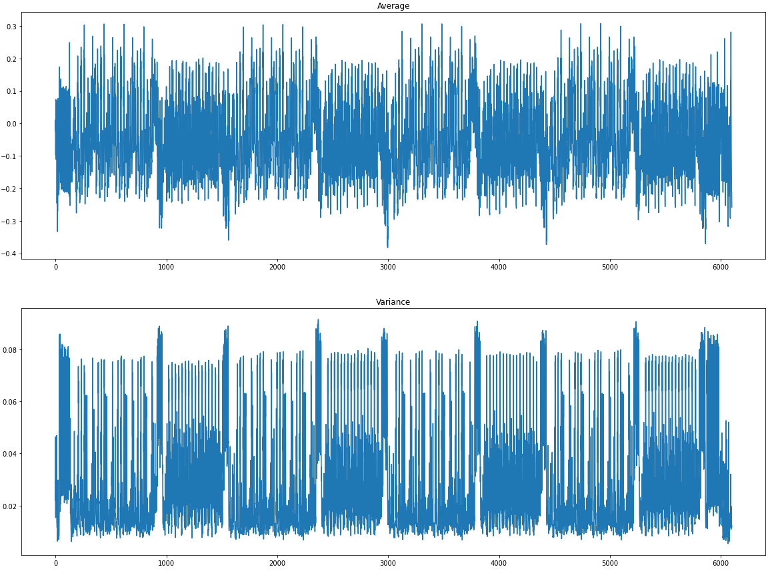
pre
i=0
i=1
i=2
i=3
post

Slide 2
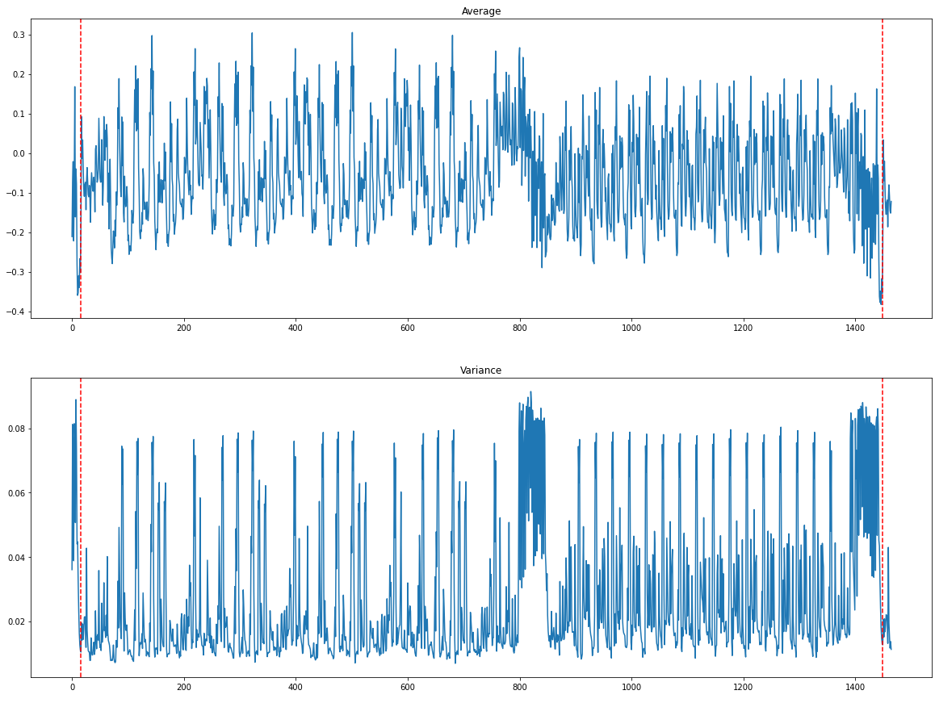
i=1
pre
j=0
j=1
j=2
j=3
SR
MC 0
MC 1
MC 2
MC 3
post

Slide 3
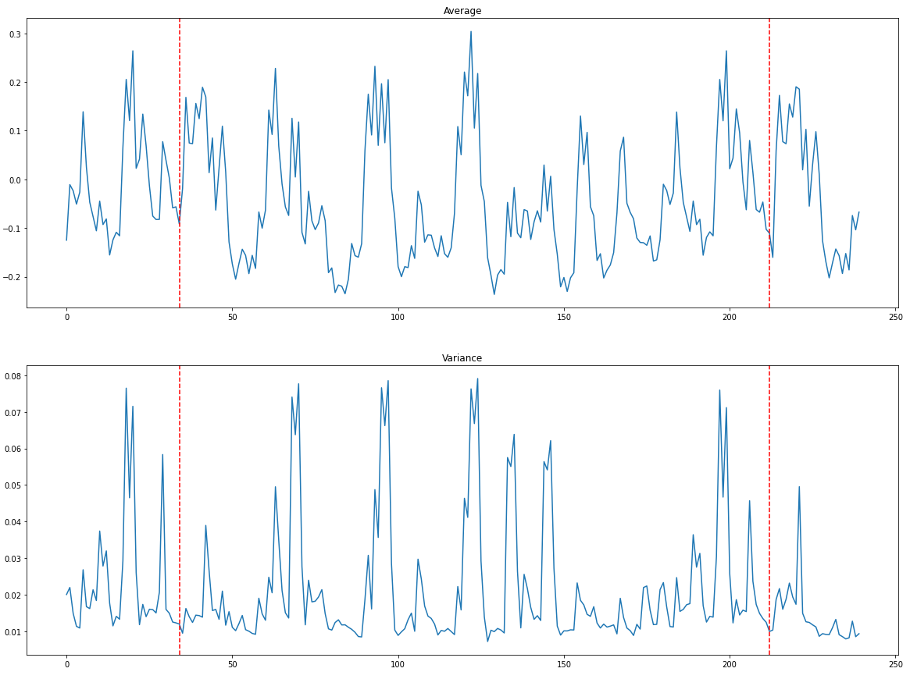
j=1
pre
4j+0
4j+1
4j+2
4j+3

Slide 4
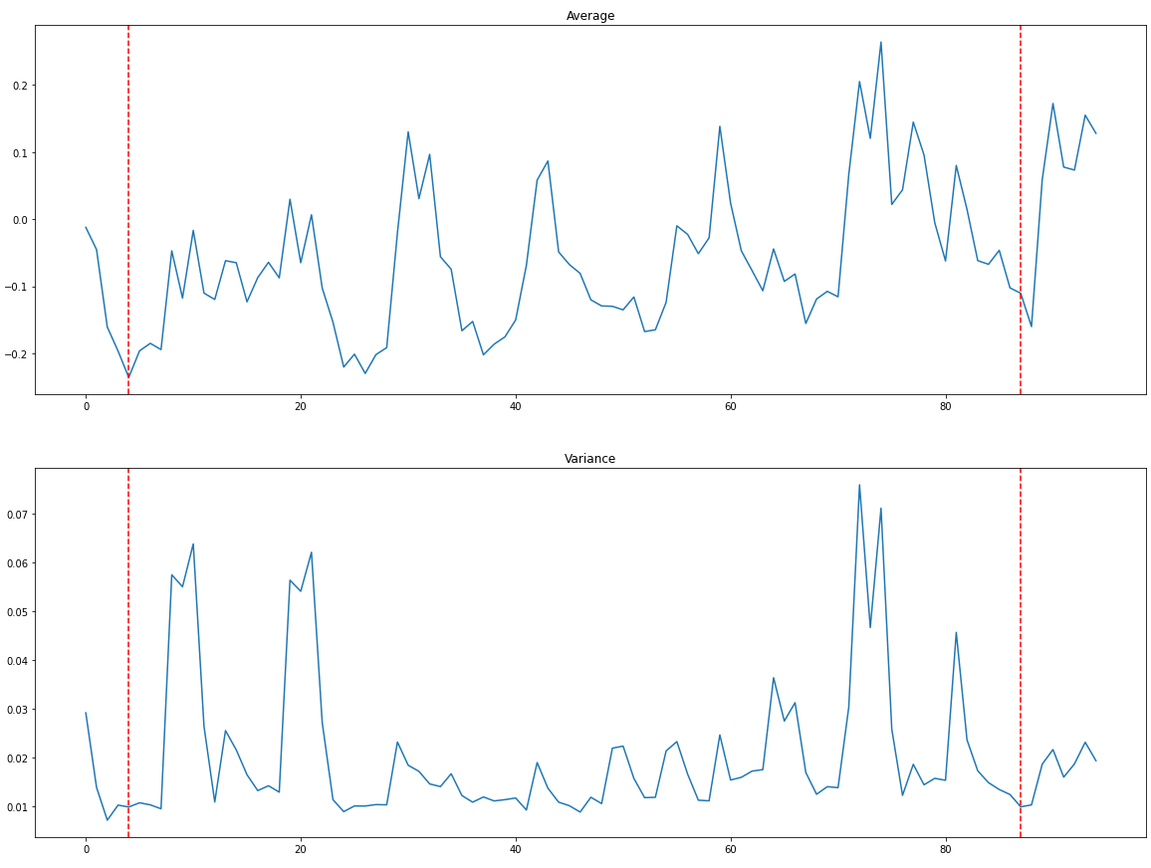
4j+3
Extract 4-bits
Multiply
XOR
ADD
Merge 4-bits

