Slide 1

Hello Everyone…

Slide 2
ARE YOU safe ?
(Privacy & Security)
Project-SkillX
1st Year Student (Dept. of CSE)
JIS University, Kolkata, India
Mr. Rahul Kamilya

Slide 3

You are not safe on the Internet !
There's almost no limit to what you can do online. The Internet makes it possible to access information quickly, communicate around the world, and much more. Unfortunately, the Internet is also home to certain risks, such as malware, spam, and phishing. If you want to stay safe online, you'll need to understand these risks and learn how to avoid them.

Slide 4


Now in this scenario, two types of people come here !
Ethical Hackers
Unethical Hackers

Slide 5
Ethical Hackers :
In simple language, This is a guy who can hack the systems with the authority's permission to check the vulnerabilities, and report developers for fix. They are also known white hat hackers.
Unethical Hackers:
Basically, they are the opposite of ethical hackers. without authority's concern, they steal sensitive information from smartphones, manipulate website data, etc unethical things...
They are also known as Black Hat hackers.

Slide 6
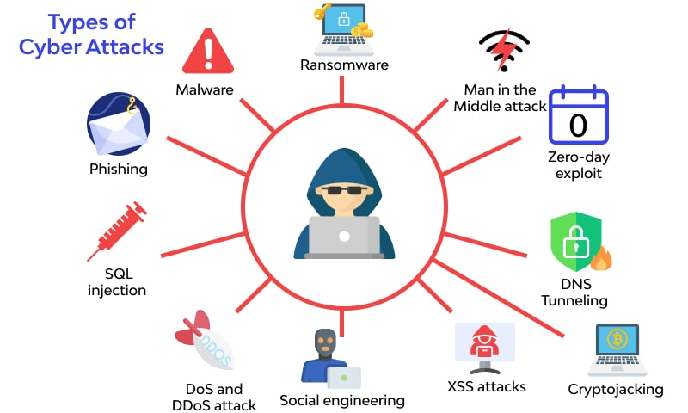
How you'll be hacked !
There are too many simple ways that you will be hacked ):

Slide 7

Social Engineering:
Here, Hacker can gathering your information from social media and other sources. They try to collect your birthdate, your mobile number, mail ID, your hobbies , places you visit, etc

Slide 8
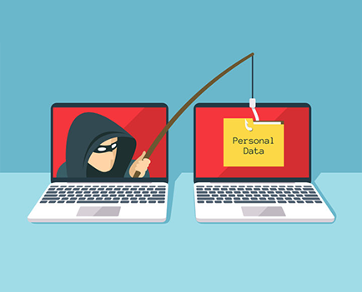
Phishing Attack :
This is the most famous technic to get credentials to form people. Hackers can create a webpage that looks like an exact facebook/messenger/Instagram login page. They send it to you, and when you put your credentials the hacker gets it.

Slide 9
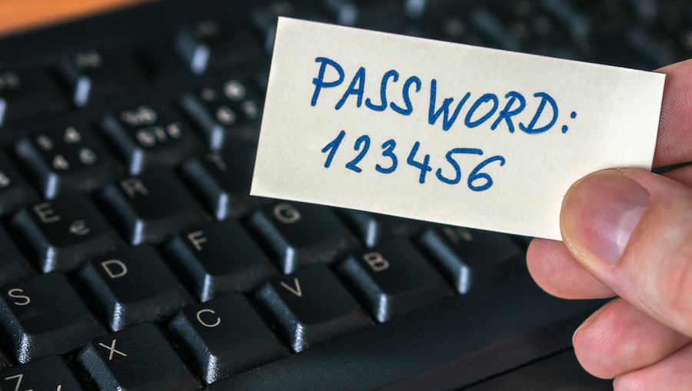
Weak Password Attack :
If your password contains your number, name , DOB your girlfriend's name you'll be hacked soon (: Hackers gathers these information using social engineering and combine it through 'password cracker tools' to get your password.

Slide 10
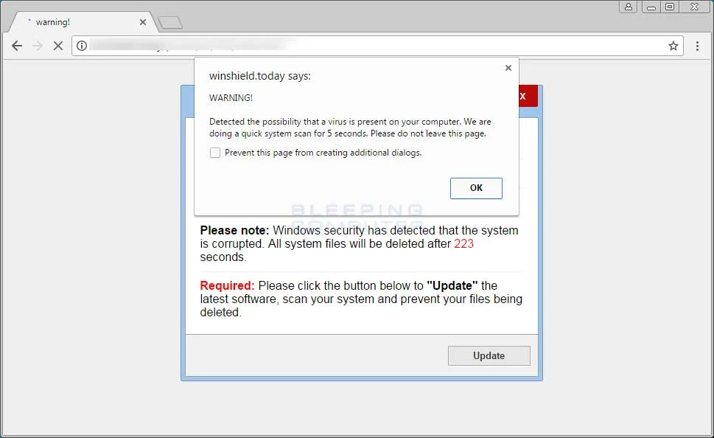
Browser Searching :
If you are searching for a new movie for free ! Or something important on different websites, There is a chance to show a pop- up on your screen. By any chance, if you clicked on this ! By, this technique hackers can easily get your browser history ! Even your saved passwords ! This is called Season intercepting.

Slide 11
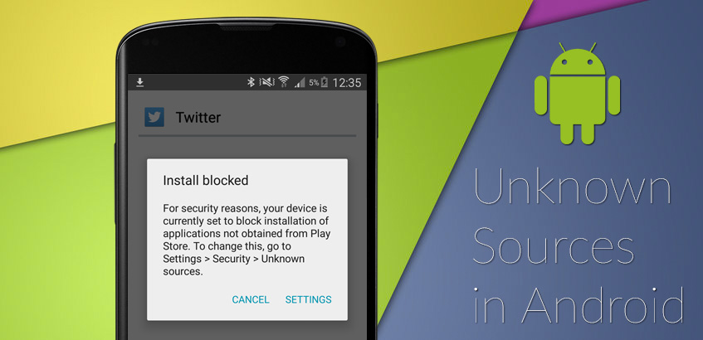
Unknown Apk's :
Installing applications for browser or another website may be harmful to your device ! It contains ransomware or spyware which steals your data and sends it to hackers.

Slide 12

How to protect yourself !
Security is just a illusion ! No one is fully protected on Internet, But, there are some mandatory steps that should you follow for secure yourself !

Slide 13
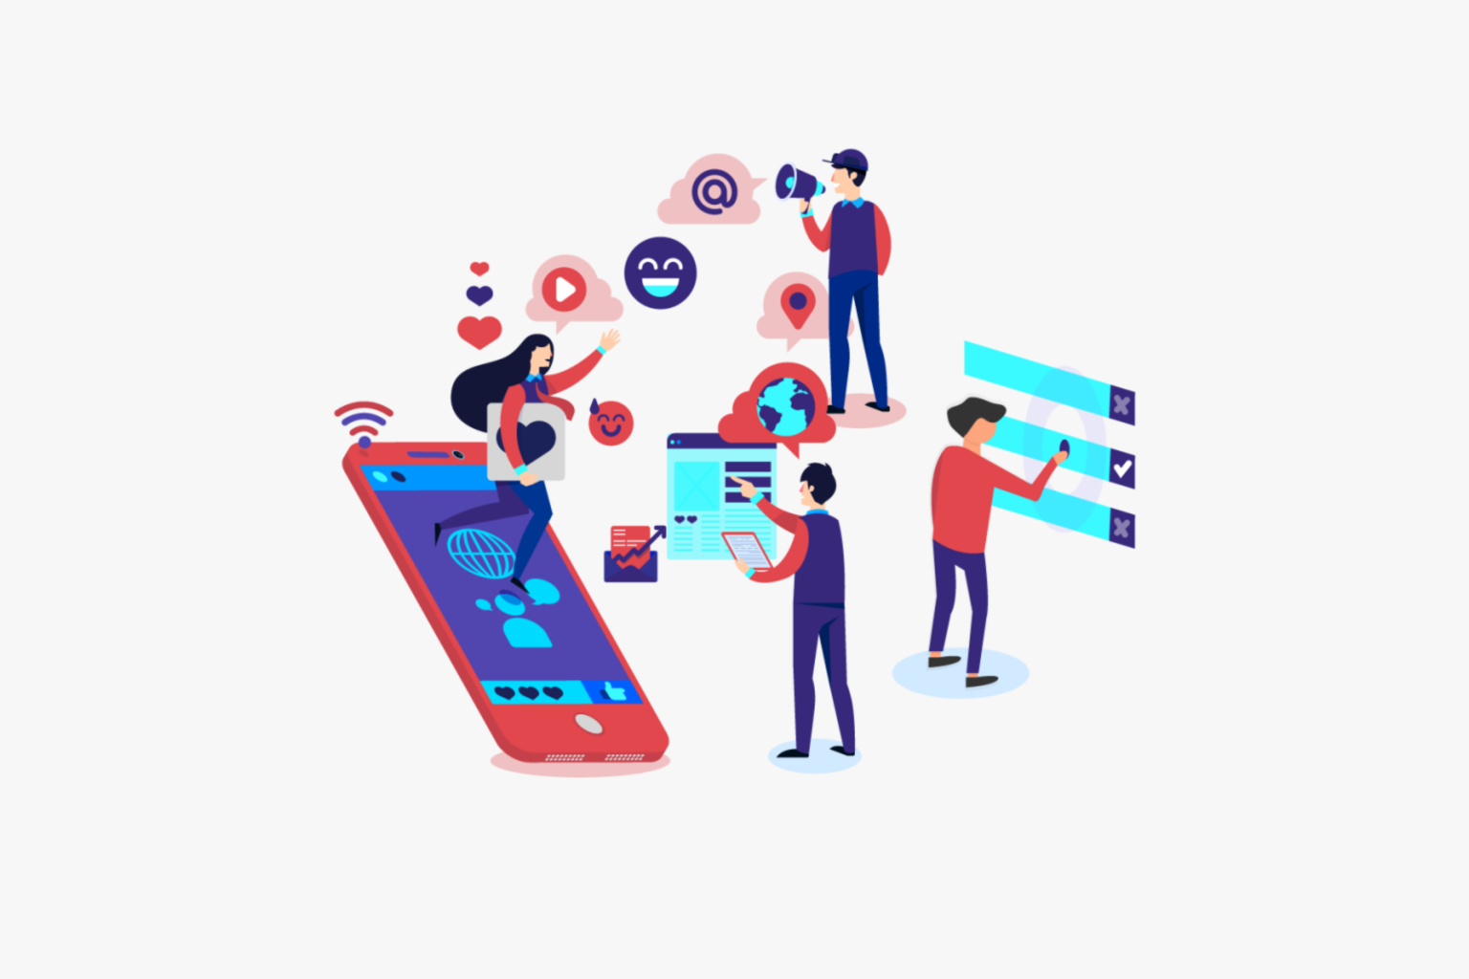
Oversharing:
Do not share everything on social media ! Hackers can easily gathering more information about you.

Slide 14
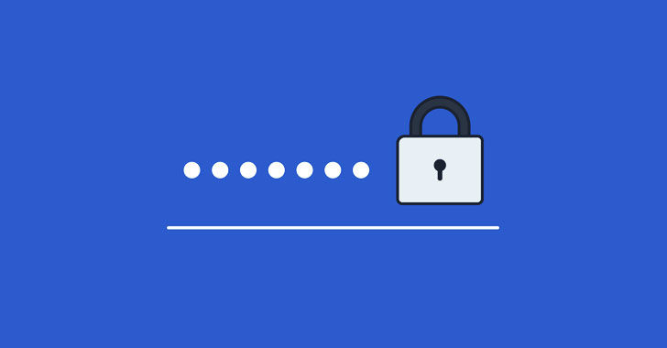
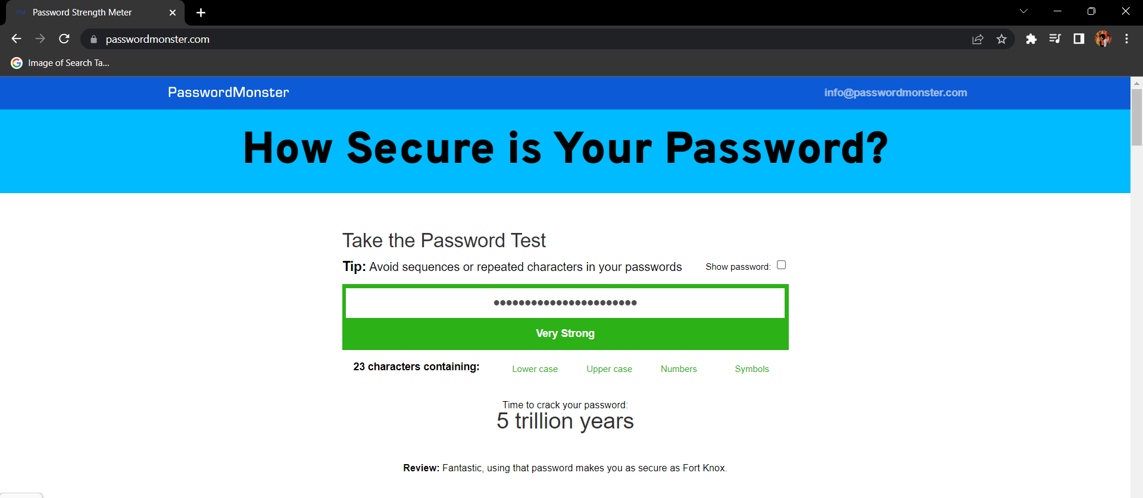
Secure passwords:
Use a strong password by using the password generator app. You can check your Password Strength Here by entering your password.
https://www.passwordmonster.com/

Slide 15
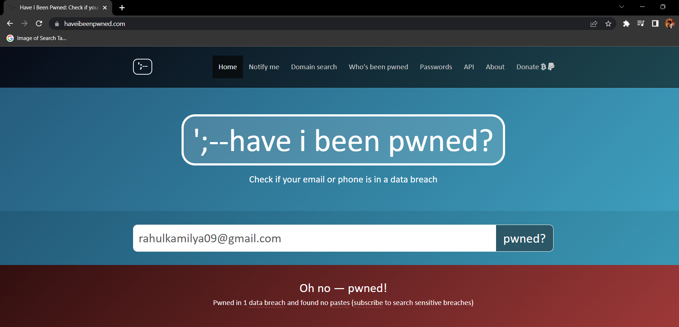
Pwned or not:
If your mail & password already leaked by any cyber-attack. You should change it as early as possible. you can check if your ID & password leaked or not on here https://haveibeenpwned.com/

Slide 16
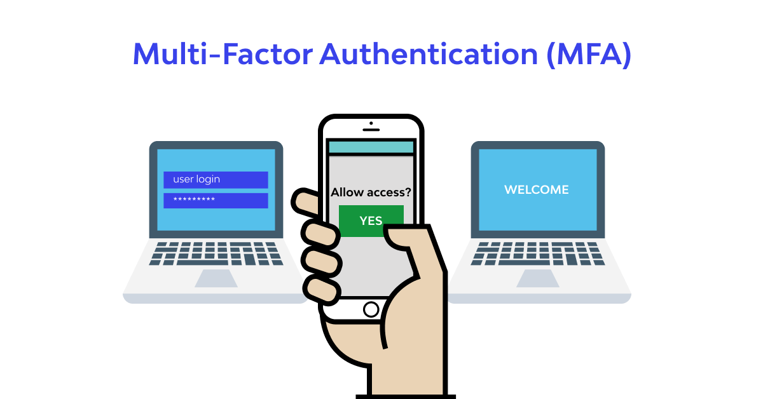

Multi-factor authentication:
Enable two-factor authentication each & every account by using google authenticator. This is a extra level protection from hackers !

Slide 17

Regular updates:
Update every application regularly. That provides you some extra security.

Slide 18
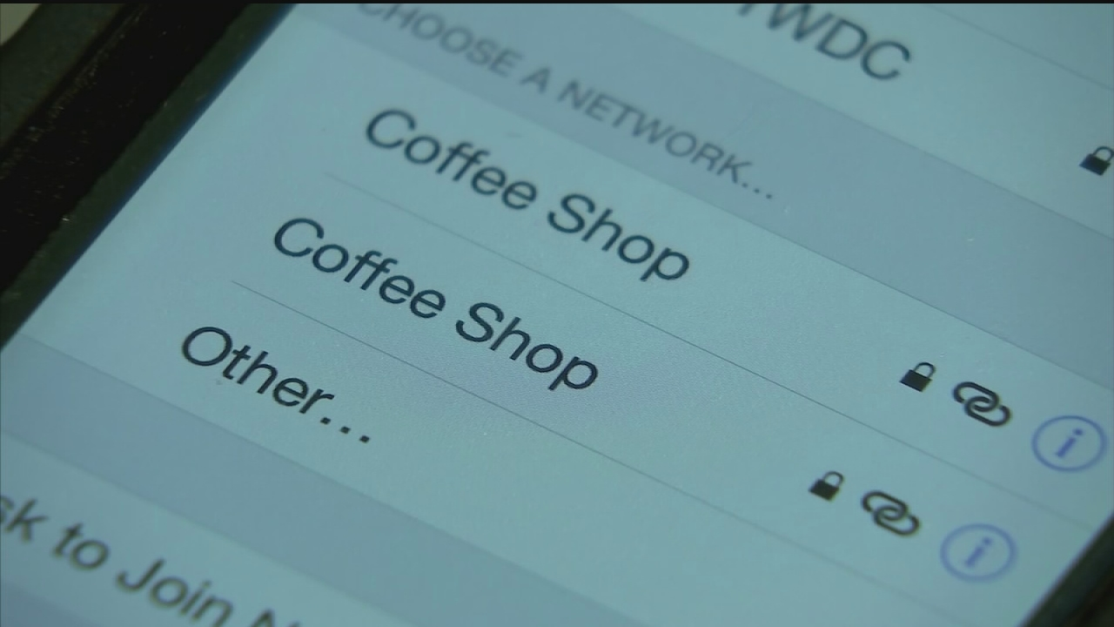
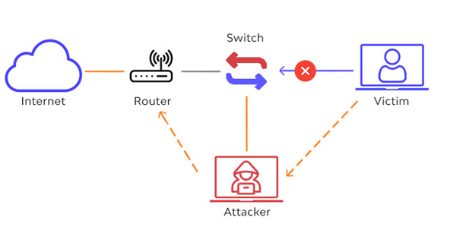
Public Wi-fi:
Never use public wi-fi for bank transactions and searching for something on the browser. Hackers can get your details through Packet Sniffing !

Slide 19
Conclusion :
At the end of the discussion, Hacking is nothing but a mistake by us. We manipulate our security by clicking unwanted links, and Un-authorized sign-in’s If you maintain your security properly you’ll be never hacked :)

Slide 20
THANK YOU

