Slide 1
Travelling Salesman Problem

Slide 2
Problem Statement
To implement the Travelling Salesman Problem(TSP) using different algorithms like Cheapest Link Algorithm and Nearest Neighbour Heuristic and to compare their performance.

Slide 3
Nearest Neighbour Algorithm
In this, the salesman starts at a random city and repeatedly visits the nearest city until all have been visited. It quickly yields a short tour, but usually not the optimal one.
A
58
A
58
A
58
A
58
217
A
58
E
E
E
C
E
C
E
79
79
113
79
113
79
B
D
B
D
B
D
B
201
201
201

Slide 4
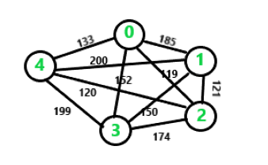
Cheapest Link Algorithm
The Cheapest-Link Algorithm begins with the edge of least weight and makes it part of the circuit. Then it selects the edge of second-smallest weight.
Continue picking and marking the cheapest unmarked link available that does not (a) close a circuit, or (b) create three edges coming out of a single vertex.
Eventually the edges will form a circuit.

Slide 5
Comparison between the two!
Time Complexity - Time complexity for cheapest link algorithm is O(E), where E refers to number of edges and time complexity for Nearest Neighbour algorithm is O(n²), where n refers to number of vertices.
Cost of Travel: For the 1st graph, travelling cost is same for both algorithms. But for 2nd graph, travelling cost using Nearest Neighbour is $773 whereas using Cheapest Link algorithm, cost is $741. Hence, we can see that travelling cost using cheapest link algorithm is less than Nearest Neighbour approach.

Slide 6
Thank you !! This was presented to you by TEAM DEVELOPERS!
Nitesh Bharti – AP18110010604
Ayush Jaiswal – AP18110010616
Syed Abrar – AP18110010620
Paduchuru Nitin Teja – AP18110010631
Link - https://github.com/team-developers/TSP

