Slide 1
Closed-Form Factorization of Latent Semantics in GANs (Shen, Y., & Zhou, B., CVPR, 2021) 딥러닝논문읽기모임 Date: 2021.08.01 Member: 고형권, 허다운 Presenter: 김상현

Slide 2
Contents
Introduction
Method
Preliminaries
Unsupervised Semantic Factorization
Q & A
Experiments
Results on Diverse Models and Datasets
Comparison with Supervised Approach
Comparison with Unsupervised Baselines
Real Image Editing
Conclusion
Q & A

Slide 3
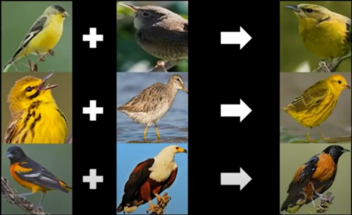
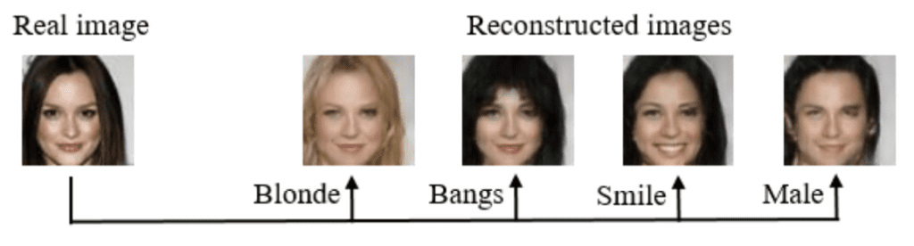

Introduction
GAN’s trend
Image Synthesis → Image Editing.
But, Existing GAN requires manual annotation definition for Image Synthesis, so practical application is limited.
→ SeFa (Semantic Factorization) algorithm (Unsupervised Learning.)

Slide 4


Method
Preliminaries
Equation (1): the first projection step.
G: Generator
z: Latent Code
Equation (2): Image Editing
n: 방향
𝛼: 강도

Slide 5



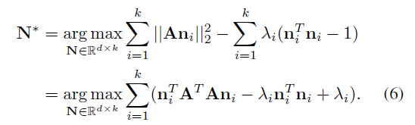
Method
Unsupervised Semantic Factorization
Image editing has nothing to do with latent code z.
Dependent on 𝛼An.
Lagrange multipliers Method.

Slide 6
Q & A

Slide 7
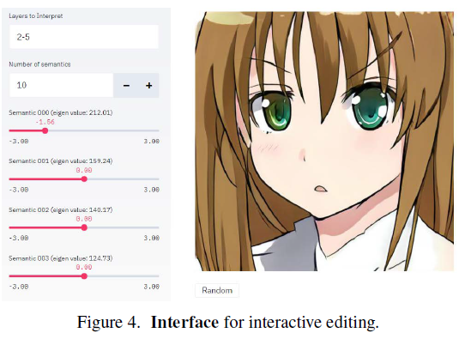
Experiments
Results on Diverse Models and Datasets
Interactive Editing by Tuning Interpretable Directions.
Models
StyleGAN
BigGAN
StyleGAN2
Datasets
Human Face(FF-HQ)
Anime faces
Scenes
Objects
Streetscapes
ImageNet
Interactive Interface

Slide 8
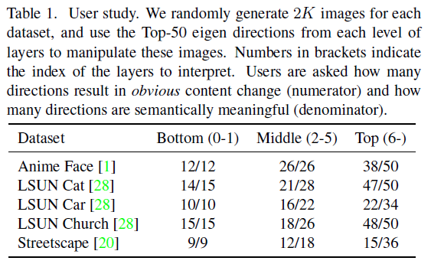
Experiments
Results on Diverse Models and Datasets
Results on StyleGAN
User Study.
( ): layer.
Numerator: how many directions result in obvious content change.
Denominator: how many directions are semantically meaningful.

Slide 9
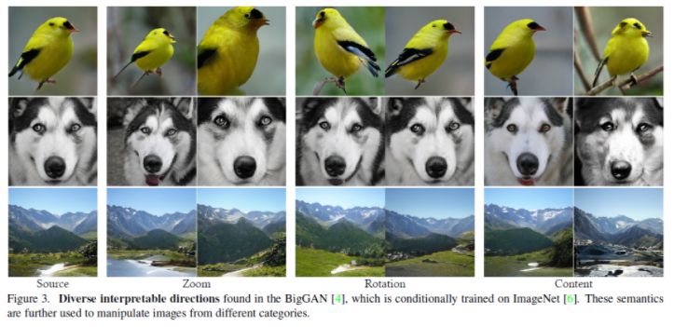
Experiments
Results on Diverse Models and Datasets
Results on BigGAN
The semantics found by SeFa can be applied to manipulating images from different categories.
This verifies the generalization ability of SeFa.

Slide 10
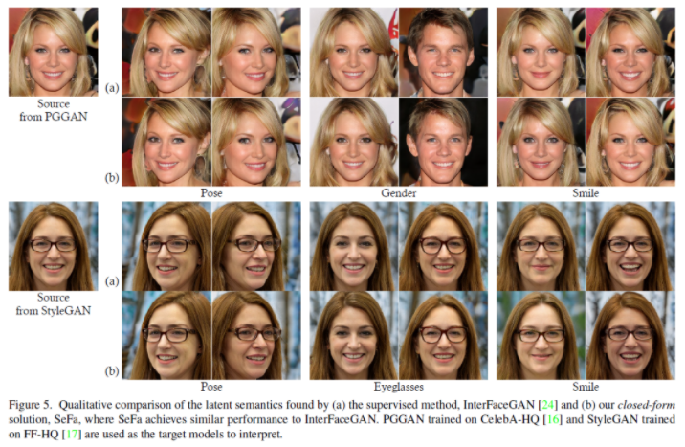
Experiments
Comparison with Supervised Approach
Qualitative Results (SeFa vs InterFaceGAN)
SeFa achieves similar performance as InterFaceGAN.
SeFa is more efficient and generalizable.

Slide 11
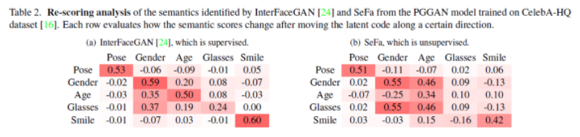
Experiments
Comparison with Supervised Approach
Re-scoring Analysis (SeFa vs InterFaceGAN)
They train an attribute predictor on CelebA dataset with ResNet-50.
3 Observation.
SeFa can adequately control some attribute similar to InterFaceGAN.
InterFaceGAN shows stronger robustness to other attributes, benefiting from its supervised training manner.
SeFa fails to discover the direction corresponding to eyeglasses.

Slide 12
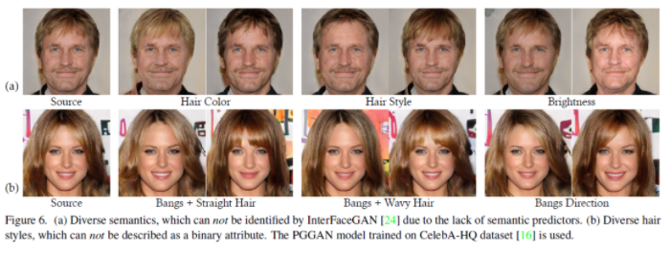
Experiments
Comparison with Supervised Approach
Diversity Comparison
Supervised learning: Depends on the available attribute predictors.
InterFaceGAN (Supervised learning): Binary attribute
SeFa (Unsupervised learning): Diverse attribute

Slide 13
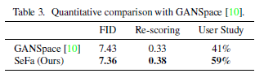
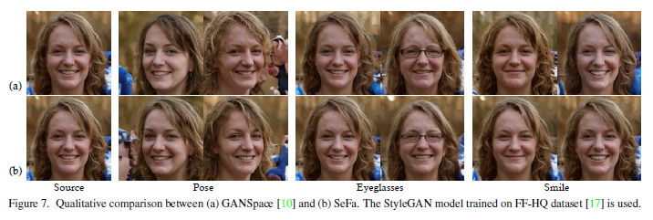
Experiments
Comparison with Unsupervised Baselines
Comparison with Sampling-based Baseline
GANSpace(a): To perform PCA on a collection of sampled data to find principal directions in the latent space.
The semantics found by SeFa lead to a more precise control.

Slide 14
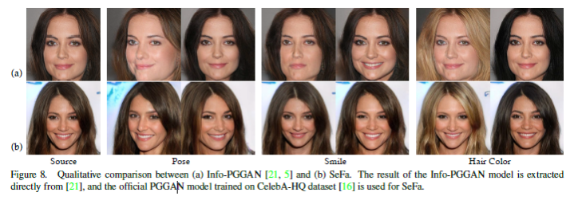
Experiments
Comparison with Unsupervised Baselines
Comparison with Learning-based Baseline ( SeFa vs Info-GAN )
the semantics identified by SeFa are more accurate than those learned from Info-PGGAN.
ex) Taking pose manipulation as an example, the hair color varies when using Info-PGGAN for editing.

Slide 15
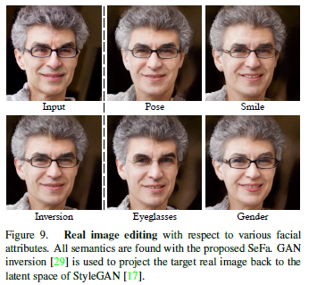
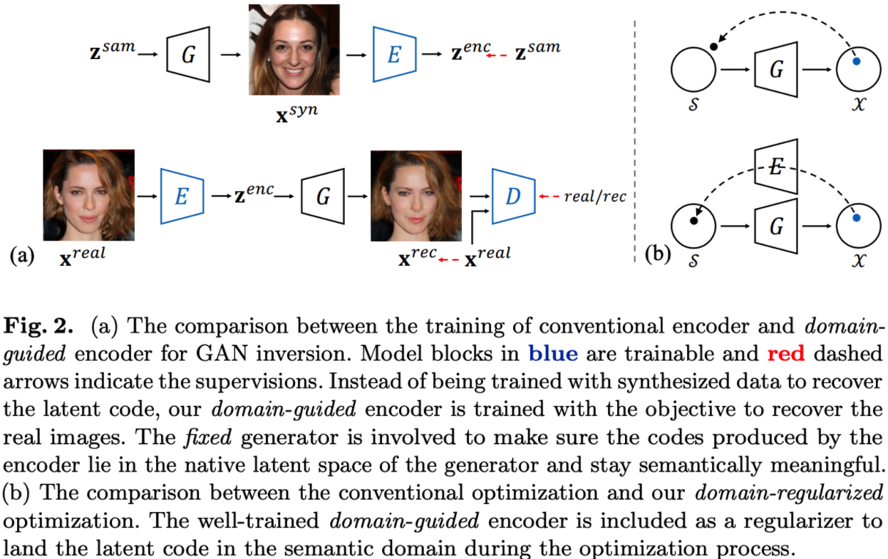
Experiments
Real Image Editing
The generator lacks the inference ability to take a real image as the input.
GAN Inversion.

Slide 16
Conclusion
Unsupervised learning을 사용.
weight 자체가 가지고 있는 learned characteristics를 직접적으로 사용.

Slide 17
Q & A

