Slide 1
Batterie 12V
Bout on/off
PQDE6W-Q24-D5-T
Bout
Bout
LED
LED pwr
Arduino Nano 33 BLE
Connect DIN
Carte
SD
DRV &
VIB

Slide 2
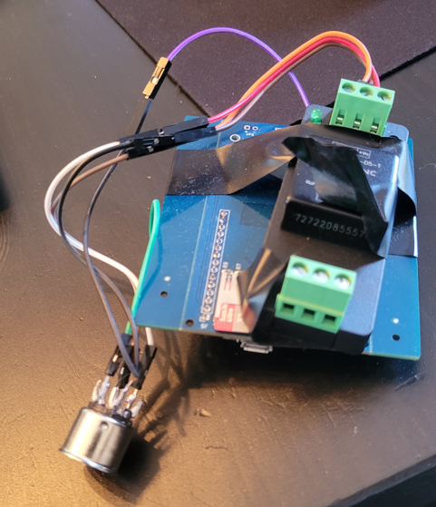
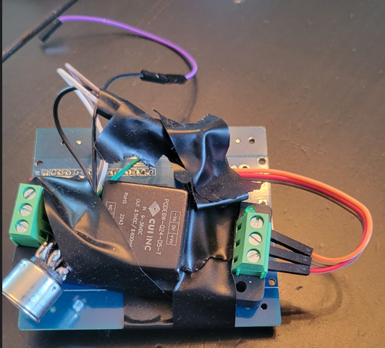
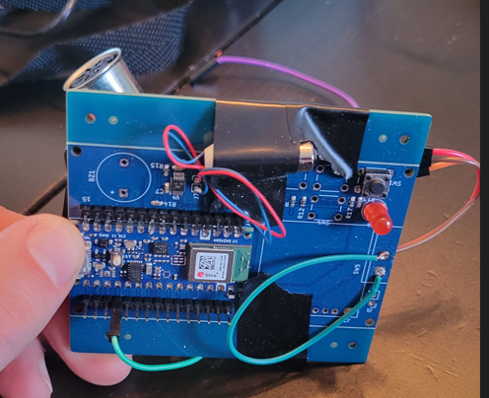

Slide 3
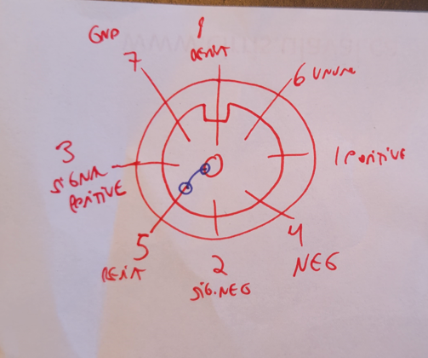
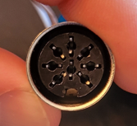
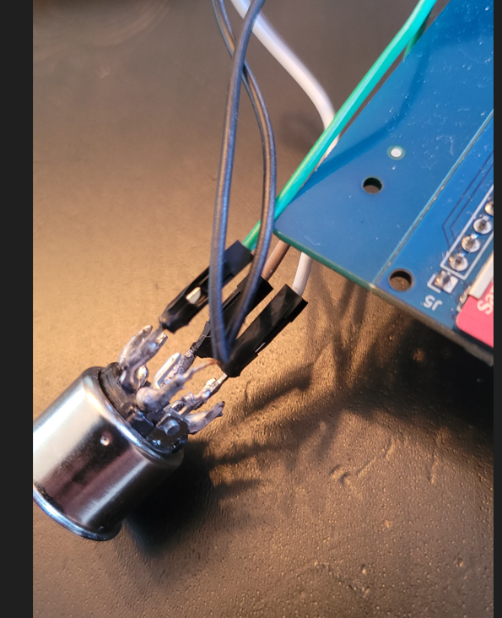

GND arduino
A0
PQDE6W-Q24-D5-T

