Slide 1
LANGBOT
10/19/2023 - Capstone Updates
Aastha, Isabel, Jess, Mon, Ram

Slide 2
Recap
Cue Based Interactive Chatbot
Beginner Spanish Learner
LLMs & Generative AI powered Web Application
COWS-L2H Dataset
Three ML Tasks
  Content Classification
  Error Detection
  Response Generation
Hello! My name is Léa. What is your name?
I name is Mon.
Oh! your name is Mon. My name is Léa. Nice to meet you. How are you?
Notes:
We are team Langbot working on a cue based interactive chatbot for beginner Spanish language learners.
We are building a web application powered by LLMs and Generative AI using the Corpus Of Written Spanish, L2 and Heritage Speakers dataset (COWS-L2H) from UC Davis. It contains Spanish college essays annotated with errors and corrections.
At a high level, we want our bot to
take an input from user
analyze errors
return cues about errors
return meaningful response to keep the conversation going.
We have identified three ML tasks:
Content Classification
Error detection and
Response generation

Slide 3
Content Classification Task
Goal: Is user’s response on topic?
Approach: Compute sentence embedding and compare to embeddings in VectorDB
Embeddings Choices:
Skip-Thought Vectors using encoder-decoder
InferSent using BiLSTM network
Universal Sentence Encoder using Transformer
Bert Embeddings (average of BERT output layer)
Sentence-BERT - BERT modified with siamese and triplet network structures.
Distance Metrics: Cosine and Manhattan distances
Our Pick: SOTA Sentence-BERT and Cosine Distance
Challenges: Response with multiple sentences, linking answers to questions.
10/19/2023 - Capstone Updates
Notes:
The Goals of Content classification task is to identify if input from user is on topic.
Our approach is to compute embeddings of the input and compare it to pre-computed embeddings stored in a vector db.
We looked at a few different options for the embeddings and selected SentenceBERT which was trained on parallel BERT networks and triplet loss function. It is the state of the art for several semantic textual similarity tasks.
We also selected cosine distance as the distance metric as it does a better job at semantic similarity.
We are still working through a few challenges like handling multiple sentences in user input and as well as question-answering.
More details on embeddings:
Skip-Thought uses an encoder-decoder architecture to predict the surrounding sentences
InferSent uses a siamese BiLSTM network with max-pooling over the output trained on SNLI dataset
Universal Sentence Encoder uses a transformer network
Bert Embeddings are average of the BERT output layer
parallel BERT follows siamese architecture

Slide 4
Error Detection Task
Goal: Identify and classify errors in user response
Approach: Grammatical Error Correction (GEC)
Model Choices:
Massively Multilingual Pre-trained Text-to-Text Transformer model with encoder-decoder arch
Encoder only BERT based model fine tuned for subsequence tagging and classification
Our Pick: Fine tune BETO (BERT based Spanish) model per existing research
Challenges:
Spanish dataset not on par with English dataset used in the paper. Needs feature engineering.
Class imbalance
10/19/2023 - Capstone Updates
Notes:
Next we have the error detection task which focuses on identifying and classifying any errors in user input.
We are relying on Grammatical Error Correction techniques for this task.
We identified two different approaches
One is to treat it as a Neural Machine Translation task and use a Seq2Seq or an encoder-decoder model
Another is to consider it as a subsequence-classification task and use a decoder only model with softmax layer on top.
As we discussed last week, we have identified a previous research that uses the second approach for English, giving us a good starting point. We are going to fine tune BETO, which is a BERT model trained on large Spanish corpus, on COWS-L2H dataset.
We have a few challenges though:
the COWS-L2H dataset is not on par with the research dataset. Needs feature engineering which I will cover in just a bit.
We also have a class imbalance issue with our dataset.

Slide 5
Response Generation Task
Goal: Generate Cue/Scaffolding as well as response
Approach: LLMs and few shot learning with output from GEC model
Model Choices:
GPT3.5/GPT4
Llama
Falcon
Aguila
Our Pick: TBD
Challenges: Trying out various models and manually evaluating results.
10/19/2023 - Capstone Updates
Notes:
The last task for us is to generate the response displayed to the user
This is a pure generative task and we are exploring few shot learning with multiple LLMs.
Biggest challenge with this task is that it needs manual evaluation.

Slide 6
Combined Response Generation
Goal: Identify errors, generate cues and response in one go
Approach: Content generation using generative AI - Few shot learning with LLMs
Model Choices:
GPT3.5/GPT4
Llama
Falcon
Aguila
Our Pick: TBD
Challenges: Prompt engineering
10/19/2023 - Capstone Updates
Notes:
We are also experimenting with collapsing error detection and content generation into one step using few shot learning and multiple LLMs

Slide 7
Feature Engineering
GEC model:
Convert COWSL2H dataset to match EXPECT dataset from paper
Evidence words
  EXPECT has evidence words from annotators
  Spanish dataset does not have evidence words
  ChatGPT with few shot learning shows promise in generating evidence words
Dependency parsing tree
  Spanish language dependency parsers are not as mature
  Experimenting with Transition-based MaltParser and Maximum Spanning Tree Parser
The other two ML tasks do not need feature engineering.
10/19/2023 - Capstone Updates
Notes:
Next I would like to touch on feature engineering. Last week we presented details about the COWS-L2H dataset itself. Since then we have identified a few more tasks around transforming and enhancing the dataset to match what was used for the reference research. Two of the main ones are
identifying evidence words for an error. Ideally we would prefer using annotators for this. Since we are short on resources, we are exploring using Chat-GPT. It showing some promise.
next is generating dependency parse tree which represents the syntactic structure of a sentence. We are evaluating few Spanish dependency parsers for this.

Slide 8
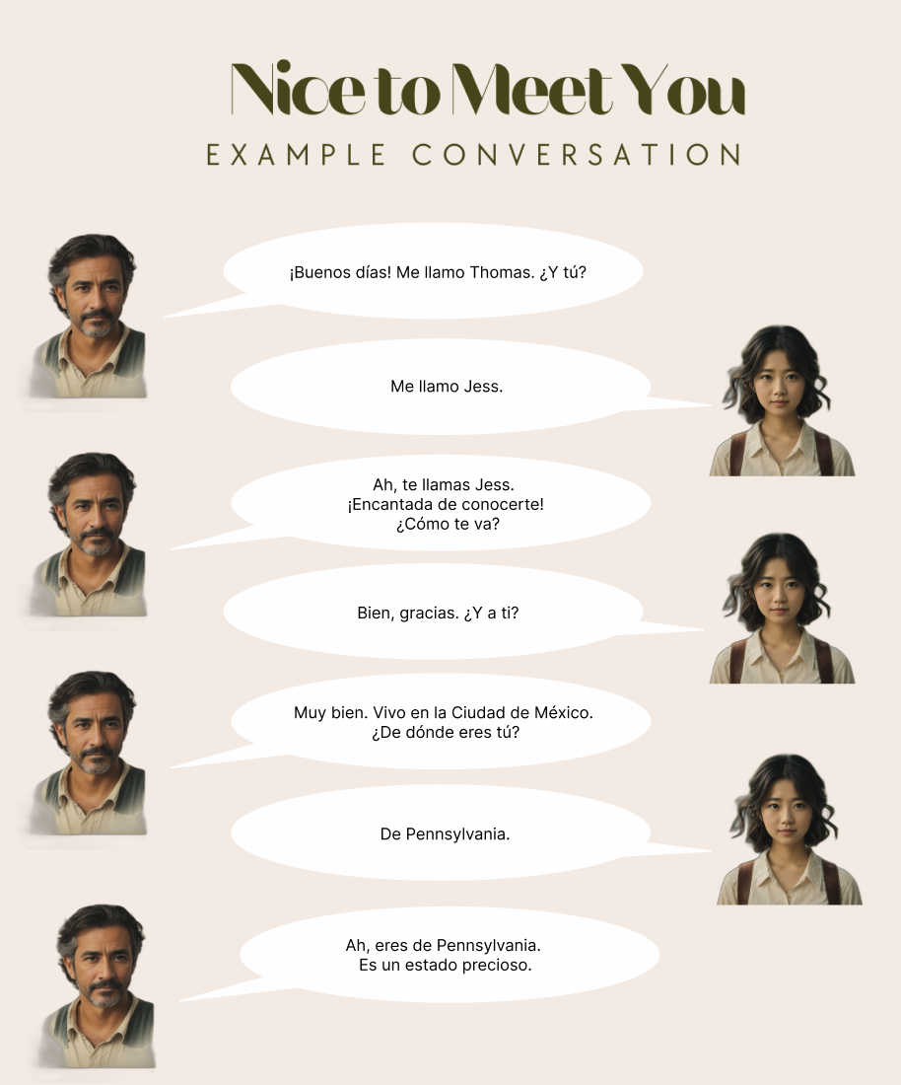

User Experience
10/19/2023 - Capstone Updates
Notes:
We also have some incremental progress on the user experience front
These two screenshots show what user sees before and during a chat session
The example conversation on left sets the context of the lesson
The chat UI on the right allows user to follow the example and interact with the bot

Slide 9
References
Davidson, S., Yamada, A., Mira, P.F., Carando, A., Gutierrez, C.H., & Sagae, K. (2020). Developing NLP Tools with a New Corpus of Learner Spanish. International Conference on Language Resources and Evaluation.
Kiros, R., Zhu, Y., Salakhutdinov, R., Zemel, R.S., Urtasun, R., Torralba, A., & Fidler, S. (2015). Skip-Thought Vectors. Neural Information Processing Systems.
Conneau, A., Kiela, D., Schwenk, H., Barrault, L., & Bordes, A. (2017). Supervised Learning of Universal Sentence Representations from Natural Language Inference Data. ArXiv, abs/1705.02364.
Cer, D.M., Yang, Y., Kong, S., Hua, N., Limtiaco, N., John, R.S., Constant, N., Guajardo-Cespedes, M., Yuan, S., Tar, C., Sung, Y., Strope, B., & Kurzweil, R. (2018). Universal Sentence Encoder. ArXiv, abs/1803.11175.
Reimers, N., & Gurevych, I. (2019). Sentence-BERT: Sentence Embeddings using Siamese BERT-Networks. Conference on Empirical Methods in Natural Language Processing.
Sun, X., Ge, T., Ma, S., Li, J., Wei, F., & Wang, H. (2022). A Unified Strategy for Multilingual Grammatical Error Correction with Pre-trained Cross-Lingual Language Model. International Joint Conference on Artificial Intelligence.
Xue, L., Constant, N., Roberts, A., Kale, M., Al-Rfou, R., Siddhant, A., Barua, A., & Raffel, C. (2020). mT5: A Massively Multilingual Pre-trained Text-to-Text Transformer. North American Chapter of the Association for Computational Linguistics.
Fei, Y., Cui, L., Yang, S., Lam, W., Lan, Z., & Shi, S. (2023). Enhancing Grammatical Error Correction Systems with Explanations. Annual Meeting of the Association for Computational Linguistics.
Muntsa Padró, Miguel Ballesteros, Héctor Martínez, and Bernd Bohnet. 2013. Finding Dependency Parsing Limits over a Large Spanish Corpus. In Proceedings of the Sixth International Joint Conference on Natural Language Processing, pages 942–946, Nagoya, Japan. Asian Federation of Natural Language Processing.
Cañete, J.L., Chaperon, G., Fuentes, R., Ho, J., Kang, H., & P'erez, J. (2023). Spanish Pre-trained BERT Model and Evaluation Data. ArXiv, abs/2308.02976.
10/19/2023 - Capstone Updates
Notes:
That concludes our presentation. We would like to take any questions now.

Slide 10
Additional References
(added after presentation)
Zhang, T., Wu, F., Katiyar, A., Weinberger, K.Q., & Artzi, Y. (2020). Revisiting Few-sample BERT Fine-tuning. ArXiv, abs/2006.05987.
Sun, C., Qiu, X., Xu, Y., & Huang, X. (2019). How to Fine-Tune BERT for Text Classification? China National Conference on Chinese Computational Linguistics.
Zhuang, B., Liu, J., Pan, Z., He, H., Weng, Y., & Shen, C. (2023). A Survey on Efficient Training of Transformers. ArXiv, abs/2302.01107.
10/19/2023 - Capstone Updates
Notes:
That concludes our presentation. We would like to take any questions now.

