Slide 1
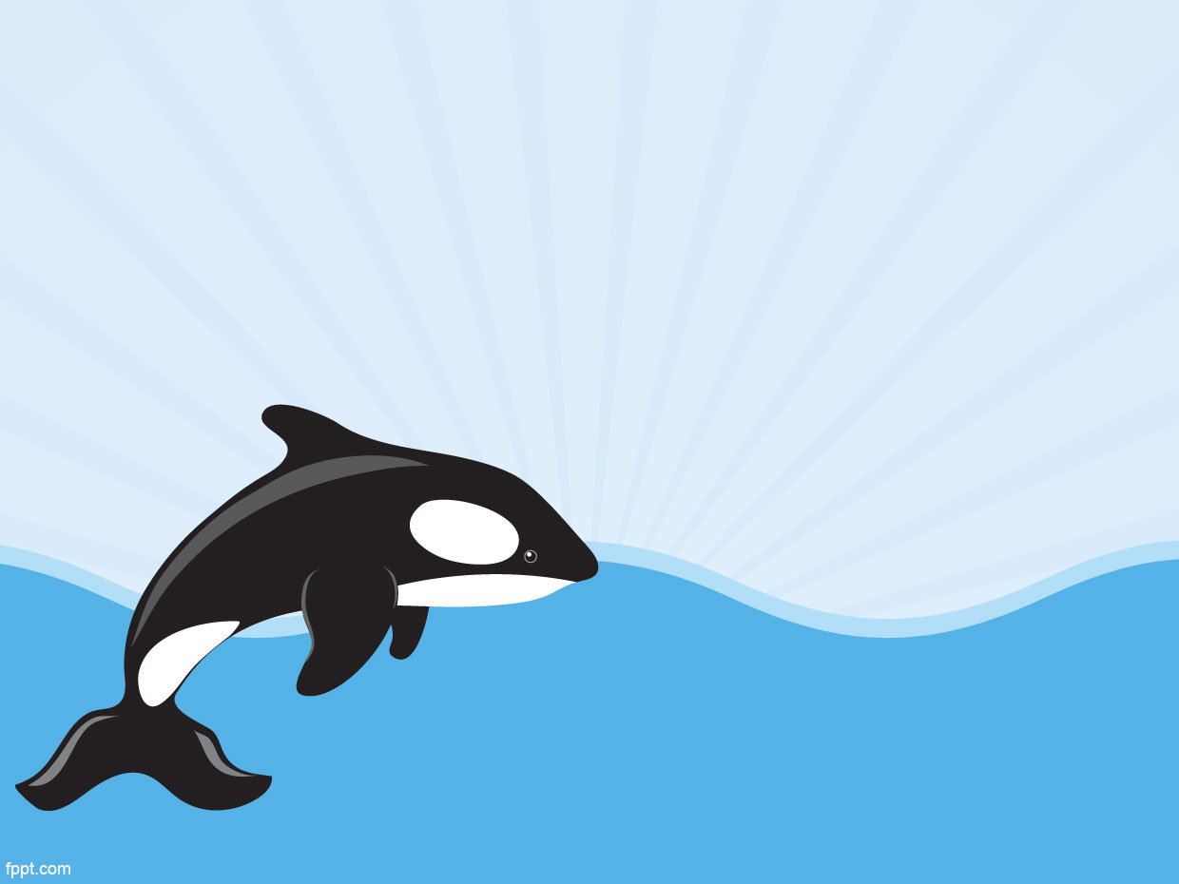
Orca - FISHACKATHON
Ozan Onur Tek – Enes Günday
Muharrem Kantar – Yağız Özbek Evren

Slide 2

What is “Selfiesh”?
Selfiesh is a mobile application that has been developed for our world. Our aim is to collect data of caught fish species.

Slide 3
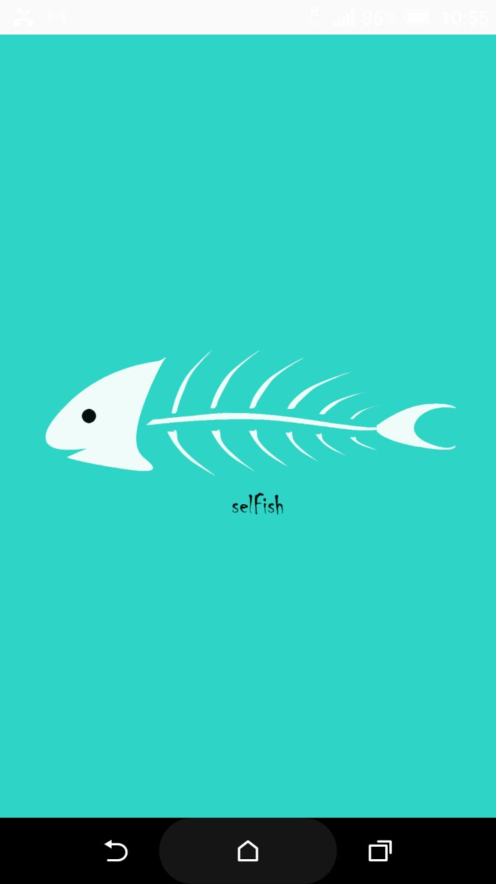

Slide 4
Data Collection
Different types of fish species caught
Number of each fish species
Length of individual fish within a species

Slide 5


Identification

Slide 6

We identify fish species via captured image of fish. (Automated)

Slide 7

We also ask user to enter the length of fish as input. (User-Input)

Slide 8
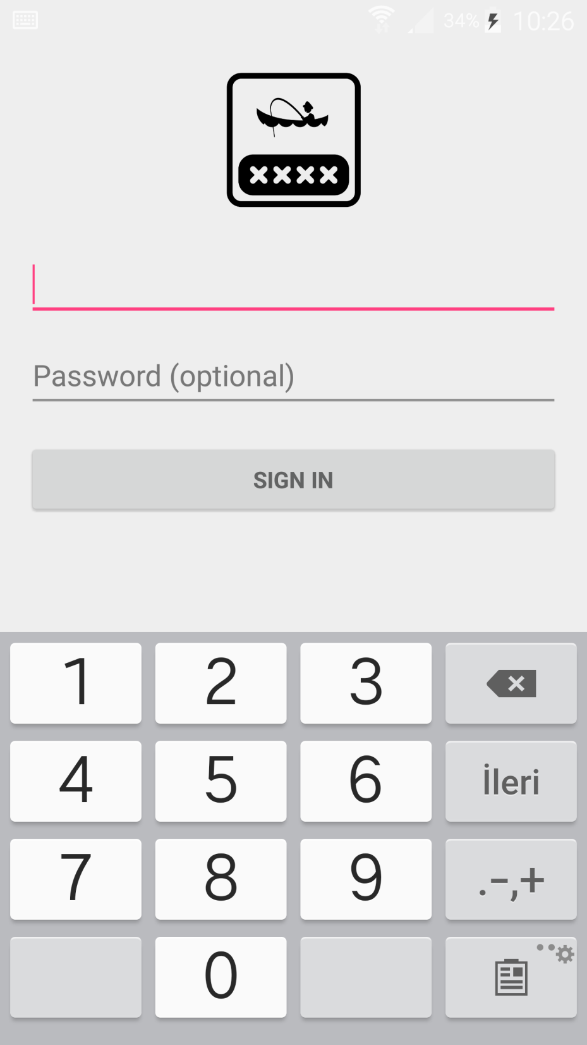

Slide 9
Two Sections
Before Hunt
On Hunt

Slide 10
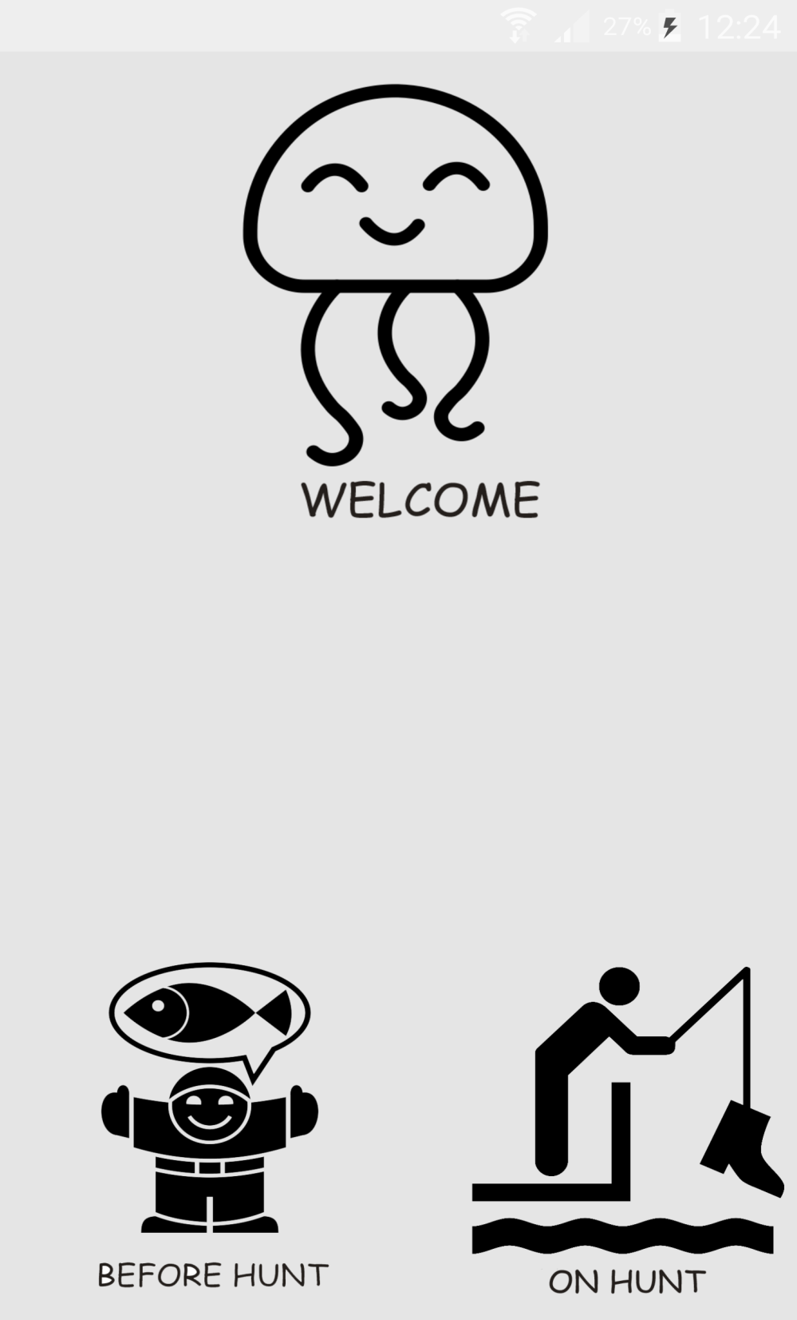

Slide 11
On Hunt Section
We ask user to send an image of caught fish, and we identify it.

Slide 12
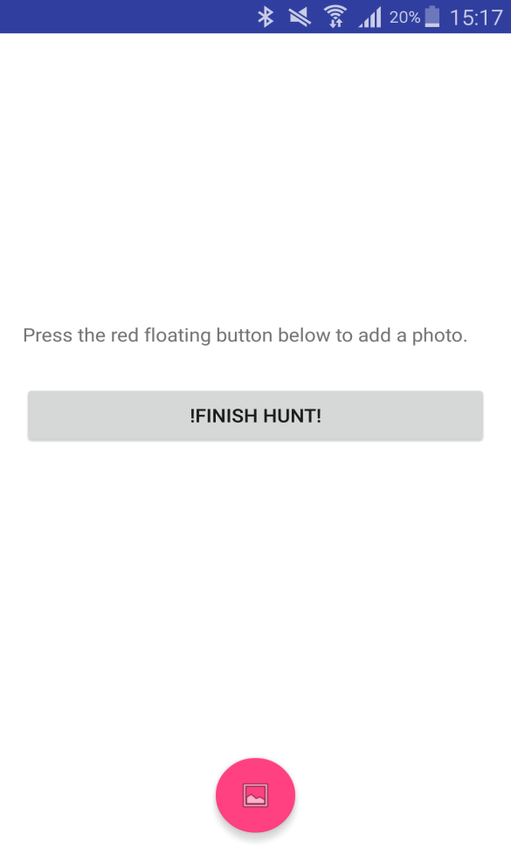
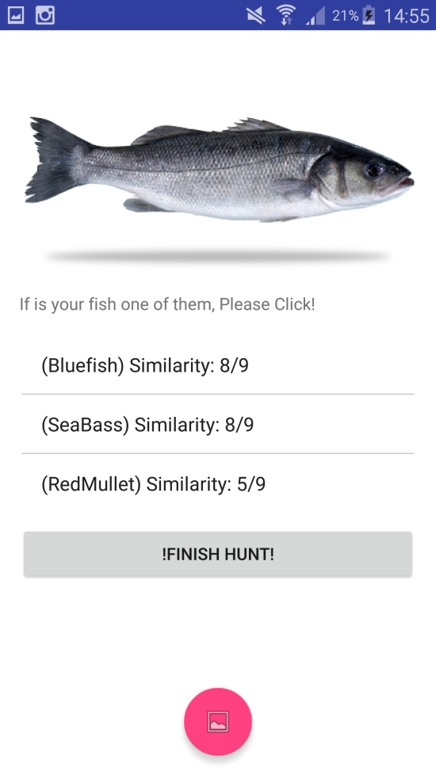
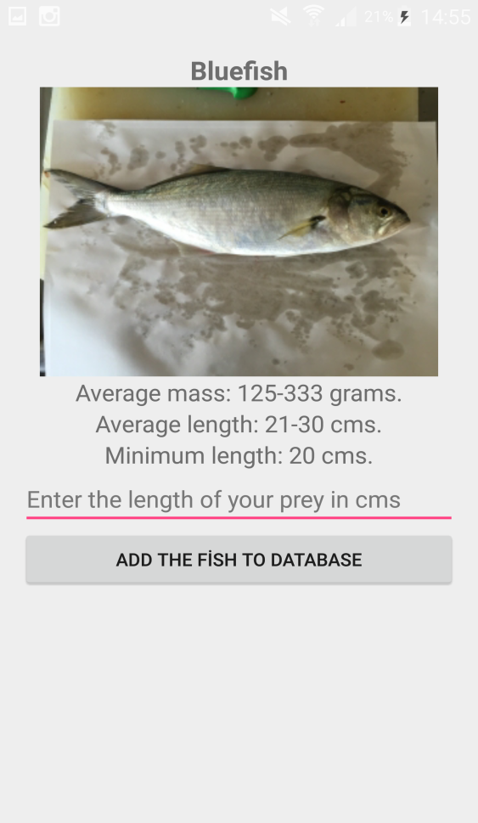
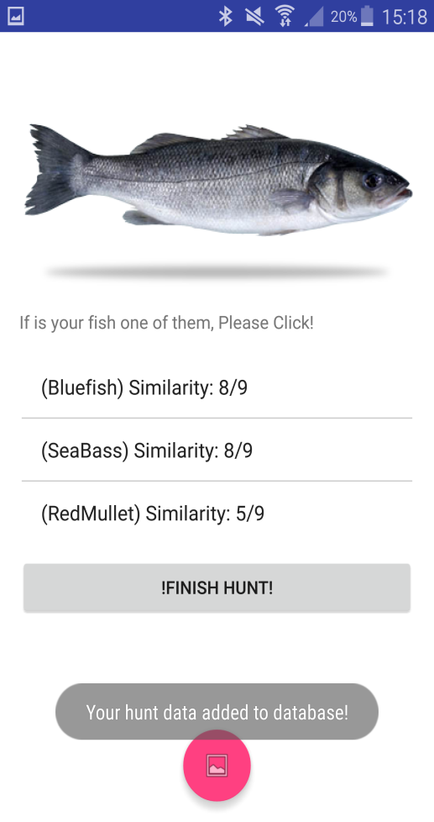

Slide 13
Before Hunt Section
User is available to see recent hunt sessions.

Slide 14
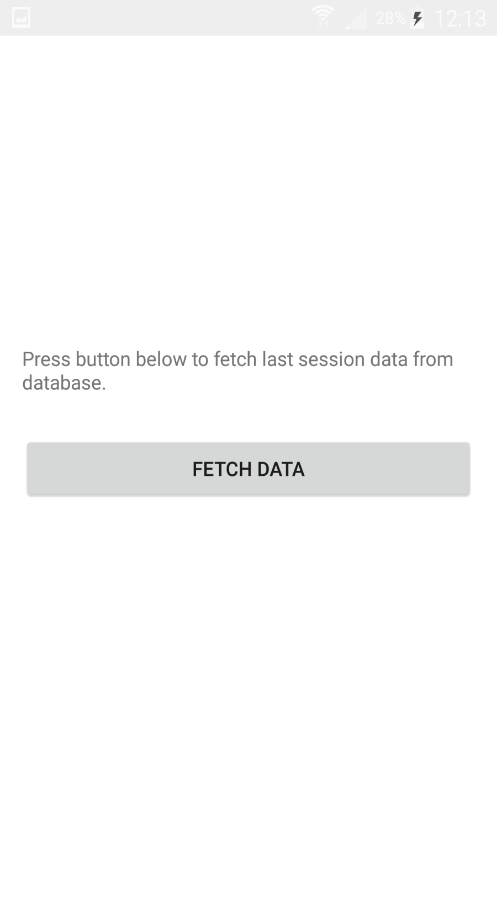

Slide 15
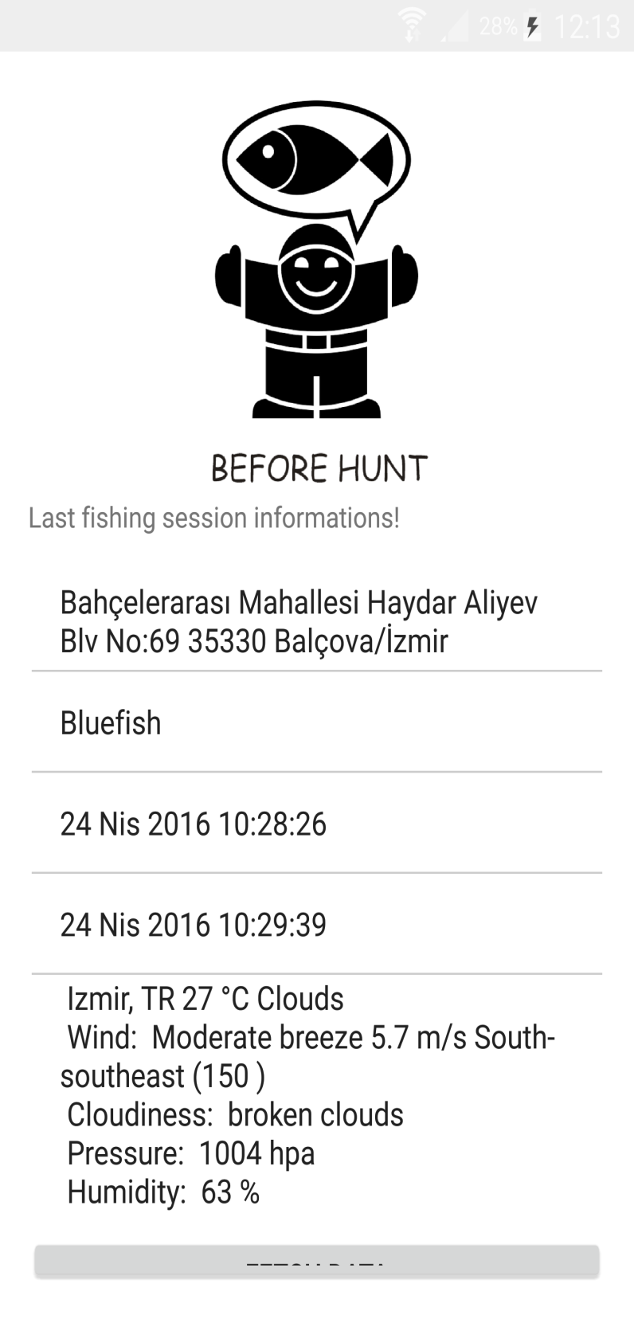

Slide 16

Recording Position

Slide 17

Selfiesh is recording fishermen's hunting area's position, including time and date.

Slide 18
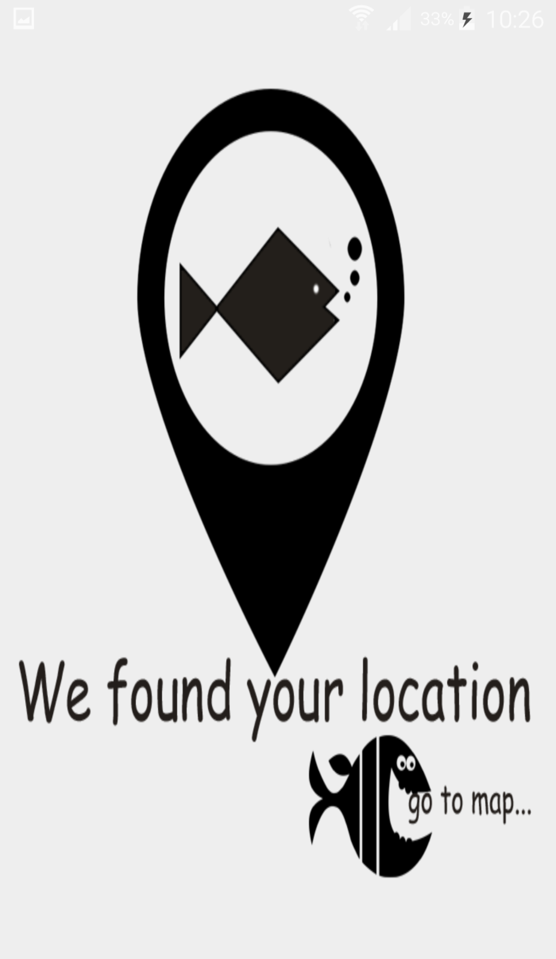

Slide 19
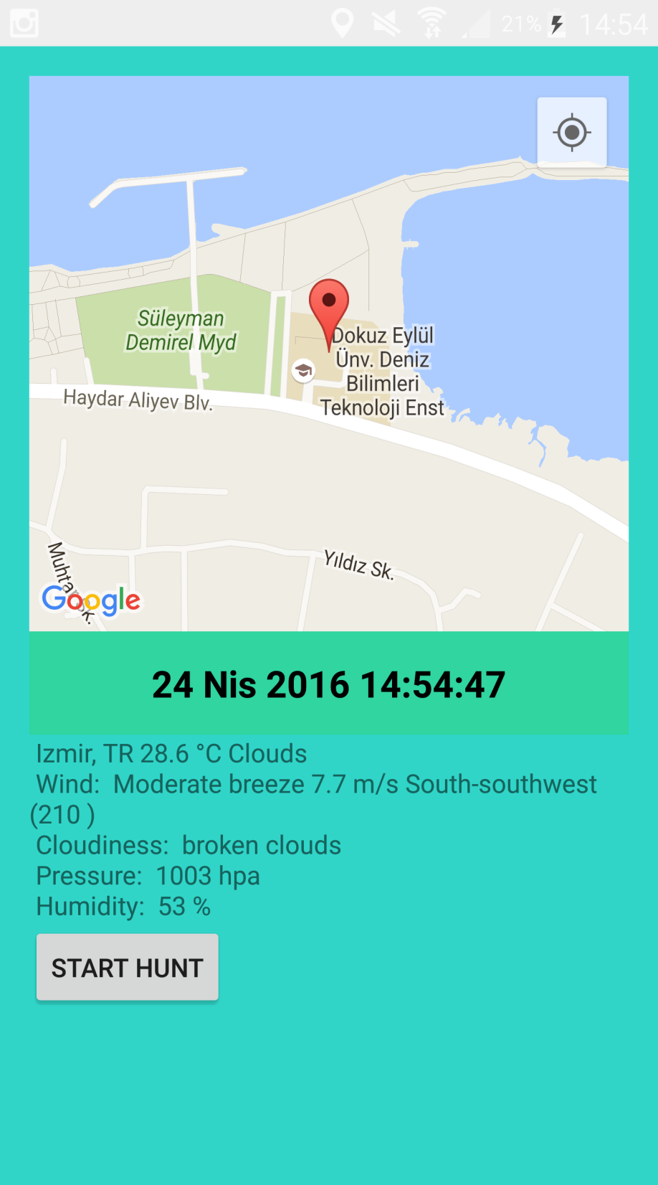

Slide 20

After all, we send all collected data to our database via internet connection.

Slide 21
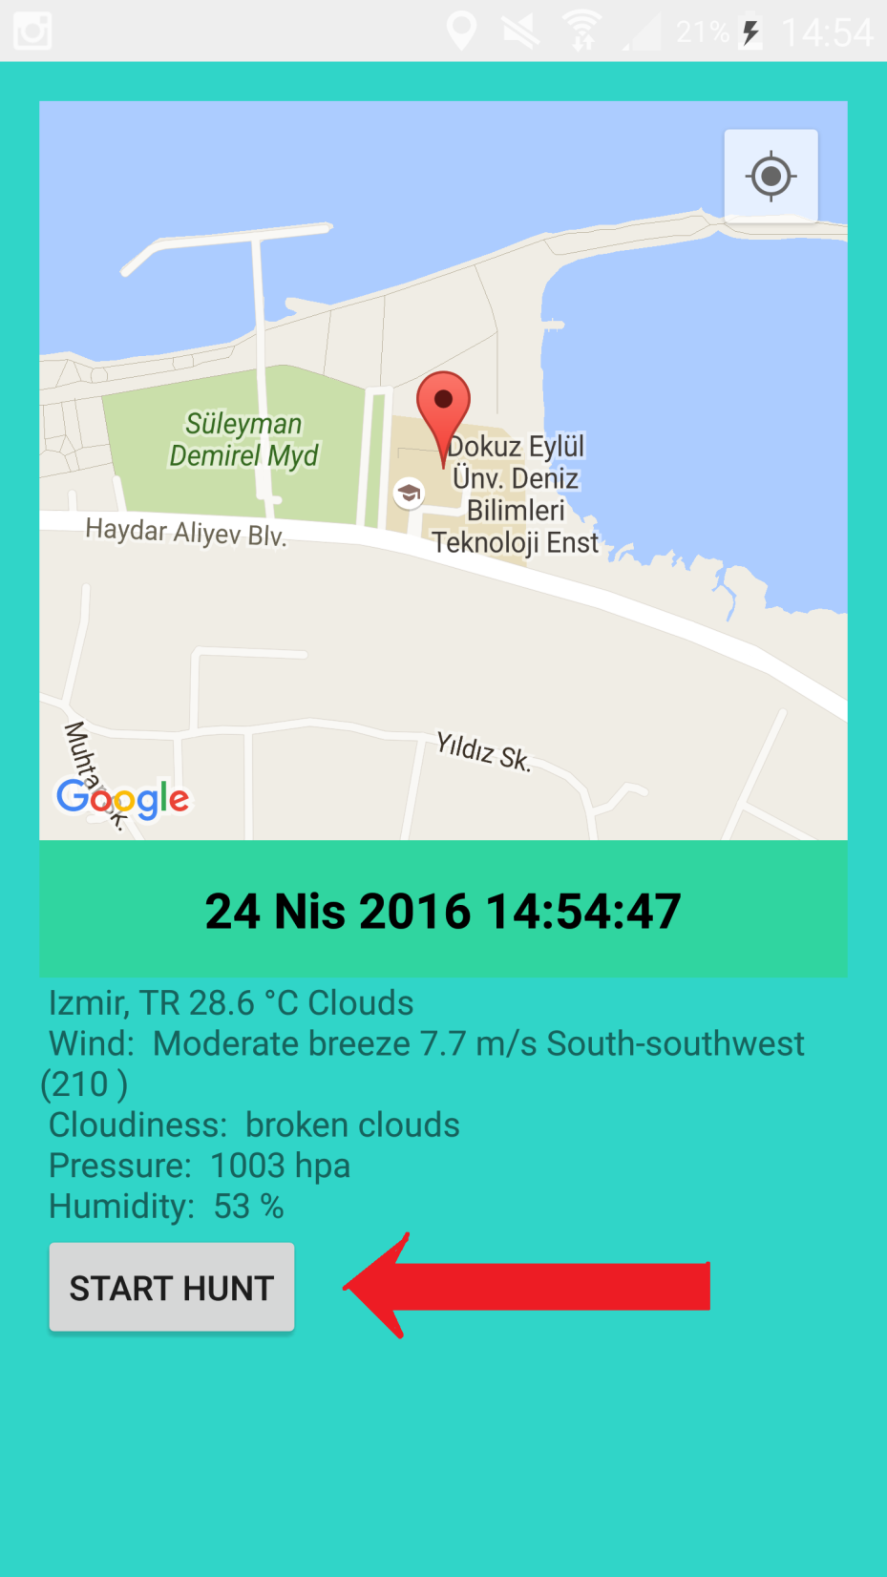

Slide 22
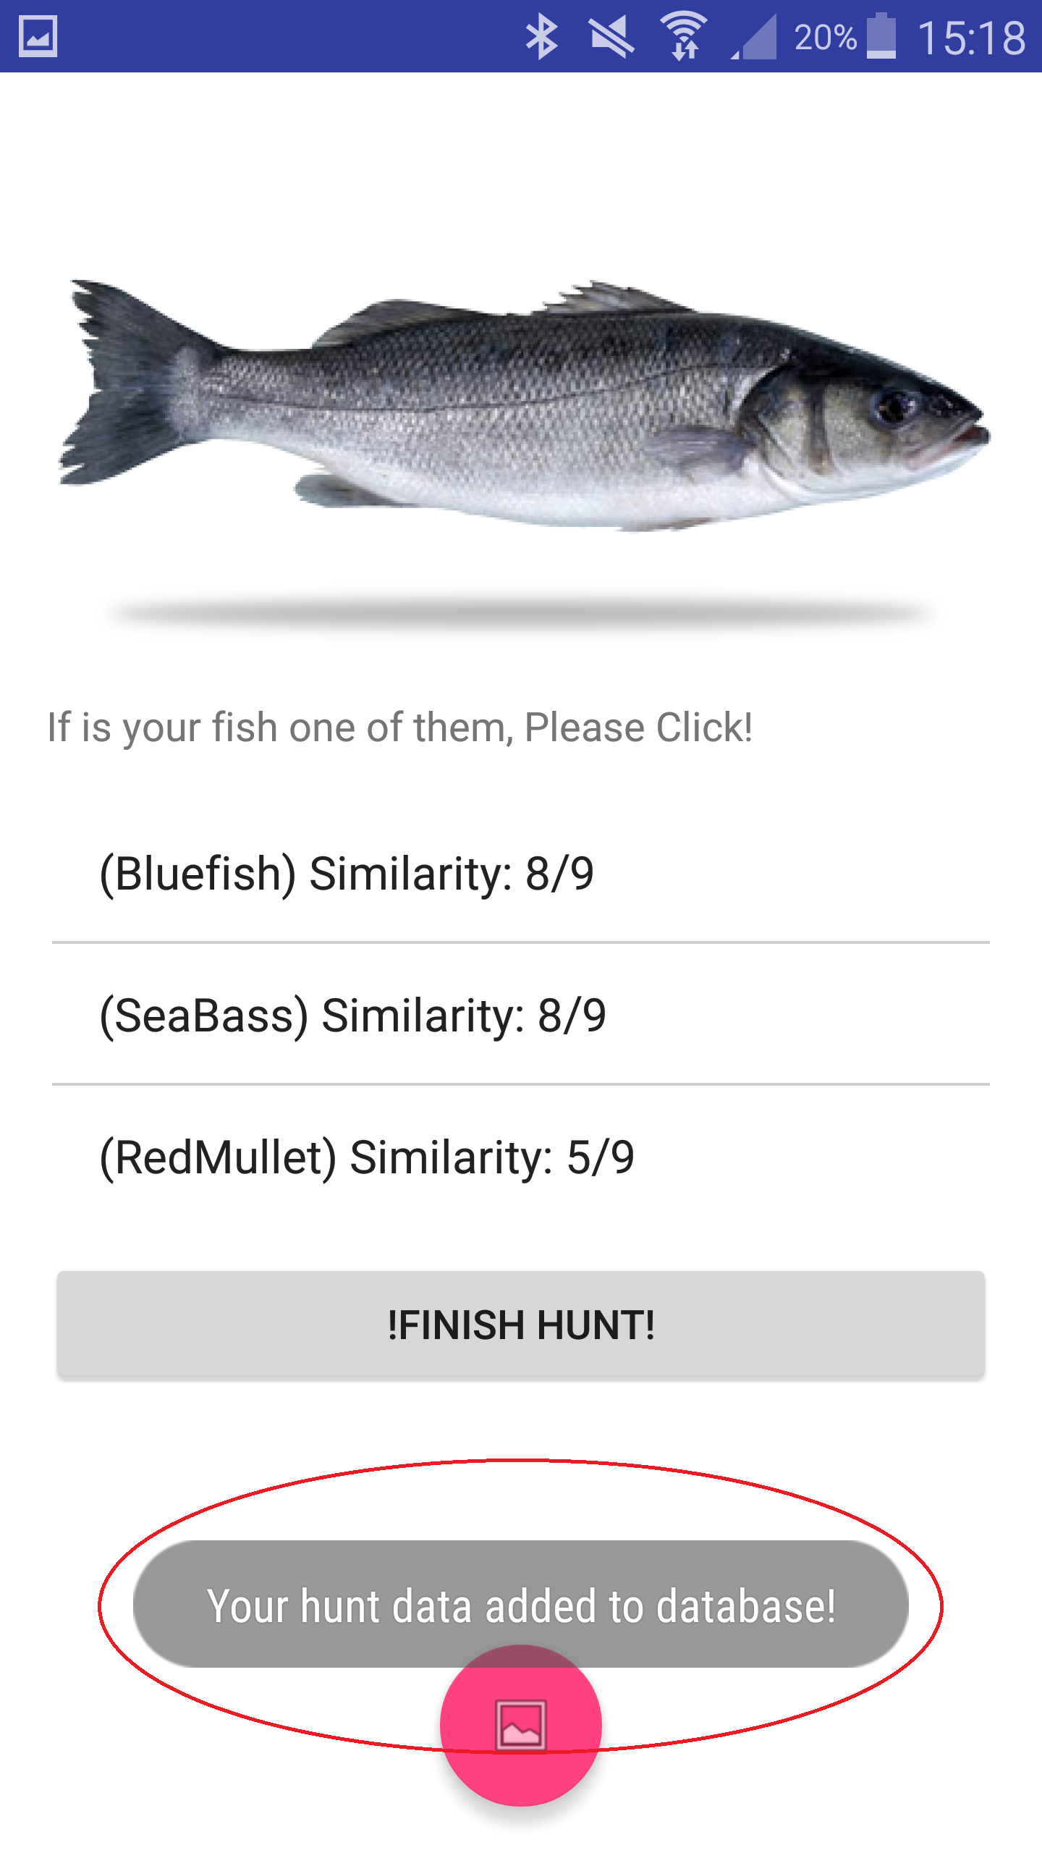

Slide 23
Why?

Slide 24
Help non-expert fishermen.
Let fishermen continue providing seafood for future generation.

Slide 25

Thank you for organization!
http://www.ozanonurtek.com/up/selfiesh.apk

Slide 26
.png owners (Noun Project)
Rflor
Creative Stall
Gregor Cresnar
Jose Hernandez
Guillermo Vera
Razmig Getzoyan
parkjisun

