Slide 18
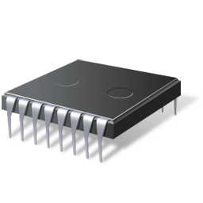
SAM3U Presentation
You can change the speed using potentiometer (VR1)
Click on the screen to stop
Notes:
OnInitCmds: slideshow start
OnRefreshCmds:
OnCloseCmds:

Slide 19


SAM3U
Flash Microcontroller

Slide 20
One-stop shop for ARM micros
32-bit MCU
32-bit Embedded MPU
Functionality
High end MPU
SAM9 MPU
ARM9 MPU
SAM9 MCU
ARM9 Flash &
Large SRAM
MCU
SAM3
Cortex M3
Flash MCU
SAM7
ARM7
Flash MCU
MHz
30
60
240
400

Slide 21
SAM3U Series enable
Large and light-speed data transfers
  World’s First Cortex-M3 Flash MCU with HS USB device
  High bandwidth architecture
    Multi-layer bus matrix, DMA, Distributed memory
Smarter control
  Cortex-M3 @ up to 96MHz for great processing power
    Complex algorithm, audio processing, filtering,…
  HW multiply and divide instructions
Better energy efficiency and low power
  First Cortex-M3 operating down 1.62V for battery operation
  < 2 µA low power mode with RTC

Slide 22
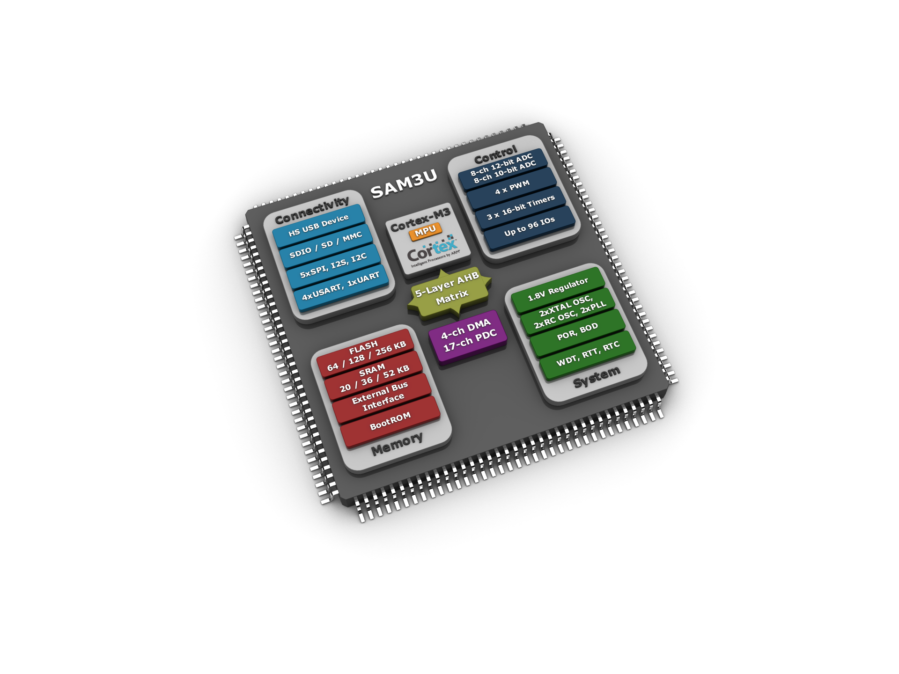
SAM3U Block Diagram
Key Features
Up to 96MHz
1.62 to 3.6V
Supply
USB 2.0 dev
w/ transceiver
Packages
QFP 100
BGA 100
QFP 144
BGA 144

Slide 23
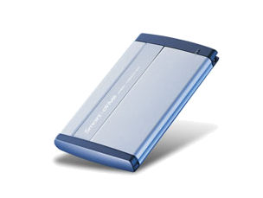

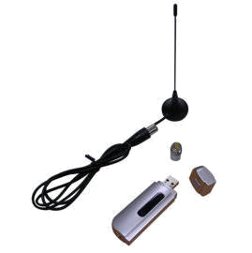
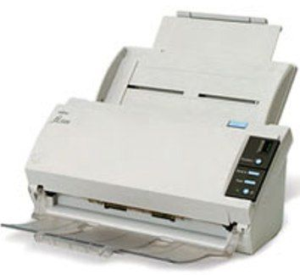
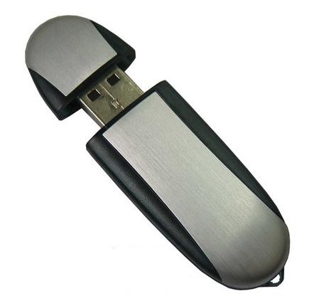
High Speed USB Device
Many applications require more than 12Mbps:
  USB Dongle: HDTV, Wireless, Memory Stick
  Dataloggers: Fast data download
  PC Application: Webcam, Printer, External HDD
  Replacement of inter-PCB links like high-speed SPI and parallel wires by USB
High Speed USB 480 Mbps is the solution

Slide 24
SAM3U – High Performance Architecture
Cortex-M3 running up to 96 MHz
Flash memory
  128-bit wide access
  2-line Prefetch Buffer
Multi-layer Matrix
  Parallel Data Transfers
PDC and DMA
Multiple SRAM banks
Results in
  Higher data throughput
  Double system performance over SAM7 generation
User
Int.
USB Device
High Speed
4-ch
DMA
Cortex-M3
JTAG ICE & SWD
SRAM
16KB
Flash
128-bit
SRAM
32KB
MPU
FIFO
DMA
Multi-layer AHB Matrix
Peripheral DMA
Controller: 17 channels

Slide 25
SAM3U - High Speed Bridging
High Speed peripherals
  USB HS Device
    with transceiver
  SPI
  SD/MMC/SDIO
  Memory-mapped FPGA
  Memory-mapped ASSP
High Speed Peripheral | Maximum bandwidth
USB Device | 425 Mbps
External Bus Interface | >500 Mbps out of 7ns SRAM
MMC interface | 384 Mbps
SDIO/SDCard | 192 Mbps
SPI | 48 Mbps

Slide 26

SAM3U – Power efficiency
Efficiency in active mode
  < 0.5mA/MHz
  Flash with 64-bit or 128-bit read mode
    64-bit mode for reduced power consumption
    128-bit mode for high performance
  Fully configurable clock system
    PLL, prescalers, dividers, clock gating at peripheral level
  Automatic low power mode on Flash during read under 10MHz operating frequency
Low voltage operation
  First Cortex-M3 MCU operating down to 1.62V
  Enable true 1.8V operation

Slide 27


SAM3U – Low Power
I (typ, 3.3V) | Processor clock | Peripherals clock | SRAM | Backup domain | Wake up time | Wake up sources
2.5µA |  |  |  |  | ~300µs | RTC, RTT, BOD, Wake up pins
15µA |  |  | (48kB) |  | <10µs | RTC, RTT, BOD, Wake up pins, USB
Consumption measured with RTC running
Consumption < 2 µA at 1.8V
Backup domain means
  RTC, RTT, POR, BOD, Xtal 32KHz, low freq internal RC
  Can be enabled or disabled except POR that is always ON

Slide 28

SAM3U – Low Power
Ultra Low Power RTC
  0.5 / 0.6µA (typ.)
  Calendar feature
Ultra Low Power RTT
  32-bit timer with minimum resolution of 100 µs
Active mode with 32KHz clock
  Entire device run from slow clock

Slide 29
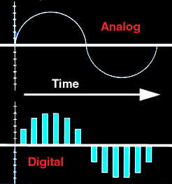
SAM3U - Analog
High-end 12-bit ADC
  1 Msamples/s
  Up to 8 channels
  Differential or single ended inputs
  Programmable gain stage (x1, x2, x4)
  2.4V to 3.6V operating range
Low power 10-bit ADC
  Up to 8 channels
  Same as on the SAM7 MCUs
  3.0V to 3.6V operating range

Slide 30

SAM3U – Safety & Security Features
MPU - Memory Protection Unit
    Improves code protection
    Secures multi-application/ task execution
Flash
  Built-in ECC
  Mirror configuration with dual bank
  Security and Lock bits
Scrambling on External Bus Interface
POR, programmable BOD, Watchdog
Clock Failure detection & backup clock circuitry
Protected Mode for peripherals
  Peripherals configuration can be locked

Slide 31

SAM3U – BOM cost reduction
Embedded POR and BOD
Factory trimmed 12/8/4MHz internal RC
< 1 µA RTC with calendar feature
Smart IOs
  Debouncing feature
    Programmable delay time
  On-Die termination
    Embedded serial resistor to preserve signal integrity

Slide 32
SAM3U Goodies
128-bit Unique ID
  Factory programmed
  Read access by user
  Can be used to generate keys
SAM-BA boot in BootROM with
  UART bootloader
  USB bootloader
  IAP routines

Slide 33




SAM3U Ecosystem
Real-Time Operating Systems & Middleware
  IAR - PowerPAC
  KEIL - RTX
  Segger - EmbOS
  Micrium - uC-OS
  FreeRTOS
Major Tools supported
  IAR EWARM
  Keil MDK
  Code Sourcery GNU Tools
JTAG-ICE/SWD/SWV Debug
  SAM-ICE V6
In-Situ Flash Programming
  SAM-BA
    USB or Serial
Notes:
OnInitCmds:
OnRefreshCmds:
OnCloseCmds: slideshow end -homepage 2

