Slide 1

Notes:
OnInitCmds: slideshow start
OnRefreshCmds:
OnCloseCmds: slideshow end

Slide 2
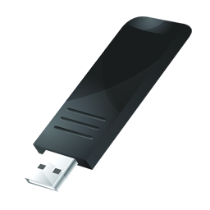


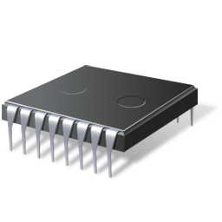



SAM3U-EK Demo Home
Notes:
OnInitCmds: statusbar start
OnRefreshCmds:
OnCloseCmds: statusbar end

Slide 3

Flash Disks
Connect the board to your PC through a USB port
Click the icon
2 disks shall appear on PC
one for SD card, one for Nandflash

Slide 4


Audio
Plug an headphone on J5
Copy audio files into SDcard or Nandflash.

Slide 5








Audio
Notes:
OnInitCmds:
OnRefreshCmds: mp3play reload
OnCloseCmds: mp3play end

Slide 6



SAM3U-EK Low Power Modes
BACKUP MODE
WAIT MODE
SLEEP MODE

Slide 7
SAM3U-EK Low Power Modes
BACKUP MODE
Power consumption: 2.5 µA
Press USR-LEFT button to wake-up. Note: this will reset the demo.
Notes:
OnInitCmds: powersave backup
OnRefreshCmds:
OnCloseCmds:

Slide 8
SAM3U-EK Low Power Modes
WAIT MODE
Power consumption: 15 µA
Press USR-LEFT button to wake-up
Notes:
OnInitCmds: powersave wait
OnRefreshCmds: slidepage goto 2
OnCloseCmds:

Slide 9
SAM3U-EK Low Power Modes
SLEEP MODE
Power consumption: 17 µA
Press USR-LEFT button to wake-up
Notes:
OnInitCmds: powersave sleep
OnRefreshCmds: slidepage goto 2
OnCloseCmds:

Slide 10




SAM3U-EK Settings

Slide 11

Setup Date
Day
Month
Year
Notes:
OnInitCmds: calendar -checkout date
OnRefreshCmds:
OnCloseCmds: calendar -set date

Slide 12
Setup Time
Hour
Min
Sec
Notes:
OnInitCmds: calendar -checkout time
OnRefreshCmds:
OnCloseCmds: calendar -set time

Slide 13


LCD Backlight

Slide 14
Temperature Monitor
Fahrenheit
Notes:
OnInitCmds: temperature start C
OnRefreshCmds:
OnCloseCmds: temperature end

Slide 15
Temperature Monitor
Celsius
Notes:
OnInitCmds: temperature start F
OnRefreshCmds:
OnCloseCmds: temperature end

Slide 16
Play Movie
Copy movie.bin into SDcard or Nandflash
Click the icon to play the sample movie
Press the LCD to stop play

Slide 17
SAM3U-EK Information
AT91SAM3U-EK demo version 1.1

