Slide 1
Safety by Design
Designing a distributed system
to mitigate and eliminate risk

Slide 2
Overview
Many sources of risk in a project like this one.
Inherited problems - Not our concern.
Hardware problems - easy to test for.
Software problems – Some easy some hard.
Notes:
Easy to test for the bugs that present themselves often. Errors that take some time or certain conditions to manifest themselves are not likely to be discovered during testing.
The first set of problems we can discover and correct in the testing phase. For issues we cannot solve we can set guidelines to mitigate problems: Speed limiting, kill button, checking connections etc.

Slide 3
Modelling
What is a model.
What does a model not do: implementation and calculation
What's the point?
SPIN/Promela:
SPIN, the Simple Promela INterpretor, is a tool used to simulate and verify the correctness of models described in the Promela language.
Notes:
The motivation to model a software system is the same as modeling a physical system. Two things: developing software takes resources and so a simple model can lead the design down an already proven path; faulty software has the same capacity to cause harm as a poorly designed bridge.

Slide 4
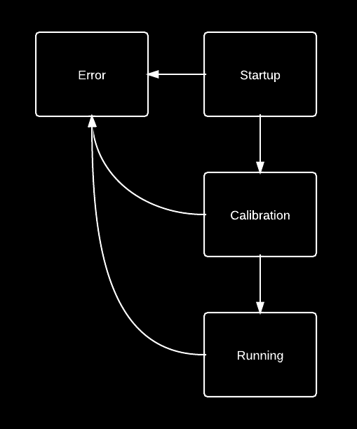
Modelling Mariokart
The implementation has a master board plus four slave boards.
All boards connected to the CAN bus.
All boards follow the same state machine.
It is important that all boards are in a consistent state.
Notes:
Briefly describe CAN bus, its uses and strengths.
Hence global state is the set of all boards’ current state.
The reasons and outputs of the states shown isn’t really relevant
Consistent state – inconsistent states must last for a negligible time

Slide 5
Modelling Mariokart
The master board drives all state transitions.
Except: all boards can drive an error state transition.
All boards may non-deterministically reset or discover an error at any point.
Correctness claims. System either executes running cycle infinitely or all boards transistion to error state.
Notes:
All boards may non-deterministically reset or discover an error (for example an actuator is jammed) at any point. SPIN will evaluate all possible executions.

Slide 6
Conclusions
Model verification finds particular class of error while modelling acts as a design tool.
Worthwhile for systems where the consequences of design errors are high.
Result: an already proven design was implemented with confidence.
Notes:
Modeling finds issues caused by bad software design.
Worthwhile due to high risk (e.g. Shuttle controls) or high usage.
Analogise modelling to sketching (but for software)

Slide 7
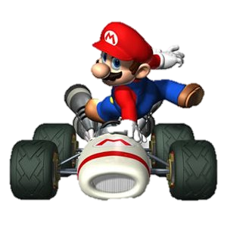
Notes:
Obligatory plumber picture

Slide 8
/**
* A simplified version of the
* client board model.
*/
proctype Client(chan input) {
Startup:
input?message
comms!message
Calibration:
// calibration stuff
Running:
do
:: // Normal loop
:: // Restart board
:: goto Error
od;
Error:
broadcast!error;
}
/**
* If one board goes into error state,
* they all must (eventually).
*/
never {
do
:: error_count > 0 -> break
:: true -> skip
od;
accept:
do
:: error_count != 3
od;
}

