Slide 1
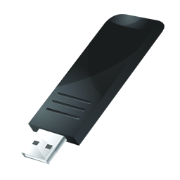
SAM3U-EK Demo
This page is for you to download demo ppt Sam3DEMO.bin into the nandflash disk.
Use SAMBA to format the Nandflash first.
Click the icon to your right, 2 disks should appear on your PC.
Copy the Sam3DEMO.bin, SamDEMOV.bin, movie.bin and mp3 files to the nandflash disk.
Reset the board to load ppt.

