Slide 1


By Cem Alemdar and Jonathan Shiery
Notes:
0:30, Both

Slide 2
bUT
TOGETHER
SEPARATE
Logline
Notes:
1:00, Cem

Slide 3
Toy’s essential features
Using WASD or arrow keys to move two characters.
Goal of every level is to overlap the two characters.
Level resets if one character falls or when the player presses the reset button
Notes:
1:45, Jonathan

Slide 4
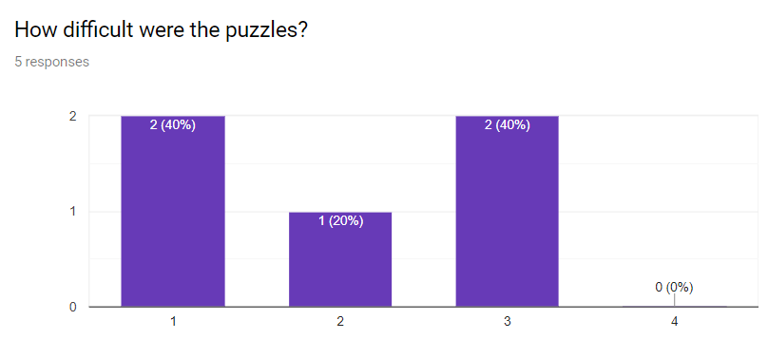
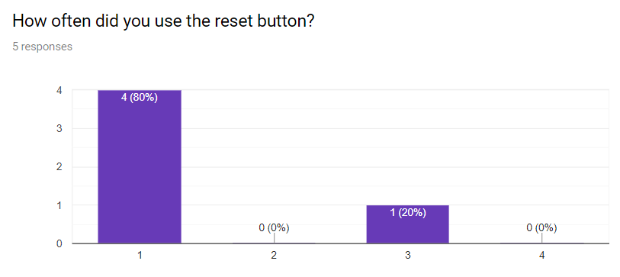
Playtesting, survey, and critiques
The reset button and level 2 had major revisions.
https://docs.google.com/forms/d/1ISBfRU1fQv_m01Wc6R52T6g7BeUVKiwwdhYhGzJzi4Q/prefill
Notes:
4:15, Jonathan
Block dust: #cae5c6

Slide 5
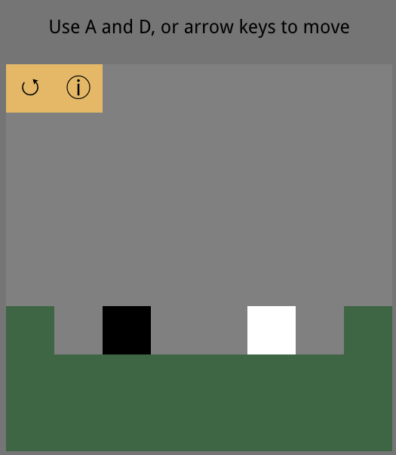
Screenshots
First level to introduce movement
Notes:
2:45, Jonathan
Colors
Ground: #496345
Background: #a0a0a0
Bubble decor: #b6dbff

Slide 6
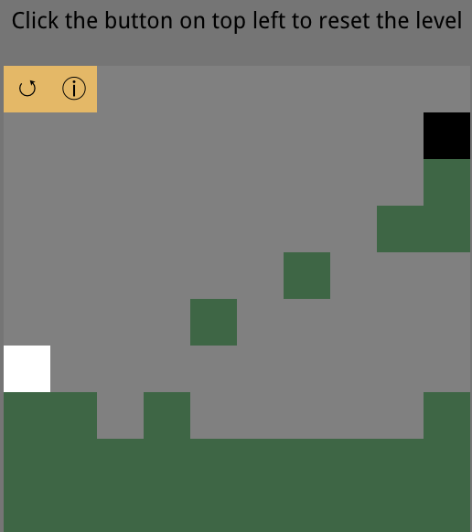
Screenshots
Next level introduces gravity and the ability to reset.
Notes:
3:45, Cem
Orange: deb76e
Green: 77964b
Gray: c7c7c7

Slide 7
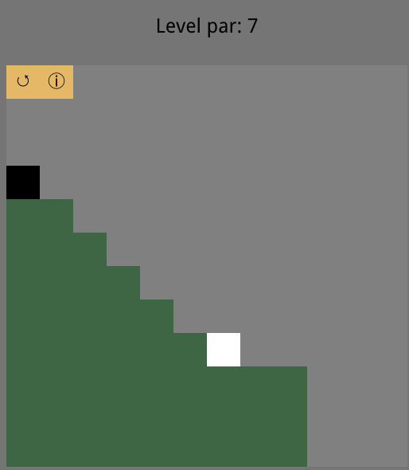
Screenshots
Later levels utilize several mechanics to provide a challenge.
Notes:
4:15, Jonathan
Block dust: #cae5c6

Slide 8
Demo Time

