Slide 1
Whither Mod
Cem Alemdar

Slide 2
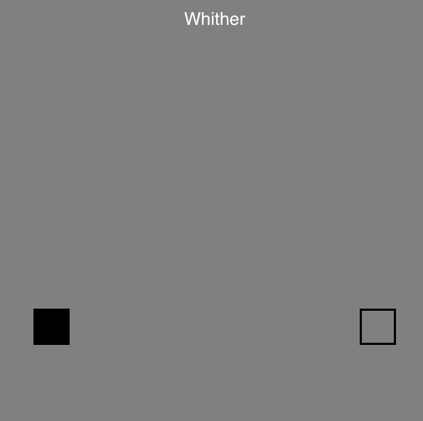
Final Level Analysis
Infinite loop
Left a feeling of unaccomplishment
Tried to find a way to finish it
Frustrating

Slide 3
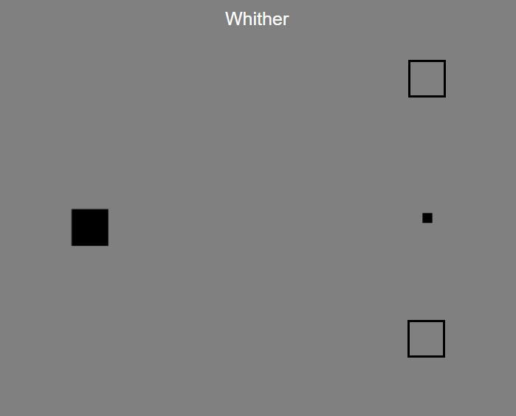
New Design
Reinforces the idea of nowhere else to go
More options to give an idea of a solution
Introduces an unconventional element
Still frustrating

Slide 4
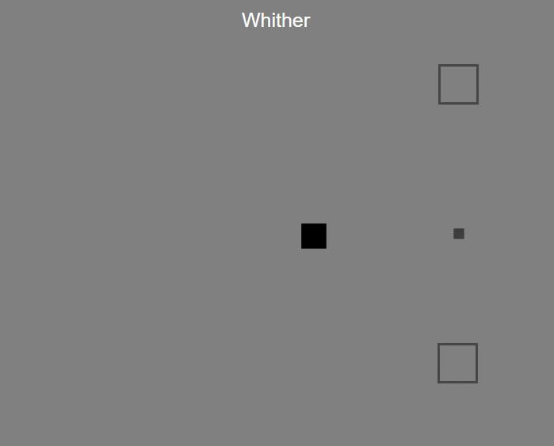
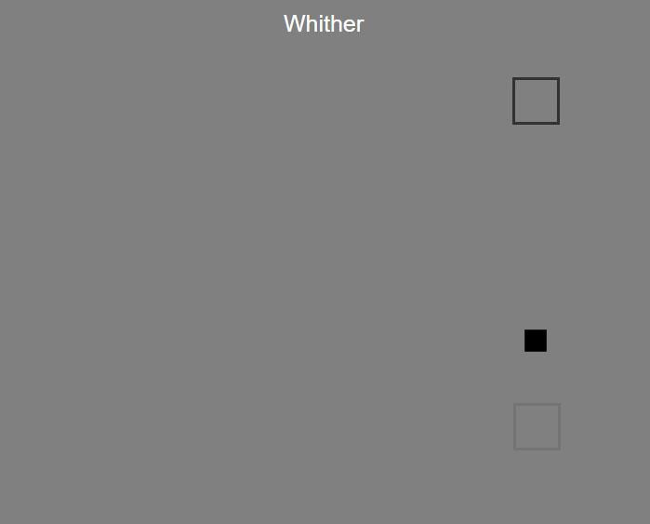
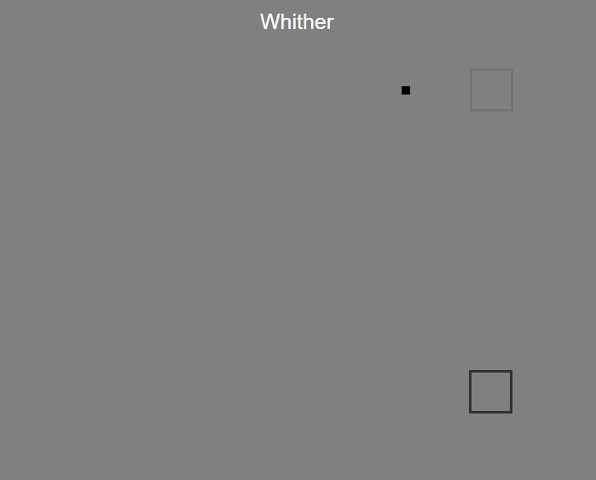
Mockups

