Slide 1

Cat & Mouse
By Cem Alemdar and Jonathan Shiery
Notes:
0:30, Both

Slide 2
Predator - Prey Simulation
Logline
Notes:
1:00, Cem

Slide 3
Toy’s essential features
Primitive AI
Drop cats in the toy with the mouse
Ability to change grid size with keyboard
Entertaining to watch
No end condition
Notes:
1:45, Jonathan

Slide 4
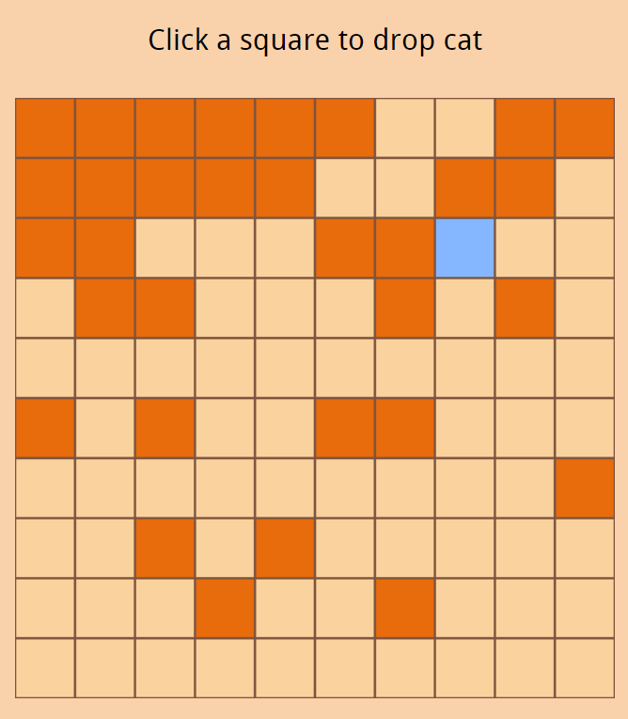
Screenshots
Orange = Mouse
Blue = Cat
Watch as the mice continue to multiply.
Notes:
2:45, Jonathan

Slide 5
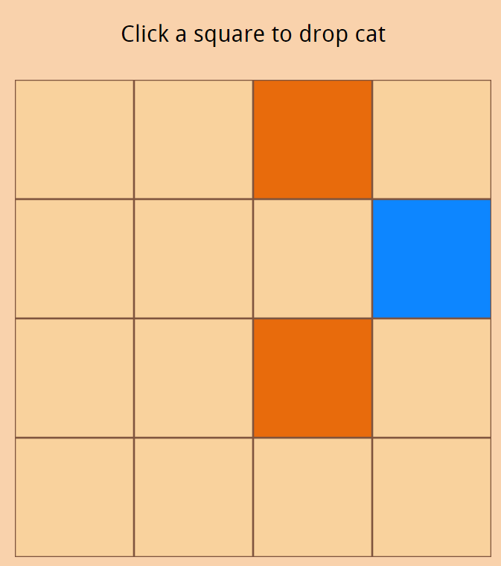
Screenshots
Orange = Mouse
Blue = Cat
The grid is able to change sizes with the keyboard.
Notes:
4:15, Jonathan

Slide 6
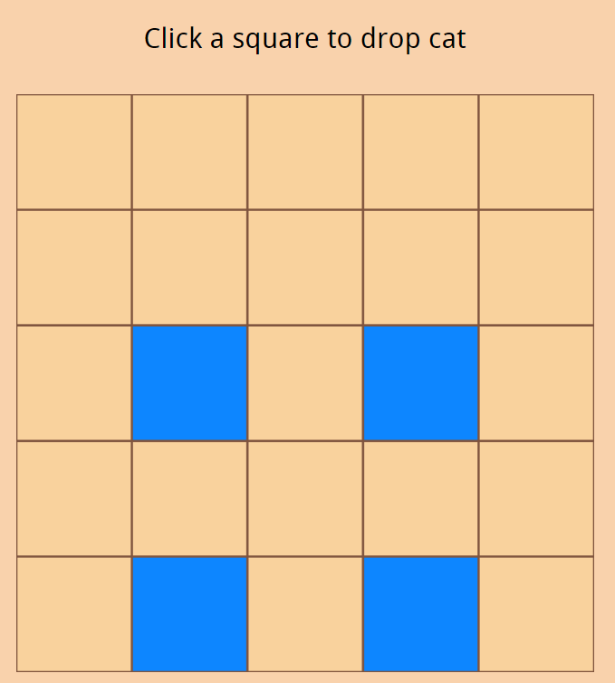
Screenshots
Orange = Mouse
Blue = Cat
If the cats do not eat any mice, they will slowly die out.
Notes:
4:15, Jonathan

Slide 7
The End

