Slide 1


By Cem Alemdar and Jonathan Shiery
Notes:
0:30, Both

Slide 2
bUT
TOGETHER
SEPARATE
Logline
Notes:
1:00, Cem

Slide 3
Toy’s essential features
Using WASD to move two characters.
Many different puzzle mechanics
Reset button
Notes:
1:45, Jonathan

Slide 4

Screen Mockups
You take control of two characters at once.
Notes:
2:45, Jonathan
Colors
Ground: #496345
Background: #a0a0a0
Bubble decor: #b6dbff

Slide 5
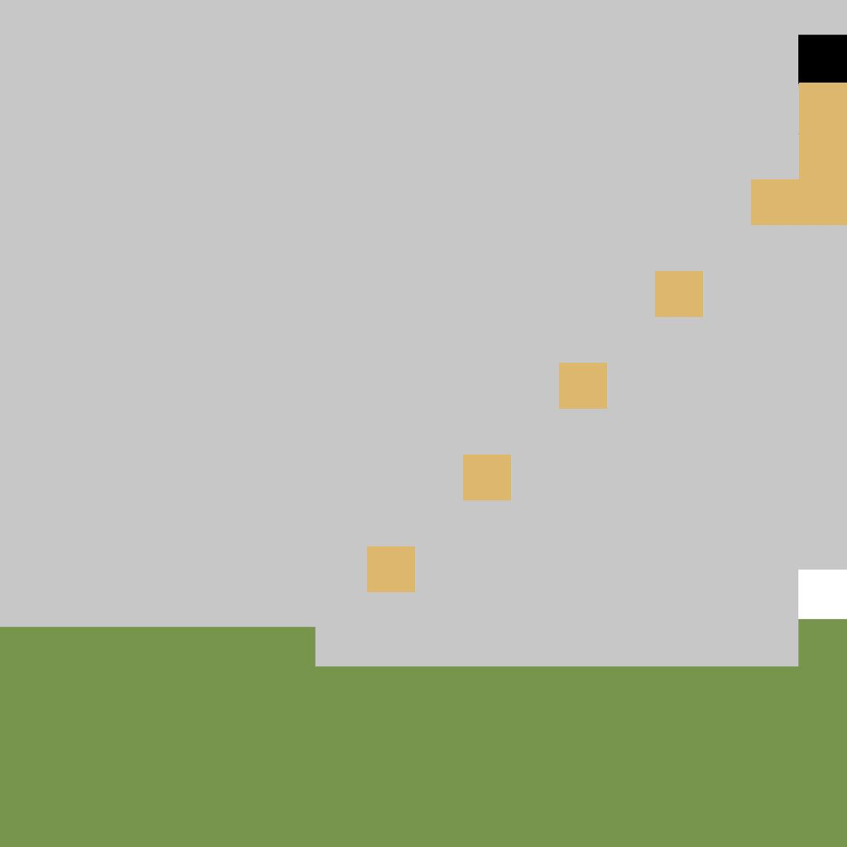
Screen Mockups
Each character is unable to jump and will fall with gravity.
Notes:
3:45, Cem
Orange: deb76e
Green: 77964b
Gray: c7c7c7

Slide 6
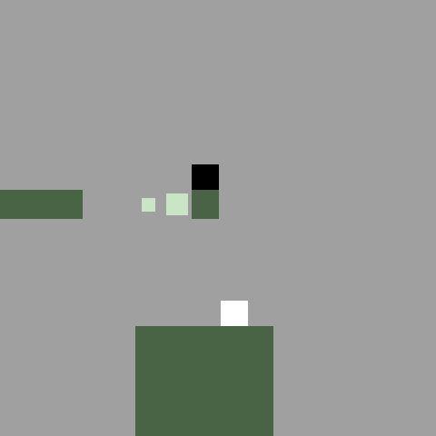
Screen Mockups
Moving blocks can transport characters to other locations.
Notes:
4:15, Jonathan
Block dust: #cae5c6

Slide 7
Prototype Time

