Slide 1


By Cem Alemdar and Jonathan Shiery

Slide 2
“Building onto one another”

Slide 3
Features
Game Mechanics
Build using previously placed beads
The beads stick to each other
Goal is to get from the start to the end
Different floor types that affect building
Game Progression
Hub world
Unlock new doors by completing a certain number of levels

Slide 4

How is this wisdom?
Most of our wisdom consists of knowledge provided by previous knowledge. In this game, you progress by building on previous versions of yourself.

Slide 5
Restrictions
The grid cannot exceed 16 beads in either dimension at any time.
No glyphs are allowed in any beads.
Using only WASD and the space bar.
Only using the status line for the title and not using words of any kind.

Slide 6
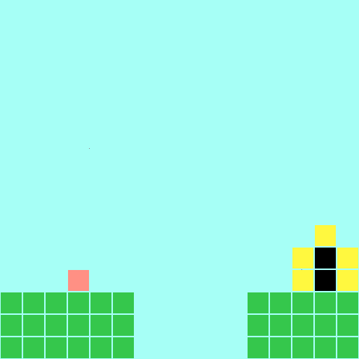
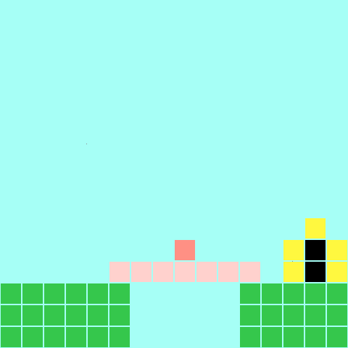
Screen Mockups
Before
After
After
Notes:
Sky - a6fff6
Frozen Player - ffd1cd
Player - ff9084
Ground - 35c74c
Border - fff83f
Door - 000000

Slide 7
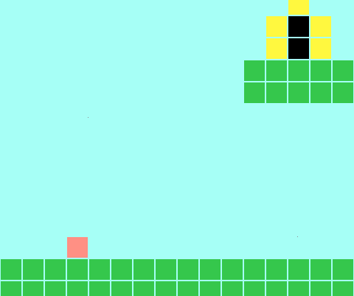
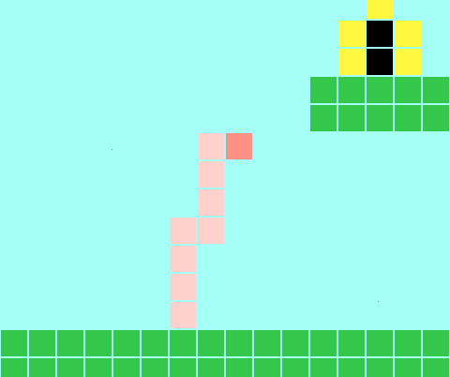
Screen Mockups
Before
After

Slide 8
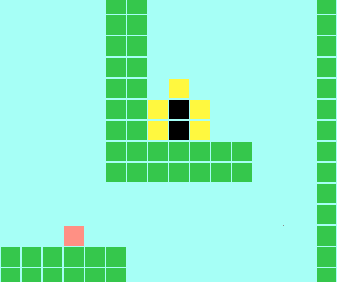
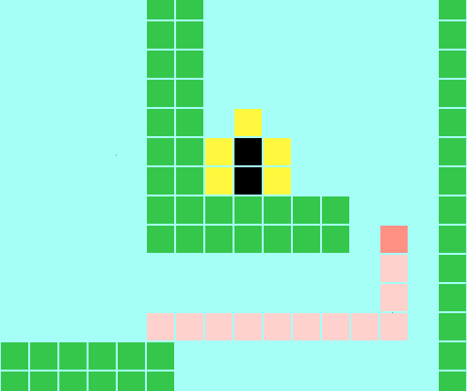
Screen Mockups
Before
After

Slide 9
The End

