Slide 1
2
Last Visit Border
Setting Button
Help Button
Entry
Progress Bar
Section Menu

Slide 2




2
Last Visit Border
Setting Button
Help Button
Entry
Progress Bar
Section Menu

Slide 3
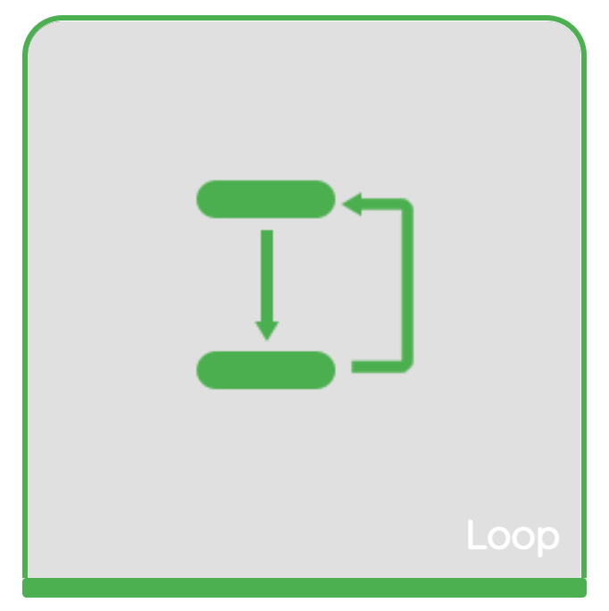


2
Last Visit Border
Setting Button
Help Button
Entry
Progress Bar
Section Menu

Slide 4

2
Last Visit Border
Setting Button
Help Button
Entry
Progress Bar
Section Menu

Slide 5
2
Last Visit
Entry
Setting Button
Help Button
Progress Bar
Choice Menu

