Slide 1
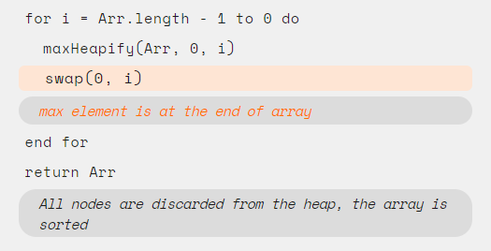
Pseudo Code
Compiling
Code
Compiling
Assertion
Assertion

Slide 2
What is an assertion?
“An assertion is simply a statement about what holds at a particular state in a computation. ”
In this module, we will show you sorting algorithms with assertions to help you understand the correctness of these algorithms.

