Slide 1
What is correctness?
“An algorithm for a computational problem is correct,
if for every legal input instance, the required output is produced.”
In this tutorial, we will show you an example to help you understand
the correctness of algorithms

Slide 2
First
Let’s see the definition of “algorithm”
A sequence of steps which provides a solution to a given problem
A step-by- step method for solving a problem
A solution to a computational problem that specifies a desired
input-output relationship

Slide 3
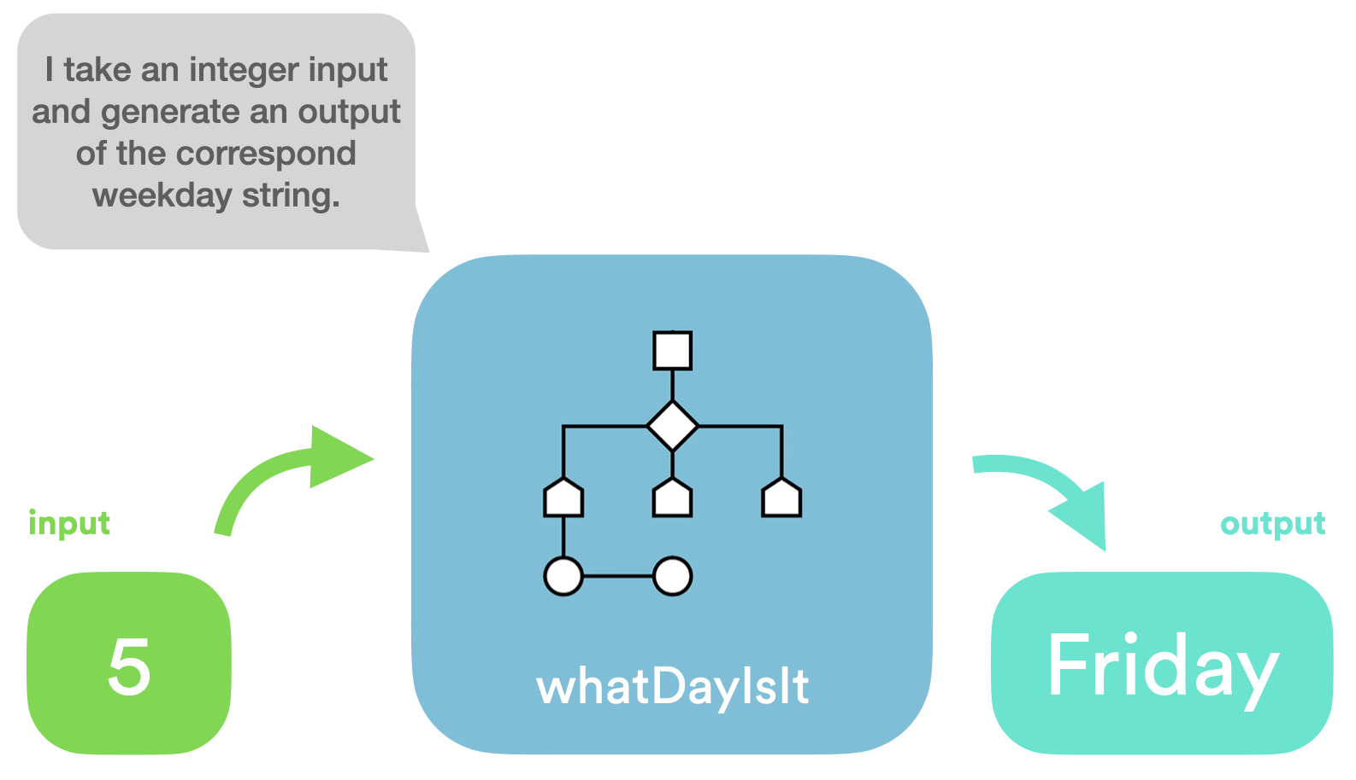

Slide 4
Second
Let’s see legal input and illegal input
“In a computer program
A legal input is something that can be put into a program
and it will work.
An illegal input is not what a specific algorithm expects to take.”

Slide 5
