Slide 1
What is attractive?
Smoother animation

Slide 2
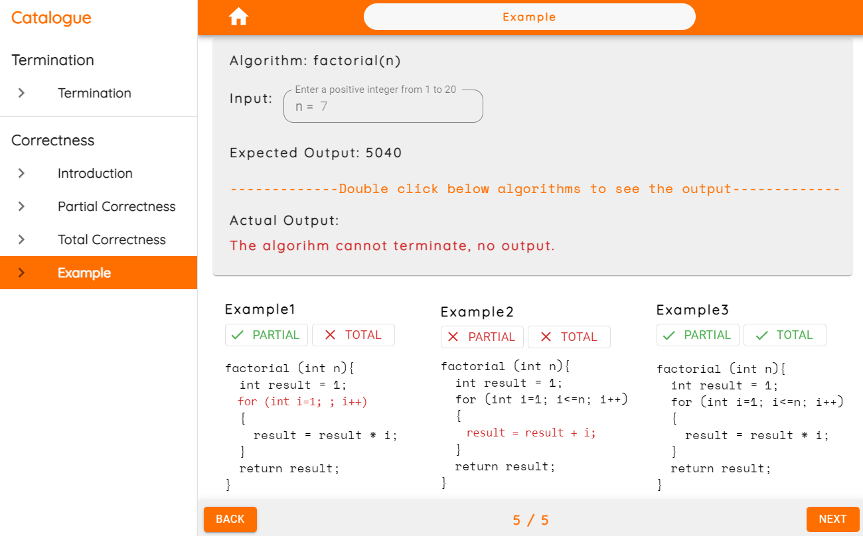
What is attractive?
Introduce correctness to software

Slide 3
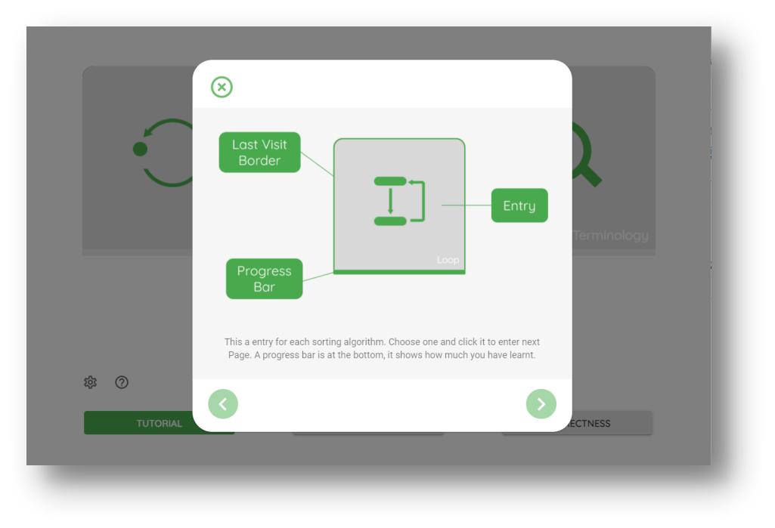
What is attractive?
User Interaction

Slide 4
Research and Acceptance testing
Why have we come up this idea?
Result of acceptance testing
(放我们acceptance testing 表格的图）
Different types of algorithm animation could enhance users’ understanding of the visualized processes (Naps and Grissom, 2002)

Slide 5

However, what pity is…

