Slide 1
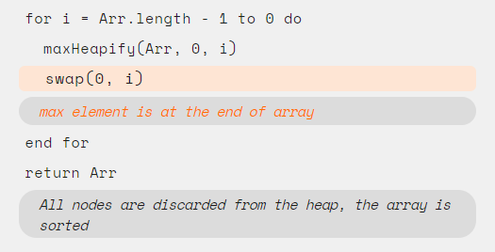
Pseudo Code
Compiling
Code
Compiling
Assertion
Assertion

Slide 2
What is an assertion?
“An assertion is simply a statement about what holds at a particular state in a computation. ”
In this module, we will show you sorting algorithms with assertions to help you understand the correctness of these algorithms.

Slide 3
Proof with assertions
“An assertion is simply a statement about what holds at a particular state in a computation. ”
In this module, we will show you sorting algorithms with assertions in plain language to help you understand how to prove the correctness of these sorting algorithms.

Slide 4

Terminology
In this module, we introduce you basic knowledge about pseudo-code.
We may use some symbols and syntax in pseudo-code in iCanSort. You will get to know some simple expressions, syntax and structures by viewing this module.

Slide 5
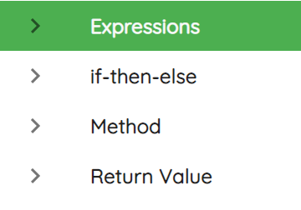
Four Sections

