Slide 1

Website design –
the intersection of plain language and usability
Presented by
www.plainlanguage.gov

Slide 2
What is Plain Language?
Communication that your audience or readers can understand the first time they hear or read it.
Plain language means writing so your customers can:
  Find what they need
  Understand what they find
  Use what they find to fill their needs
Plain language techniques are especially important on the web!

Slide 3
Presentation Outline
Background
  How people use the web
  Why people use the web
    Who are your customers or audience
Writing for the web
  The difference between print and web writing
  Plain language techniques

Slide 4
How do people use the web

Slide 5
We know people don’t read on the web
They scan.
Nielsen and Morkes, in a famous 1997 study, found that 79 percent of their test users always scanned any new page they came across; only 16 percent read word-by-word.
A recent study of people reading long-form text on tablets finds higher reading speeds than in the past, but they're still slower than reading print.
http://www.useit.com/alertbox/ipad-kindle-reading.html

Slide 6
People rarely read dense text
Eye tracking research shows how people deal with a page with dense text.
The map on the next slide is from Jakob Nielsen’s website, useit.com
It shows the typical “F” pattern of reading. Red shows the most read parts of the page.
On average, users read the first 2 words on each line.

Slide 7
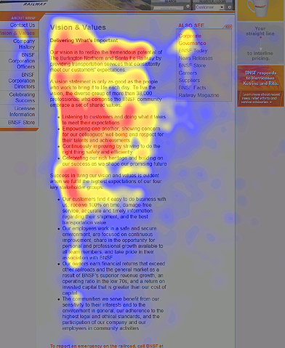

Slide 8
Some horrifying facts*
Based on analysis of 45,237 page views, Nielsen found that people read an average of 18% of what’s on a page.
However, as the number of words on a page goes up, the percentage read goes down.
To get people to read half your words, you have to limit your page to 110 words or fewer.
*http://www.useit.com/alertbox/percent-text-read.html

Slide 9
What does that look like?
http://google.com – shopping 104 words
Plain language—government mandates 103 words in the main text area

Slide 10
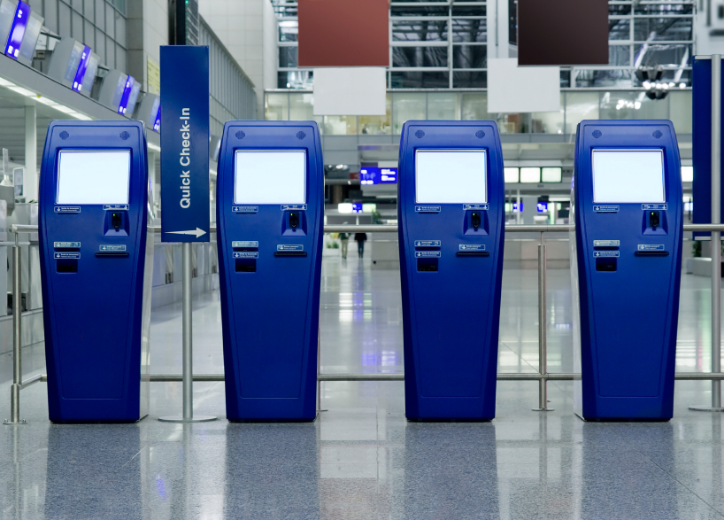
So if they don’t read, what do they do?
Customers come to your site to perform a task.
They come because they expect to get self-service.
Think about how well your website allows customers to get something done.

Slide 11

Identify customers’ top tasks
People come to your website with a specific task in mind. If your website doesn’t help them complete that task, they’ll leave.
Identify the mission—the purpose—of your website, to help you clarify the #1 top task your website should help people accomplish.

Slide 12
Are you being clear?
Your content is NOT clear unless your audience can:
Find what they need
Understand what they find
Use what they find to meet their needs

Slide 13
Use Plain Language Techniques
Identify your audience
Write to meet the needs of your audience
Choose simple, everyday words
Keep your sentences and paragraphs short
Use active voice, headings and pronouns
Use bulleted lists and tables

Slide 14
Identifying your audience
DON’T
Write for your supervisor or co-workers
DO
Write for your audience
Make a list of who reads your content
Decide why they read it and what information they need
Address your audiences’ top tasks

Slide 15
How to find out about users
You can read about techniques for accomplishing this on www.usability.gov

Slide 16
Writing for the web

Slide 17

Print Writing
Tells a story
Is linear — has a beginning, middle, and end
Is often consumed in a relaxed setting
Written in complete sentences

Slide 18

Web Writing
Easy to scan
Quick, accessible source of info
Minimal text
User-friendly — Users may be stressed, impatient, skeptical, or disoriented
Interactive

Slide 19
Writing content
Before you write content, identify the type of page you’re working on.
There are three main types of pages:
  Homepages (portals)
  Connector or pathway pages
  Content pages
The first two types should contain a minimum of text.

Slide 20
Let’s look at some homepages
Every office should think of its first page as a homepage.
Plain language
Usability
Godiva
Exchanges

Slide 21
Now let’s look at some pathways
Depending on the complexity and size of your site, you might not have pathways. Rather, you might go right from the homepage to content.
USA.gov
Usability
Lands End
Public works

Slide 22
Writing content pages
When you start thinking about content pages, keep these points in mind:
Think topics, not stories.
Think about having a conversation with your customer. Eliminate anything that’s not part of the conversation.
A very few content pages might contain more extensive information.

Slide 23
Remember!
On average, visitors read about 18% of what’s on the page, and the more words you have, the lower the percent they read.

Slide 24
The most important principle:
Think about your audience!

Slide 25
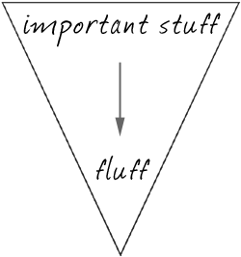
Time Matters
Use the inverted pyramid. Begin with the shortest and clearest statement you can make about your topic.
Conclusions/Key Info
Background

Slide 26
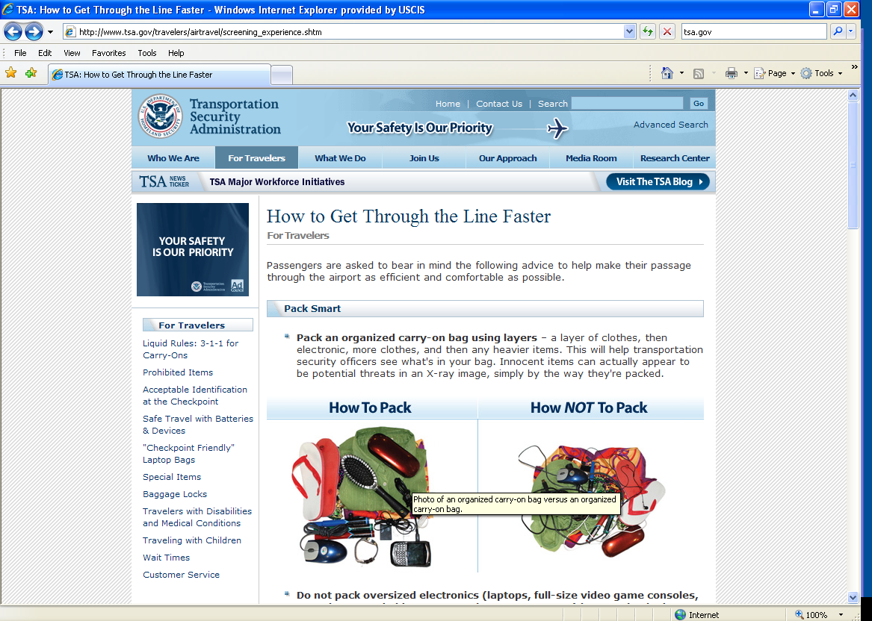

Slide 27

Seconds Count
First 11 characters of a page title most important
People decide in 5 seconds if your site is useful
  http://www.uie.com/articles/five_second_test/
Divide information into small clear pieces (“Chunk Content”)
  Use headings to cluster or chunk similar content (great with similar or related topics)

Slide 28
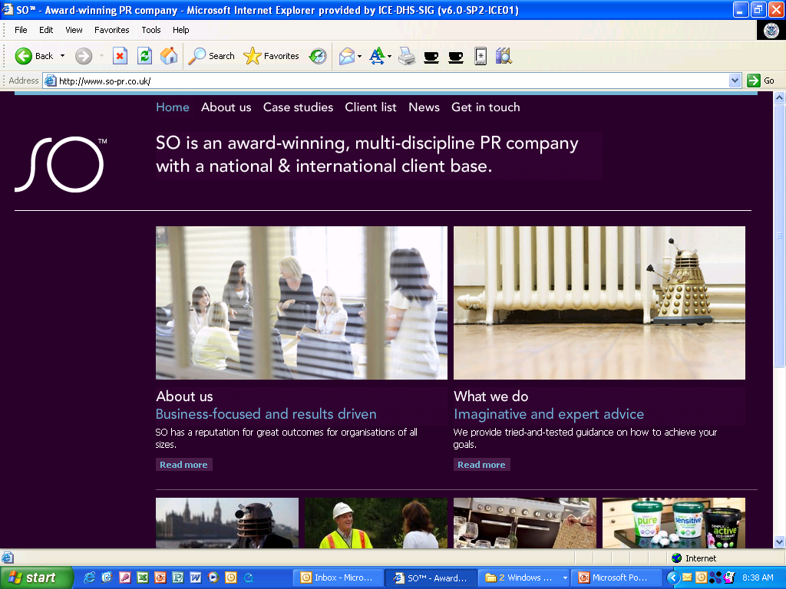

Slide 29
Seconds Count (cont)
Use numerals for numbers
Keep the user’s trust: no spelling or grammatical errors, no broken links or images
Use timeless text (no “Today blah, blah”)
Only use bold when needed
Avoid all-CAPS
No blue or underlined text (reserved for links)

Slide 30

Getting rid of excess content
There are two major sources of excess content:
Excess words in written material.
Content that shouldn’t be there at all.

Slide 31
Eliminate excess words
Learning to recognize and get rid of excess words will always be a challenge.
Bureaucratic writing tends to include many unnecessary words, probably because people think adding words makes material look authoritative.
The web especially is full of many many many unnecessary words.

Slide 32
Unnecessary words—the usual suspects
Some common sources of wordiness—
Passive voice
Redundancies
Prepositional phrases
Hidden verbs
Unnecessary modifiers
Failure to use pronouns

Slide 33
We’ll cover passive voice and pronouns shortly.

Slide 34
Excess words - redundancies
Redundancies are words or phrases you don’t need because you already said the same thing.

Slide 35
Redundancies
Later
During that time, or then
Worked together
Coverage
Will plan
At least 12
At a later time
During that time period
Worked jointly together
Level of coverage
Will plan in the future
At least 12 years of age or older

Slide 36
Unnecessary words - prepositional phrases
Did you notice that a lot of the previous examples included prepositional phrases?
Suspect prepositional phrases as a source of excess words
Try to reduce these phrases to one or two words

Slide 37
Instead of Use
For the purpose of
At this point in time
In relation to
On the grounds that
On a monthly basis
For, to
Now
About, in, with
Because
Monthly

Slide 38
Excess words - hidden verbs
Hidden verbs are verbs disguised as nouns. They are generally longer than their true verb forms.
Hidden verbs are very common in bureaucratic writing.

Slide 39
Avoid Verbs Disguised as Nouns
Conduct an analysis
Present a report
Do an assessment
Provide assistance
Came to the conclusion of
Analyze
Report
Assess
Help/Assist
Concluded

Slide 40
Excess words – unnecessary modifiers
English speakers use many excess modifiers in our writing and in our speech.
They pad our writing, and often don’t make sense.

Slide 41
Common excess modifiers
Absolutely, completely, totally, really, very
Eliminate them. If the resulting wording doesn’t convey your meaning, pick a stronger word.

Slide 42
It is absolutely essential that you contact me at once.
It is imperative that you contact me at once.
You must contact me at once.
Or Contact me immediately.
I had a really good time at your party.
I had a wonderful time at your party.

Slide 43
When you think about them, these excessive modifiers often don’t even make sense.
Totally unaffected
Completely finished
Really pregnant
An absolute success!

Slide 44
Unnecessary words - doublets
In English, we love to repeat words, especially in legal forms.

Slide 45
Common doublets
Cease and desist
Due and payable
Begin and commence
Knowledge and information

Slide 46
General wordy phrase help
For a list of wordy phrases and suggested alternatives, see www.plainlanguage.gov

Slide 47
Excess words – Meaningless formal language
Meaningless formal language wastes space and your reader’s time.
It conveys the impression that you are insincere.
Bureaucratic letters often contain this language, especially in the first and last sentences.

Slide 48
Omit information the audience doesn’t need
Remember, your web content is a conversation with your customer. If material doesn’t belong in the conversation, it doesn’t belong on the web.
Hopefully, you can research what customers really want.
You aren’t Santa Claus. You can’t serve all customers. If you serve your top 3 or 4 customer groups, you’re doing good.

Slide 49
Here are some topics customers don’t care about
When your office was formed
Who is the head
What the head said the day he was sworn in
What the head looks like
What your annual report from 3 years ago looked like
How the Bureau is organized
What you did for customers 5 years ago
The text of a law that authorizes your office

Slide 50
Let’s look at some specific plain language techniques.

Slide 51
Use:
Logical organization
Informative headings
  Pronouns
  Active voice
  Lists and tables
  Common words, no jargon

Slide 52
Avoid:
  “Hidden verbs”
  Abbreviations
  Long sentences
  Unnecessary words
  Information the reader doesn’t want

Slide 53
Critical techniques for web writing
We don’t have time to talk about all the plain language techniques on those lists (and they aren’t even all the techniques), so we’ll focus on a few that are especially important to writing for the web.

Slide 54
Write in short sentences
Use pronouns
Use strong, active verbs
Use your customer’s vocabulary
Develop good lists
Use lots of useful headings

Slide 55
General rules for sentence length
Your document should have an average sentence length of 20 words, or fewer, in documents, and 15 on the web.
On the web, no single sentence should be longer than 25 words.
Use short paragraphs with ONE topic sentence that develops ONE idea.

Slide 56
How can we shorten this?
There is no escaping the fact that it is considered very important to note that a number of various available applicable studies ipso facto have generally identified the fact that additional appropriate nocturnal employment could usually keep juvenile adolescents off thoroughfares during the night hours, including but not limited to the time prior to midnight on weeknights and/or 2 a.m. on weekends.
62 words

Slide 57
Short and Sweet
More night jobs would keep youths off the streets.
9 words
“The most valuable of all talents is never using two words when one will do.”
~Thomas Jefferson

Slide 58
How would you rewrite these? (Each bullet is only one sentence)
Hosted by academic institutions throughout the United States, the Student Leader Institutes include an intensive academic component, an educational study tour to other regions of the country, local community service activities, and a unique opportunity to get to know American peers.
The Global Undergraduate Exchange Program (also known as the Global UGRAD Program) provides one semester and academic year scholarships to outstanding undergraduate students from underrepresented sectors in East Asia, Eurasia and Central Asia, the Near East and South Asia and the Western Hemisphere for non-degree full-time study combined with community service, internships and cultural enrichment.

Slide 59
Use pronouns to speak to the audience
Research shows that people relate better to information that talks directly to them by using pronouns.
Using general nouns such as “beneficiary” or “purchaser” requires the audience to “translate” before they can be sure you are talking to them.

Slide 60
Using pronouns
Refer to your agency as “we.”
Refer to the reader as “you” in the text and as “I” in questions.
Make sure you define “we” and “you.”

Slide 61
Do not use these “pronouns”!
He/she
His/her
S/he

Slide 62
Use strong, active verbs
The best sentences follow the model you first learned in school.
Subject, verb, predicate – Who, does what, to what or whom.
We published the new report.
NOT
The new report was published.

Slide 63
Passive verbs, hidden verbs, and complex verb forms make your writing weak and confusing.
In passive verbs, the subject of the sentence is not the actor. The actor comes later, often in a prepositional phrase, or there may be no actor identified at all.

Slide 64
Some passive verbs
The training was originally developed for employees of L.A. County by the Office of Human Resources. (Office of Human Resources is the actor, prepositional phrase)
This website has been created to acquaint you with the County's purchasing and contracting programs. (no actor identified)

Slide 65
Passive to Active
The sealed envelope must then be sent via express mail to the address below.
Excess and/or unauthorized expenses, delays, or luxury accommodations and services will not be reimbursed by the company, but will be borne by the employee.
Your application has been denied by the Department of State.
The submission you filed will be reviewed by the judges.

Slide 66
Possible Answers
Send your sealed envelope via express mail to the address below.
The company will not reimburse employees for
  unauthorized expenses,
  delays, or
  luxury accommodations and services.
The Department of State has denied your application
The judges will review your submission.

Slide 67
Hidden verbs
We’ve already discussed hidden verbs. Remember to avoid them. They aren’t strong and they increase sentence length unnecessarily.

Slide 68
Avoid complex verb forms
Prefer the simple present.
Use the simple past and simple future where necessary.
Try to avoid all other forms.

Slide 69
Write in your customer’s words
Avoid bureaucratic and legal language
Avoid jargon
Avoid foreign and Latin terms
Avoid abbreviations
All of these confuse and annoy your customer.

Slide 70
Bureaucratic speak and Legalistic Terms—What do they mean?
integrating quality solutions
promoting an informed and inclusive multicultural society
strategically engaging schools, community organizations, and so on . . .
instill in each employee the necessity to effectively appreciate . . .
Herein
Hereafter
Hereby
Pursuant to
In accordance with
Shall (use “must” instead)

Slide 71
Jargon
racialized
continuity assumptions
evidence-based programs
paternity disestablishment

Slide 72
Latin Terms
“i.e.” and “e.g.” are major problems.
  Many people do not know what these mean.
  Many who do know the meanings don’t remember which is which.
Other Latin terms to avoid – “via” “per”

Slide 73
Abbreviations (including Acronyms)
Readers complain more about abbreviations and acronyms than about any other feature of bureaucratic writing.
Using abbreviations turns your material into a research project for readers.
If your abbreviation has another, more common meaning, your audience will forget your special meaning and remember the more common one.

Slide 74
How can you fix abbreviations
Don’t use more than two, and at most three, abbreviations in each written document.
Instead, use “nicknames” such as “unit” instead of WPU for Witness protection unit, or “case review” instead of PQCR for Peer Quality Case Review.

Slide 75
Use common words
Instead of Use
Utilize
Facilitate
Discretionary
Expend
Regarding
Prior to
Use
Help
Optional, available
Use
About
Before

Slide 76
Using lists
Lists can be a very powerful way to convey information.
Make sure that all the items in a list are constructed in a parallel way – each item should start with the same part of speech.
Using conjunctions (“and”) and disjunctions (“or”) improperly can confuse the audience, and even give incorrect information.

Slide 77
Lists, cont’d
Don’t make lists too long-- Research suggests that 7 items is the maximum number of items that can be understood easily.
Have an obvious reason for the order of your list. The best order is the way the customer wants it. Alphabetical is an OK fall-back way to organize.

Slide 78
Bulleted lists
Use for 3 to 7 items for increased effectiveness
Introduce list with a concise phrase or sentence
Use parallel construction
Indent run-over lines under the text, not the bullet
Omit initial articles “a” “the” and repetitive words, just list what is unique
Numbered lists – for steps in a sequence ONLY

Slide 79
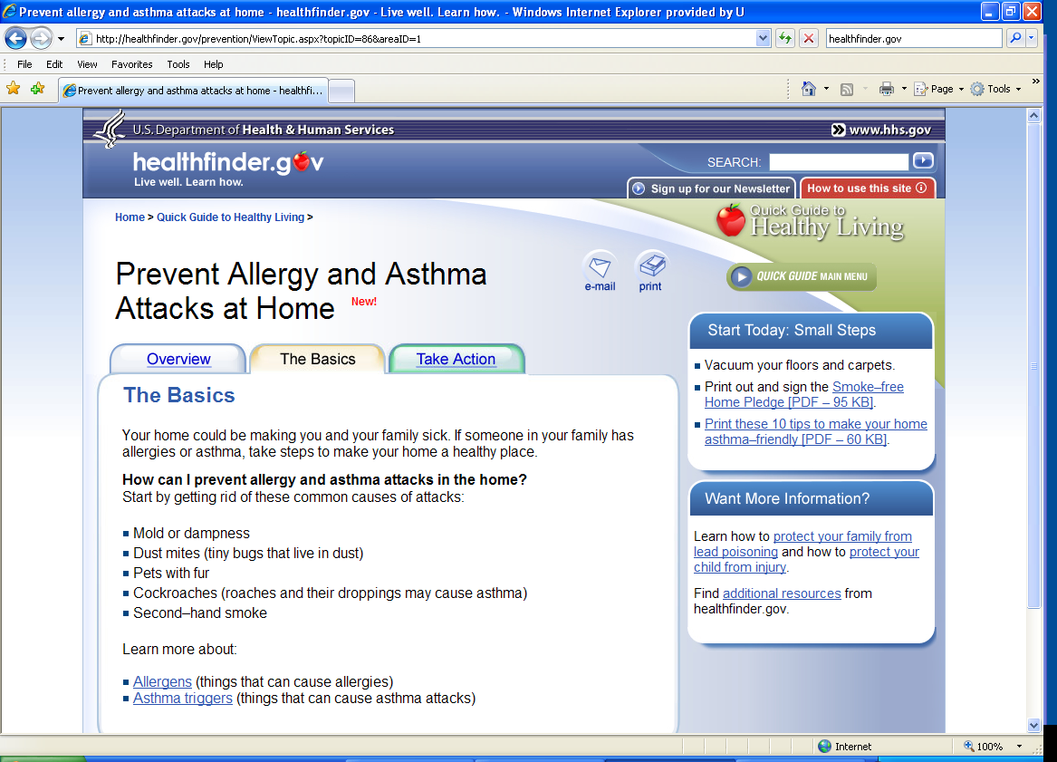

Slide 80
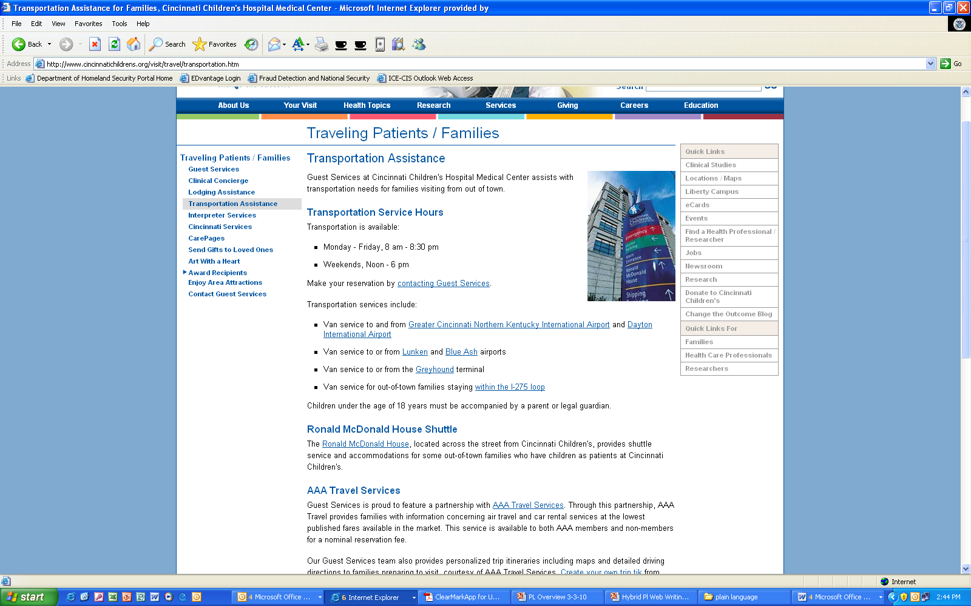

Slide 81
Bullet exercise
There are many ways to protect your child from lead dust. You can keep children away from rooms with chipping or peeling paint or you can cover peeling or chipping paint with duct tape or contact paper. Also you can use a wet paper towel or mop to clean up dust regularly especially around windows and floors.

Slide 82
Protect your children from lead dust by:
Keeping children away from rooms with chipping or peeling paint
Covering peeling or chipping paint with duct tape or contact paper
Using a wet paper towel or mop to clean up dust regularly, especially around windows and floors

Slide 83
Hosted by academic institutions throughout the United States, the Student Leader Institutes include an intensive academic component, an educational study tour to other regions of the country, local community service activities, and a unique opportunity to get to know American peers.

Slide 84
Hosted by academic institutions throughout the United States, the Student Leader Institutes include:
intensive academic component,
educational study tour to other regions of the country,
local community service activities, and
unique opportunity to get to know American peers.

Slide 85
Use Tables
If you have | Then Use
Lots of “Ifs or thens” Or a Series of complex conditional instructions | A table
Create tables with “Insert table” command (not tabs and spaces)
Use column command for columns (not tab key) — Format> Column

Slide 86
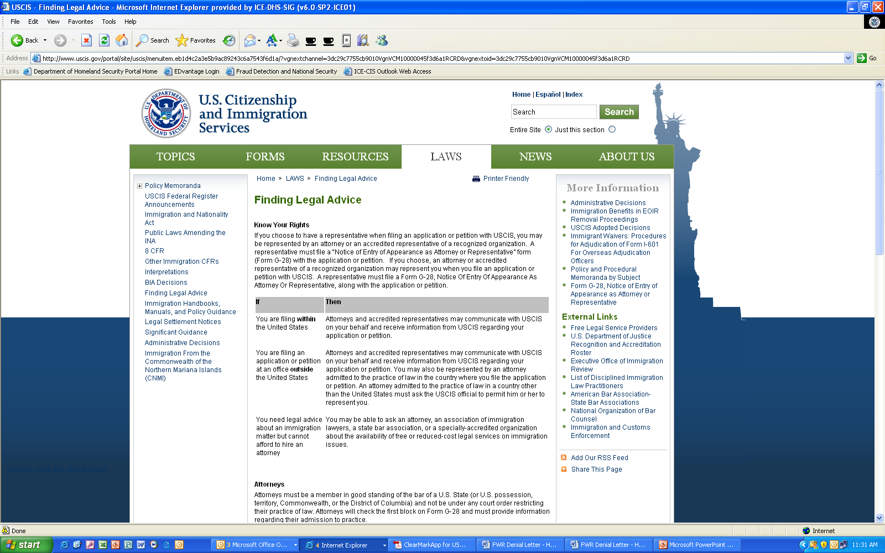

Slide 87
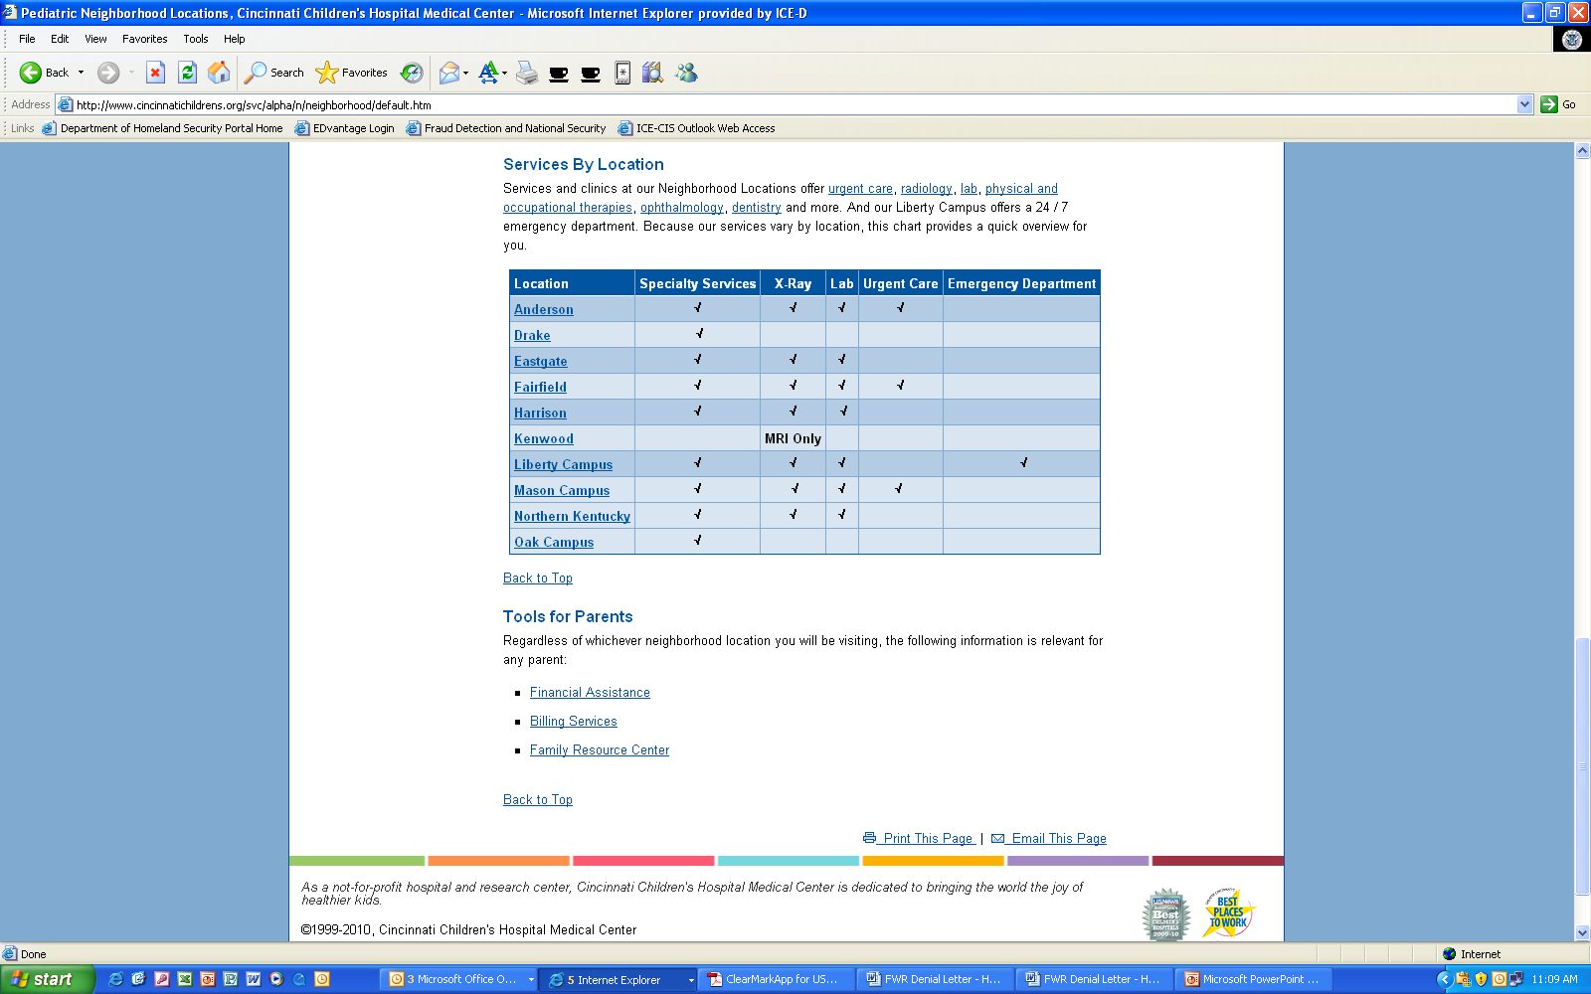

Slide 88
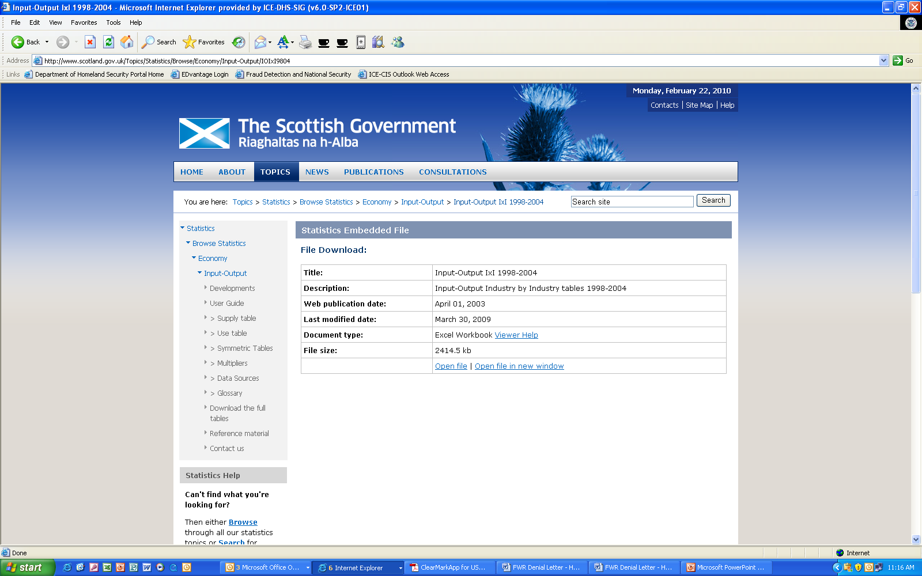

Slide 89
Table exercise
If the estimated value of the forest products offered does not exceed $50,000, the advertisement shall be made for not less than 15 days; if the estimated value exceeds $50,000 but not $250,000, for not less than 30 days; if the estimated value exceeds $250,000, for not less than 60 days.

Slide 90
In table form
Forest Product Advertisement Schedule
If the estimated value of the forest products is | Then the ad will run for
< $50,000 | 15 days
>$50,000 < $250,000 | 30 Days
> $250,000 | 60 Days

Slide 91
Headings
Headings are critical on the web.
They are a part of navigation—the area where many public websites get low customer-satisfaction scores.
We know people don’t read on the web—headings help them get to the material they want.

Slide 92
Good headings
Get the reader interested
Help them get a quick overview of the page
Help them scan the page and find what they want
Make the content appear less dense
Help the writer organize material

Slide 93
Headings
Headings should:
Be short and direct
Use keywords
Use powerful language
Use active voice
Use subheadings liberally — never scroll for more than a screen and a half without seeing one.

Slide 94
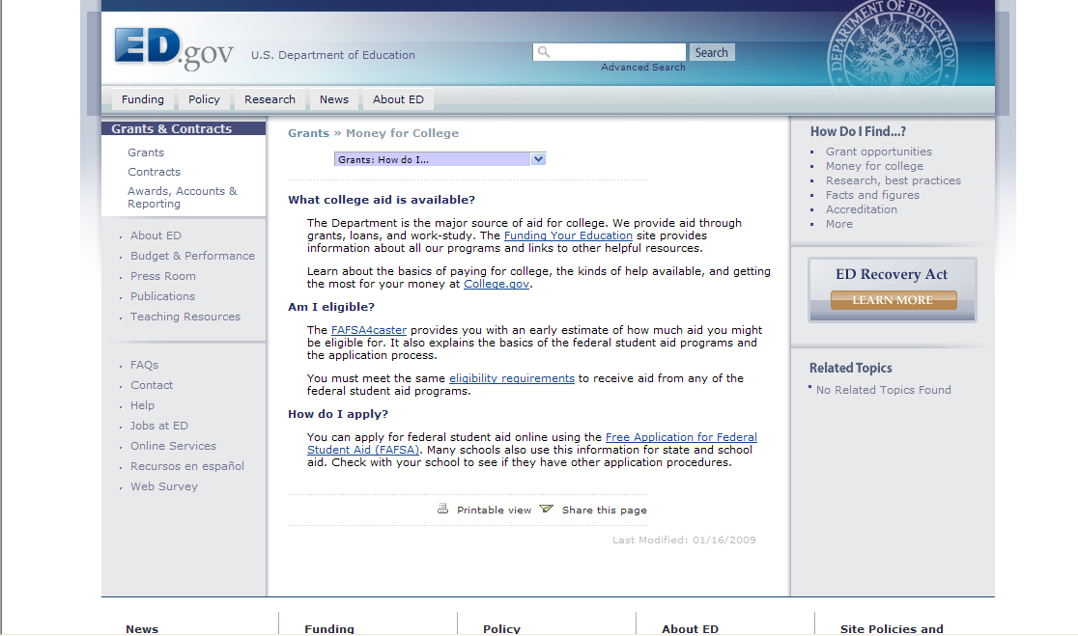

Slide 95
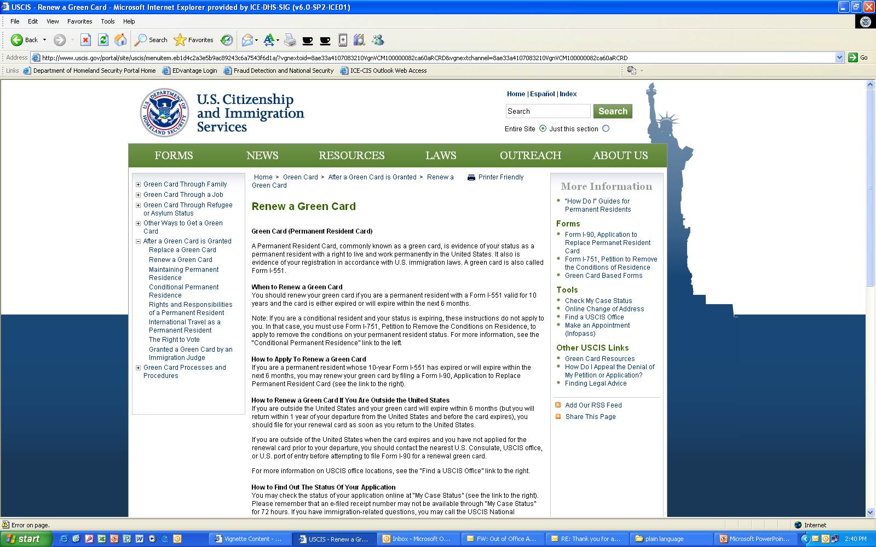

Slide 96
Writing links
Links are about both content and navigation.
Effective link names are key to satisfying your customers.

Slide 97
Eye Track study results*
The best links in the study: | The worst links in the study:
☺ Used plain language | ☹ Used bland, generic words
☺ Were specific and clear | ☹ Used made-up words or terms
☺ Used common words | ☹ Started with speech- introduction language
☺ Started with the essence of the message
☺ Were action-oriented
* http://www.useit.com/alertbox/nanocontent.html

Slide 98
Four general link types
Full sentences, either statements or questions.
Questions are ideal if you know your customers’ questions.
Phrases.
Action phrases with verbs—Contact us, Apply for a permit. This is the best type for action items.
Categories—Kids, Senior citizens, Builders. Use this type of link with care!

Slide 99
Some rules for writing links
Link names should be the same as the page name linked to.
Don’t use the full name of a document or program as a link name.
Be as explicit as you can—too long is better than too short.
Make the link meaningful. Don’t use “click here” or “more.”
Don’t embed links in text. It just invites people to leave your text!
Add a short description when needed to clarify the link.

Slide 100
What do you think of the links on these sites?
LA County Info
Food Stamps
Private Sector Exchange

Slide 101
General Resources for Developing Sites
http://www.useit.com/
http://webstyleguide.com/
http://usability.gov
http://usability.gov/pdfs/guidelines.html
http://www.usa.gov/webcontent/
http://www.gerrymcgovern.com/
Designing Web Usability: The Practice of Simplicity and other works by Jakob Nielsen
Killer Web Content: Make the Sale, Deliver the Service, Build the Brand and other works by Gerry McGovern

Slide 102
Resources for writing
NIH plain language training on the web
Plainlanguage.gov
Federal plain language guidelines
Center for Plain Language
Writing Web Content that Works, by Janice (Ginny) Redish

