Slide 1
Plain language and the web –
How to make your content clear, logical, and accessible
Presented by www.plainlanguage.gov

Slide 2
What is Plain Language?
Communication that your audience or readers can understand the first time they hear or read it.
Plain language means writing so your customers can:
Find what they need
Understand what they find
Use what they find to fill their needs
Plain language techniques are especially important on the web!

Slide 3
Plain Language Myths
Plain Language is NOT:
Baby talk, or an attempt to be folksy, playful, or pc
Stripping out necessary technical and legal information
Just editorial “polishing” after you finish writing
Imprecise
Just using pronouns in a Q and A format
Something the lawyers will never go for
Something the Federal Register and OMB will never go for
Easy

Slide 4
Presentation Outline
Background
How people use the web
Why people use the web
Who are your customers or audience
Writing for the web
The difference between print and web writing
Plain language techniques

Slide 5
How do people use the web?

Slide 6
We know people don’t read on the web
They scan.
Nielsen and Morkes, in a famous 1997 study, found that 79 percent of their test users always scanned any new page they came across; only 16 percent read word-by-word.
A recent study of people reading long-form text on tablets finds higher reading speeds than in the past, but they're still slower than reading print.
http://www.useit.com/alertbox/ipad-kindle-reading.html

Slide 7
People rarely read dense text
Eye tracking research shows how people deal with a page with dense text.
The map on the next slide is from Jakob Nielsen’s website, useit.com
It shows the typical “F” pattern of reading. Red shows the most read parts of the page.
On average, users read the first 2 words on each line.

Slide 8
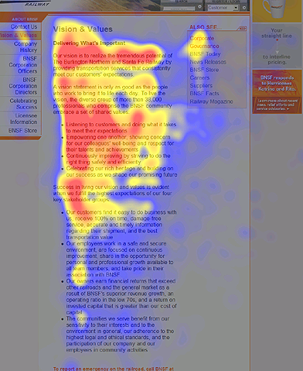

Slide 9
Some horrifying facts*
Based on analysis of 45,237 page views, Nielsen found that people read an average of 18% of what’s on a page.
However, as the number of words on a page goes up, the percentage read goes down.
To get people to read half your words, you have to limit your page to 110 words or fewer.
*http://www.useit.com/alertbox/percent-text-read.html

Slide 10
What does that look like?
http://google.com – shopping 104 words
Plain language—government mandates 103 words in the main text area

Slide 11
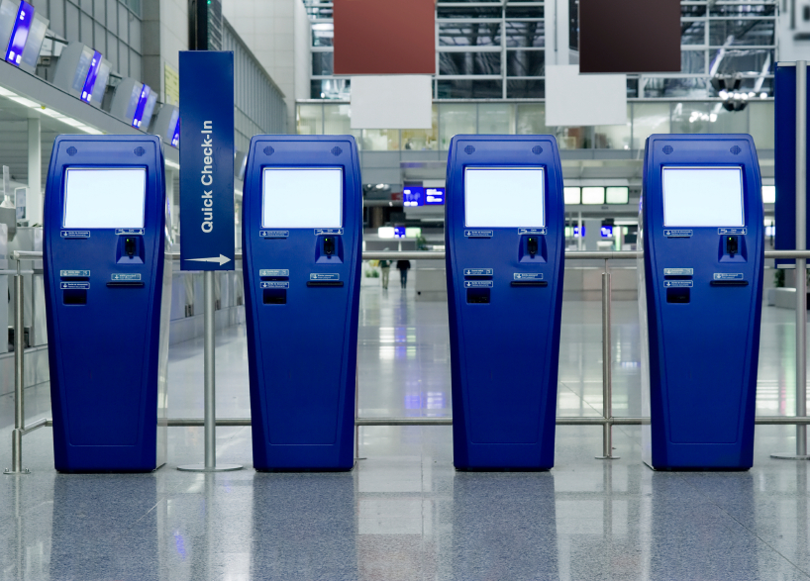
So if they don’t read, what do they do?
Customers come to your site to perform a task.
They come because they expect to get self-service.
Think about how well your website allows customers to get something done.

Slide 12

Identify customers’ top tasks
People come to your website with a specific task in mind. If your website doesn’t help them complete that task, they’ll leave.
Identify the mission—the purpose—of your website, to help you clarify the #1 top task your website should help people accomplish.

Slide 13
Are you being clear?
Your content is NOT clear unless your audience can:
Find what they need
Understand what they find
Use what they find to meet their needs

Slide 14
Why use plain language?
Plain Language:
Shows customer focus
Communicates effectively
Eliminates barriers
Reduces time spent explaining
Improves compliance

Slide 15
Use Plain Language Techniques
Identify your audience
Write to meet the needs of your audience
Choose simple, everyday words
Keep your sentences and paragraphs short
Use active voice, headings and pronouns
Use bulleted lists and tables

Slide 16
Identifying your audience
DON’T
Write for your supervisor or co-workers
DO
Write for your audience
Make a list of who reads your content
Decide why they read it and what information they need
Address your audiences’ top tasks

Slide 17
Who is my audience?
You can read about techniques for finding out about this on www.usability.gov

Slide 18
Writing for the web

Slide 19

Print Writing
Tells a story
Is linear — has a beginning, middle, and end
Is often consumed in a relaxed setting
Written in complete sentences

Slide 20

Web Writing
Easy to scan
Quick, accessible source of info
Minimal text
User-friendly — Users may be stressed, impatient, skeptical, or disoriented
Interactive

Slide 21
Writing content
Before you write content, identify the type of page you’re working on.
There are three main types of pages:
Homepages (portals)
Connector or pathway pages
Content pages
The first two types should contain a minimum of text.

Slide 22
Writing content pages
When you start thinking about content pages, keep these points in mind:
Think topics, not stories.
Think about having a conversation with your customer. Eliminate anything that’s not part of the conversation.
A very few content pages might contain more extensive information.

Slide 23
Remember!
On average, visitors read about 18% of what’s on the page, and the more words you have, the lower the percent they read.

Slide 24
The most important principle:
Think about your audience!

Slide 25
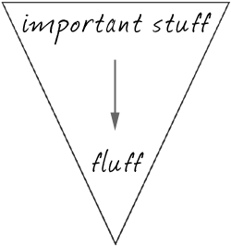
Time Matters
Use the inverted pyramid. Begin with the shortest and clearest statement you can make about your topic.
Conclusions/Key Info
Background

Slide 26
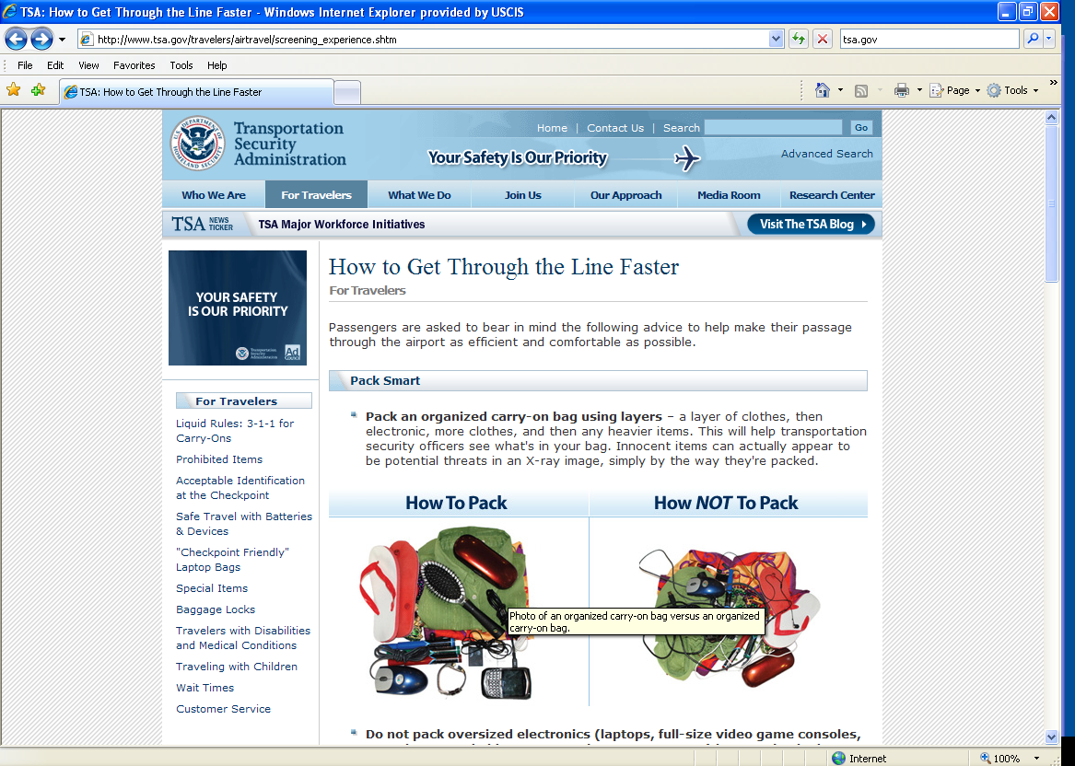

Slide 27
Seconds Count
First 11 characters of a page title most important
People decide in 5 seconds if your site is useful
http://www.uie.com/articles/five_second_test/
Divide information into small clear pieces (“Chunk Content”)
Use headings to cluster or chunk similar content (great with similar or related topics)

Slide 28
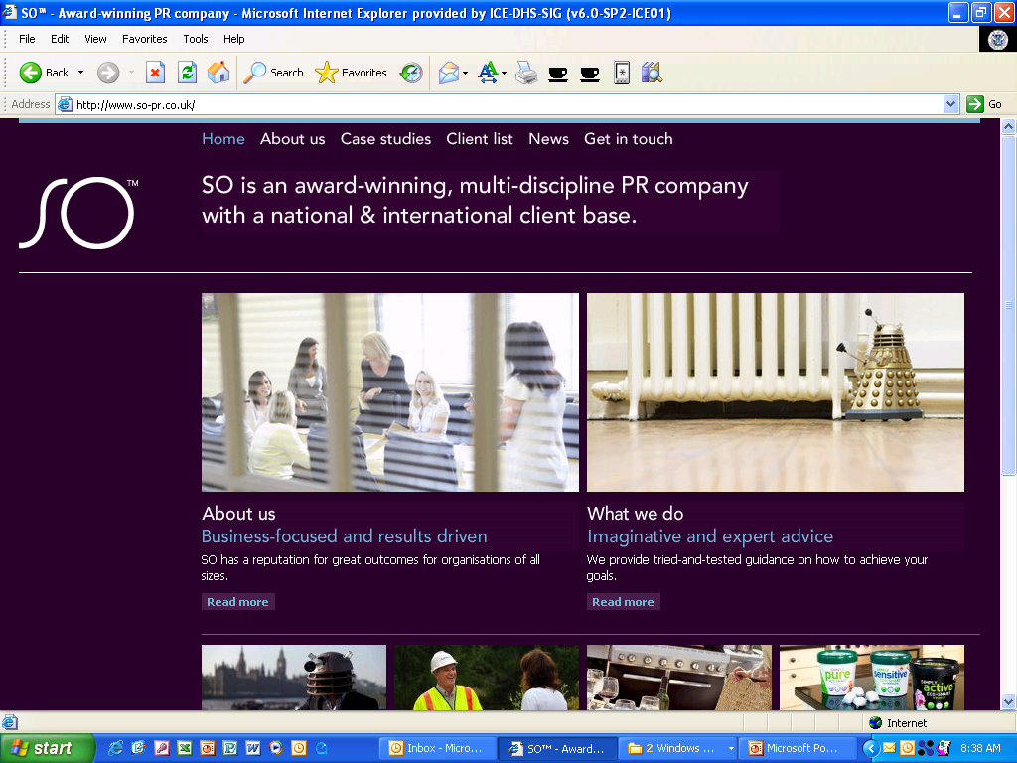

Slide 29
Seconds Count (cont)
Use numerals for numbers
Keep the user’s trust: no spelling or grammatical errors, no broken links or images
Use timeless text (no “Today blah, blah”)
Only use bold when needed
Avoid all-CAPS
No blue or underlined text (reserved for links)

Slide 30

Getting rid of excess content
There are two major sources of excess content:
Excess words in written material.
Content that shouldn’t be there at all.

Slide 31
Eliminate excess words
Learning to recognize and get rid of excess words will always be a challenge.
Bureaucratic writing tends to include many unnecessary words, probably because people think adding words makes material look authoritative.
The web especially is full of many many many unnecessary words.

Slide 32
Unnecessary words—the usual suspects
Some common sources of wordiness—
Passive voice
Redundancies
Prepositional phrases
Hidden verbs
Unnecessary modifiers
Failure to use pronouns

Slide 33
We’ll cover passive voice and pronouns shortly.

Slide 34
Excess words - redundancies
Redundancies are words or phrases you don’t need because you already said the same thing.

Slide 35
Redundancies
Later
During that time, or then
Worked together
Coverage
Will plan
At least 12
At a later time
During that time period
Worked jointly together
Level of coverage
Will plan in the future
At least 12 years of age or older

Slide 36
Unnecessary words - prepositional phrases
Did you notice that a lot of the previous examples included prepositional phrases?
Suspect prepositional phrases as a source of excess words
Try to reduce these phrases to one or two words

Slide 37
Instead of Use
For the purpose of
At this point in time
In relation to
On the grounds that
On a monthly basis
For, to
Now
About, in, with
Because
Monthly

Slide 38
Excess words - hidden verbs
Hidden verbs are verbs disguised as nouns. They are generally longer than their true verb forms.
Hidden verbs are very common in bureaucratic writing.

Slide 39
Avoid Verbs Disguised as Nouns
Conduct an analysis
Present a report
Do an assessment
Provide assistance
Came to the conclusion of
Analyze
Report
Assess
Help/Assist
Concluded

Slide 40
Excess words – unnecessary modifiers
English speakers use many excess modifiers in our writing and in our speech.
They pad our writing, and often don’t make sense.

Slide 41
Common excess modifiers
Absolutely, completely, totally, really, very
Eliminate them. If the resulting wording doesn’t convey your meaning, pick a stronger word.

Slide 42
It is absolutely essential that you contact me at once.
It is imperative that you contact me at once.
You must contact me at once.
Or Contact me immediately.
I had a really good time at your party.
I had a wonderful time at your party.

Slide 43
When you think about them, these excessive modifiers often don’t even make sense.
Totally unaffected
Completely finished
Really pregnant
An absolute success!

Slide 44
Unnecessary words - doublets
In English, we love to repeat words, especially in legal forms.

Slide 45
Common doublets
Cease and desist
Due and payable
Begin and commence
Knowledge and information

Slide 46
General wordy phrase help
For a list of wordy phrases and suggested alternatives, see www.plainlanguage.gov

Slide 47
Excess words – Meaningless formal language
Meaningless formal language wastes space and your reader’s time.
It conveys the impression that you are insincere.
Bureaucratic letters often contain this language, especially in the first and last sentences.

Slide 48
Omit information the audience doesn’t need
Remember, your web content is a conversation with your customer. If material doesn’t belong in the conversation, it doesn’t belong on the web.
Hopefully, you can research what customers really want.
You aren’t Santa Claus. You can’t serve all customers. If you serve your top 3 or 4 customer groups, you’re doing good.

Slide 49
Here are some topics customers don’t care about
When your office was formed
Who is the head
What the head said the day he was sworn in
What the head looks like
What your annual report from 3 years ago looked like
How the Bureau is organized
What you did for customers 5 years ago
The text of a law that authorizes your office

Slide 50
Let’s look at some specific plain language techniques.

Slide 51
Use:
Logical organization
Informative headings
Pronouns
Active voice
Lists and tables
Common words, no jargon

Slide 52
Avoid:
“Hidden verbs”
Abbreviations
Long sentences
Unnecessary words
Information the reader doesn’t want

Slide 53
Critical techniques for web writing
We don’t have time to talk about all the plain language techniques on those lists (and they aren’t even all the techniques), so we’ll focus on a few that are especially important to writing for the web.

Slide 54
Write in short sentences
Use pronouns
Use strong, active verbs
Use your customer’s vocabulary
Develop good lists
Use lots of useful headings

Slide 55
General rules for sentence length
Your document should have an average sentence length of 20 words, or fewer, in documents, and 15 on the web.
On the web, no single sentence should be longer than 25 words.
Use short paragraphs with ONE topic sentence that develops ONE idea.

Slide 56
How can we shorten this?
There is no escaping the fact that it is considered very important to note that a number of various available applicable studies ipso facto have generally identified the fact that additional appropriate nocturnal employment could usually keep juvenile adolescents off thoroughfares during the night hours, including but not limited to the time prior to midnight on weeknights and/or 2 a.m. on weekends.
62 words

Slide 57
Short and Sweet
More night jobs would keep youths off the streets.
9 words
“The most valuable of all talents is never using two words when one will do.”
~Thomas Jefferson

Slide 58
The members, representing a wide spectrum of fisheries, environmental, academic, state, tribal, consumer and other related national interests, draw on their expertise and other appropriate sources to evaluate and recommend priorities and needed changes in national programs, including the periodic reauthorization of the Magnuson-Stevens, the Endangered Species and the Marine Mammal Protection Acts.
OSF works to manage fish stocks important to commercial, recreational, and subsistence fisheries by providing guidance to our Regional Offices and Regional Fishery Management Councils; facilitating effective communication between and among constituents; and supporting safe seafood.

Slide 59
The members represent a wide spectrum of:
fisheries,
environmental,
academic, state,
tribal,
consumer, and
other related national interests.
They use their expertise and other appropriate sources to evaluate and recommend priorities and needed changes in national programs. These programs include the periodic reauthorization of the Magnuson-Stevens, the Endangered Species, and the Marine Mammal Protection Acts.
Notes:
59

Slide 60
OSF works to manage fish stocks important to commercial, recreational, and subsistence fisheries by:
providing guidance to our Regional Offices and Regional Fishery Management Councils;
facilitating effective communication between and among constituents; and
supporting safe seafood.
Notes:
60

Slide 61
Use pronouns to speak to the audience
Research shows that people relate better to information that talks directly to them by using pronouns.
Using general nouns such as “beneficiary” or “purchaser” requires the audience to “translate” before they can be sure you are talking to them.

Slide 62
Using pronouns
Refer to your agency as “we.”
Refer to the reader as “you” in the text and as “I” in questions.
Make sure you define “we” and “you.”

Slide 63
Do not use these “pronouns”!
He/she
His/her
S/he

Slide 64
Use strong, active verbs
The best sentences follow the model you first learned in school.
Subject, verb, predicate – Who, does what, to what or whom.
We published the new report.
NOT
The new report was published.

Slide 65
Passive verbs, hidden verbs, and complex verb forms make your writing weak and confusing.
In passive verbs, the subject of the sentence is not the actor. The actor comes later, often in a prepositional phrase, or there may be no actor identified at all.

Slide 66
Some passive verbs
The training was originally developed for employees of L.A. County by the Office of Human Resources. (Office of Human Resources is the actor, prepositional phrase)
This website has been created to acquaint you with the County's purchasing and contracting programs. (no actor identified)

Slide 67
Passive to Active
The sealed envelope must then be sent via express mail to the address below.
Excess and/or unauthorized expenses, delays, or luxury accommodations and services will not be reimbursed by the company, but will be borne by the employee.
Your application has been denied by the Department of State.
The submission you filed will be reviewed by the judges.

Slide 68
Possible Answers
Send your sealed envelope via express mail to the address below.
The company will not reimburse employees for
unauthorized expenses,
delays, or
luxury accommodations and services.
The Department of State has denied your application
The judges will review your submission.

Slide 69
Exercises – Pronouns and Active Voice
The scientific report was used to develop the Dietary Guidelines jointly between the two Departments and forms the basis of recommendations that will be used by USDA and HHS for program and policy development.
Consumer messages have been developed to educate the public about the Key Recommendations in the Dietary Guidelines and will be used in materials targeted for consumers separate from this publication.
Recently, it was reported that dietary patterns consistent with recommended dietary guidance were associated with a lower risk of mortality among individuals age 45 years and older in the United States.
These two similar eating patterns are designed to integrate dietary recommendations into a healthy way to eat and are used in the Dietary Guidelines to provide examples of how nutrient-focused recommendations can be expressed in terms of food choices.

Slide 70
Hidden verbs
We’ve already discussed hidden verbs. Remember to avoid them. They aren’t strong and they increase sentence length unnecessarily.

Slide 71
Avoid complex verb forms
Prefer the simple present.
Use the simple past and simple future where necessary.
Try to avoid all other forms.

Slide 72
Write in your customer’s words
Avoid bureaucratic and legal language
Avoid jargon
Avoid foreign and Latin terms
Avoid abbreviations
All of these confuse and annoy your customer.

Slide 73
Bureaucratic speak and Legalistic Terms—What do they mean?
integrating quality solutions
promoting an informed and inclusive multicultural society
strategically engaging schools, community organizations, and so on . . .
instill in each employee the necessity to effectively appreciate . . .
Herein
Hereafter
Hereby
Pursuant to
In accordance with
Shall (use “must” instead)

Slide 74
Jargon
racialized
continuity assumptions
evidence-based programs
paternity disestablishment

Slide 75
Latin Terms
“i.e.” and “e.g.” are major problems.
Many people do not know what these mean.
Many who do know the meanings don’t remember which is which.
Other Latin terms to avoid – “via” “per”

Slide 76
Abbreviations
Readers complain more about abbreviations and acronyms than about any other feature of bureaucratic writing.
Using abbreviations turns your material into a research project for readers.
If your abbreviation has another, more common meaning, your audience will forget your special meaning and remember the more common one.

Slide 77
TWIP
TDWR
ARTS
TAEP
ASOS
ACD
DEDS
FIAT
CTAS
ACE-IDS
TDLS
SATDS
IPDS
RACD
ASR
ITWS
TDW
ATB
TRACON
DBRITE
FDIO
ICAO
IWG
ETVS
FDAD
pb-ICE
STARS
TVSR
IPT
DVRS
FAA
77
Notes:
77
Acronyms are common in bureaucratic writing. At some departments/agencies (homeland security or FAA), it sometimes seems we can’t write a sentence without 2 or 3 acronyms. The problems are that people are turned off by acronyms, the reader has to work harder to remember what they mean, and they can be confusing. For example, CFR (Is it Code of Federal Regulations or campaign finance reform?), DOG (Is it an animal or deployable operations group?), and PDA (Is it a public display of affection or a personal data assistant?). Does the IRA on that license plate mean Irish Republican Army or Individual Retirement Account?
In this slide, you can see what sometimes happens when the acronyms are flying thick and fast.

Slide 78
How can you fix abbreviations
Don’t use more than two, and at most three, abbreviations in each written document.
Instead, use “nicknames” such as “unit” instead of WPU for Witness protection unit, or “case review” instead of PQCR for Peer Quality Case Review.

Slide 79
Use common words Instead of Use
Utilize
Facilitate
Discretionary
Expend
Regarding
Prior to
Use
Help
Optional, available
Use
About
Before

Slide 80
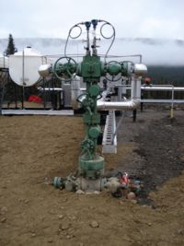
What is this?
80
Notes:
80
This is a special oil machine referred as a Christmas Tree in the industry. a petroleum engineer asked for a Christmas Tree on the cover of an oil and gas drilling handbook. He got an evergreen. Beware of jargon.

Slide 81
Using lists
Lists can be a very powerful way to convey information.
Make sure that all the items in a list are constructed in a parallel way – each item should start with the same part of speech.
Using conjunctions (“and”) and disjunctions (“or”) improperly can confuse the audience, and even give incorrect information.

Slide 82
Lists, cont’d
Don’t make lists too long-- Research suggests that 7 items is the maximum number of items that can be understood easily.
Have an obvious reason for the order of your list. The best order is the way the customer wants it. Alphabetical is an OK fall-back way to organize.

Slide 83
Bulleted lists
Use for 3 to 7 items for increased effectiveness
Introduce list with a concise phrase or sentence
Use parallel construction
Indent run-over lines under the text, not the bullet
Omit initial articles “a” “the” and repetitive words, just list what is unique
Numbered lists – for steps in a sequence ONLY

Slide 84
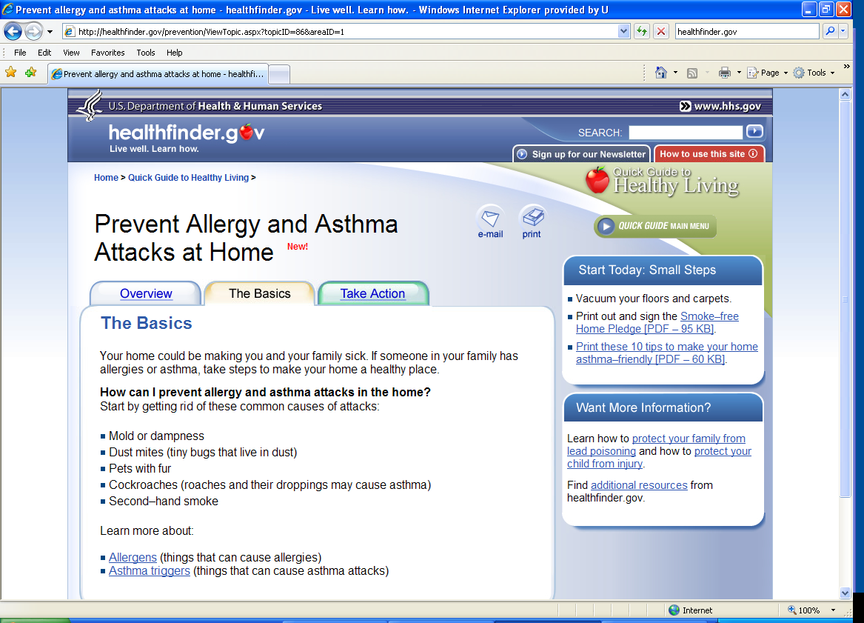

Slide 85
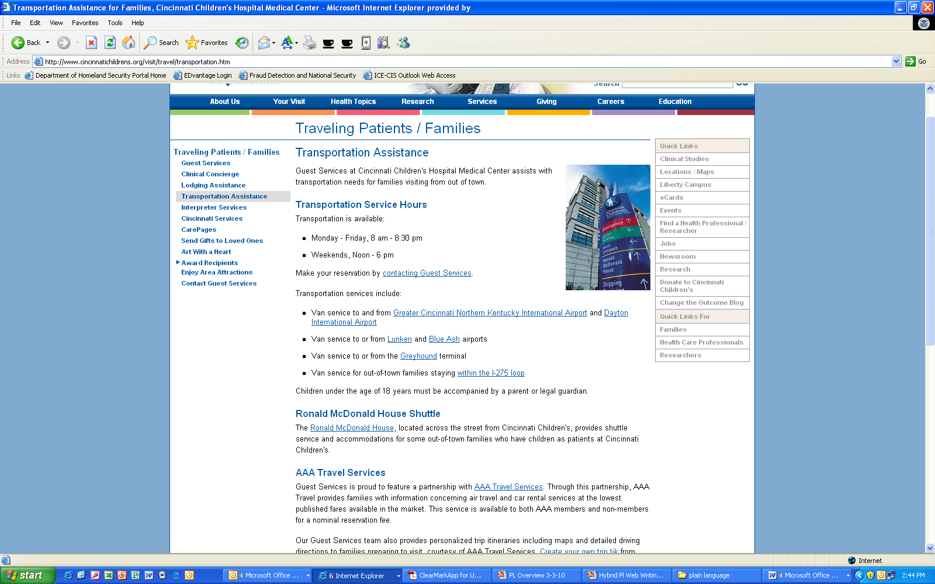

Slide 86
Bullet exercise
There are many ways to protect your child from lead dust. You can keep children away from rooms with chipping or peeling paint or you can cover peeling or chipping paint with duct tape or contact paper. Also you can use a wet paper towel or mop to clean up dust regularly especially around windows and floors.

Slide 87
Protect your children from lead dust by:
Keeping children away from rooms with chipping or peeling paint
Covering peeling or chipping paint with duct tape or contact paper
Using a wet paper towel or mop to clean up dust regularly, especially around windows and floors

Slide 88
Exercises - Lists
Failure to file an answer within the 30-day period may be treated as consent to the award requested, unless the Department or other agency requests an extension of time for filing or files a statement of intent to negotiate under paragraph (b) of this section.
The Superintendent or Area Director will provide you a written notice specifying the action that we will take under this part and explaining the reason(s) for the action. The notice will be delivered to you by certified mail or in person. The notice will include your appeal rights under § 70.10.
If you determine the value of your oil under this subpart, you must retain all data relevant to the determination of royalty value. You must be able to show how you calculated the value you reported, including all adjustments for location, quality, and transportation, and how you complied with the requirements of this subpart.

Slide 89
Examples of activities that may require a section 10(a)(1)(A) permit include, but are not limited to: abundance surveys, genetic research, hatchery operations, relocations, capture and marking, and telemetric monitoring. Under certain circumstances, a section 10(a)(1)(A) permit may also be required to possess tissues and/or body parts of ESA-listed species.

Slide 90
Examples of activities that may require a section 10(a)(1)(A) permit include, but are not limited to:
abundance surveys,
genetic research,
hatchery operations, relocations,
capture and marking, and
telemetric monitoring.
Under certain circumstances, you may also need a section 10(a)(1)(A) permit to possess tissues and/or body parts of ESA-listed species.

Slide 91
Use Tables
If you have | Then Use
Lots of “Ifs or thens” Or a Series of complex conditional instructions | A table
Create tables with “Insert table” command (not tabs and spaces)
Use column command for columns (not tab key) — Format> Column

Slide 92
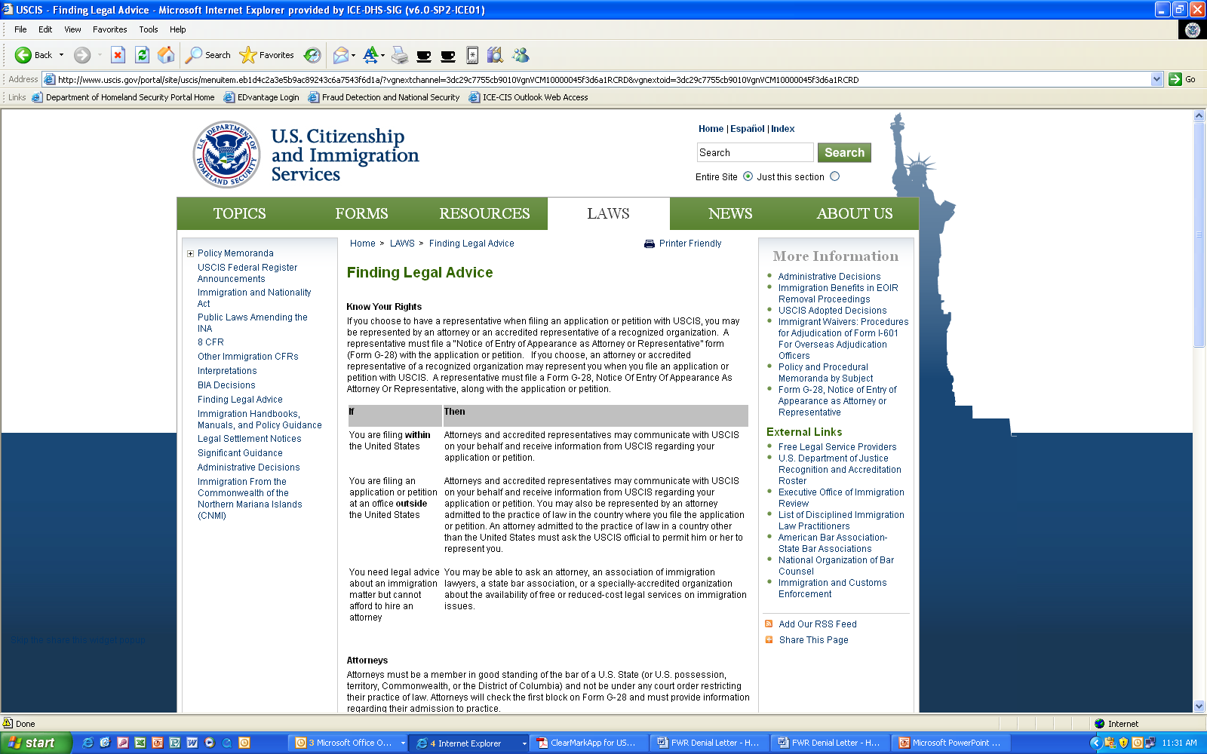

Slide 93
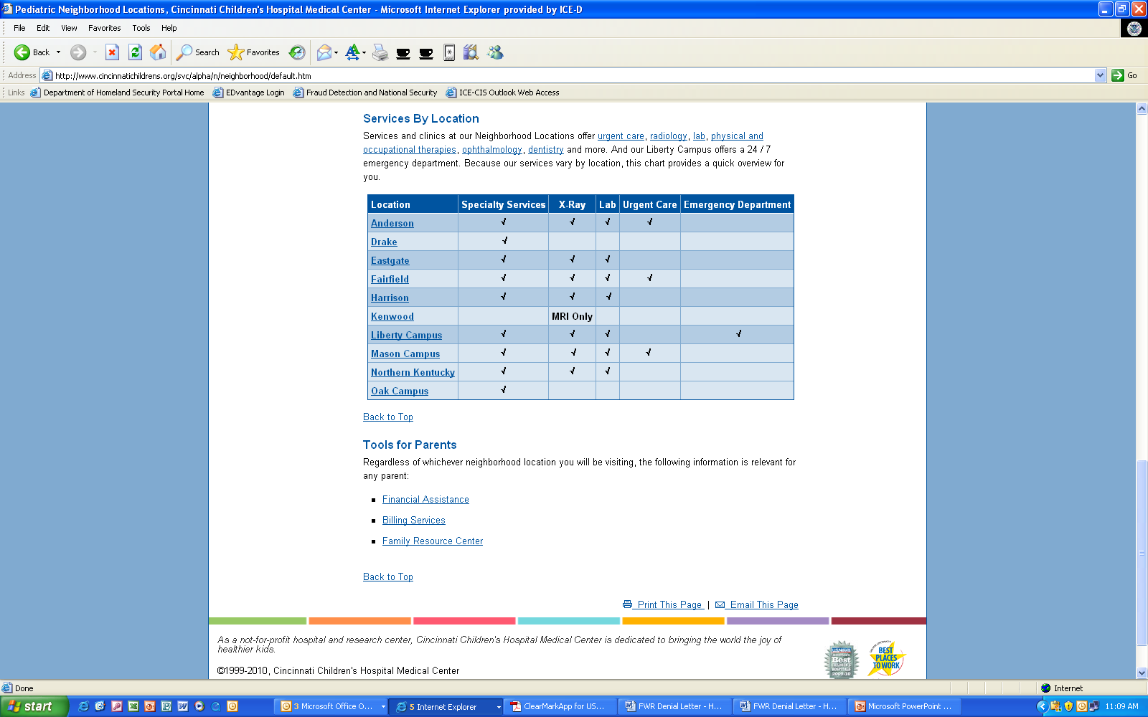

Slide 94
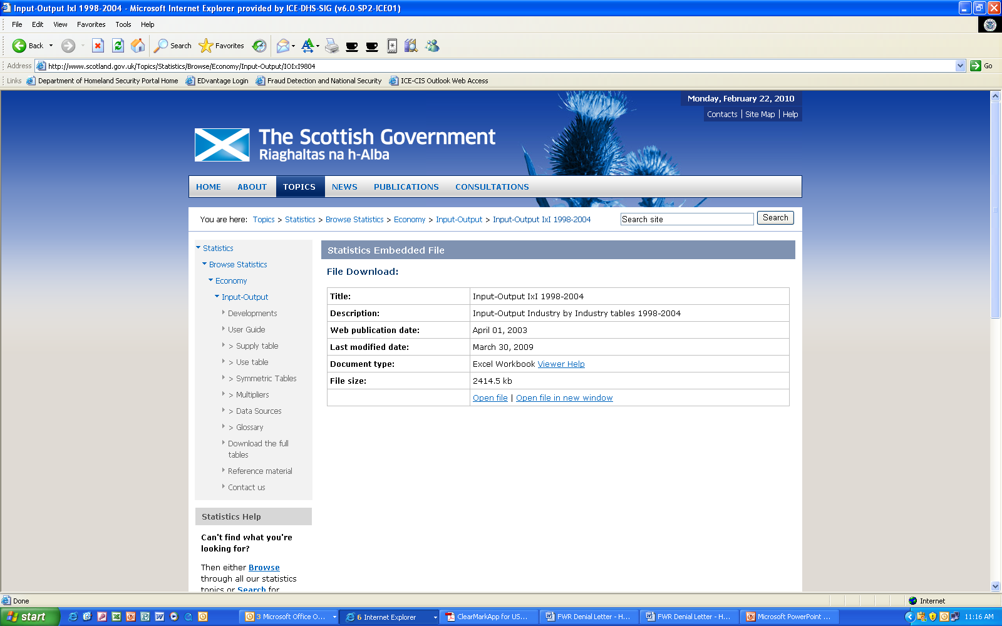

Slide 95
Table exercise
If the estimated value of the forest products offered does not exceed $50,000, the advertisement shall be made for not less than 15 days; if the estimated value exceeds $50,000 but not $250,000, for not less than 30 days; if the estimated value exceeds $250,000, for not less than 60 days.

Slide 96
In table form
Forest Product Advertisement Schedule
If the estimated value of the forest products is | Then the ad will run for
< $50,000 | 15 days
>$50,000 < $250,000 | 30 Days
> $250,000 | 60 Days

Slide 97
Exercises - Tables
If an action or decision on your request was made by an Agency Superintendent, you should appeal to the Area Director. If an action or decision on your request was made by an Area Director, you should appeal to the Commissioner. If an action or decision on your request was made by the Commissioner, the action or decision is final and you may not appeal.

Slide 98
Headings
Headings are critical on the web.
They are a part of navigation—the area where many public websites get low customer-satisfaction scores.
We know people don’t read on the web—headings help them get to the material they want.

Slide 99
Good headings
Get the reader interested
Help them get a quick overview of the page
Help them scan the page and find what they want
Make the content appear less dense
Help the writer organize material

Slide 100
Headings
Headings should:
Be short and direct
Use keywords
Use powerful language
Use active voice
Use subheadings liberally — never scroll for more than a screen and a half without seeing one.

Slide 101
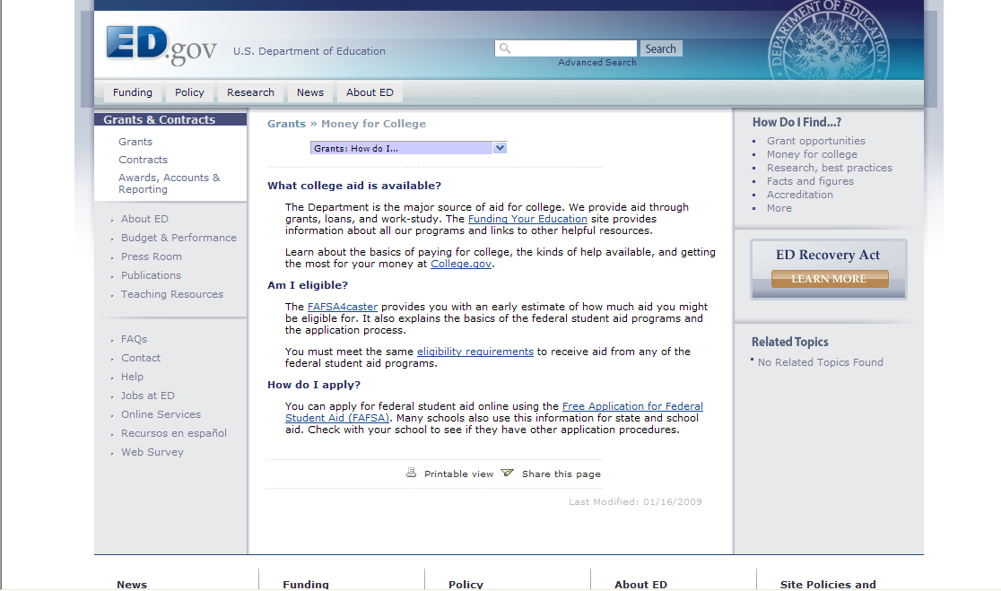

Slide 102
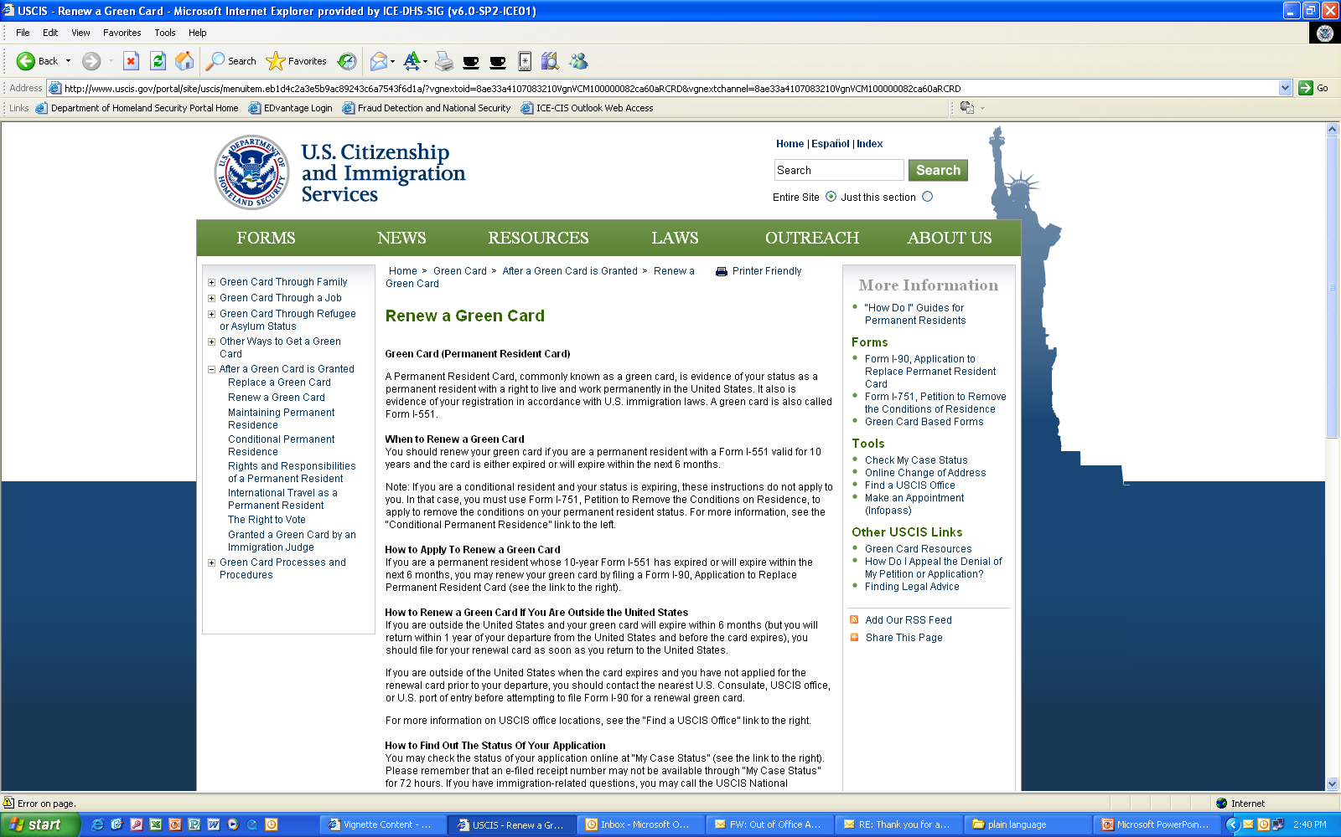

Slide 103
Writing links
Links are about both content and navigation.
Effective link names are key to satisfying your customers.

Slide 104
Eye Track study results*
The best links in the study: | The worst links in the study:
☺ Used plain language | ☹ Used bland, generic words
☺ Were specific and clear | ☹ Used made-up words or terms
☺ Used common words | ☹ Started with speech- introduction language
☺ Started with the essence of the message
☺ Were action-oriented
* http://www.useit.com/alertbox/nanocontent.html
Notes:
104

Slide 105
Four general link types
Full sentences, either statements or questions.
Questions are ideal if you know your customers’ questions.
Phrases.
Action phrases with verbs—Contact us, Apply for a permit. This is the best type for action items.
Categories—Kids, Senior citizens, Builders. Use this type of link with care!

Slide 106
Some rules for writing links
Link names should be the same as the page name linked to.
Don’t use the full name of a document or program as a link name.
Be as explicit as you can—too long is better than too short.
Make the link meaningful. Don’t use “click here” or “more.”
Don’t embed links in text. It just invites people to leave your text!
Add a short description when needed to clarify the link.

Slide 107
What do you think of these sites?
http://www.nmfs.noaa.gov/pr/permits/faq_esapermits.htm
http://www.nmfs.noaa.gov/pr/permits/faq_mmpermits.htm
http://www.nmfs.noaa.gov/
http://www.nesdis.noaa.gov/SatProducts.html

Slide 108
General Resources for Developing Sites
http://www.useit.com/
http://webstyleguide.com/
http://usability.gov
http://usability.gov/pdfs/guidelines.html
http://www.usa.gov/webcontent/
http://www.gerrymcgovern.com/
Designing Web Usability: The Practice of Simplicity and other works by Jakob Nielsen
Killer Web Content: Make the Sale, Deliver the Service, Build the Brand and other works by Gerry McGovern

Slide 109
Resources for writing
NIH plain language training on the web
Plainlanguage.gov
Federal plain language guidelines
Center for Plain Language
Writing Web Content that Works, by Janice (Ginny) Redish

