Slide 1
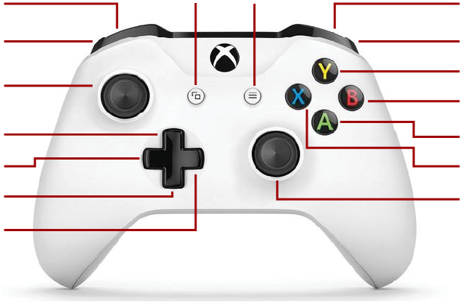
Swervebot
Reset Center Mode
Zero Position
Absolute Mode
Relative Mode
Rotate
Center up right, down, left
Swerve

