Slide 1
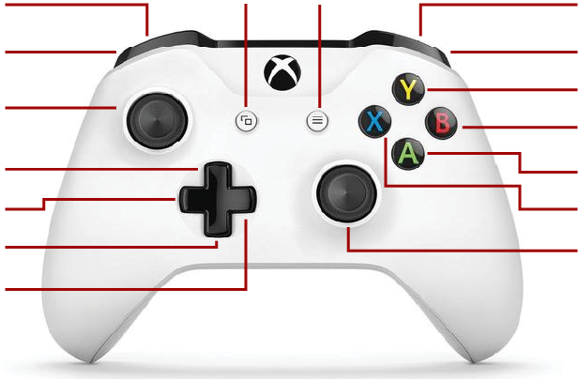
Swervebot
Reset Center Mode
Zero Position
Absolute Mode
Relative Mode
Rotate
Center up right, down, left
Swerve

Slide 2
Team 2393
Cube Mode
Grab
Near Mode
Cone Mode
Eject
Mid Mode
Far Mode
Balance Mode
Drive Mode
Swerve
Rotate

