Slide 1
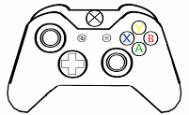
Main Controller
Left trigger:
Reset position and heading to 0,0,0
Right trigger: Rotate to ball
Right bumper:
Reset center of rotation to middle of robot
Left bumper:
Toggle relative/absolute drive mode
‘Click’ center of rotation up, down, left, right
Swerve forward/backward,
Swerve left/right
Rotate
Arm up/down,
Right to reverse intake

