Slide 1


Slide 2
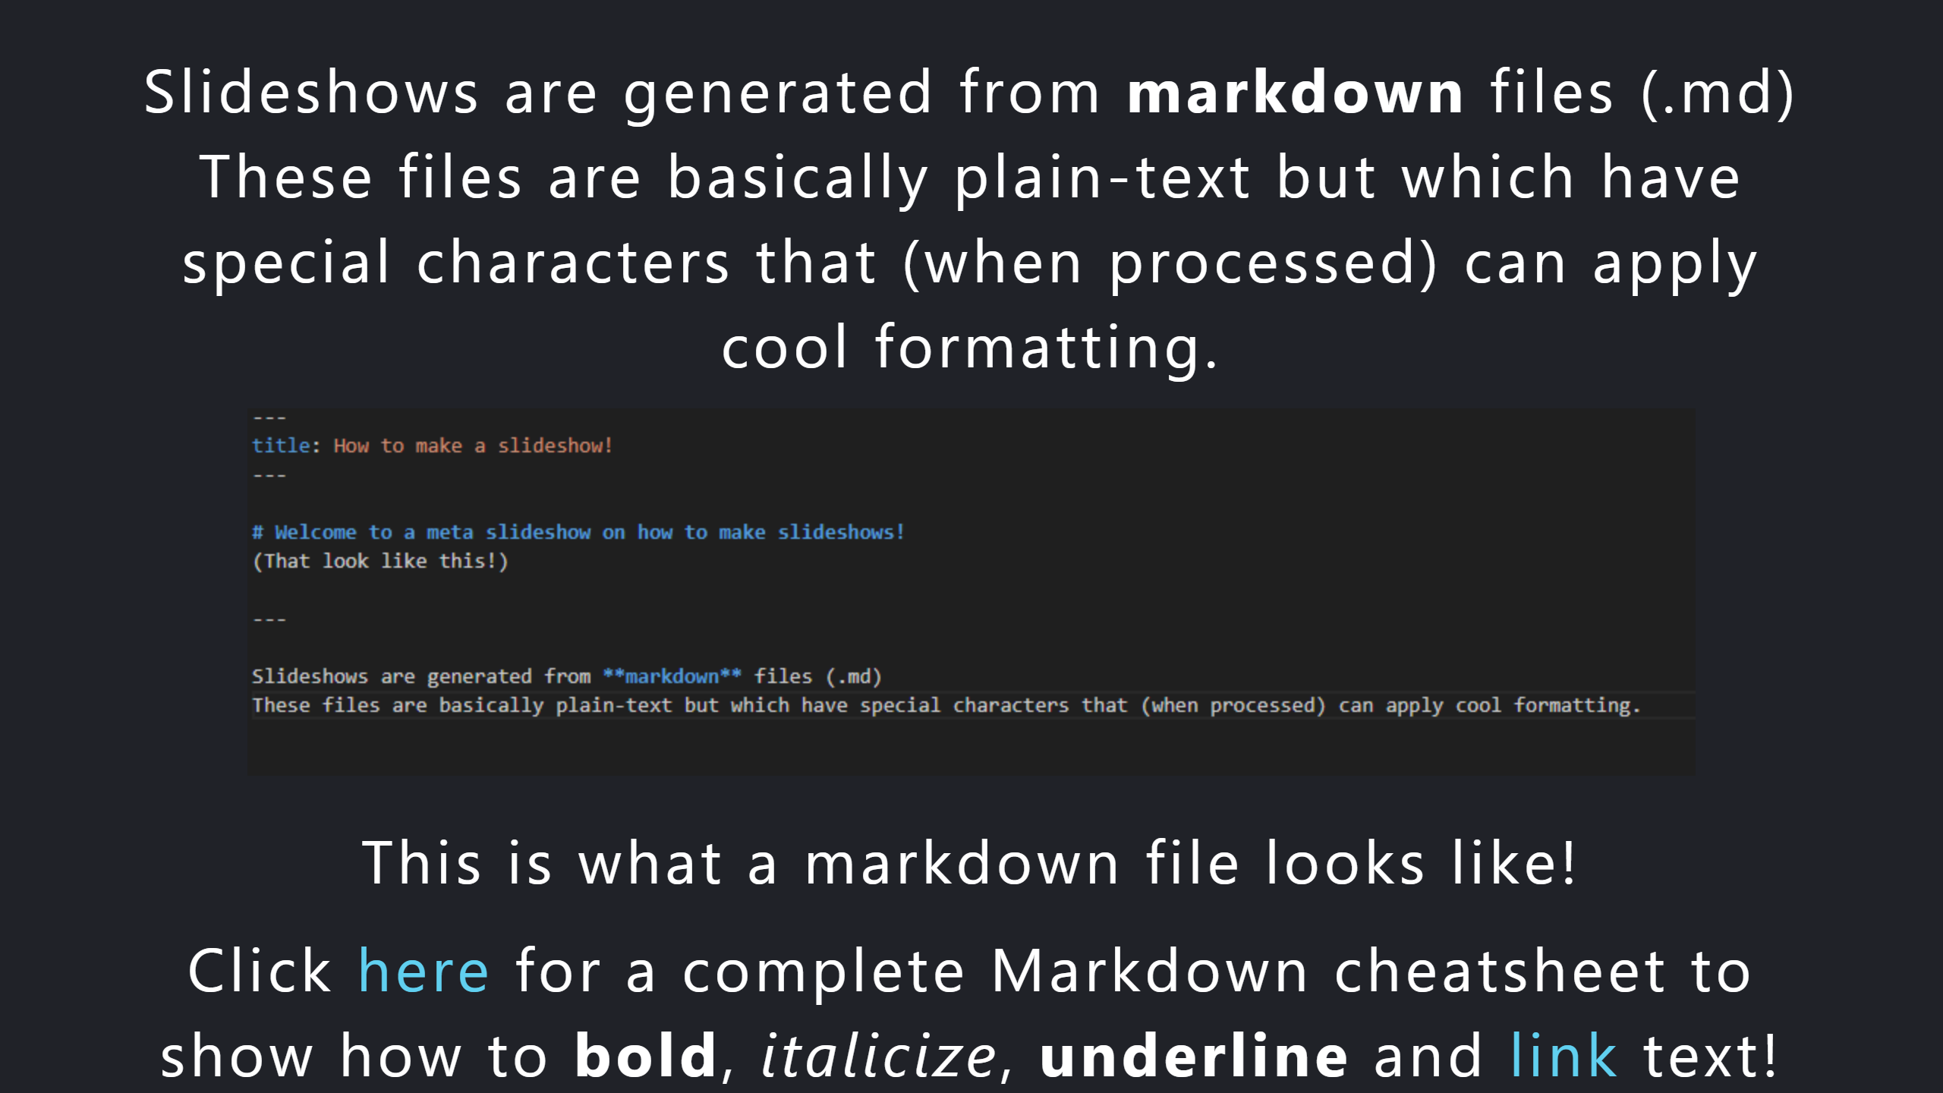

Slide 3
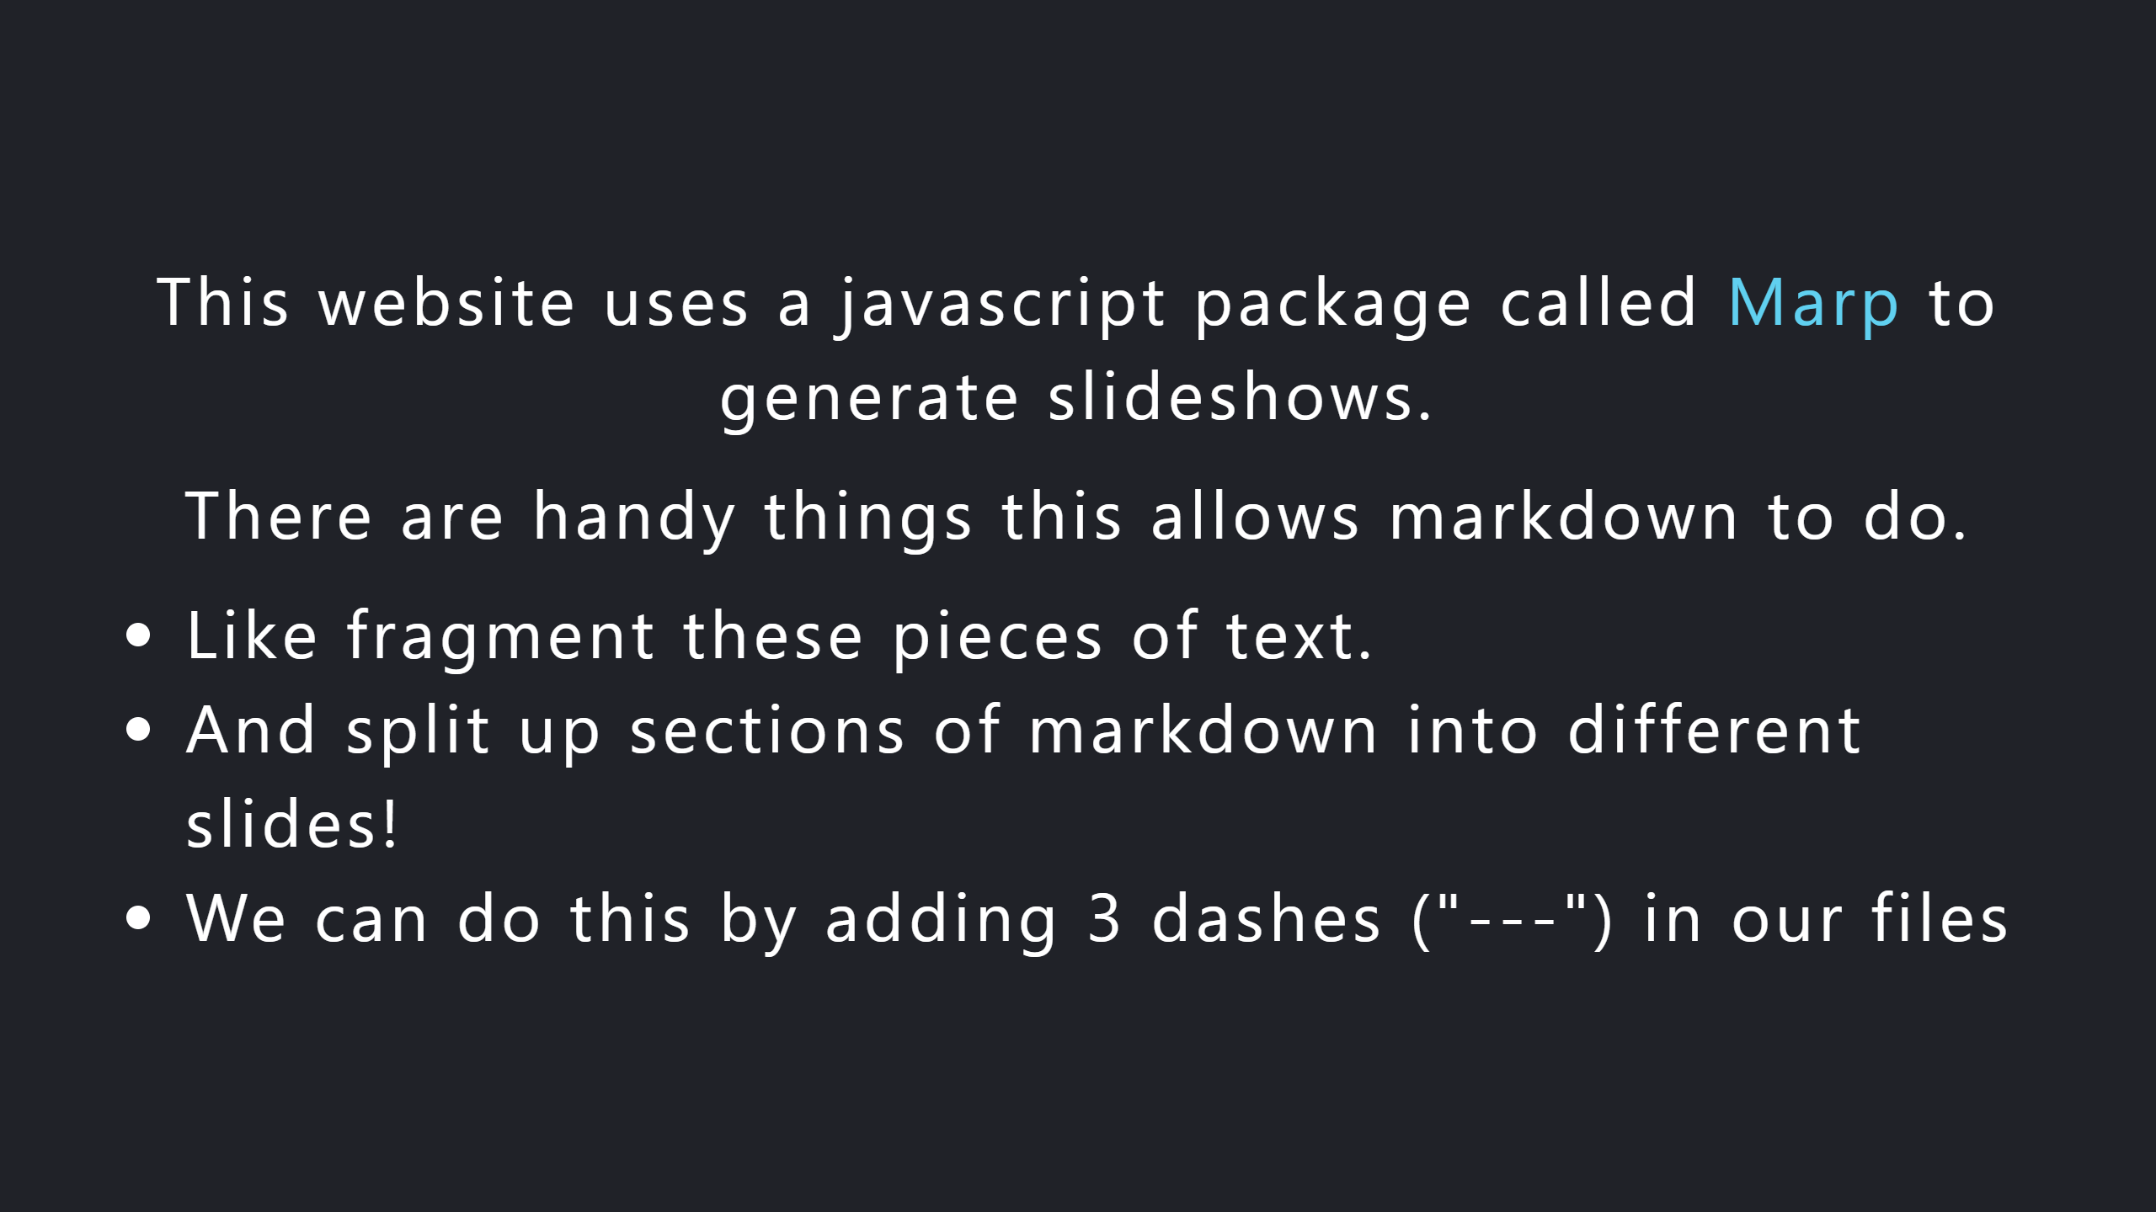
Notes:
.element: class="fragment" data-fragment-index="1" .element: class="fragment" data-fragment-index="2" .element: class="fragment" data-fragment-index="3" .element: class="fragment" data-fragment-index="4"

Slide 4
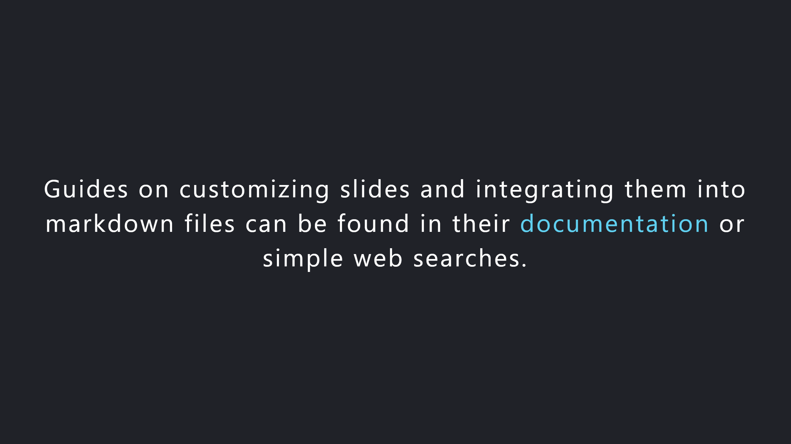

Slide 5
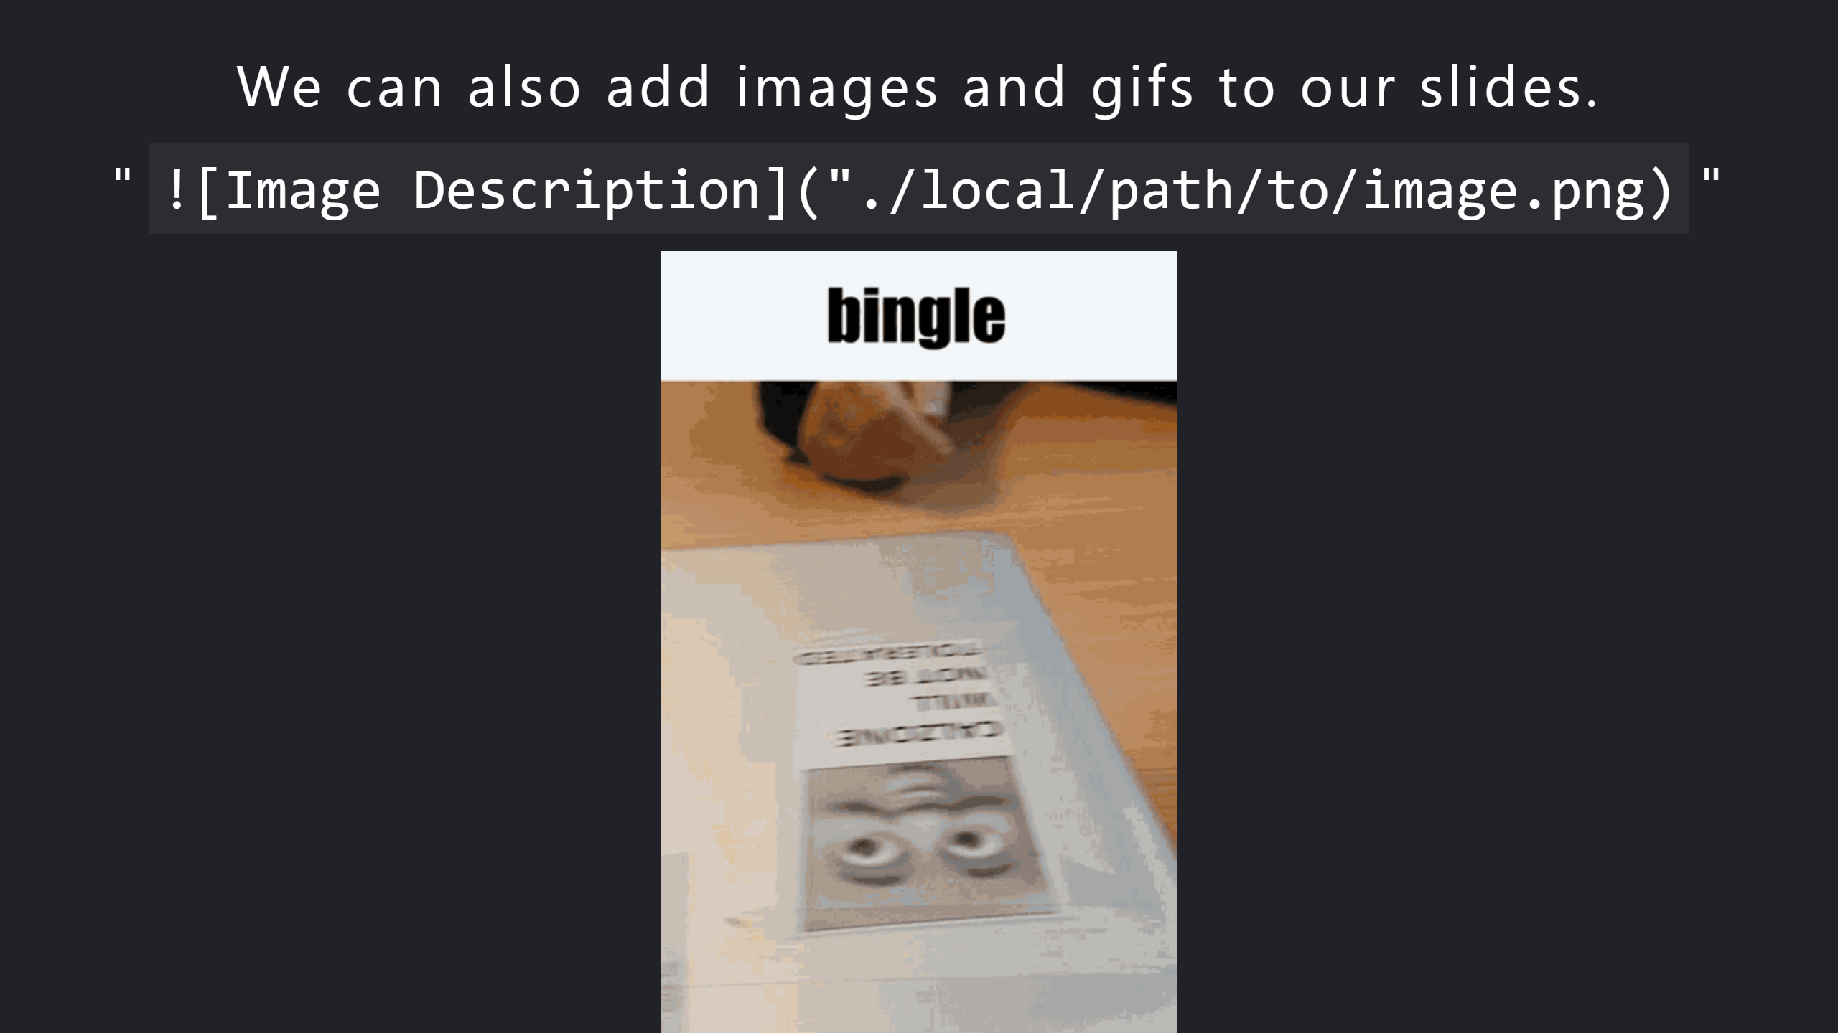

Slide 6
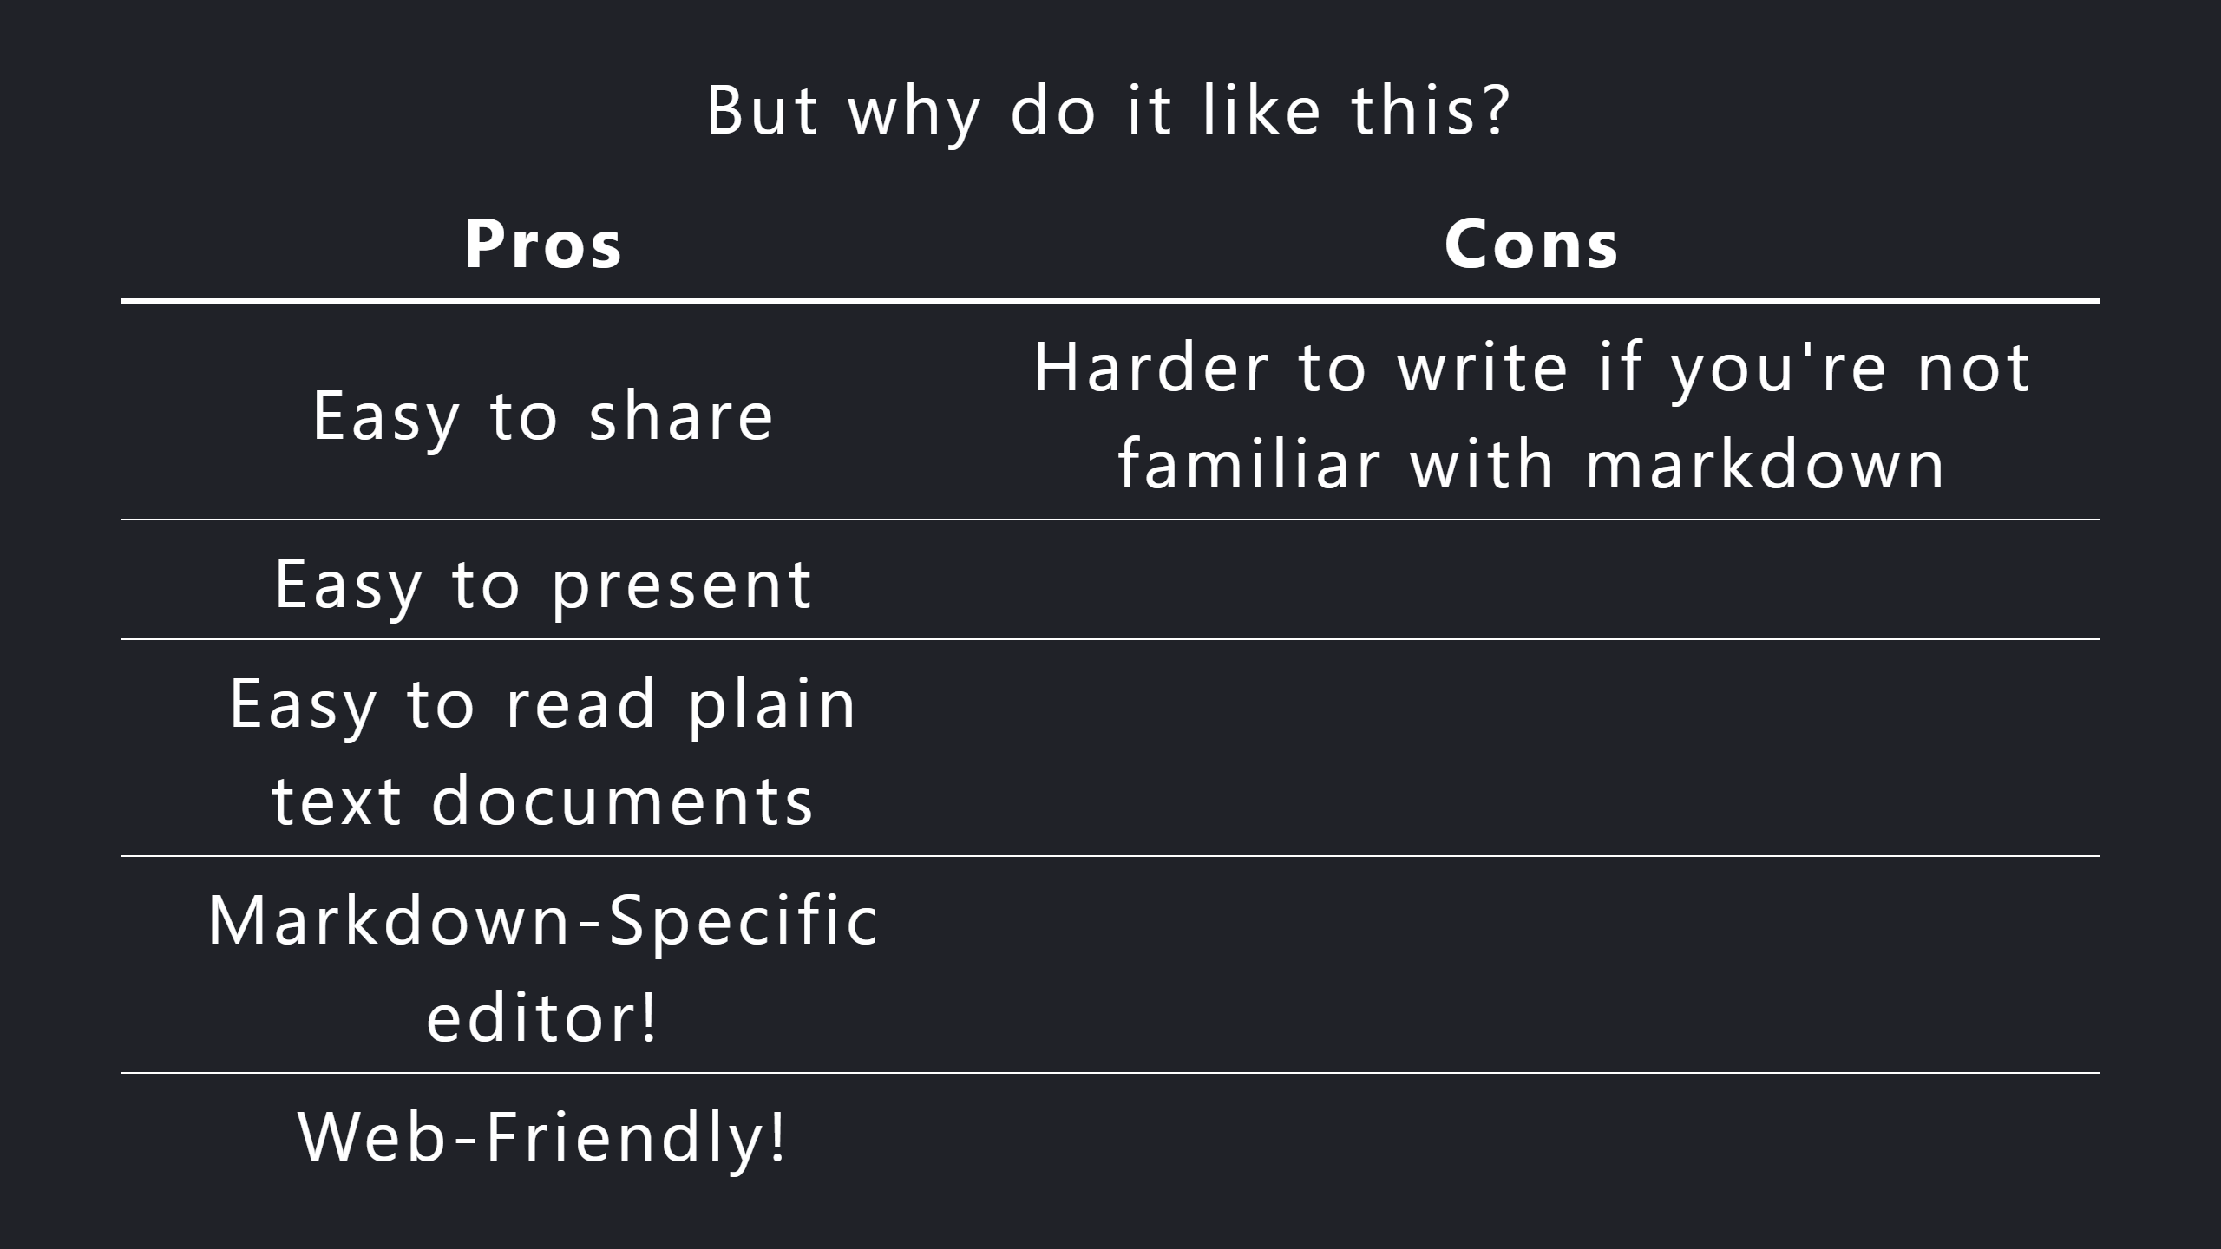

Slide 7
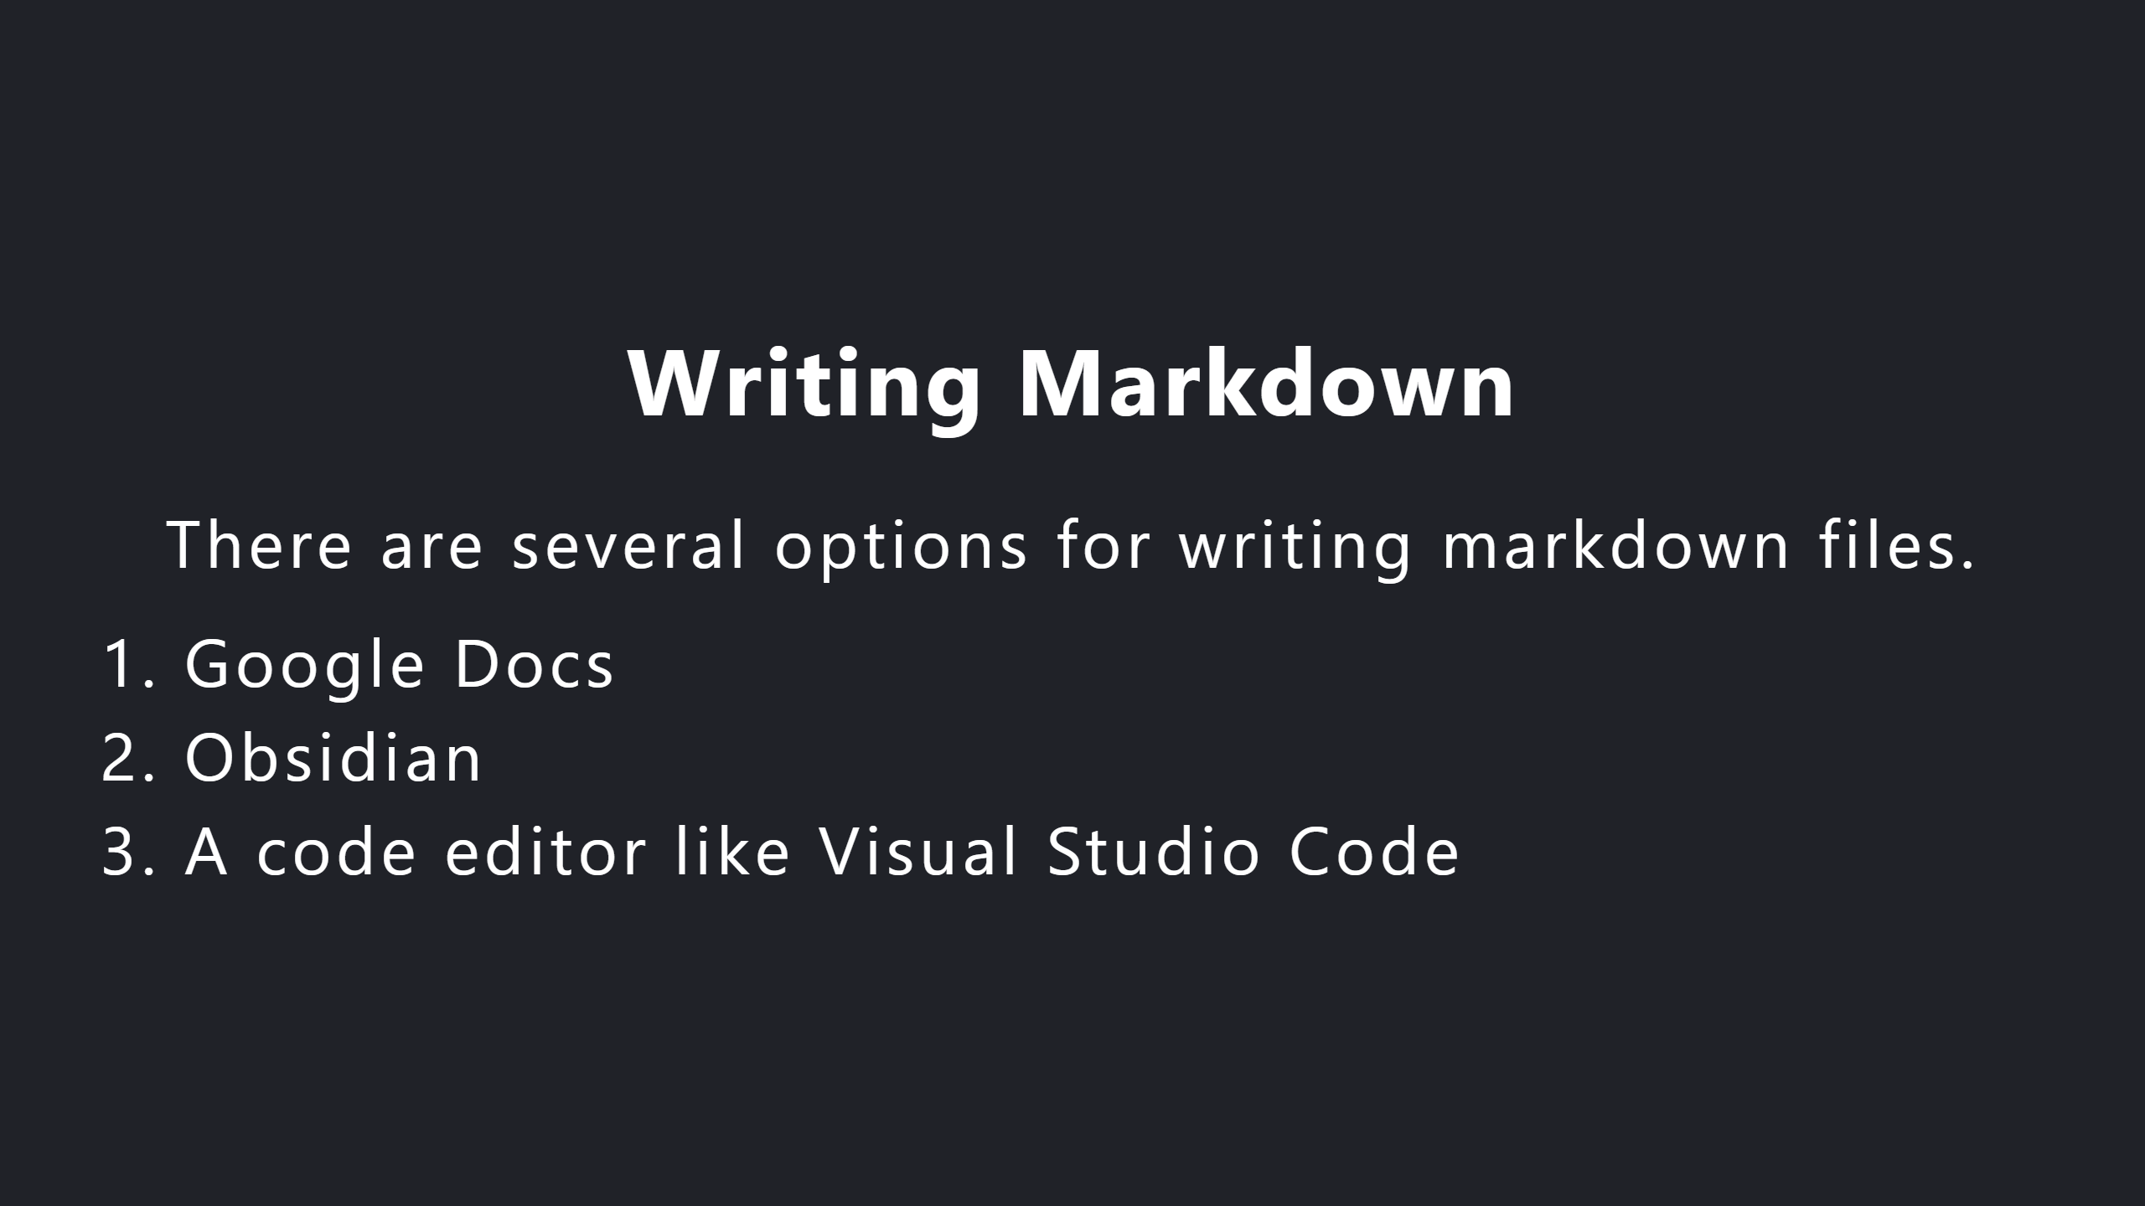

Slide 8


Slide 9
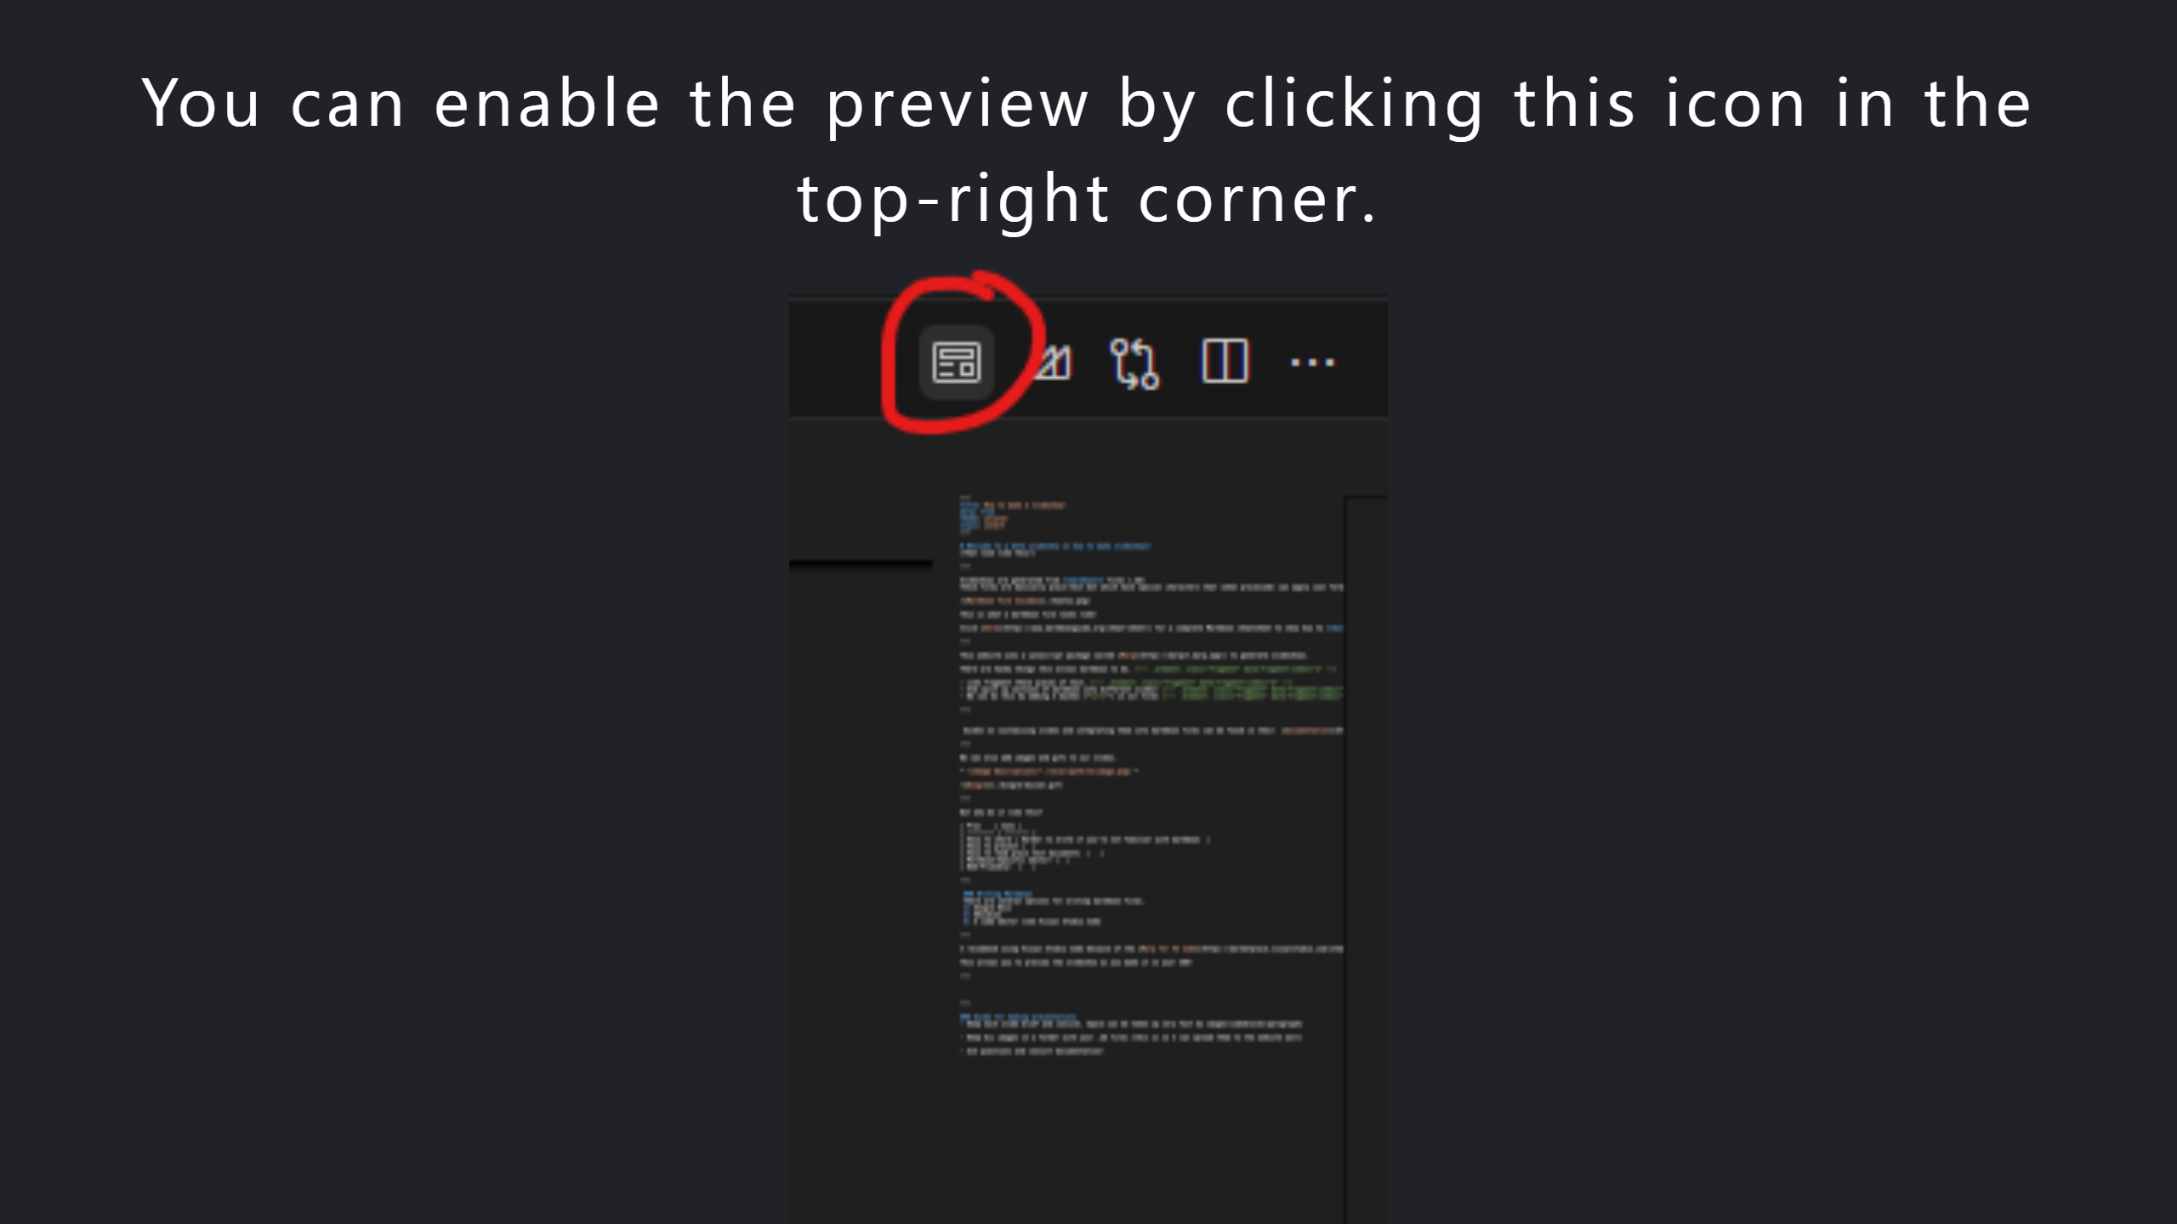

Slide 10
