Slide 1


DIGITAL EGYPT PIONEERS BUILDERS · RWAAD MISR
Threat Hunting & Automated SOC Alerting
A centralized Wazuh SIEM/XDR environment for internal endpoint monitoring — tracking native Windows processes and DLL-injection persistence on a Windows 10 / DVWA host, wired to a color-coded Discord SOC channel.
Team 2
Project Documentation & Final Defense
2026
Notes:
Welcome. This is our graduation project for the Digital Egypt Pioneers Builders — Rwaad Misr program: a centralized Wazuh SIEM environment with automated Discord SOC alerting. I'm presenting on behalf of Team 2.

Slide 2
TEAM 2 · RWAAD MISR
Meet the team
MD
Mohamed Deyaa
AO
Ahmed Ossama
Project Manager & Documentation Lead
Lead Technical Architect
EA
Eman Ayman
AM
Ali Mohamed
Threat Analyst & Simulator
Detection & Telemetry Specialist
HA
Hoda Alaa
MS
Mariam Salama
System Integration Specialist
Quality Assurance & Technical Writer
Notes:
Before we dive in, this is Team 2 — the six of us behind the project, each owning a distinct layer of the pipeline.

Slide 3
CONTENTS
Agenda
01
The Challenge
02
System Design
The visibility & alerting gap we set out to close
Lab topology, architecture & data model
03
Detection & Automation
04
Validation
Endpoint rules, MITRE mapping & the Discord pipeline
Endpoint simulation, dashboards & test results
05
Reflection & Roadmap
Evaluation, timeline & what comes next
~18 minutes · Q&A to follow
Notes:
Here's the flow: we open with the security gap we set out to close, walk through the system design, then the detection engineering and Discord automation, validate it by simulating an internal endpoint threat, and close with results and next steps.

Slide 4
01
The Challenge
Why fragmented endpoints and web apps leave analysts blind — and always tethered to a dashboard.
Notes:
Part one: the problem.

Slide 5
PROBLEM STATEMENT
Endpoints and web apps are monitored in isolation — so internal threats go unseen
IT environments span both endpoints and web applications, yet they frequently lack centralized visibility — leaving them exposed to undetected exploitation, persistence, and unauthorized access. In a lab or SOC-training context, analysts also lack an always-on notification channel.
No centralized visibility
No out-of-band alerting
Endpoint and web-server telemetry live in separate silos, so suspicious host activity slips through unnoticed.
Analysts must watch the console continuously to notice a live incident — there is no push notification away from the dashboard.
Notes:
Modern environments span endpoints and web apps but lack centralized visibility. In a small SOC or training context there's a second gap: analysts have no out-of-band, real-time notification — they must sit and watch the dashboard. We set out to close both.

Slide 6
OBJECTIVES
What we set out to build
01
02
Centralized SIEM/XDR
Detection engineering
A Wazuh Manager ingesting real-time logs from a Windows 10 endpoint and a DVWA web server.
Custom rules mapped to MITRE ATT&CK — including process-creation and DLL-load detection (rules 67027 / 92154).
03
04
Endpoint threat simulation
Automated notification
Prove the pipeline by simulating suspicious native Windows processes and DLL-injection persistence on the endpoint.
A custom-discord.py integration delivering severity-based, color-coded incident cards to a SOC channel.
Notes:
Four objectives: stand up a centralized Wazuh platform, do MITRE-mapped detection engineering, validate it by simulating suspicious internal endpoint behavior, and automate notification through our custom Discord integration.

Slide 7
02
System Design
An isolated lab, a hub-and-spoke SIEM, and an outbound automation edge to the cloud.
Notes:
Part two: how the system is designed.

Slide 8
SOLUTION OVERVIEW
Three components on one isolated subnet
.130
.131
HTTPS
Wazuh Manager
Windows 10 + DVWA
Discord Webhook
The hub — decodes logs, evaluates rules, generates alerts, and invokes the integration.
The monitored endpoint — hosts the Wazuh Agent and Sysmon, generating internal process telemetry.
Cloud SOC dashboard — receives severity-colored incident cards in real time.
All nodes run on an isolated VMware NAT switch —
VMnet8 · 192.168.135.0/24
Notes:
Three moving parts on one isolated subnet: the Wazuh Manager as the hub, the Windows 10 / DVWA endpoint as the monitored target, and the Discord webhook as a cloud-hosted SOC dashboard. There are no external attacker machines — everything we watch originates on the host itself.

Slide 9
DEPLOYMENT · VMNET8
Lab topology & node addressing
Node
IP Address
Role
Wazuh Manager
192.168.135.130
Central SIEM hub — log decoding, rule evaluation, alert generation, custom-discord.py integration.
Windows 10 Target
192.168.135.131
The monitored endpoint — hosts the Wazuh Agent, Sysmon and the DVWA (Apache / XAMPP) server.
Discord Webhook API
Outbound HTTPS
Cloud SOC dashboard receiving severity-colored incident embeds.
Notes:
The exact addressing. A distributed VM model on VMware Workstation simulating a small enterprise network, fully isolated so the exercise is safe and reproducible.

Slide 10
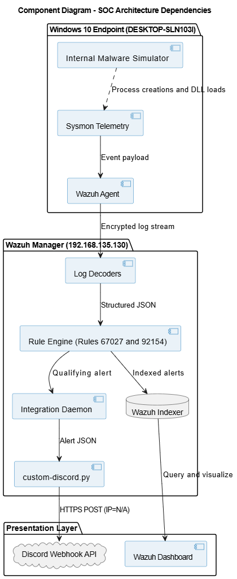
SOFTWARE ARCHITECTURE
Hub-and-spoke SIEM with an automation edge
The hub
The Wazuh Manager is the central aggregation and analysis engine — decode, evaluate against local_rules.xml, index alerts.
The spokes
Agents on the Windows 10 endpoint and DVWA server forward filtered, encrypted telemetry to the hub.
The automation edge
On a qualifying alert, the Manager invokes custom-discord.py for an outbound HTTPS call to the Discord Webhook — a cloud presentation layer alongside the on-prem dashboard.
Notes:
Architecturally this is a classic hub-and-spoke SIEM — the Manager is the hub, the agents are spokes forwarding filtered encrypted telemetry. Our contribution is the outbound automation edge: on a qualifying alert the Manager invokes the Python integration, which pushes to Discord, extending the hub's reach beyond the isolated lab without exposing internal infrastructure.

Slide 11
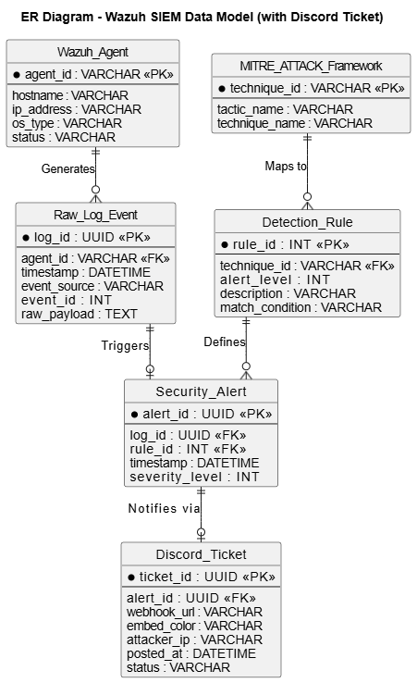
DATABASE DESIGN
A document model, correlated by rules
Data is stored as JSON documents in the Wazuh Indexer. Decoders parse unstructured logs into structured fields — rule.id, agent.name, data.srcip . Relationships come from correlation: a Security Alert is generated when a Raw Log Event matches a Detection Rule , and each alert may produce a Discord Ticket.
Notes:
As a SIEM, Wazuh uses a NoSQL document store, not a relational DB. Decoders parse raw logs into key-value pairs. The logical model: a raw log event matching a detection rule generates a security alert, which in turn produces a Discord ticket.

Slide 12
DATA FLOW · END TO END
From endpoint event to alert in six stages
01
02
03
04
05
06
Event
Telemetry
Collect
Process
Integrate
Respond
A suspicious process spawns on the Windows 10 endpoint.
Sysmon records the process creation and module load.
The Agent filters and forwards logs over an encrypted channel.
The Manager correlates it → Rules 67027 / 92154 → persistence.
custom-discord.py extracts the IP, maps color, formats the embed.
A color-coded incident card appears instantly in the SOC channel.
Notes:
End to end, six stages: a suspicious process spawns on the endpoint, Sysmon records it, the agent forwards it, the Manager correlates it — triggering rules 67027 and 92154 for process creation and the taskschd.dll load — the Python integration formats the alert, and Discord displays a color-coded card instantly.

Slide 13
03
Detection & Automation
Custom MITRE-mapped rules, endpoint telemetry, and the Python integration that turns an alert into a Discord card.
Notes:
Part three: the heart of the project — detection engineering and the Discord automation.

Slide 14
DETECTION ENGINEERING
Endpoint rules, mapped to MITRE ATT&CK
Rule ID
Detection
MITRE
67027
A process was created — internal Windows executables
Execution
92154
Process loaded taskschd.dll — delayed-execution persistence
T1053
100001
Credential dumping via lsass.exe
T1003
100110
Registry Run-key persistence
T1547
Rule 92154 is the critical catch — loading taskschd.dll signals a scheduled / delayed execution task, a common malware persistence technique.
Notes:
We authored custom rules in local_rules.xml, each mapped to a MITRE technique, all focused on the endpoint. The two headline catches: rule 67027, a process was created — tracking internal Windows executables — and rule 92154, a process loaded the taskschd.dll module. That second one is the critical security catch: loading the Task Scheduler DLL indicates a delayed execution task, commonly used by malware for persistence. We also detect credential dumping and registry Run-key persistence.

Slide 15
ENDPOINT TELEMETRY
Actionable signal, not raw noise
Sysmon & Security events
Real-time file integrity
The Windows Agent integrates Microsoft Sysmon and collects targeted operational channels and Security Event IDs:
The <syscheck> module runs FIM on DVWA web-upload paths and critical registry keys:
4624
4688
4702
Web-shell uploads — .php · .php5 · .phtml
Registry — Run · RunOnce · Winlogon
Notes:
On the endpoint, the agent integrates Sysmon and collects specific Security event IDs — 4624, 4688, 4702 — rather than everything, keeping noise down. File Integrity Monitoring watches the web-upload directories for web-shell extensions and the critical registry run keys.

Slide 16
AUTOMATED DISCORD ALERTING
Turning an alert into a color-coded card
JSON parsing
Smart IP extraction
Dynamic color
Reads the alert file from the integrator daemon and isolates the rule and data objects.
Searches data.srcip then win.eventdata.ipAddress ; internal system events with no source fall back to N/A.
Maps the Wazuh severity level to the embed border color, then POSTs to the webhook.
Green
Orange
Red
Level 1–4 · low risk
Level 5–9 · medium risk
Level 10+ · high / critical
Notes:
The automation script has three jobs: parse the JSON alert, smart-extract the attacker IP from whichever field holds it, and map the Wazuh severity level to an embed color. Crucially, every card also carries the level as text — so severity reads clearly even without color.

Slide 17
IMPLEMENTATION · LISTING 5.2
Smart IP parsing & dynamic severity color
# source IP — network field, else Windows field, else N/A
src_ip = (data.get("srcip")
or data.get("win", {}).get("eventdata", {}).get("ipAddress")
or "N/A")
# embed color from the Wazuh severity level
if level >= 10: color = 0xE74C3C
elif level >= 5: color = 0xE67E22
else: color = 0x2ECC71
requests.post(hook_url, json=embed)
Notes:
Here's the core logic. Level comes from the rule. The smart IP parse falls through multiple fields. Then the severity ladder picks the hex color — red at 10-plus, orange at 5, green otherwise — and the embed is POSTed to the webhook. Roughly forty lines do the whole job.

Slide 18
04
Validation
A simulated internal endpoint threat, the real dashboards it lit up, and the test results.
Notes:
Part four: does it actually work? We put it to the test.

Slide 19
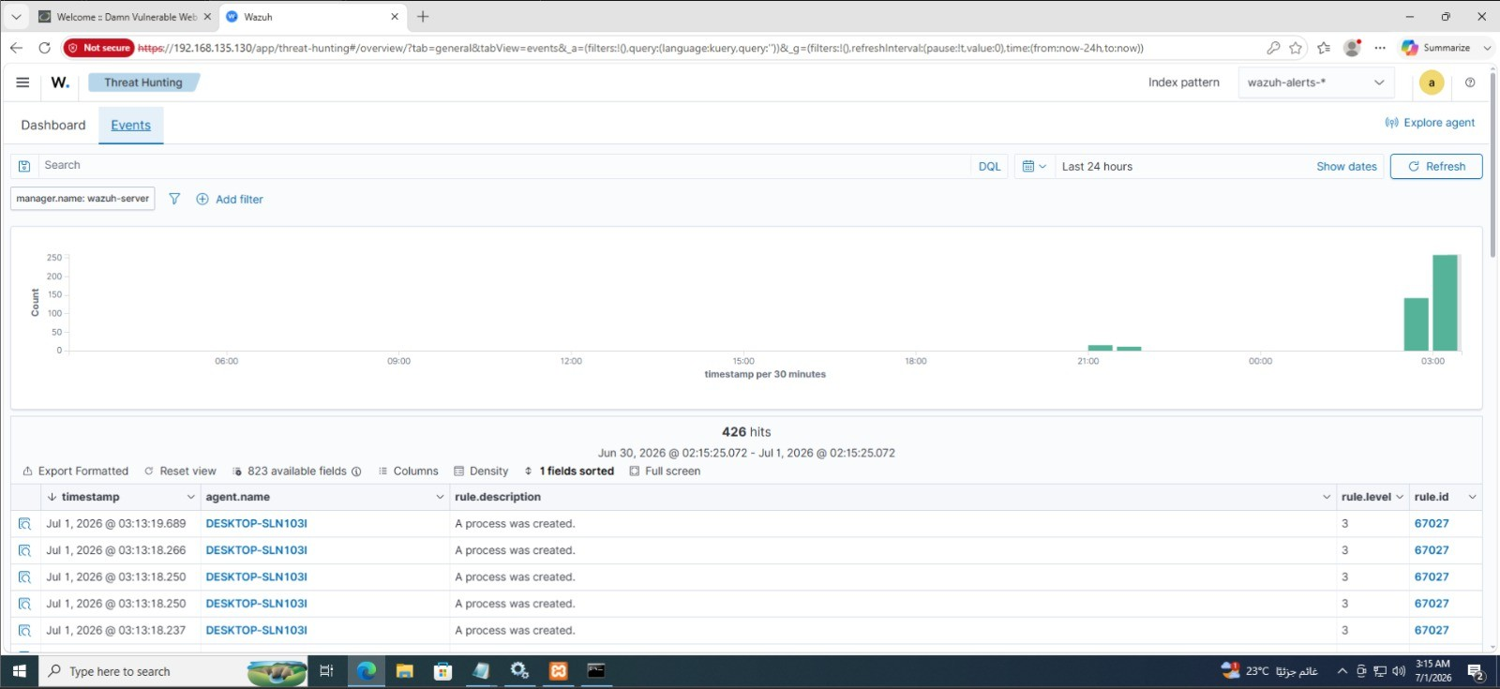
THREAT SIMULATION · THE TEST
Simulating the threat within: processes & DLL injection
The test was entirely internal — no external actor, no network attack. The threat originates on the host itself.
We simulated and monitored suspicious native Windows background processes spawning on the endpoint.
A process loaded taskschd.dll — the Task Scheduler module — a hallmark of DLL-injection persistence.
Loading taskschd.dll sets up a delayed / scheduled execution task — a technique malware uses to survive reboots and re-run later.
Wazuh → Threat Hunting → Events: rule 67027 "A process was created" on DESKTOP-SLN103I.
Notes:
Our test was internal, not a network attack. We simulated suspicious native Windows background processes on the endpoint and, critically, a process loading taskschd.dll — the Task Scheduler module. Loading that DLL is a classic persistence signal: it sets up delayed or scheduled execution, exactly what malware does to survive a reboot. Wazuh caught the process creation as rule 67027 and the module load as 92154 on DESKTOP-SLN103I.

Slide 20
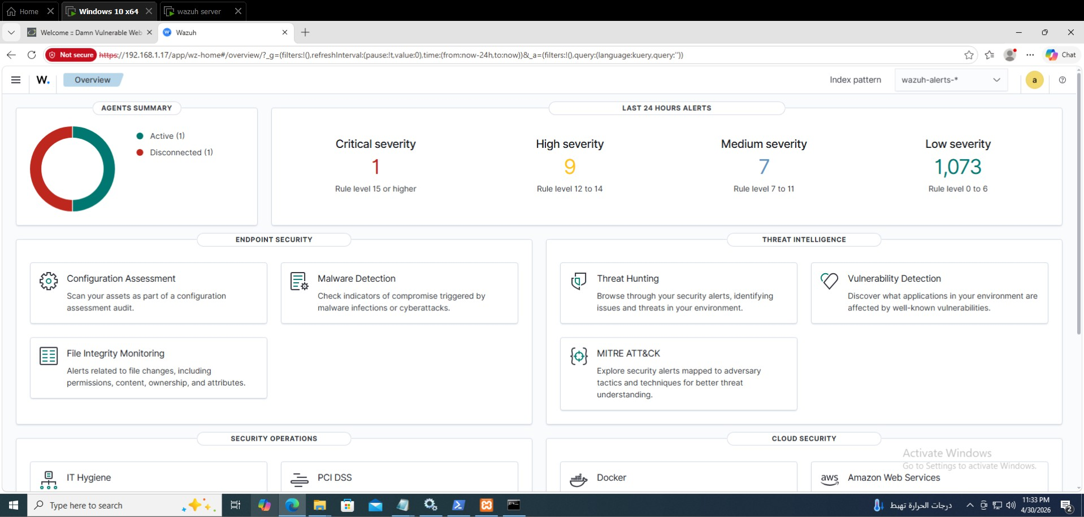
UI/UX · ON-PREM CONSOLE
The Wazuh SOC overview dashboard
Figure 4.7 — Agent summary and a severity-graded 24-hour alert breakdown drive progressive drill-down.
Notes:
This is the on-prem SOC console — the OpenSearch-based Wazuh dashboard. Agent summary on the left, and the last-24-hours severity breakdown across the top: one critical, nine high, seven medium, and over a thousand low-severity events.

Slide 21
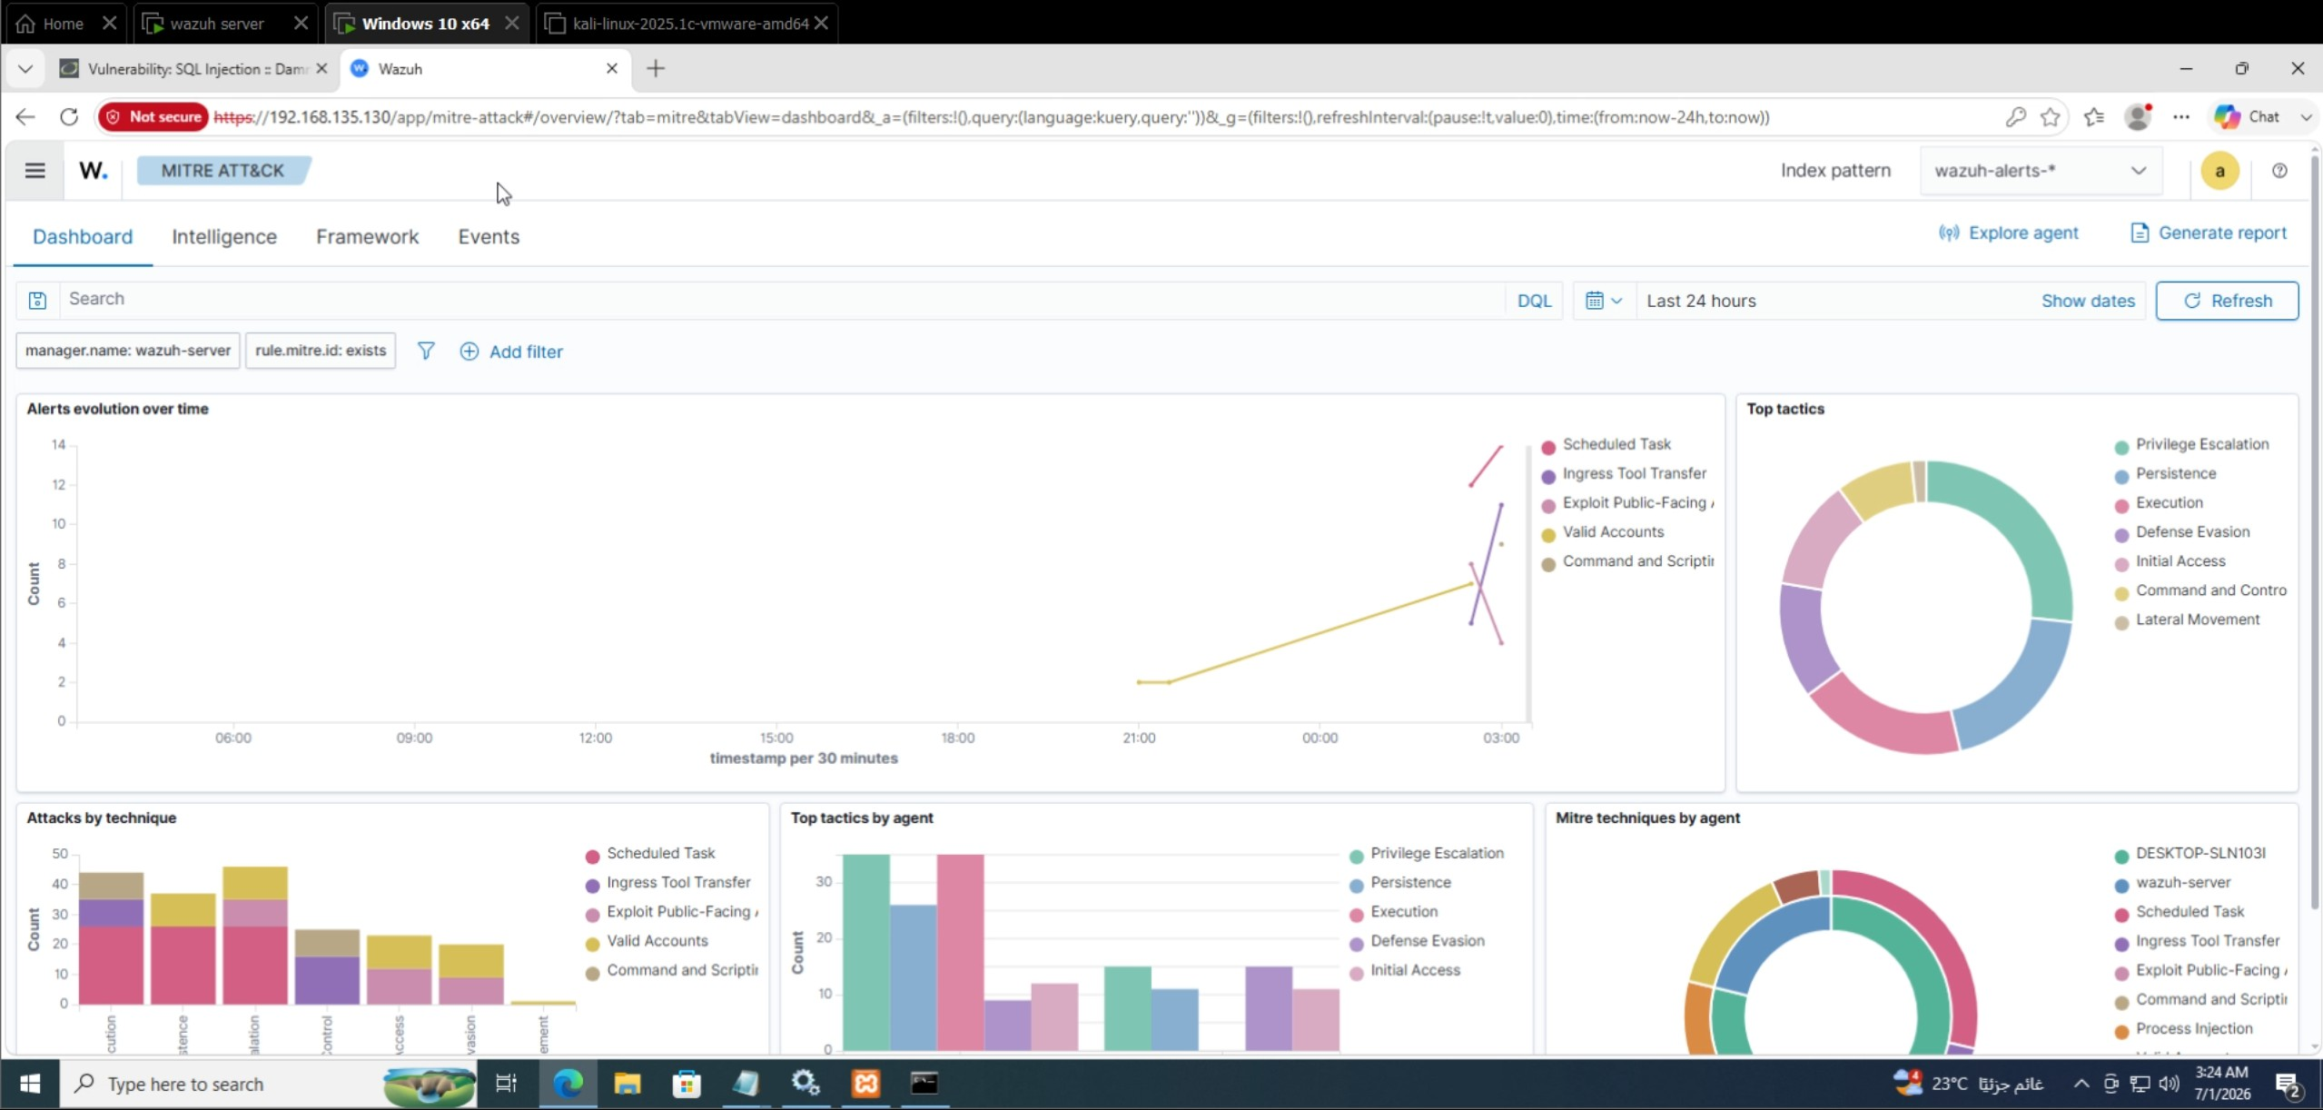
THREAT INTELLIGENCE
Alerts mapped to adversary tactics
Figure 4.8 — The ATT&CK matrix: alerts over time, top tactics, and detections by technique.
Notes:
Drilling into threat intelligence, the MITRE ATT&CK view maps every triggered alert to adversary tactics and techniques — alerts over time, top tactics like execution and persistence, and detections broken down by technique.

Slide 22
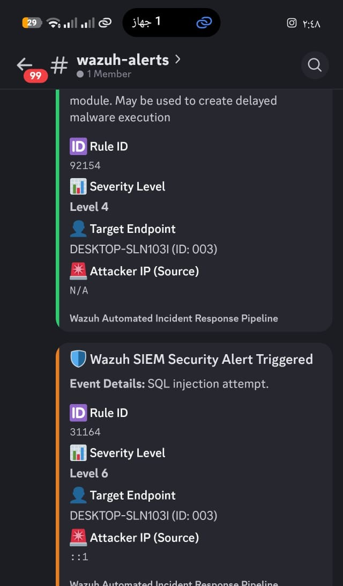
CLOUD SOC INTERFACE
An always-on SOC channel in Discord
Rule ID & event
92154 — module load, may create delayed execution.
Target Endpoint
DESKTOP-SLN103I — the monitored Windows host.
Attacker IP — N/A
Internal system event, so there is no external source IP to report.
Redundant text labels mean severity and context are clear without relying on color alone — an accessibility win.
Notes:
And the payoff — the Discord channel as a lightweight, always-on SOC dashboard. Here's the taskschd.dll persistence alert: rule 92154, the target endpoint shown as DESKTOP-SLN103I, and the Attacker IP marked N/A. That N/A is deliberate and correct — this is an internal system event, not a network attack, so there is no external source IP. Analysts scan the colored border first, then read the endpoint and rule.

Slide 23
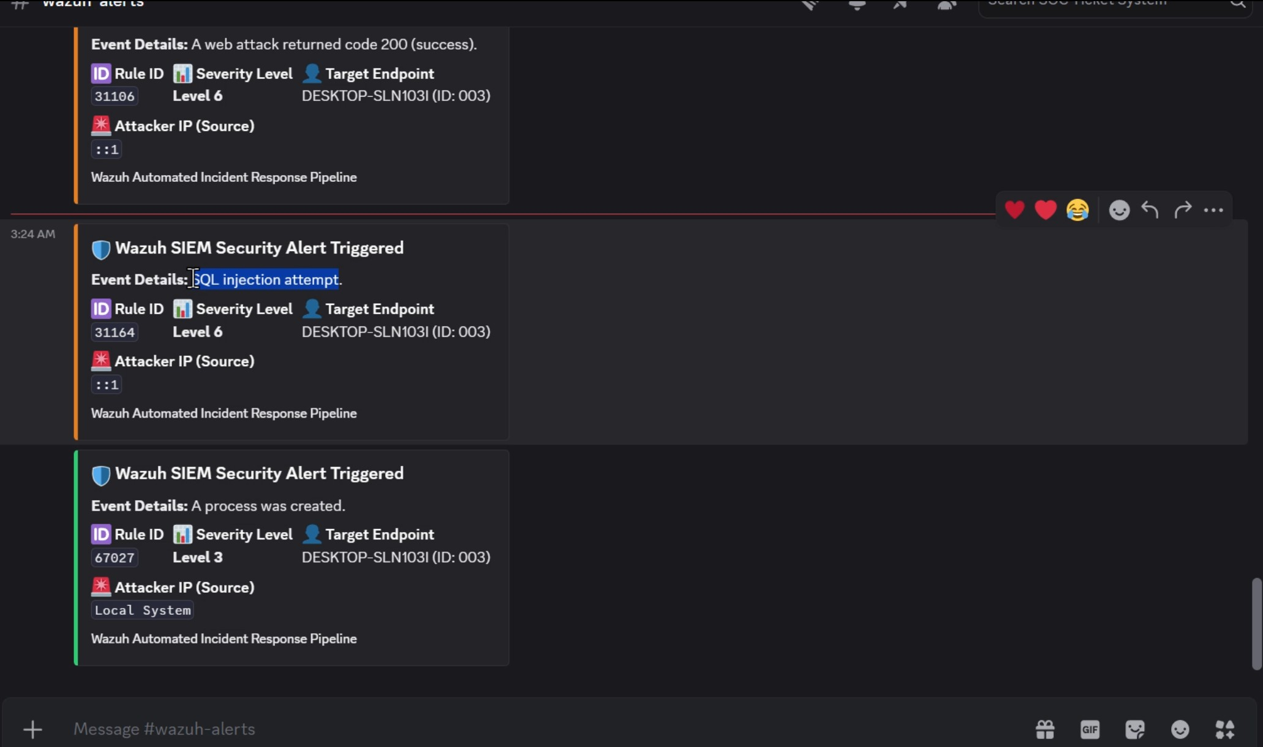
TESTING & QUALITY ASSURANCE
Validated end to end — every test passed
1,089
420
total hits recorded
direct hits · target met
8 / 8
test cases passed — simulation, correlation, MITRE mapping, IP parse, color coding, webhook delivery & stability.
Notes:
The headline result: during the simulation the system recorded 1,089 total hits and 420 direct hits on the Threat Hunting dashboard — confirming accurate rule parsing. All eight test cases passed, from rule correlation through the HTTP 204 webhook delivery and pipeline stability under the burst.

Slide 24
05
Reflection & Roadmap
Evaluation, the delivery timeline, and where this pipeline goes next.
Notes:
Finally, reflection — what the evaluator said, the project timeline, and where we'd take this next.

Slide 25
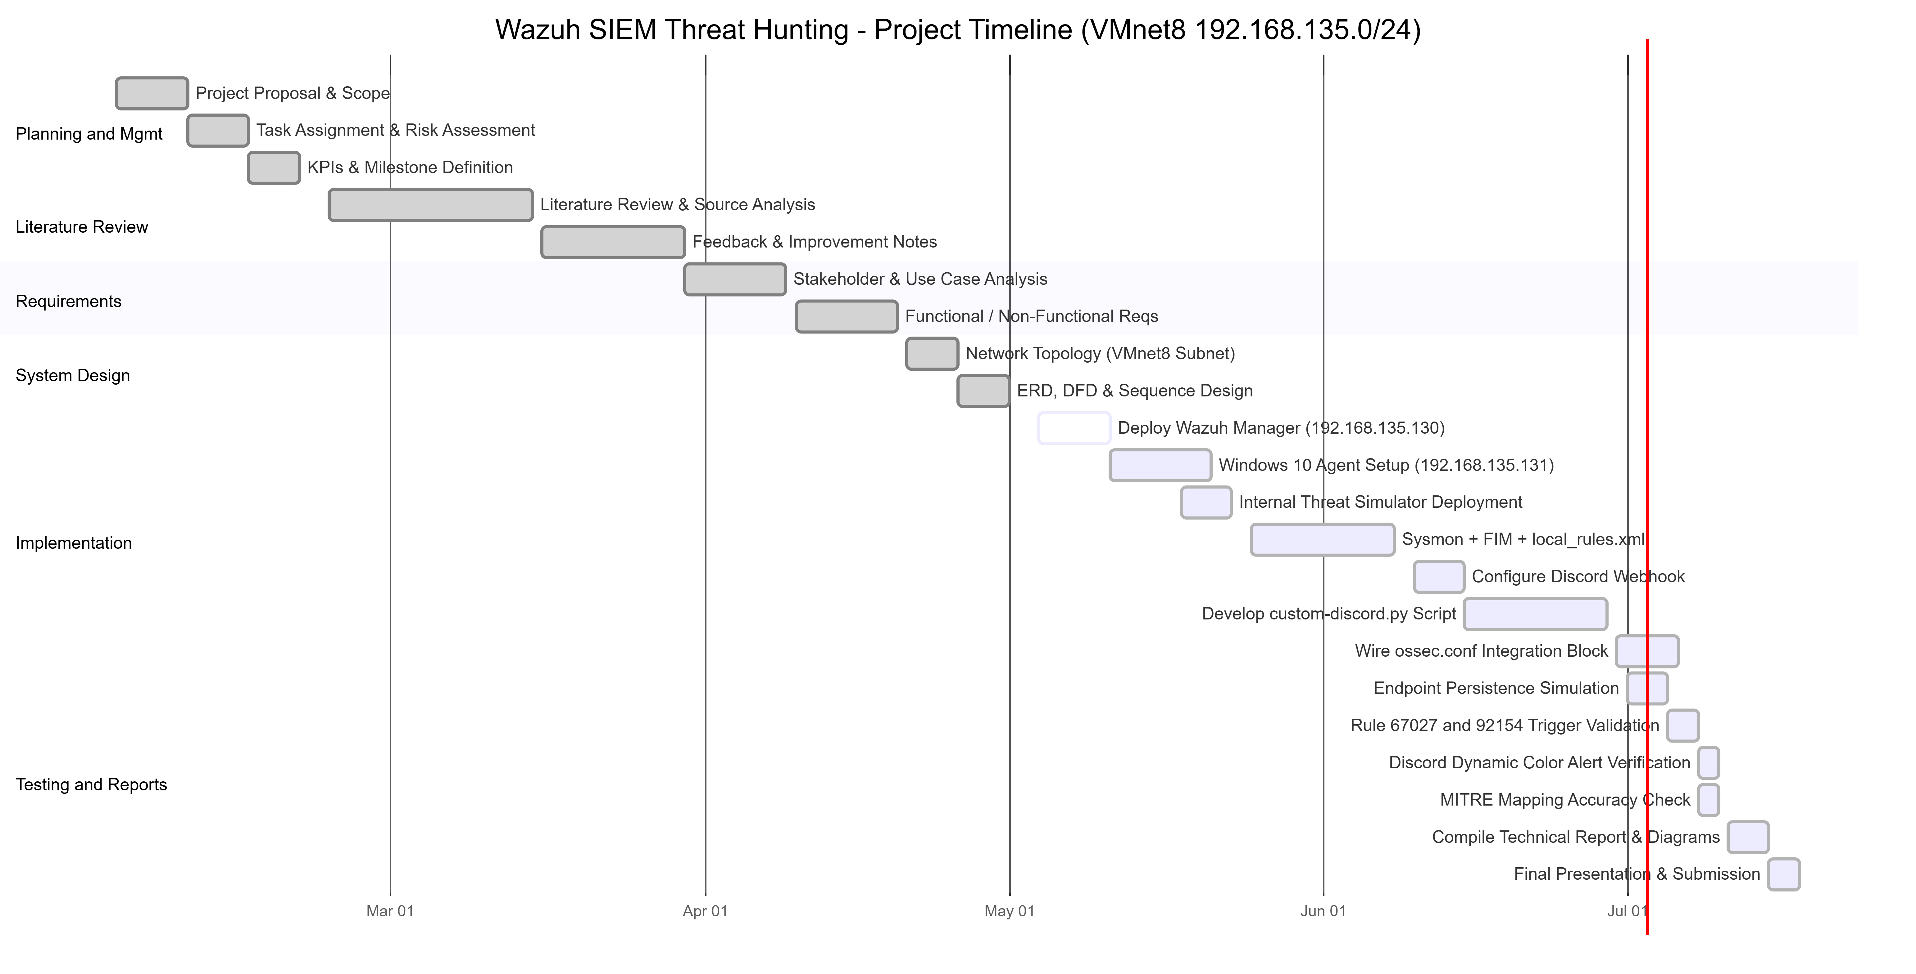
PROJECT MANAGEMENT
A phased plan, aligned to the milestones
Figure 1.1 — Gantt schedule across six milestones, from Planning (20 Feb) to Testing & Reports (17 Jul).
Notes:
For context on delivery: the project ran on a phased plan aligned to the Rwaad Misr milestone deadlines — planning, literature review, requirements, system design, implementation, and finally testing and reports, from February through July.

Slide 26
EVALUATION & FUTURE WORK
What the evaluator saw — and what's next
Suggested improvements
Strengths
Multi-stage correlation — e.g. a process launch followed by a suspicious DLL load.
A complete, working pipeline — from raw log ingestion, through custom MITRE-mapped correlation, to an automated Discord channel. The integration and internal endpoint simulation show practical, end-to-end SOC engineering , well mapped to recognized frameworks.
Rate-limiting and retry / back-off against Discord API throttling.
Threat-intel enrichment (VirusTotal / IP reputation) before posting.
Externalize the webhook URL into a protected secret store.
Notes:
The evaluator called it a complete, working detection pipeline — practical end-to-end SOC engineering, not a theoretical design. For next steps: multi-stage correlation rules, rate-limiting and retry in the script, threat-intel enrichment before posting, and moving the webhook URL into a secret store.

Slide 27
CONCLUSION
A complete, validated SOC pipeline — from raw log to a color-coded alert.
A Wazuh Manager ingesting Windows 10 / DVWA telemetry, custom MITRE-mapped detection rules, a simulated internal endpoint threat — process creation and DLL-injection persistence — and an automated custom-discord.py integration delivering dynamic, color-coded incident alerts to a Discord SOC dashboard — all on an isolated VMnet8 network.
Notes:
To conclude: we delivered a complete, validated SOC pipeline on an isolated network — Wazuh ingesting internal endpoint telemetry, custom MITRE-mapped rules, a simulated internal threat of process creation and DLL-injection persistence, and automated color-coded Discord alerting. 1,089 total and 420 direct hits confirm the accuracy and reliability of the workflow.

Slide 28
TEAM 2 · RWAAD MISR
Thank you
Questions welcome — happy to dive deeper into any part of the internal endpoint monitoring pipeline.
MONITORED HOST
KEY CATCHES
RESULT
DESKTOP-SLN103I
Rules 67027 · 92154
1,089 hits · 8/8 tests
Notes:
Thank you for your time. We're happy to take questions and walk through any part of the internal endpoint monitoring pipeline in more detail.

