Slide 1
Agenda
what makes design patterns important?
implementation of patterns Builder, Adapter, Strategy
data validation approach
version 0.1

Slide 2




LITERATURE

Slide 3
Software Design
version 0.1

Slide 4
Before software can be reusable it has first to be usable
Ralph Johnson
There are two ways of constructing a software design:
One way is to make it so simple that there are obviously no deficiencies, and the other way is to make it so complicated that there are no obvious deficiencies.
The first method is far more difficult.
Charles Antony Richard Hoare
version 0.1

Slide 5
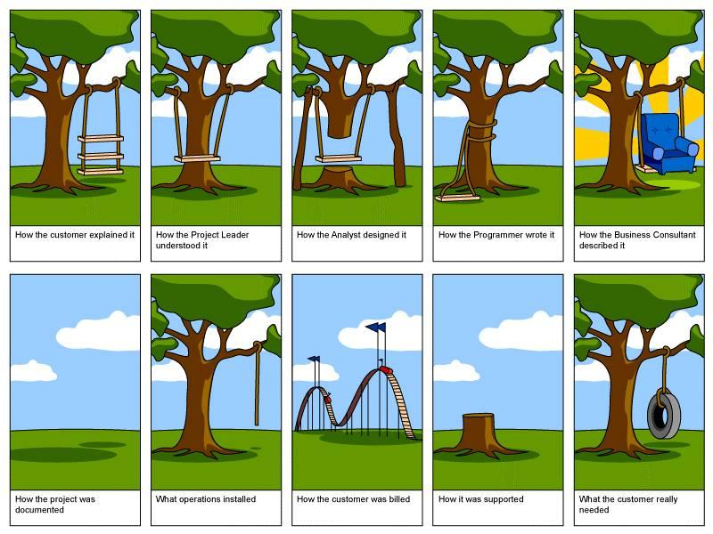
version 0.1

Slide 6

O(1)
version 0.1

Slide 7
O(MG)
version 0.1

Slide 8
builder
java 7
java 8

Slide 9
Builder
with increasing the number of constructor parameters,
number of constructors increases
exponentially — telescoping construction anti-pattern.
more flexible way of creating objects, more efficient for creating complex objects
helps to create a DSL (domain-specific language) for adding a business meaning to the process of building meaningful entity
implementation in Java API:
java.lang.StringBuilder#append(), java.nio.ByteBuffer#put()

Slide 10
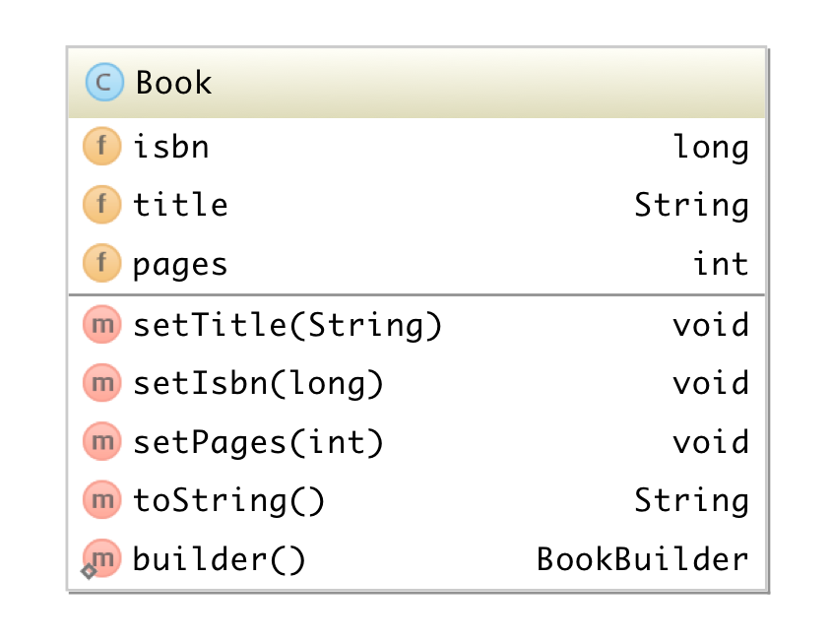
Builder
class Book { private long isbn; private String title; private int pages; public void setTitle(final String title) { this.title = title; } public void setIsbn(final long isbn) { this.isbn = isbn; } public void setPages(final int pages) { this.pages = pages; } @Override public String toString() { final StringBuilder sb = new StringBuilder("Book{"); sb.append("isbn=").append(isbn); sb.append(", title='").append(title).append('\''); sb.append(", pages=").append(pages); sb.append('}'); return sb.toString(); } }

Slide 11
Builder
? s = Book::new; ? setIsbn = Book::setIsbn;

Slide 12
Builder
Supplier<Book> s = Book::new; BiConsumer<Book, Long> setIsbn = Book::setIsbn;

Slide 13
Builder
static class BookBuilder { Book book = new Book(); List<Consumer<Book>> modifiers = new ArrayList<>(); public <U> BookBuilder with(
BiConsumer<Book, U> consumer, U value) { Consumer<Book> c = instance ->
consumer.accept(instance, value); modifiers.add(c); return this; } public Book getBook() { modifiers.forEach(m -> m.accept(book)); return book; } }

Slide 14
Builder
static class BookBuilder { Book book = new Book(); List<Consumer<Book>> modifiers = new ArrayList<>(); public <U> BookBuilder with(
BiConsumer<Book, U> consumer, U value) { Consumer<Book> c = instance ->
consumer.accept(instance, value); modifiers.add(c); return this; } public Book getBook() { modifiers.forEach(m -> m.accept(book)); return book; } }

Slide 15
Builder
Book book = Book.builder() .with(Book::setTitle, "test") .with(Book::setPages, 300) .with(Book::setIsbn, 232323L) .getBook();

Slide 16
Builder
public class ObjectBuilder<T> {
private final Supplier<T> supplier; private List<Consumer<T>> consumers = new ArrayList<>(); public ObjectBuilder(Supplier<T> supplier) { this.supplier = supplier; } public static <T> ObjectBuilder<T> of(Supplier<T> supplier) { return new ObjectBuilder<T>(supplier); } public <U> ObjectBuilder<T> with(BiConsumer<T, U> consumer, U value) { Consumer<T> c = instance -> consumer.accept(instance, value); consumers.add(c); return this; } public T build() { T value = supplier.get(); consumers.forEach( c -> c.accept(value)); consumers.clear(); return value; } }

Slide 17
Builder
import static st.pr.builder.ObjectBuilder.of;
Book b = of(Book::new) .with(Book::setPages, 400) .with(Book::setIsbn, 232323L) .with(Book::setTitle, "test") .build();

Slide 18

adapter
adapter

Slide 19



Adapter
Manager requests a Task
Programmer works with concrete requirements
Business analyst serves as a link between manager and programmer

Slide 20
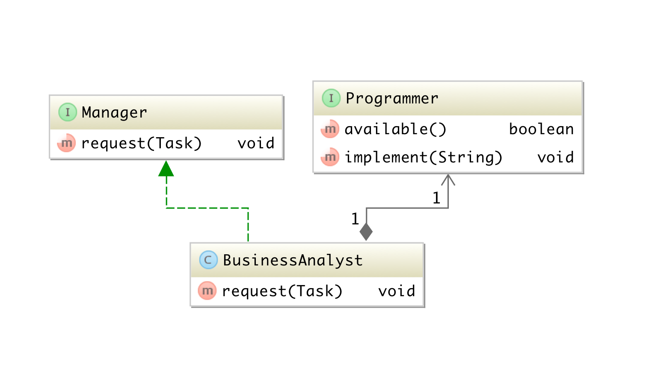
Adapter

Slide 21







Adapter
Client
Target
Manager
Adapter
BA
Adaptee
Programmer

Slide 22
Adapter
public interface Manager { void request(Task feature); }
Interface Manager specifies a method for requesting a Task for execution

Slide 23
Adapter
@FunctionalInterface public interface Programmer { default boolean available() { return true; } void implement(String requirements); }
functional interface Programmer provides method implement()
each implementation defines own logic for processing requirements

Slide 24
Adapter
public class Example { public static void main(String[] args) {
Programmer chuckNorris =
requirements -> Implementation.of(requirements).commit(); Manager analyst = task ->
chuckNorris.implement(task.requirements); Manager manager = analyst::request; manager.request(
new Task(12, "JDBC driver should be updated"));
} }

Slide 25
Adapter
Client
Target
Manager
Entity is not required
Adapter
BA
Adaptee
Programmer

Slide 26
validator

Slide 27
Validator
simple generic interface with default method validate(T model)
each implementation provides it’s own logic for validation the input model
validation errors push into collection and return as Optional

Slide 28

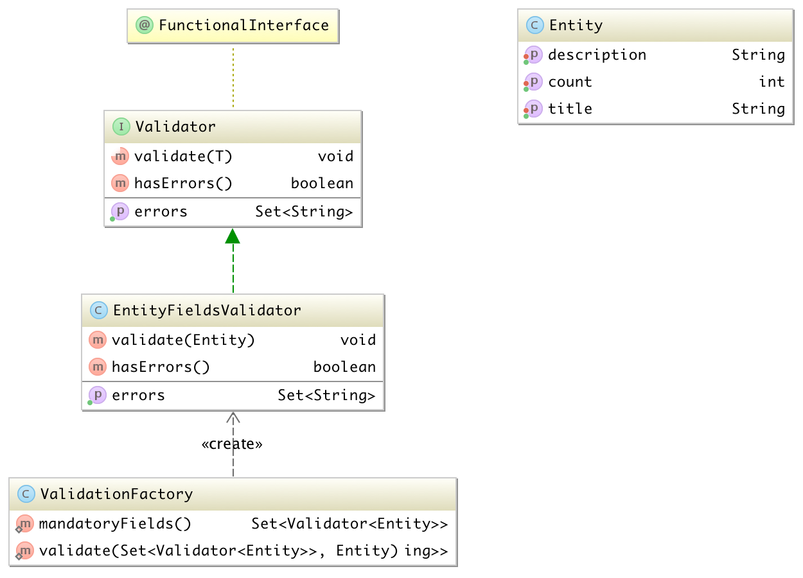
Validator

Slide 29
Validator
@FunctionalInterface public interface Validator<T> { void validate(T model); default boolean hasErrors() { return false; } default Set<String> getErrors() { return new HashSet<>(0); } }

Slide 30
Validator
public class EntityFieldsValidator implements Validator<Entity> { private Set<String> errors = new HashSet<>(); @Override public void validate(final Entity model) { if (model.getTitle() == null || "".equals(model.getTitle())) errors.add("Title should not be empty"); if (model.getCount() < 0) errors.add("Count should be greater then 0"); } @Override public boolean hasErrors() { return !errors.isEmpty(); } @Override public Set<String> getErrors() { return errors; } }

Slide 31


Validator
public static void main(String[] args) { Entity e = new Entity(); e.setTitle("Title"); e.setCount(-1); e.setDescription("Simple entity for validation"); Optional<Set<ValidationResult>> validationResults = validate(person, beforeSaving());
validationResults.ifPresent(v -> v.stream()
.map(r -> r.message)
.forEach(System.out::println));
unless(validationResults,
hasErrors.or(hasWarnings),
showErrors.andThen(showWarnings), () -> System.out.println("Ok"));
}

