Slide 1
Team 3
ALVIN, DEDRICK, VINOTH, ZHI WEI

Slide 2
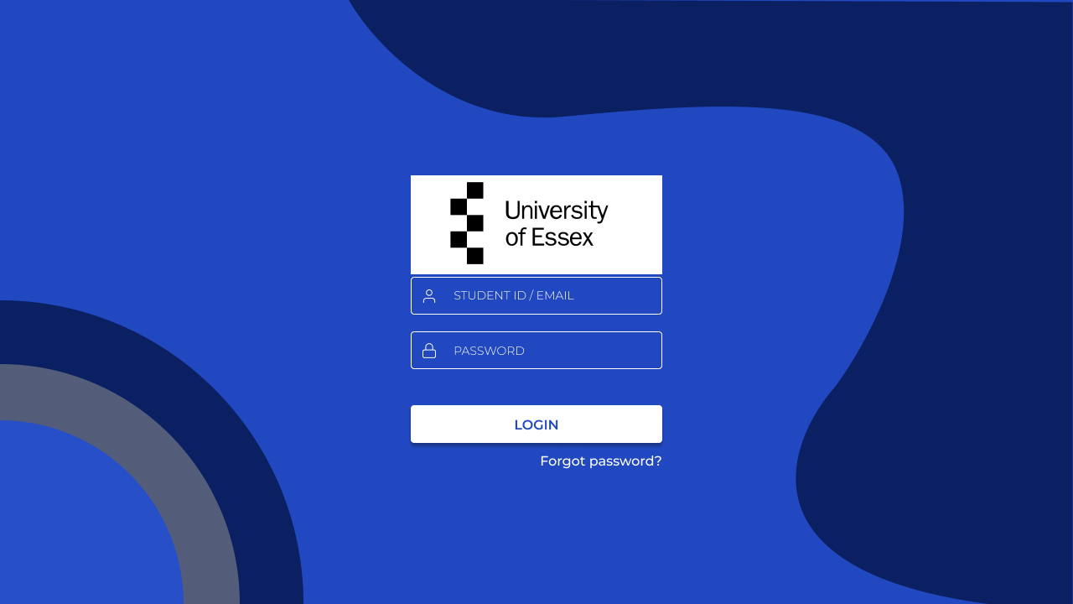
Login Page
Login using Kaplan credentials
Receive authenticate popup in phone
Confirm authenticate popup
Login Successful
Confirm authenticate popup
Login Successful
Notes:
Step 1 : Users will login to the system using their Kaplan id number
Admin (A)
Lecturer (L)
Student (S)
Step 2: Password will be their Kaplan password and login
Step 3: Receive the authenticate popup in the google platform in your mobile phone.
Step 5: User have login to the system
Explanation why the login is secure
Authenticator > Database (More secure than database)
Authenticator send code to mobile phone

Slide 3
Google Authenticator
Google Cloud Console - a web-based platform that helps to manage our Google Cloud projects and resources with graphical user interface.
Some of function that will be using are as per below :
  - API management
  - IAM (identity & Access Management)
  - Database
  - Cloud SQL

Slide 4
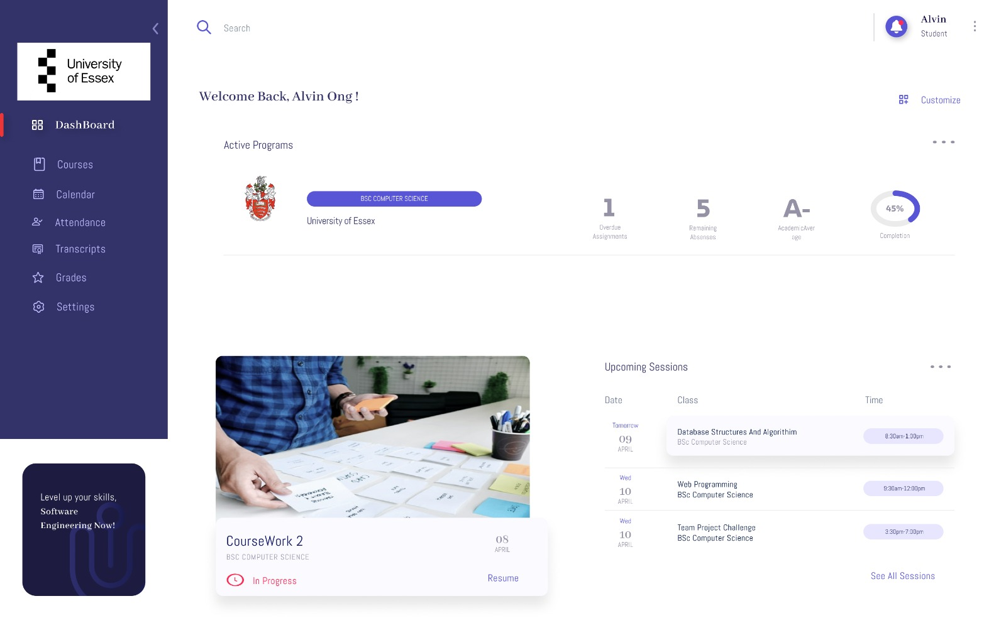
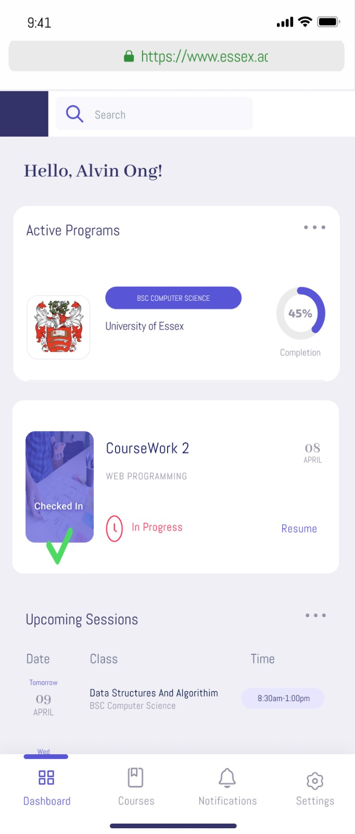
UI UX Design
UI UX Design
Notes:
Dashboard Page

Slide 5
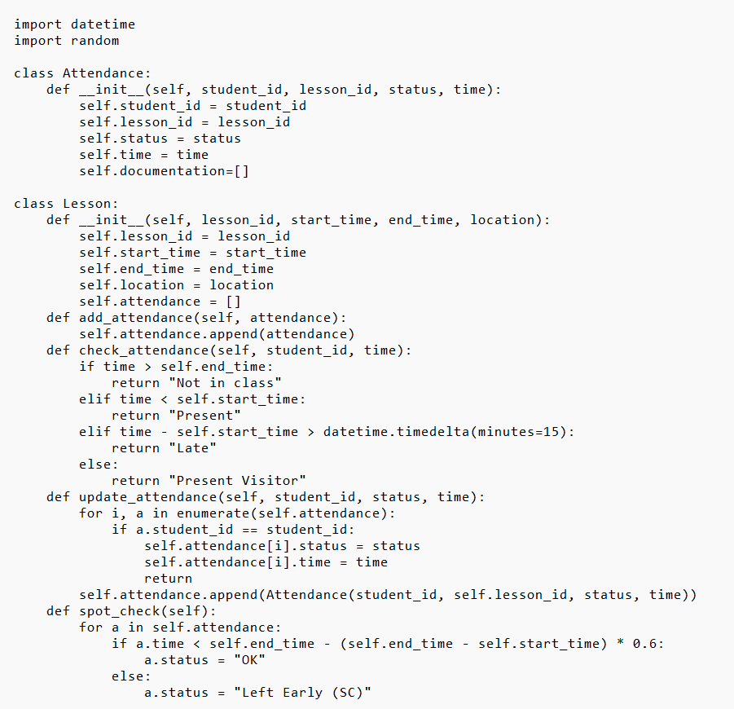
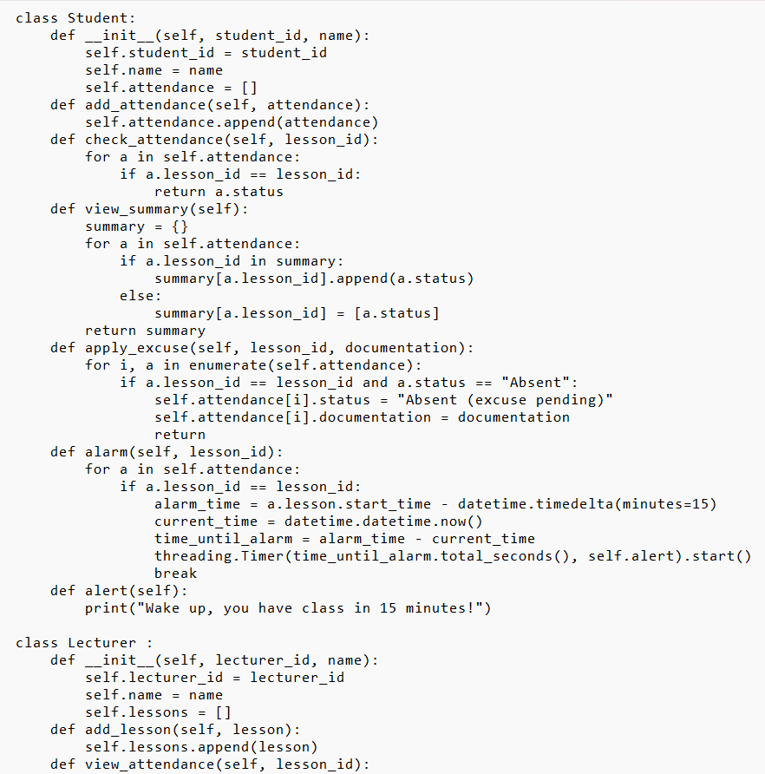
Code Part 1

Slide 6
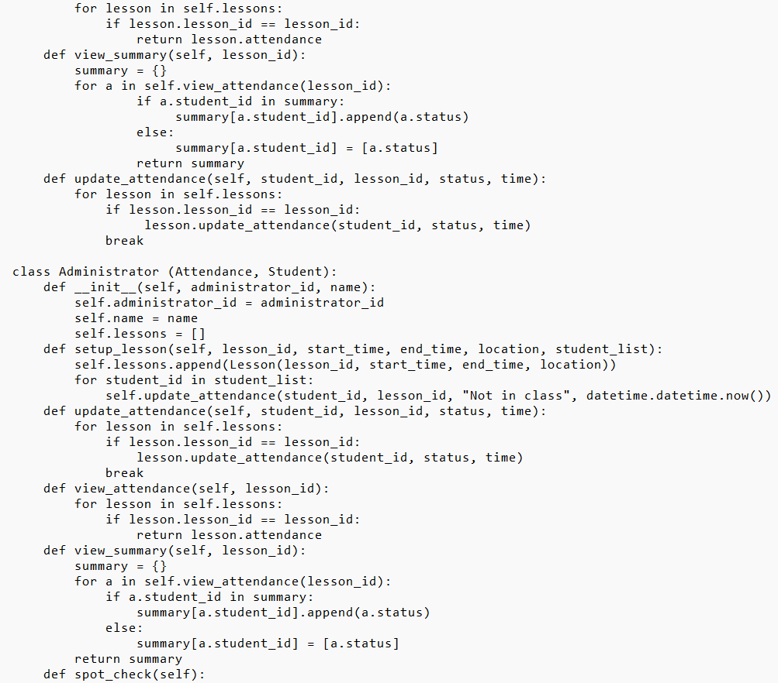
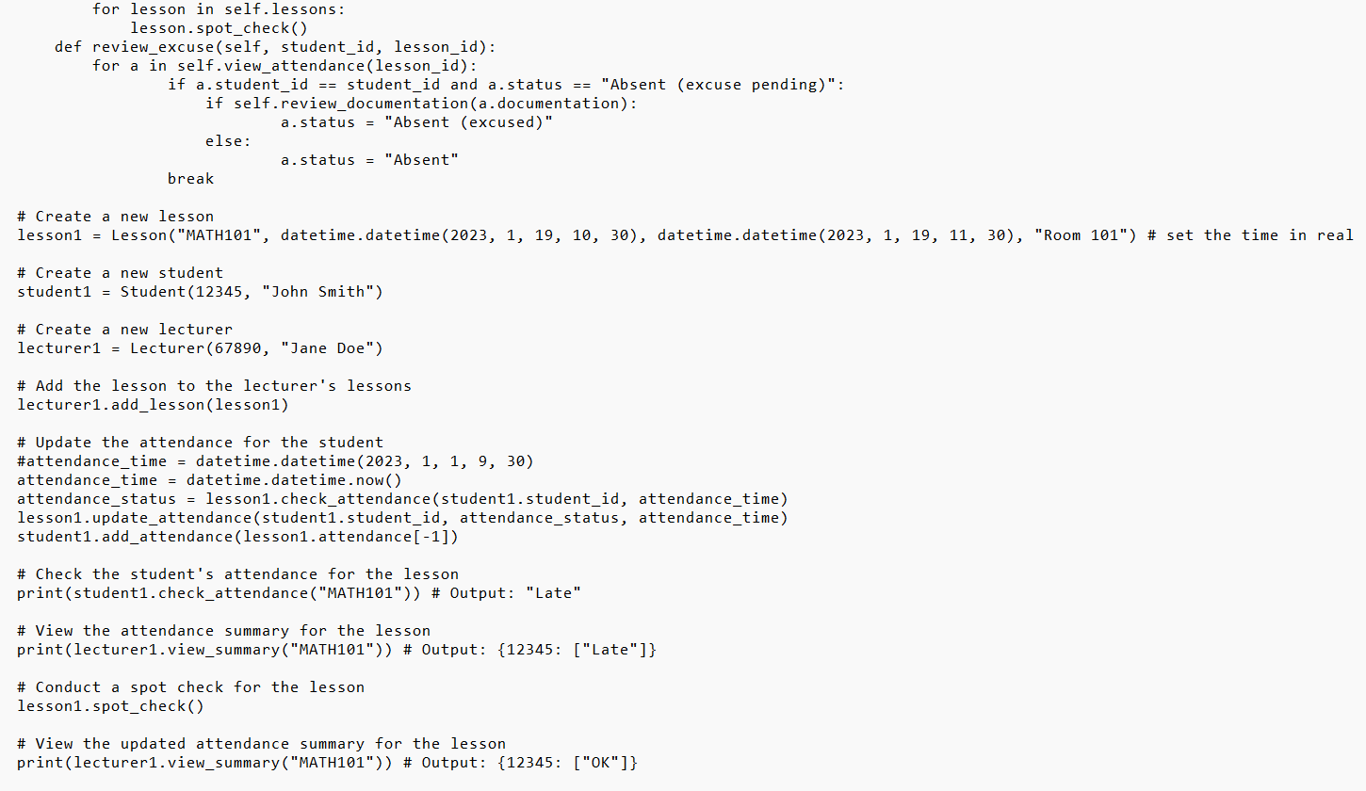
Code Part 2

Slide 7
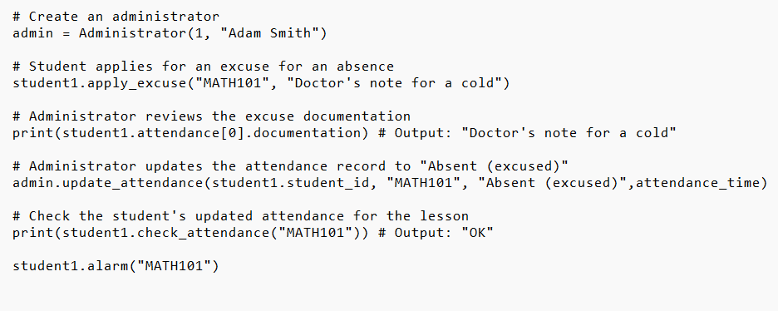
Code Part 3

Slide 8
Explanation of Code
Attendance class
Takes in student id , lesson id, status and time as input and store in variable
Lesson class
Uses lesson id , start and end time and location as input of the class
Have multiple methods to the class
  Add attendance – add the attendance object to an array
  Check attendance – check whether a student is present , absent or late
  Update attendance – allows update of statue and time
  Spot check – check is student attends class more than 60% of the lessons

Slide 9
Explanation of Code
Student class
  Has student id and name as input
  Has an empty list called attendance to store the attendance of the student
  Has multiple functions
    Add attendance – add attendance to list
    Check attendance –returns the status of the lesson based on the id
    View summary – shows a summary of the students attendance
    Apply excuse – allow student to apply leave on a specific class
    Alarm and alert – alert student 15 minutes before their class
Lecturer class
  Has lecturer id and name as input
  Allows the lecturer to add lessons, shows the attendance of all students in the class
  Allow lecturer to update the student status in the lesson
Administration class
  Has the administrator id and name as input
  Allow the admin to update attendance, review students excuse and perform spot check

Slide 10
Future Improvements
Improve the efficiency of the program by using efficient data structure. Current implementation of nested for loops is slow for large amount of inputs
Error handling should be implemented to handle unexpected inputs or exceptions that might occur during the execution.
The program could be designed to be more modular so that it can be adapted for different application

Slide 11
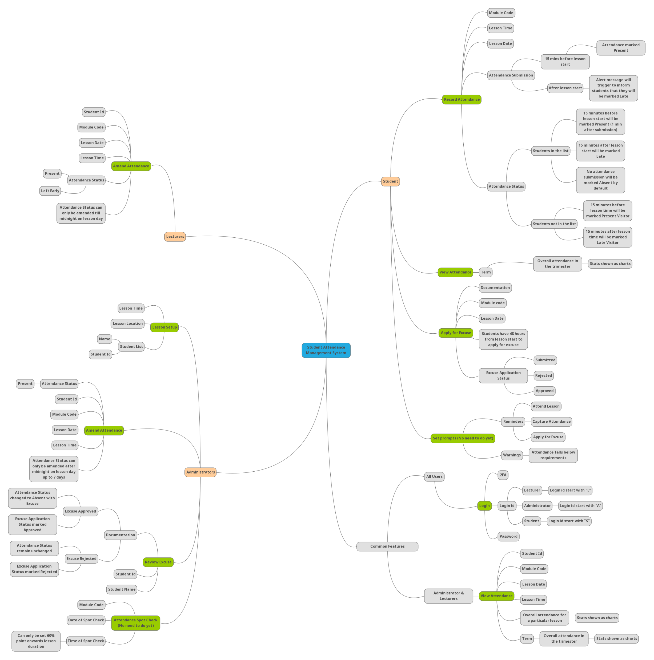
Mindmap
Link

Slide 12
Moving Forward
Integrate code with UI UX Design
UI UX Design of the Calendar will be developed next
Continue development of Login page with Google Authenticator
Further improvements to the functions
Notes:
Grill the Client about the requirements

Slide 13
Questions to ask Client
Attendance spot check for Administrator
What is the purpose of attendance spot checks ?
Why do we need to add this feature even though the lecturer is already tracking the student’s attendance?
Capture attendance for Students
Why do we need to track the attendance for students who are not on the class list?
Notes:
Administrators must conduct an attendance spot check at least once every trimester for every module
-Why do we need to conduct attendance spot check for every module and know that students are still physically at the lesson

