Slide 1
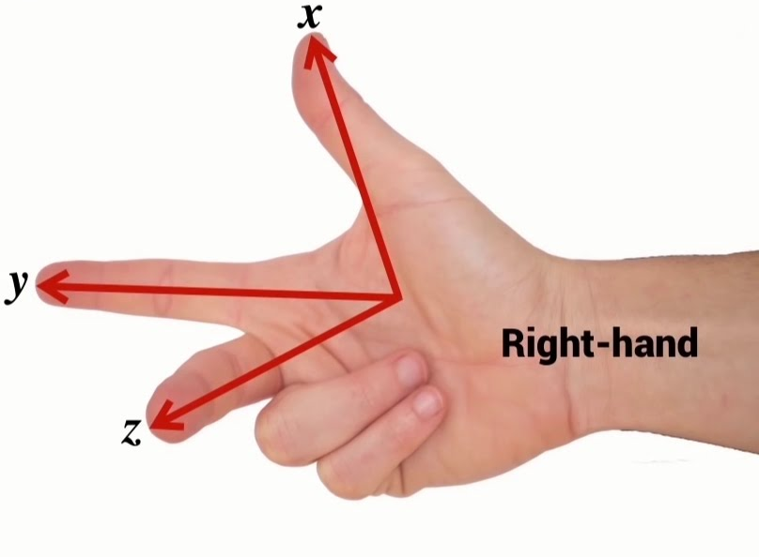
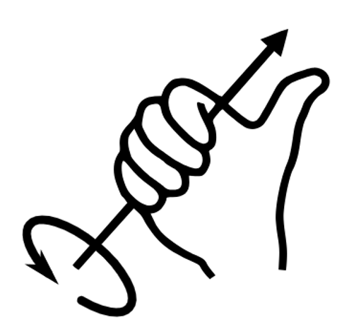
Coordinate System Guide 2023
Bevel gear should be facing –Y.
Coordinate system based on PP, +X of field is +X of robot etc.
Z direction is based on right hand rule. Pigeon and steering heading direction is the same in this case.
Y
BL
(-,+)
TL
(+,+)
frontWheelDistMeters
X
BR
(-,-)
TR
(+,-)
sideWheelDistMeters

